Slide 1
Home Affordability Map and Dashboard
Cameron Wilson, Logan Woodul, Richard Moreno, Adrian Stahl

Slide 2
Table of Contents
Project Overview
Methodology
Assumptions and Limitations
Challenges
Interactive Dashboard
Conclusions

Slide 3
Project Overview

Slide 4
We developed an interactive dashboard that presents a comparative analysis of home prices against the national average, home price appreciation relative to population growth, and affordability by state map.
The dashboard incorporates a dropdown menu allowing users to select specific states for analysis, thereby enabling the identification and highlighting of housing trends across the United States.

Slide 5
Relevance
Buying and selling homes
Understand local real estate market
Use information to negotiation when buying or selling houses
Gain insights into demand for housing vs supply leading to higher prices
Investing in real estate
Investors can identify areas with high growth potential
Economic development
Identify expensive/low cost areas
Attract business / plan for affordable housing

Slide 6
Methodology

Slide 7
Data Sources
Geojson map
https://eric.clst.org/tech/usgeojson/
Plotly Map JS code
https://plotly.com/javascript/line-and-scatter/
CSV to JSON Converter
https://www.convertcsv.com/csv-to-json.htm
National Home Value Data
FRED: https://fred.stlouisfed.org/series/MSPUS
CSV
Census Data
https://www.census.gov/data/tables/time-series/dec/popchange-data-text.html
CSV

Slide 8
Project Characteristics
Languages
HTML
Javascript
SQL
Programs
VS Code
Web Framework
Python Flask

Slide 9
Assumptions and Limitations
These maps display affordability without considering:
Credit History
Capital (presented at time of purchase)
Such as assets presented at any level i.e. per capita, county, or state level
Nor Conditions
Characteristics of the latter include, but are not limited to :
Loan Amount
Interest Rate
Loan Term
These are important as they impact the lender’s decision to approve the loan and impact the borrower’s ability to make payments over time.
Though our work considers Income per state, it does not consider Debt which in turn affects Debt-to-Income ratio, a key aspect under "Capacity” which helps Banking Institutions determine a borrower’s ability to repay the loan.
The basis of our work relies on Income per State (DTI) and Home Values which is considered under Collateral.

Slide 10
Challenges
Getting the data to read CSV files (JS does not love CSV)
Once we got CSV read the function would not work between states
Converting CSV files into JSON files
Hard Code tweaking JSON files to be read appropriately after converting
…AND time we initially wanted to include individual counties and not just states as well as monthly comparisons instead of just yearly

Slide 11
Interactive Dashboard

Slide 12
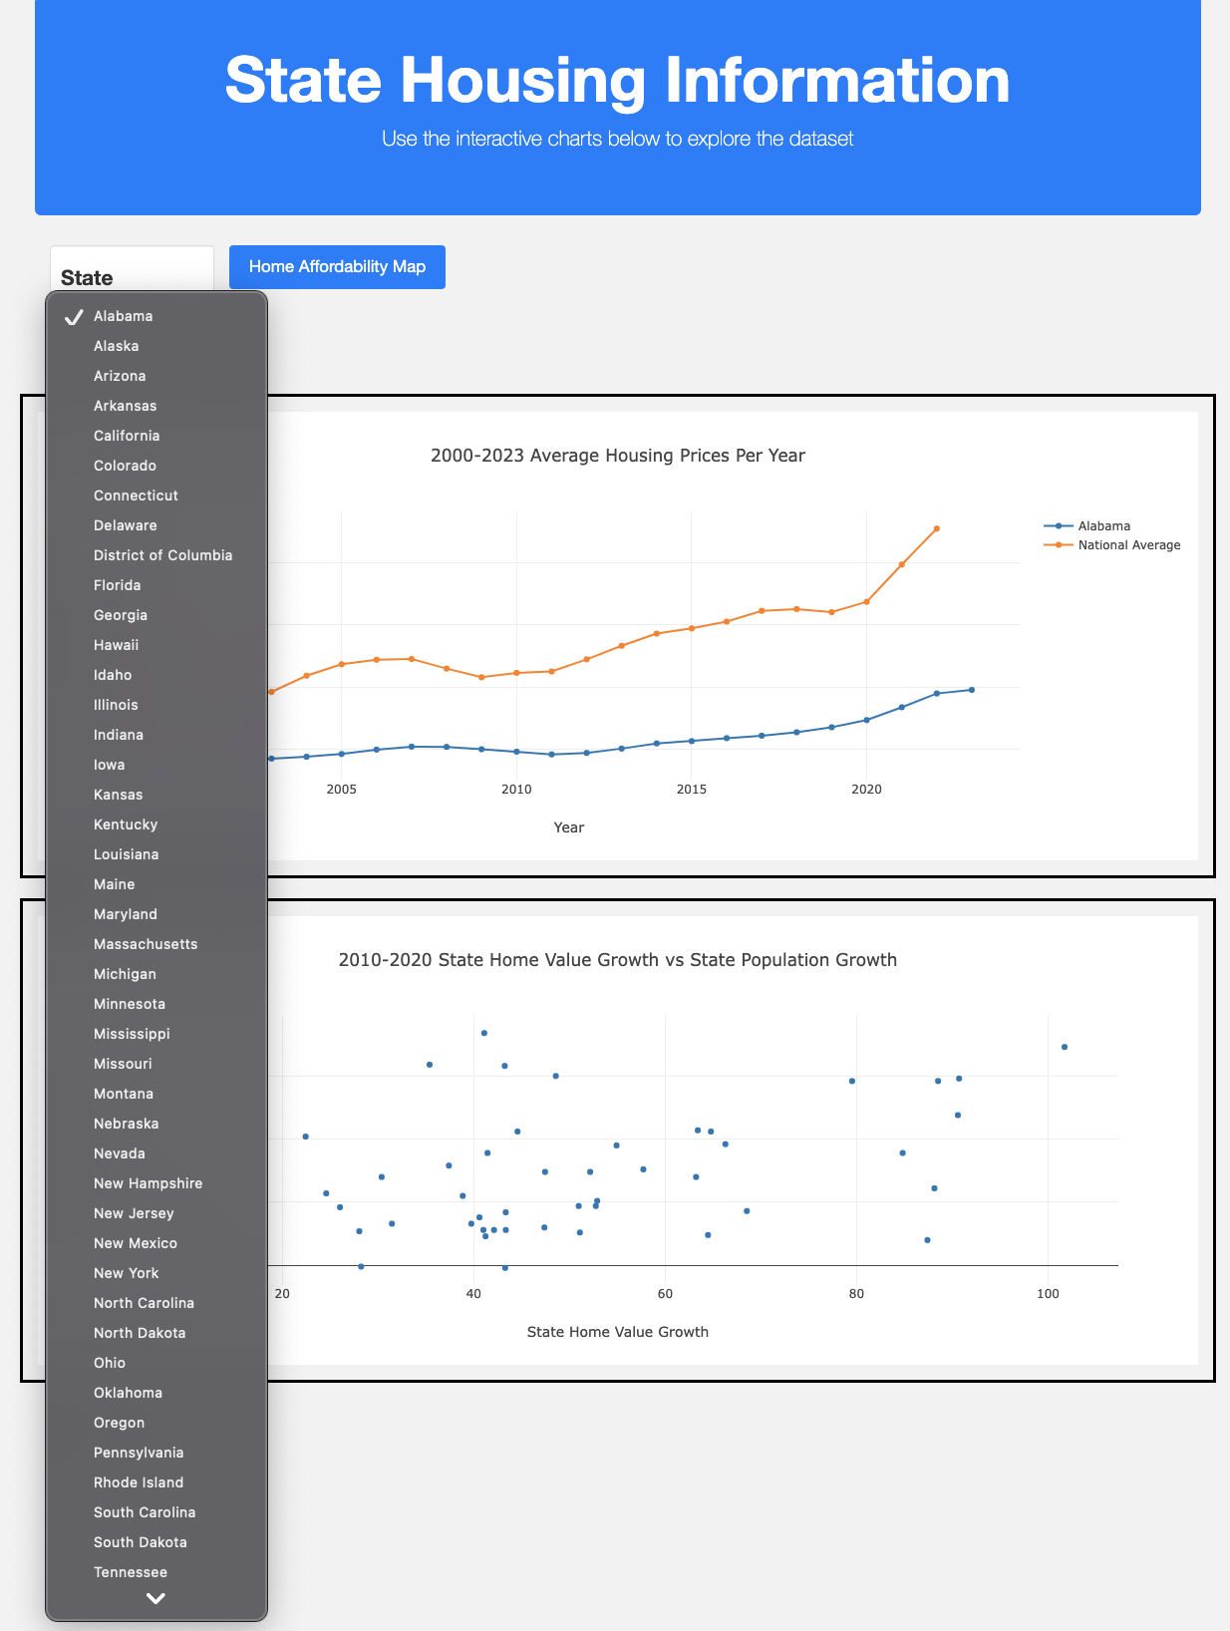

Slide 13
Visualizations

Slide 14
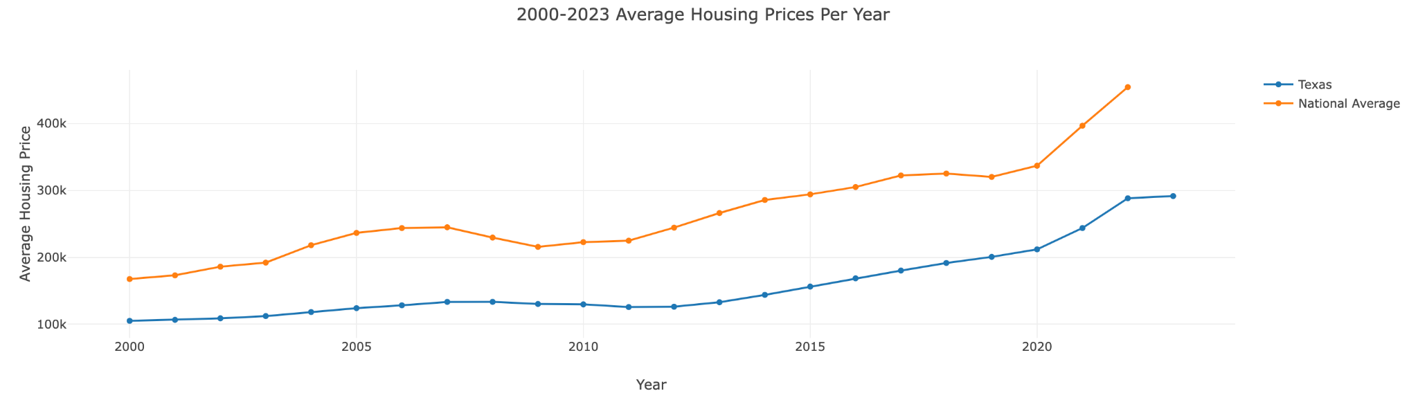
Selecting States and Highlighting Trends

Slide 15
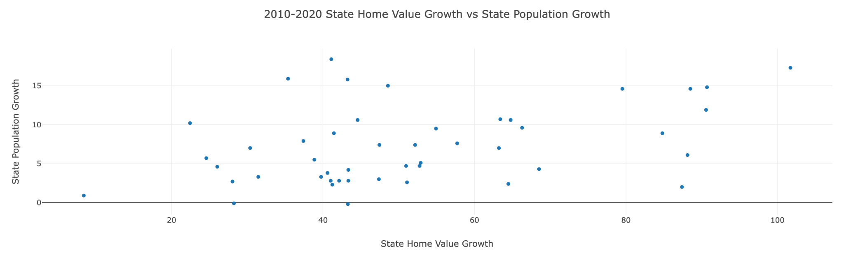
Home Value Growth vs State Population Growth

Slide 16
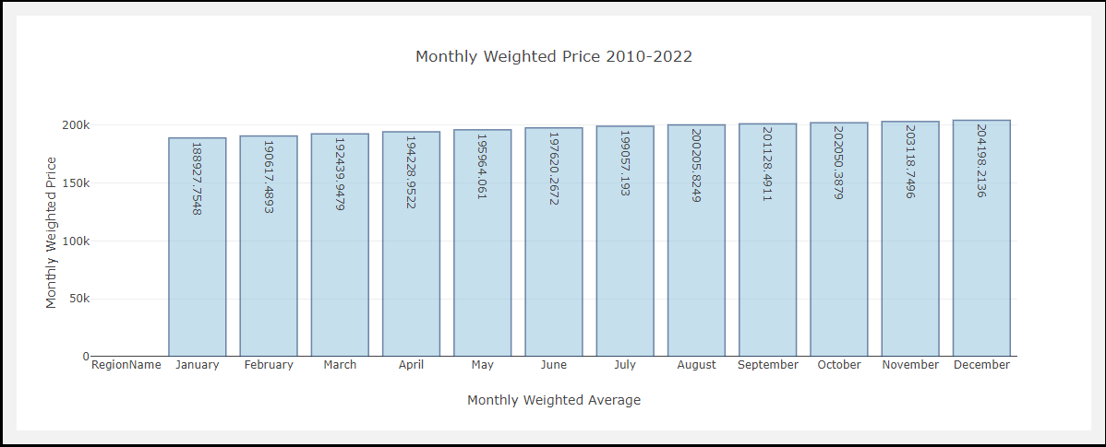
Monthly Price Comparisons

Slide 17
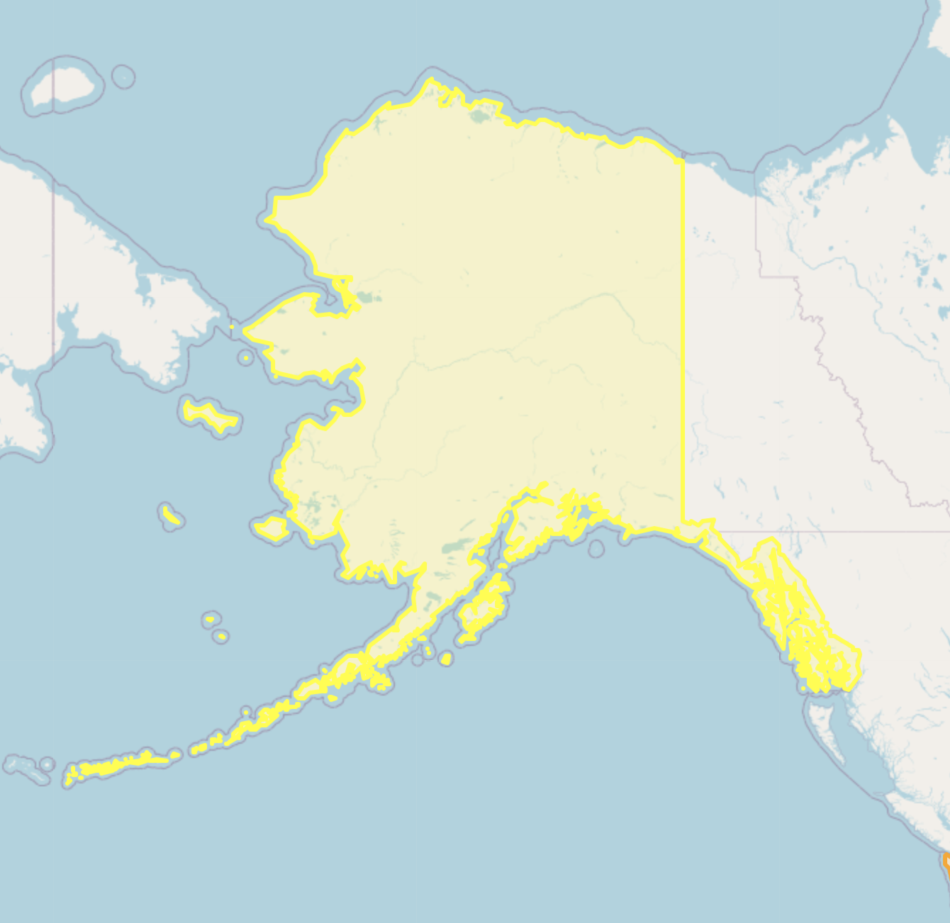
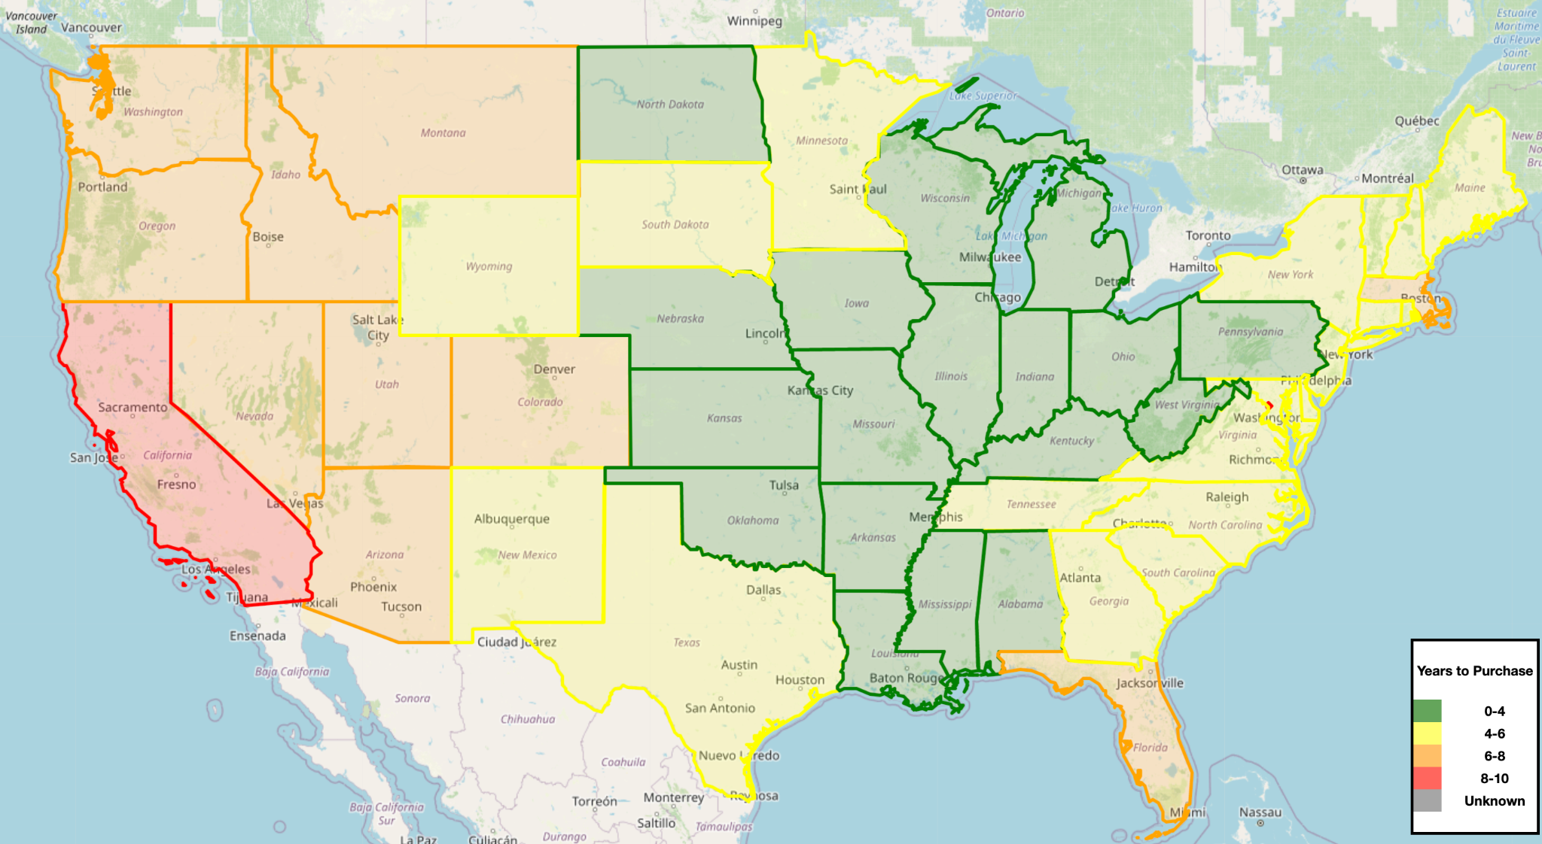
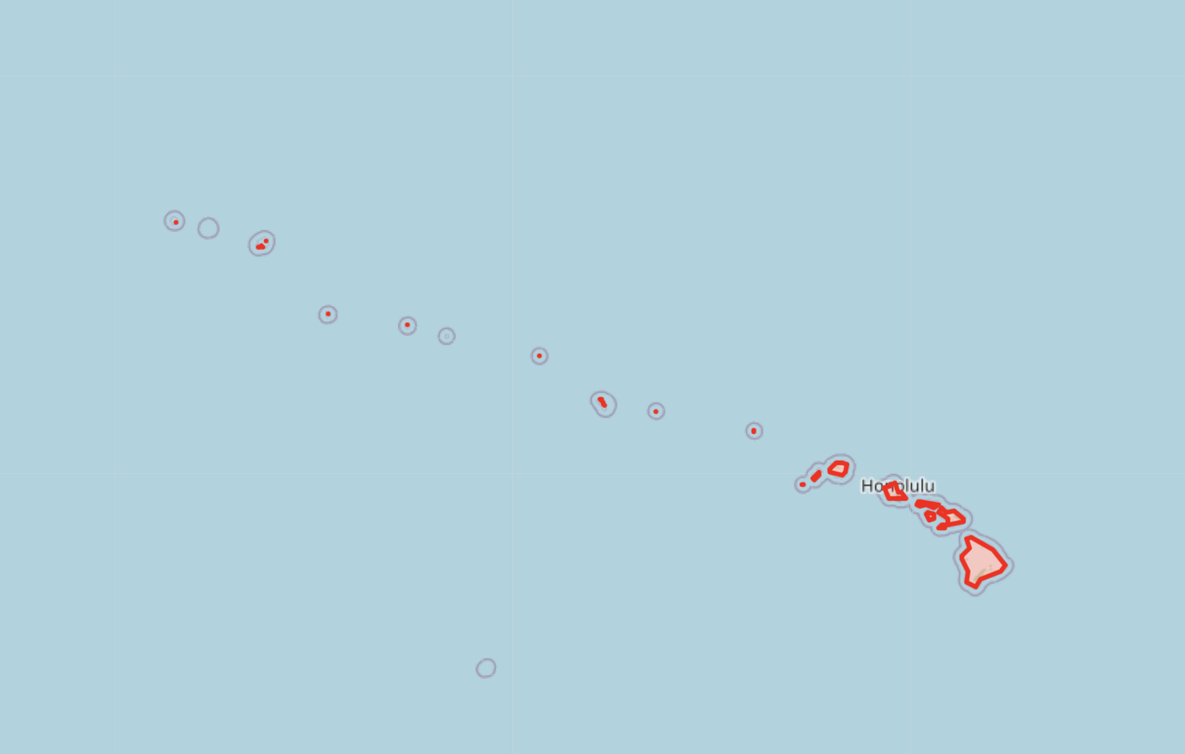
Home Affordability Map

Slide 18
Conclusions
Based on the Line Graph, in every state home values are increasing, some are higher than the national average like California, Hawaii, and some are much lower like West Virginia, Arkansas, and Iowa. Regardless they are all trending upward.
Based on our scatter plot, Population Growth is not directly affecting the Housing Pricing Increase as the data shows no real correlation between states with high growth rates and states with high home value growth rates
The best month to buy is January and worst month is December? Data even weighted for more recent years is skewed by the constant housing price increase that has happened between 2010-2022
Viewing the Plotly we can see the Midwest has generally the most affordable houses based on the average income of their population vs Home Values

Slide 19
Shout Outs
To the semi-colon (;) for truly showing why it is The Reigning, Defending, Undisputed Hide & Seek Champion of the World throughout the Project
To Console.log for being the best troubleshooting tool that money is not needed to by

Slide 20
Questions?

