Slide 1
Federal Funds Rate Impact On Market Indexes
Group 1 - Project 1
Jose Santos
Cameron Wilson
Adrián Stahl
Sierra Morgan

Slide 2
Table of Contents
Project Overview
Data Cleaning & Wrangling
Data Analysis
Line graphs: Valuations vs Time
Box Plots: Indexes Percent Change
Regression Lines
Statistical Analysis
Independent T-Tests & Correlation Coefficient
Conclusion

Slide 3
Project Overview

Slide 4
Our Scope:
We are going to pull the federal funds rate data from the FED website and compare it to the data of market indexes over time to determine if the growth of the market indexes is correlated with the federal funds rate.

Slide 5
Key Variables
Federal Funds Rate - Set by the Federal Reserve, this interest rate is the basis for banks borrowing and lending from the central bank overnight thereby impacting everything in the economy from inflation to unemployment.
S&P 500 - Stock market index measuring the performance of the 500 largest companies publicly traded in the United States
NASDAQ - Nasdaq Index tracks over 3,000 stocks which comprise the global online Nasdaq stock exchange
DowJones - Stock market index which measures the stock performance of 30 leading publicly owned blue-chip companies in the United States

Slide 6
Our Null Hypothesis:
The Federal Funds rate does not impact the growth rate of the market indexes.

Slide 7
Data Cleanup & Wrangling

Slide 8
Data Sources
Federal Funds Rate:
FRED: https://fred.stlouisfed.org/series/FEDFUNDS
FEDFUNDS csv data
API/JSON
S&P 500, Dow Jones, Nasdaq:
FRED: Federal Funds Effective Rate (FEDFUNDS) | FRED | St. Louis Fed (stlouisfed.org)
API/JSON

Slide 9
Data Cleaning
Data types
Numeric types (integers, floats, datetime)
Drop
Duplicated or null rows (and columns)
Rename
Columns, variables
Check and correct
Alignment, typos, casing, spacing
Merged Dataframes - pulled in the jsons and merged them all in with an inner join in order to have all the data in one dataframe

Slide 10
Data Analysis

Slide 11
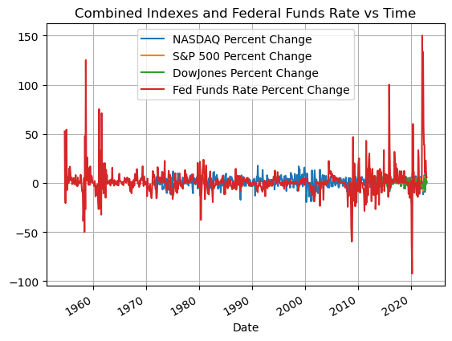

Slide 12
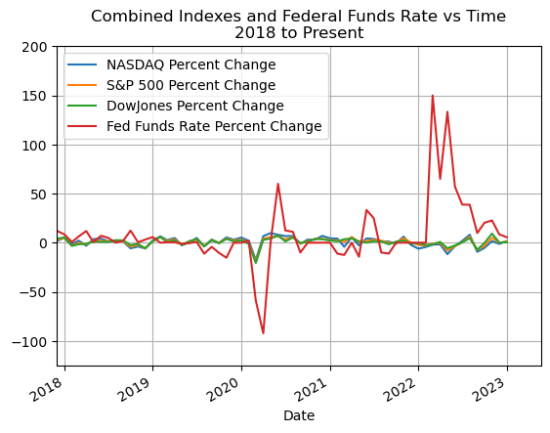
Making sense out of it…..

Slide 13
It’s Key to Understand
Basis Points:
One basis point is equal to 1/100th of a percentage point.
Federal Interest Rates and Stock Markets:
*CAN* be inversely related.

Slide 14
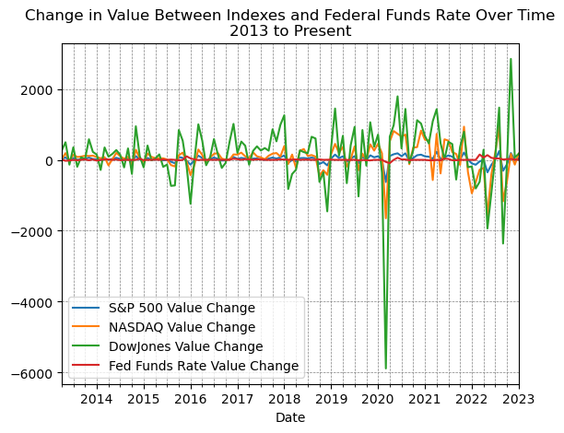

Slide 15
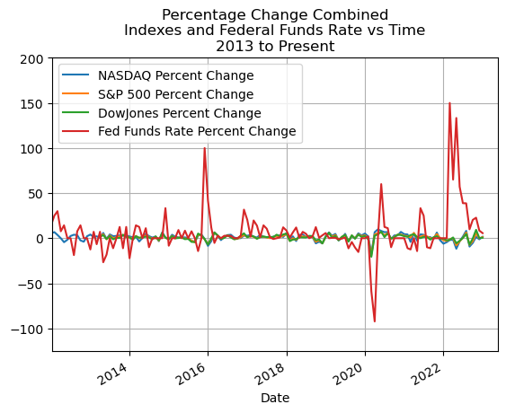

Slide 16
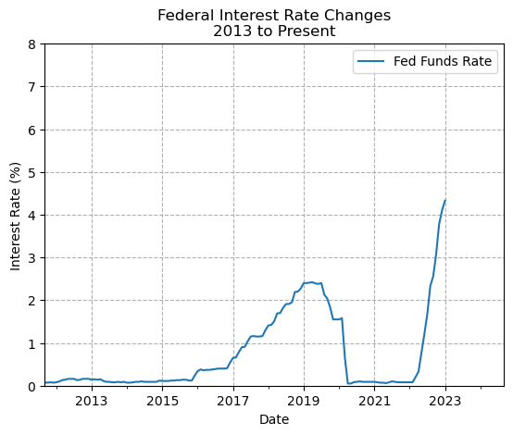
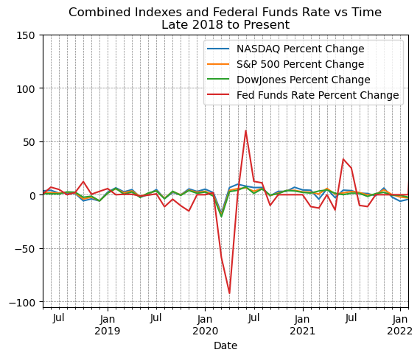
Let’s take a look in history:

Slide 17
Let’s remember: Correlation does not mean Causation

Slide 18
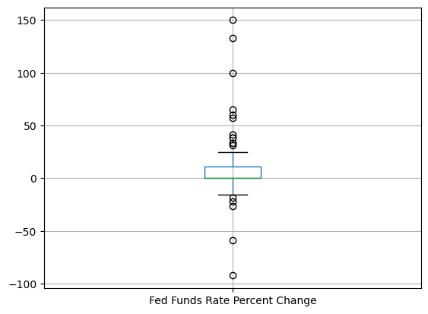

Slide 19
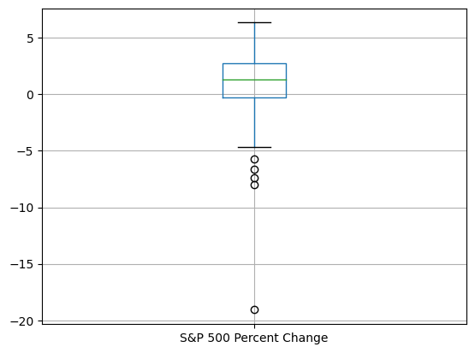

Slide 20
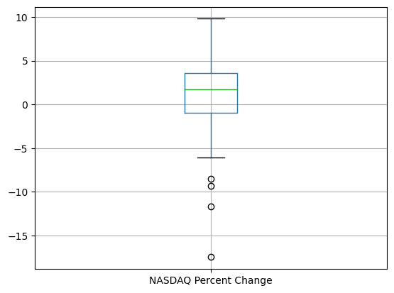

Slide 21
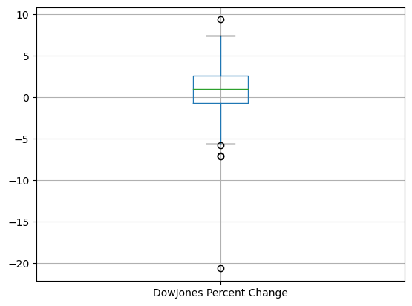

Slide 22
Statistical Analysis

Slide 23
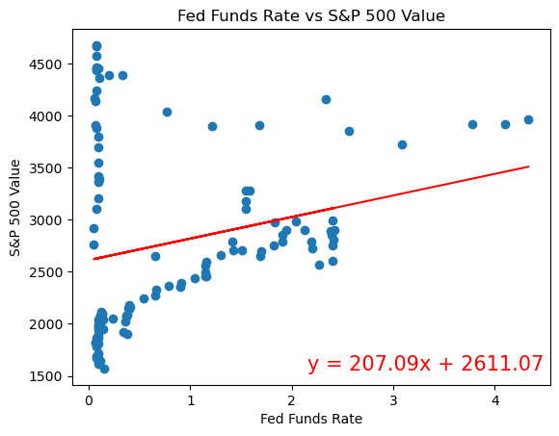
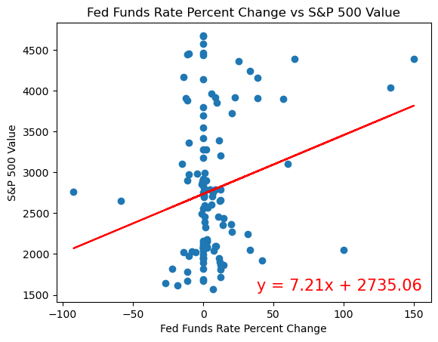
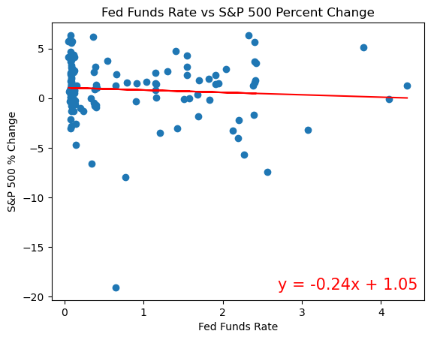
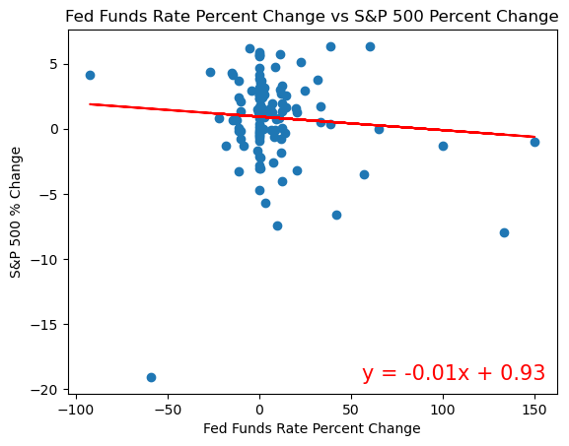
Regression Lines - S&P 500

Slide 24
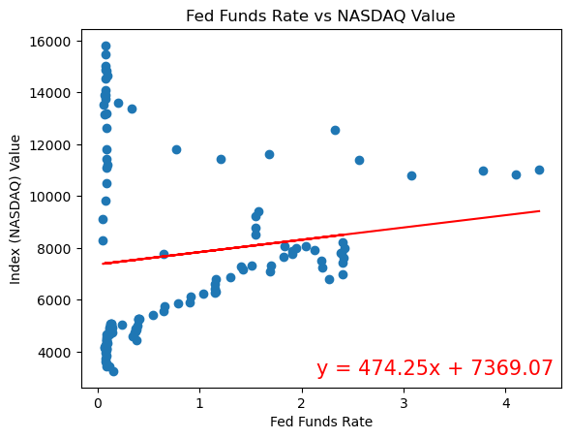
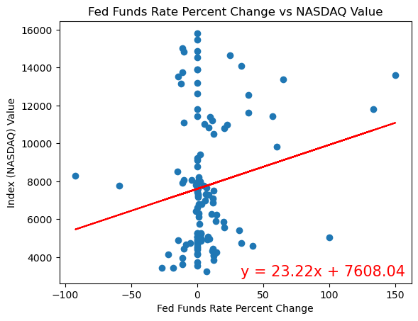
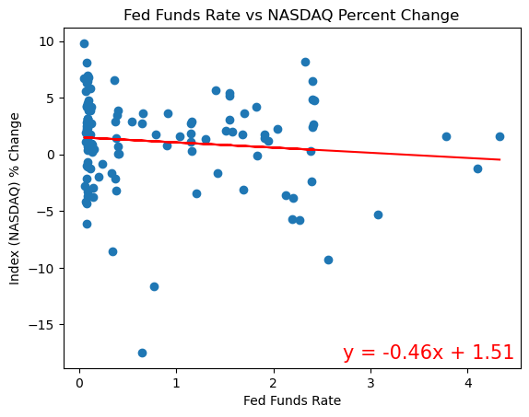
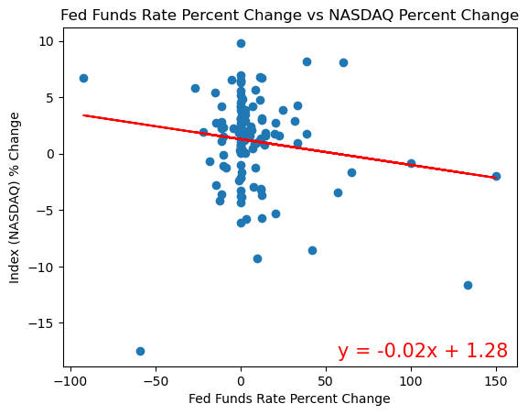
Regression Lines - NASDAQ

Slide 25
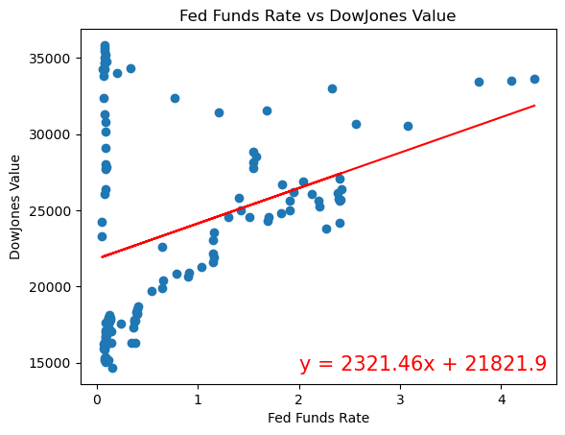
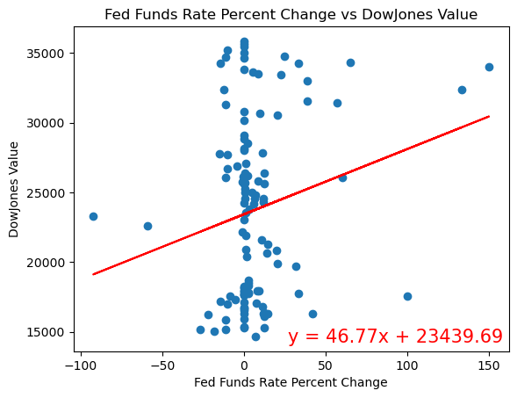
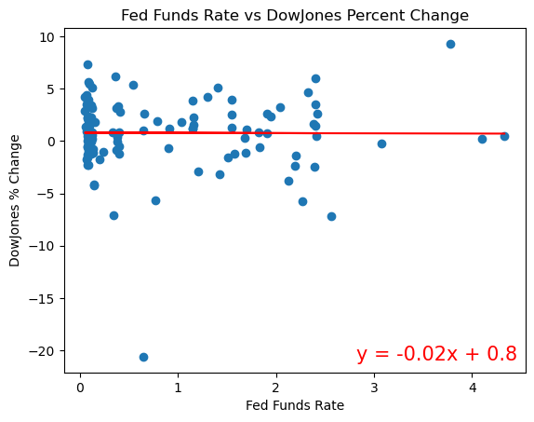
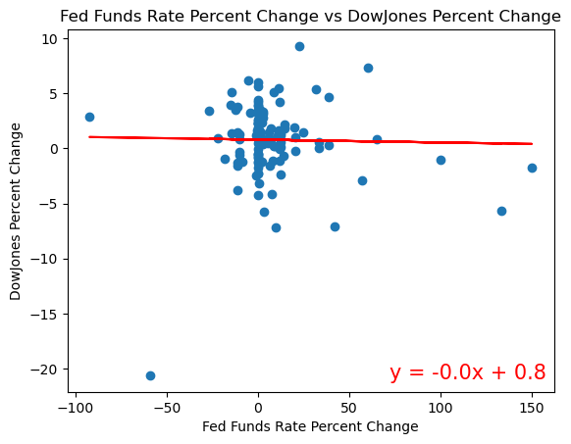
Regression Lines - DowJones

Slide 26
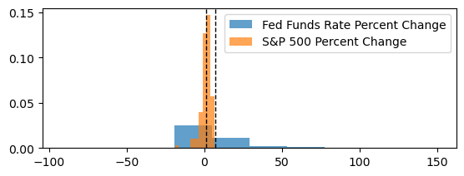
Independent T-tests & Correlation Coefficient: S&P 500
Ttest_indResult(statistic=2.3401496829413113, pvalue=0.020918626168423198)
The Correlation Coefficient is -0.08305477059254535
Decision: Since our pvalue is less than .05 we reject our null hypothesis. With a correlation coefficient of -.08 there is an extremely weak negative correlation. The Fed Fund Rate does not largely impact changes in the S&P 500.

Slide 27
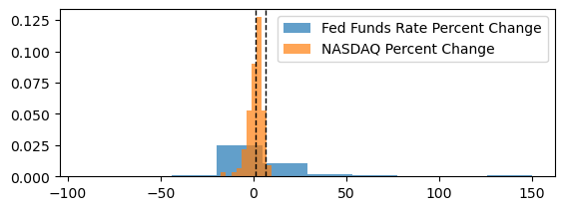
Independent T-tests & Correlation Coefficient: NASDAQ
Ttest_indResult(statistic=2.2223905306419343, pvalue=0.02809340425539805)
The Correlation Coefficient is -0.15026512401901942
Decision: Since our pvalue is less than .05 we accept our null hypothesis. With a correlation coefficient of -.15 there is a very weak negative correlation. The Fed Fund Rate does not largely impact changes in the NASDAQ.

Slide 28
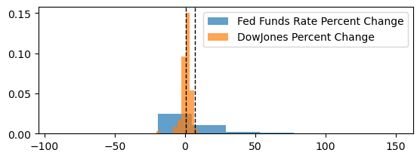
Independent T-tests & Correlation Coefficient: DowJones
Ttest_indResult(statistic=2.3694005804854568, pvalue=0.019402526667183336)
The Correlation Coefficient is -0.020329389016606574
Decision: Since our pvalue is less than .05 we accept our null hypothesis. With a correlation coefficient of -.02 there is an extremely weak negative correlation. The Fed Fund Rate does not largely impact changes in the DowJones.

Slide 29
Conclusion

Slide 30
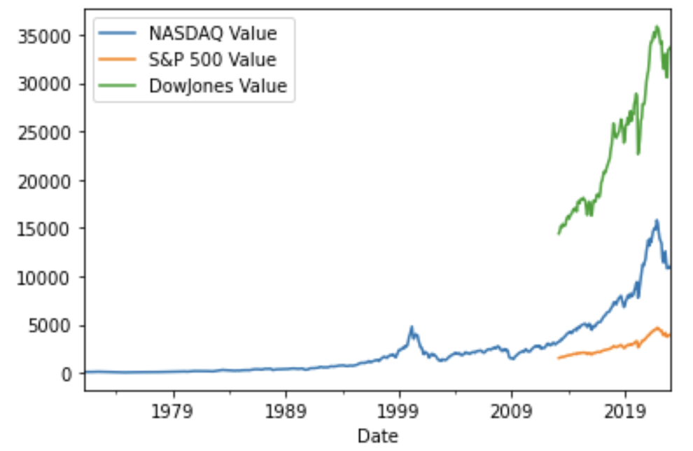
Conclusion: Limitations

Slide 31
Conclusion
We failed to reject the null hypothesis - The federal funds rate does not impact the growth rate of the market indexes.

Slide 32
Sources:
"Nasdaq in Correction as Alphabet, Facebook Dive on Earnings" (Bloomberg, 2/4/2019) - https://www.bloomberg.com/news/articles/2019-02-04/nasdaq-in-correction-as-alphabet-facebook-dive-on-earnings
"The stock market's biggest winners and losers of the last decade" (CNBC, 12/31/2019) - https://www.cnbc.com/2019/12/31/the-stock-markets-biggest-winners-and-losers-of-the-last-decade.html
"Fed rate hikes and trade war hit Nasdaq's top stocks in 2018" (Financial Times, 12/24/2018) - https://www.ft.com/content/56e1c752-06f6-11e9-9fe8-acdb36967cfc
"The Nasdaq is in bear market territory, and Facebook, Apple, Netflix and Google are leading the rout" (CNBC, 12/21/2018) - https://www.cnbc.com/2018/12/21/nasdaq-bear-market-facebook-amazon-apple-netflix-and-google-lead-rout.html
What Is The Federal Funds Rate? – Forbes Advisor - https://www.forbes.com/advisor/investing/federal-funds-rate/#:~:text=The%20Federal%20Open%20Markets%20Committee,currently%204.50%25%20to%204.75%25.
What is the S&P 500? How are companies selected? - Market Business News - marketbusinessnews.com.financial-glossary/sp-500
What Nasdaq Is, History, and Financial Performance (investopedia.com) - https://www.investopedia.com/terms/n/nasdaq.asp
What Is the Dow Jones Industrial Average (DJIA)? (investopedia.com) - https://www.investopedia.com/terms/d/djia.asp

