Slide 1
Professional electronic diary
Anthony DI STASIO, Adrien MOUSTY, Tony WIGNY

Slide 2
Table of contents
Why social worker ?
Our schemata
Features
Tools used
Novelties
A short demonstration of our application
Problems encountered
Conclusion

Slide 3
Our schemata
Static context diagram

Slide 4
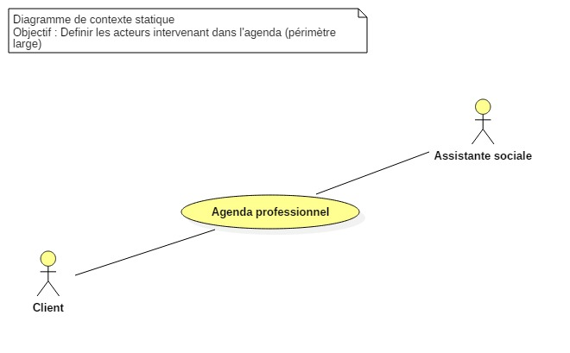
Static context diagram
Defining the actors of our application

Slide 5
Our schemata
Static context diagram
Database schema

Slide 6
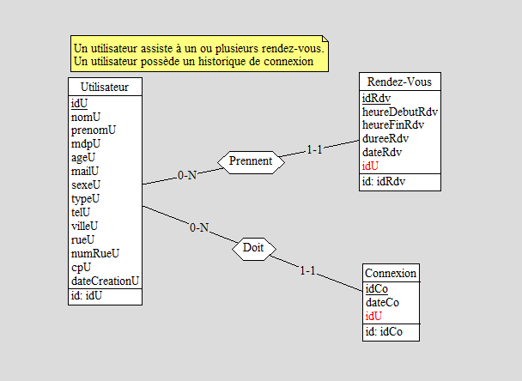
Database schema
Defining the attrbutes and the links between the tables

Slide 7
Our schemata
Static context diagram
Database schema
Use case diagram

Slide 8
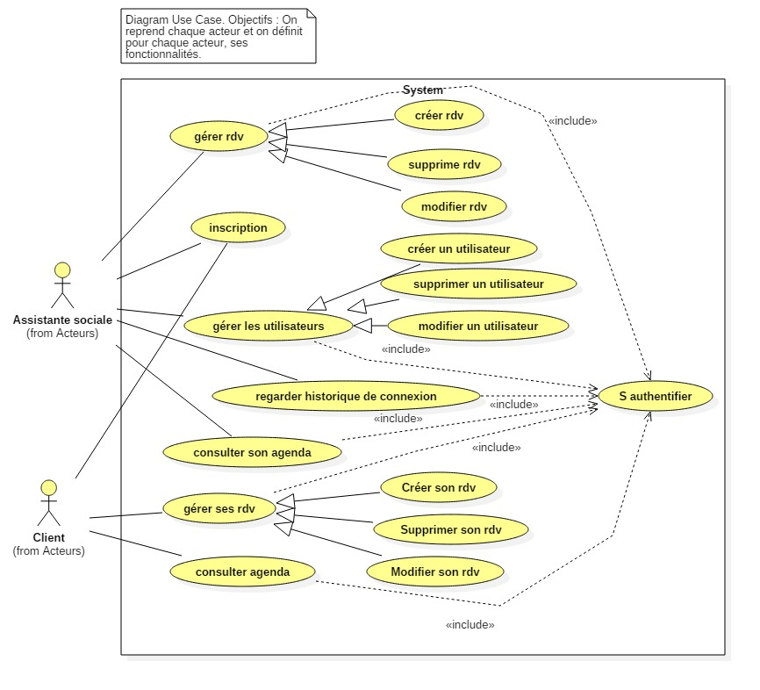
Use case diagram
Interactions between actors and the system

Slide 9
Our schemata
Static context diagram
Database schema
Use case diagram
Iterative use case Diagram

Slide 10
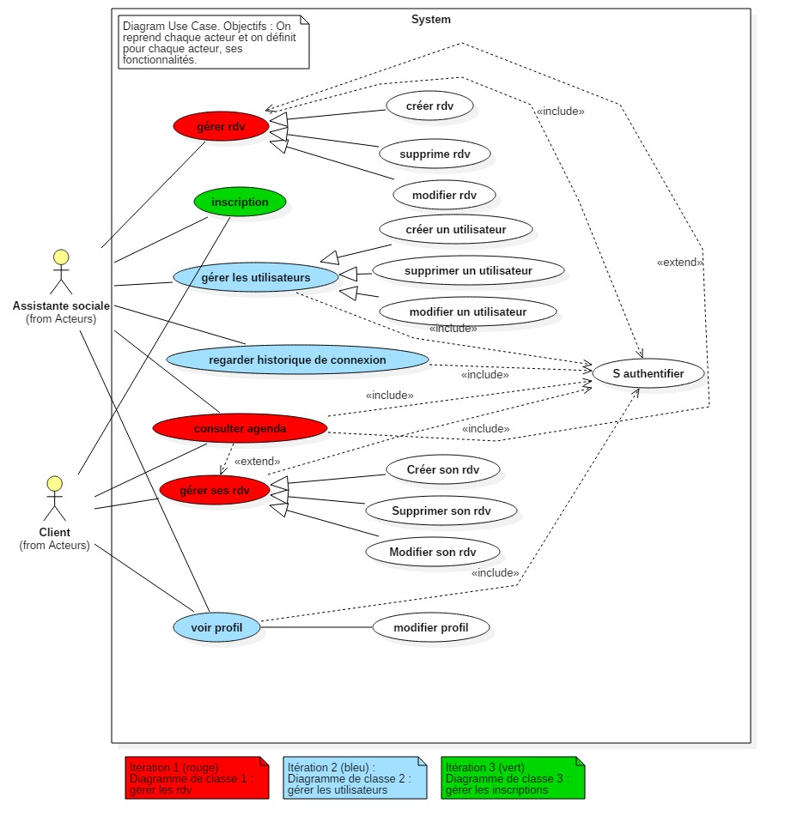
Iterative Use case Diagram
Defining the iteration

Slide 11
Our schemata
Static context diagram
Database schema
Use case diagram
Iterative use case Diagram
Sequence diagram

Slide 12
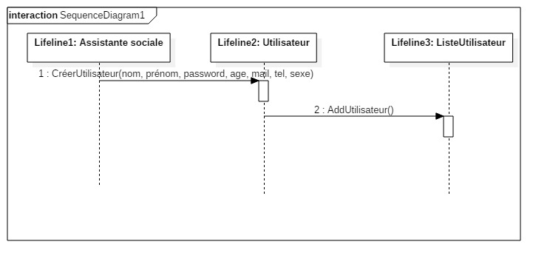
Sequence diagram
Defining the methods in the various classes

Slide 13
Our schemata
Static context diagram
Database schema
Use case diagram
Iterative use case Diagram
Sequence diagram
Full class diagram

Slide 14
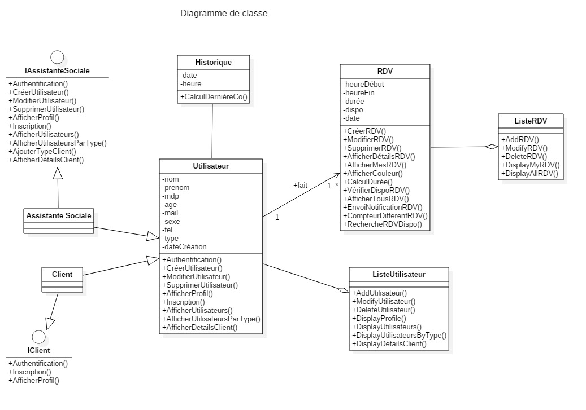
Class diagram
Defining the attributes and methods of our classes

Slide 15
Features
Customer’s part
Sees the free and reserved hours
Sees his/her appointments
Adds an appointment
Deletes/updates his/her appointments
Adds/modifies his/her profile

Slide 16
Features
Social worker’s part
Sees all appointments
Adds/deletes/modifies an appointment
Sees/modifies his/her profile
Adds/deletes/modifies a user
Sees details of a user
Sees the user’ login history

Slide 17
Tools used
StarUML
DB-Main
Visual Studio 2015
Blend
Azure

Slide 18
Novelties
NuGet
Add theme and some other features (Google Maps, …)
Azure
Online database
« Sprocs »

Slide 19
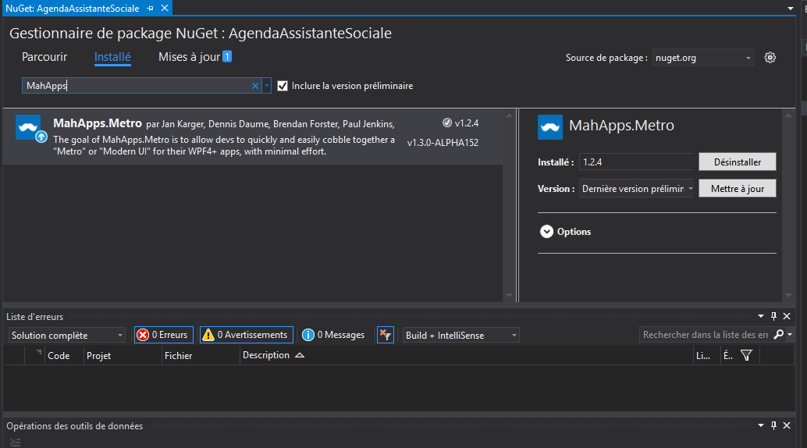
NuGet
A Visual Studio extension

Slide 20
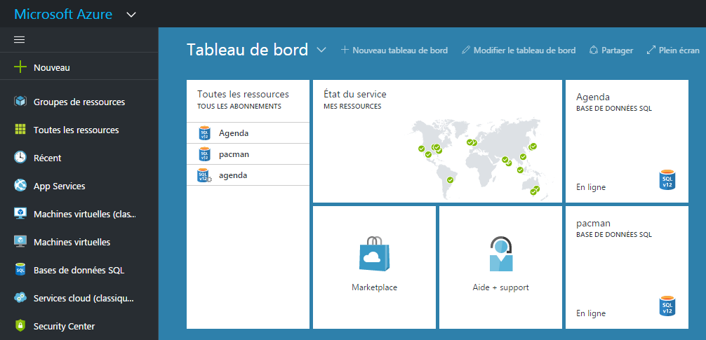
Azure
Online database

Slide 21
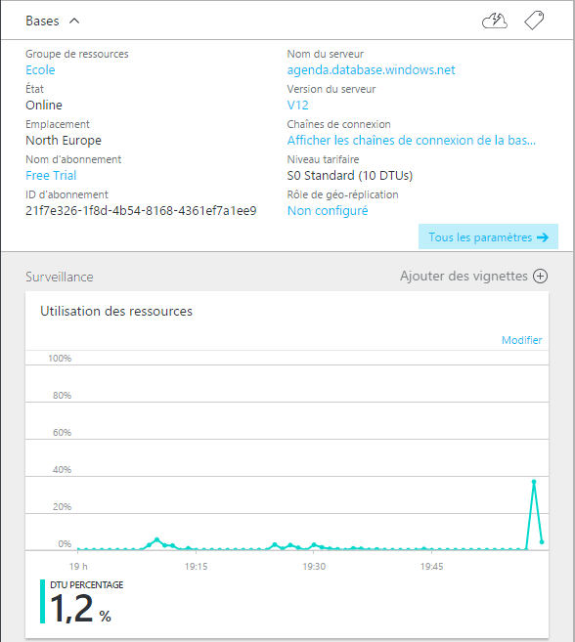
Azure

Slide 22
Presentation of our application

Slide 23
Problems encounter
How to correctly display the appointments
How to verify when a time slot isn’t available
How to transform Linq queries into « sprocs »
Communication within our group

Slide 24
Conclusion
Anthony’s opinion
Adrien’s opinion
Tony’s opinion

