Slide 1



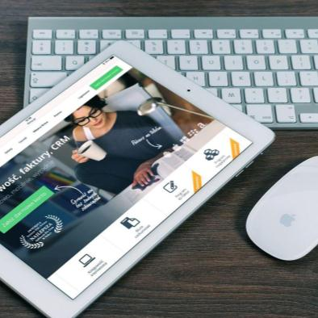
今年工作总结
The user can demonstrate on a projector or computer, or presentation and make it film to be used in a wider field
The user can demonstrate on a projector or computer, or presentation and make it film to be used in a wider field
The user can demonstrate on a projector or computer, or presentation and make it film to be used in a wider field
The user can demonstrate on a projector or computer, or presentation and make it film to be used in a wider field

