Slide 1
Linked Lists
Lab 15

Slide 2
Java
LinkedList

Slide 3
Java Collections
Map
Sub
Interfaces
-extends
Collection
Implementing
Classes
SortedMap
Sub
Interfaces
-extends
HashMap
HashTable
Implementing
Classes
List Set
Sub
Interfaces
-extends
RandomAccess
TreeMap
SortedSet
ArrayList
LinkedList
Vector
TreeSet
Implementing
Classes
AbstractSet
HashSet
LinkedHashSet
Implementing
Classes

Slide 4
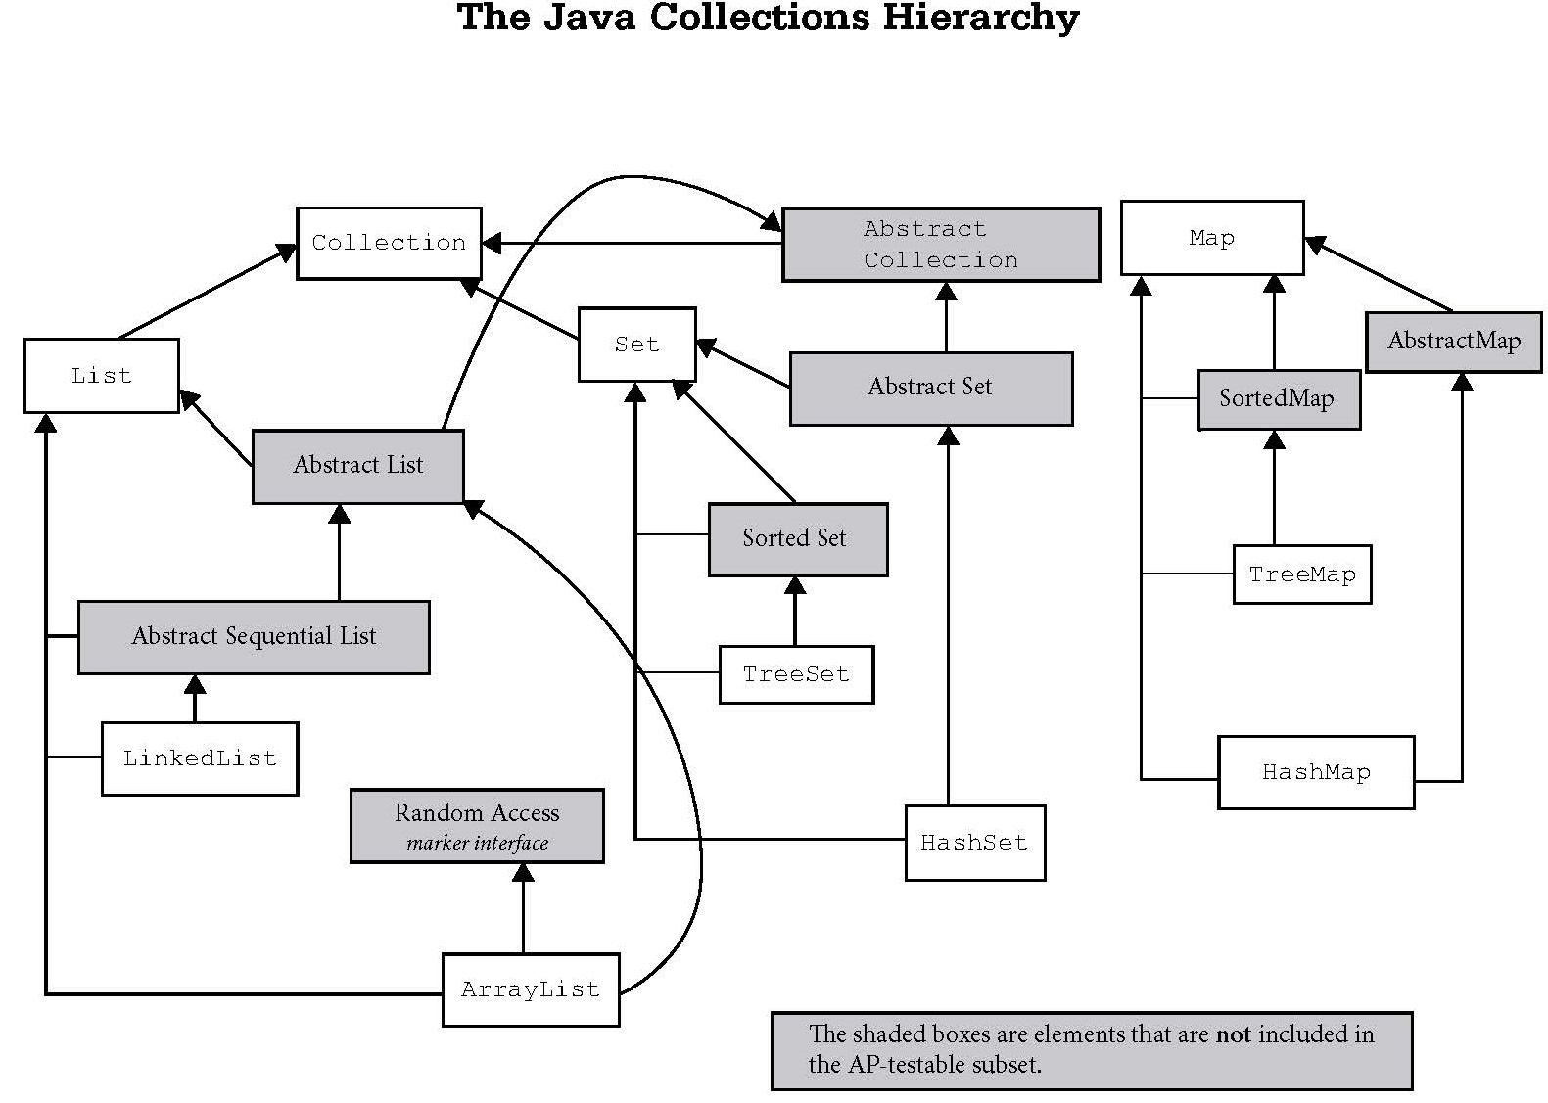
Iterable
Vector
Stack

Slide 5
public interface RandomAccess
Marker interface used by List implementations to indicate that they support fast (generally constant time) random access.
The primary purpose of this interface is to allow generic algorithms to alter their behavior to provide good performance when applied to either random or sequential access lists.
The best algorithms for manipulating random access lists (such as ArrayList) can produce quadratic behavior when applied to sequential access lists (such as LinkedList).
Generic list algorithms are encouraged to check whether the given list is an instanceof this interface before applying an algorithm that would provide poor performance if it were applied to a sequential access list, and to alter their behavior if necessary to guarantee acceptable performance.

Slide 6
This is a O(n) loop for RandomAccess lists (such as ArrayLists), but O(n²) list for LinkedLists:
for (int i=0, n=list.size(); i < n; i++)
list.get(i);
This is a O(n) loop for ANY list:
Iterator i=list.iterator();
while (i.hasNext())
i.next();
Notes:
As a rule of thumb, a List implementation should implement the RandomAccess interface if, for typical instances of the class, the first loop runs faster than the second loop.

Slide 7
// Positional Access Operations /** * Returns the element at the specified position in this list. * * @param index index of the element to return * @return the element at the specified position in this list * @throws IndexOutOfBoundsException {@inheritDoc} */ public E get(int index) { return entry(index).element; }

Slide 8
/** * Returns the indexed entry. */ private Entry<E> entry(int index) { if (index < 0 || index >= size) throw new IndexOutOfBoundsException("Index: "+index+ ", Size: "+size); Entry<E> e = header; if (index < (size >> 1)) { for (int i = 0; i <= index; i++) e = e.next; } else { for (int i = size; i > index; i--) e = e.previous; } return e; }

Slide 9
private static class Entry<E> { E element; Entry<E> next; Entry<E> previous;
Entry(E element, Entry<E> next, Entry<E> previous) { this.element = element; this.next = next; this.previous = previous; } }

Slide 10
ArrayList | LinkedList
Uses a dynamic array to store the elements. | Uses a doubly linked list to store the elements.
Manipulation is slow since when any element is removed, all following bits are shifted in memory. | Manipulation is faster because no bit shifting is required in memory.
Can only act as a list since it only implements List. | Can act as a list or queue (including a stack) because it implements List and Deque interfaces.
ArrayList is better for storing and accessing data. | LinkedList is better for manipulating data.

Slide 11
LinkedList
Methods

Slide 12
LinkedList frequently used methods
Name | Use
add(x) | adds item x to the list
set(x,y) | set location x to the value y
get(x) | get the item at location x
size() | returns the # of items in the list
remove() | removes an item from the list
clear() | removes all items from the list
import java.util.LinkedList;

Slide 13
add()
LinkedList<String> list;
list = new LinkedList<String>();
list.add("c");
list.add("b");
list.add("a");
list.add(1, "d");
out.println(list);
OUTPUT
[c, d, b, a]

Slide 14
get()
LinkedList<String> list;
list = new LinkedList<String>();
list.add("c");
list.add("b");
list.add("a");
list.add(1, "d");
out.println(list.get(0) );
out.println(list.get(1) );
out.println("first " + list.getFirst());
out.println("last " + list.getLast());
OUTPUT
c
d
first c
last a

Slide 15
Open
linkedlistadd.java
linkedlistget.java

Slide 16
Open
linkedlistdemo.java

Slide 17
Start work
on Lab 15a

Slide 18
Linked Lists
A linked list is a group of nodes. Each node contains a value and a
reference to the next node in
the list.

Slide 19
Simple Node Class
public class Node
{
private Comparable data;
private Node next;
public Node(Comparable dat, Node nxt)
{
data=dat;
next=nxt;
}
}

Slide 20
A Single Node
0xF2
node
B
null
0xF2
A node typically has a data
component and a reference
to the next node.

Slide 21
Don’t draw the null reference this way!
0xF2
node
B
null
0xF2
This leads to the misconception that the “B” node points to a node that stores a null value, but there simply is no node after the “B” node.

Slide 22
Linkable Interface
public interface Linkable
{
Comparable getValue();
Linkable getNext();
void setNext(Linkable next);
void setValue(Comparable value);
}

Slide 23
public class ListNode implements Linkable
{
private Comparable listNodeValue;
private ListNode nextListNode;
public ListNode(){
listNodeValue = null;
nextListNode = null;
}
public ListNode(Comparable value, ListNode next)
{
nextListNode = next;
listNodeValue = value;
}
//other methods not shown
//refer to the Linkable interface
}
The
ListNode
Class
This ListNode class is similar to the AP ListNode.
You can obtain the official AP ListNode class from the college board website. You will be provided with a copy of the AP ListNode class when you take the AP Computer Science AB exam.

Slide 24
Creating A
Single Node
Linkable node = new ListNode("10", null);
out.println(node.getValue());
out.println(node.getNext());
OUTPUT 10 null
0xFA
node
null
10
0xFA

Slide 25
Open
onenode.java

Slide 26
Linking Nodes

Slide 27
Linking Nodes
OUTPUT10 12 11
ListNode x = new ListNode("10",
new ListNode("11",
new ListNode("12",null)));
out.println(x.getValue());
out.println(x.getNext().getNext().getValue());
out.println(x.getNext().getValue());

Slide 28
Open
linkone.java

Slide 29
Linking Nodes
ListNode x = new ListNode("10", null);
ListNode y = new ListNode("11",x);
ListNode z = new ListNode("12",y);
0x12
0x15
0x17
z
12
0x15
11
0x17
10
null
0x12
y
x
0x15
0x17

Slide 30
Linking Nodes
ListNode x = new ListNode(10.3, null);
ListNode y = new ListNode(11.0, x);
ListNode z = new ListNode(12.5, y);
z
12.5
11.0
10.3
null
y
x

Slide 31
Linking Nodes
ListNode x = new ListNode(10.3, null);
ListNode y = new ListNode(11.0, x);
ListNode z = new ListNode(12.5, y);
out.println(z.getValue());
out.println(z.getNext().getNext().getValue());
out.println(z.getNext().getValue());
OUTPUT12.5
10.3
11.0

Slide 32
Open
linktwo.java

Slide 33
Using Loops
With Lists

Slide 34
Printing All Nodes
ListNode x = new ListNode("10",
new ListNode("11",
new ListNode("12",null)));
while( x != null )
{
out.println( x.getValue() );
}
OUTPUT10 10 10 . . .

Slide 35
Open
printAll_1.java

Slide 36
Printing All Nodes
ListNode x = new ListNode("10",
new ListNode("11",
new ListNode("12",null)));
while( x != null )
{
out.println( x.getValue() );
x = x.getNext();
}
OUTPUT10 11 12

Slide 37
Open
printAll_2.java

Slide 38
Summing All Nodes
ListNode x = new ListNode(11,
new ListNode(8,
new ListNode(5,null)));
int sum=0;
while( x != null )
{
sum = sum + (Integer)x.getValue();
x = x.getNext();
}
out.println(sum);
OUTPUT24

Slide 39
Open
sumone.java

Slide 40
Adding
Nodes

Slide 41
add
0xF2
front
cat
null
0xF2
front = new ListNode("cat", null);

Slide 42
add
0xF33
0xF2
front
dog
cat
null
0xF2
0xF33
front = new ListNode ("dog", front);

Slide 43
add
0xF17
0xF33
0xF2
front
pig
0xF33
dog
0xF2
cat
null
0xF17
front = new ListNode ("pig", front);

Slide 44
add
OUTPUT
12 10 11
OUTPUT
12 10 11
OUTPUT
12 10 11
OUTPUT
12 10 11
ListNode front=null;
front = new ListNode("10", front);
front = new ListNode("11",front);
front = new ListNode("12",front);
out.println(front.getValue());
out.println(front.getNext().getNext().getValue());
out.println(front.getNext().getValue());

Slide 45
Open
add.java

Slide 46
Finding A
Node

Slide 47
Finding a Node
ListNode list = front;
while ( there are more nodes to check )
{
if( a node containing the value was found )
return true;
move to the next node to check
}
return false;

Slide 48
Open
contains.java

Slide 49
Removing
Nodes

Slide 50
Removing the
First Node

Slide 51
Removing the first node
pig is to be removed.
0xF17
0xF21
0xFEA
front
0xF17
pig
0xF21
dog
0xFEA
cat
null
front refers to the 1st node in the list.

Slide 52
Removing the first node
front = front.getNext();
front
0xF17
0xF21
0xFEA
0xF21
pig
0xF21
dog
0xFEA
cat
null
front moves up one node.

Slide 53
Removing any Node

Slide 54
Removing any node
dog is to be removed. current = front;
0xF17
0xF21
0xFEA
front
0xF17
pig
0xF21
dog
0xFEA
cat
null
current
0xF17
front and current store the same memory address.

Slide 55
Removing any node
previous = current;
0xF17
0xF21
0xFEA
front
0xF17
pig
0xF21
dog
0xFEA
cat
null
current
0xF17
previous
0xF17
front, current, and previous all store the same memory address.

Slide 56
Removing any node
current=current.getNext();
0xF17
0xF21
0xFEA
front
0xF17
pig
0xF21
dog
0xFEA
cat
null
current
0xF17
current
previous
0xF21
0xF17
current moves forward one node.

Slide 57
Removing any node
previous.setNext(current.getNext());
0xF17
0xF21
0xFEA
front
0xF17
pig
0xF21
dog
cat
null
0xFEA
0xFEA
current
previous
0xF21
0xF17
Found dog. Removed dog from the list.

Slide 58
Removing any node
Some things you have to account for!
What if the linked list is null?
2. What if I need to remove the 1st node?
3. How do I process the remaining nodes?
4. Do I remove more than 1 occurrence
of the same value or just the 1st one?

Slide 59
Removing any node
current = previous.getNext();
0xF17
0xF21
0xFEA
front
0xF17
pig
0xFEA
dog
0xFEA
cat
null
previous
current
0xF17
0xF21
Found dog. Removed dog from the list.

Slide 60
Open
remove.java

Slide 61
Doubly
Linked Lists

Slide 62
DoublyNode Class
class DoublyNode
{
private Comparable data;
private DoublyNode next;
private DoublyNode prev;
public DoublyNode(Comparable dat,
DoublyNode prv, DoublyNode nxt)
{
data=dat;
prev=prv;
next=nxt;
}
//other methods not shown
}

Slide 63
A DoublyNode
0xF2
 | B
null
null
A doubly node typically has a data
component and a reference to the
next node and the previous node.

Slide 64
A DoublyNode
0xF2
0xF4
 | B
 | C
0xF4
0xF4
0xF2
0xF2
Doubly nodes can be used to make
a circular linked list where the front
points at the back and vice versa.

Slide 65
Comparing Runtimes
of Arrays & Lists

Slide 66
Big-O Notation
Big-O notation is an assessment of an
algorithm’s efficiency. Big-O notation
helps gauge the amount of work that
is taking place.
Common Big O Notations :
O(1) O(Log₂N)
O(2^{N}) O(N²)
O(N Log₂N) O(N)
O(Log₂N) O(N³)

Slide 67
Arrays
traverse all spots O(N)
search for an item O(N) or O(Log₂N)
remove any item O(N) location unknown
get any item O(1) location known
add item at the end O(1)
add item at the front O(N)
If sorted, use binary search
An array is a collection of like variables.
1 | 5 | 8 | 9 | 11

Slide 68
Java Collections – ArrayList
traverse all spots O(N)
search for an item O(N) or O(Log₂N)
remove any item O(N) location unknown
get any item O(1) location known
add item at the end O(1)
add item at the front O(N)
ArrayList is implemented with an array.
If sorted, use binary search

Slide 69
Single Linked Lists
traverse all nodes O(N)
search for an item O(N)
remove any item O(N) location unknown
get any item O(N) location unknown
add item at the end O(1) (if tail is stored)
O(N) (if no link to tail)
add item at the front O(1)
A single linked node has a reference to the next node only.
A single linked node has no reference to the previous node.
10
null
null

Slide 70
Double Linked Lists
Java’s LinkedList class is a doubly-linked list.
traverse all nodes O(N)
search for an item O(N)
remove any item O(N) location unknown
get any item O(N) location unknown
add item at the end O(1)
add item at the front O(1)
null
10
null

Slide 71
Java Collections – LinkedList
LinkedList is implemented with a double linked list.

Slide 72
Continue work
on Lab 15

