Slide 1
Stacks

Slide 2
Stacks & Queues
These common abstract data types allow insertion and removal at the ends only, not in the middle.

Slide 3
What is a Stack?
A stack is a group of items all of the same type where items are added to the top of the stack and removed from the top.
Stacks work in a LIFO manner.

Slide 4

What is a Stack?
Stack<Integer> stack;
stack = new Stack<Integer>();
stack will only store
Integer values.

Slide 5
What is a Stack?
stack.push(15);
push adds an item
to the stack.
15

Slide 6
What is a Stack?
stack.push(47);
47
15
push adds an item
to the stack.

Slide 7
What is a Stack?
11
47
15
stack.push(11);
push adds an item
to the stack.

Slide 8
What is a Stack?
stack.pop();
47
15
pop removes an item from the stack.

Slide 9
What is a Stack?
stack.pop();
pop removes an item from the stack.
15

Slide 10
Stack
Methods

Slide 11
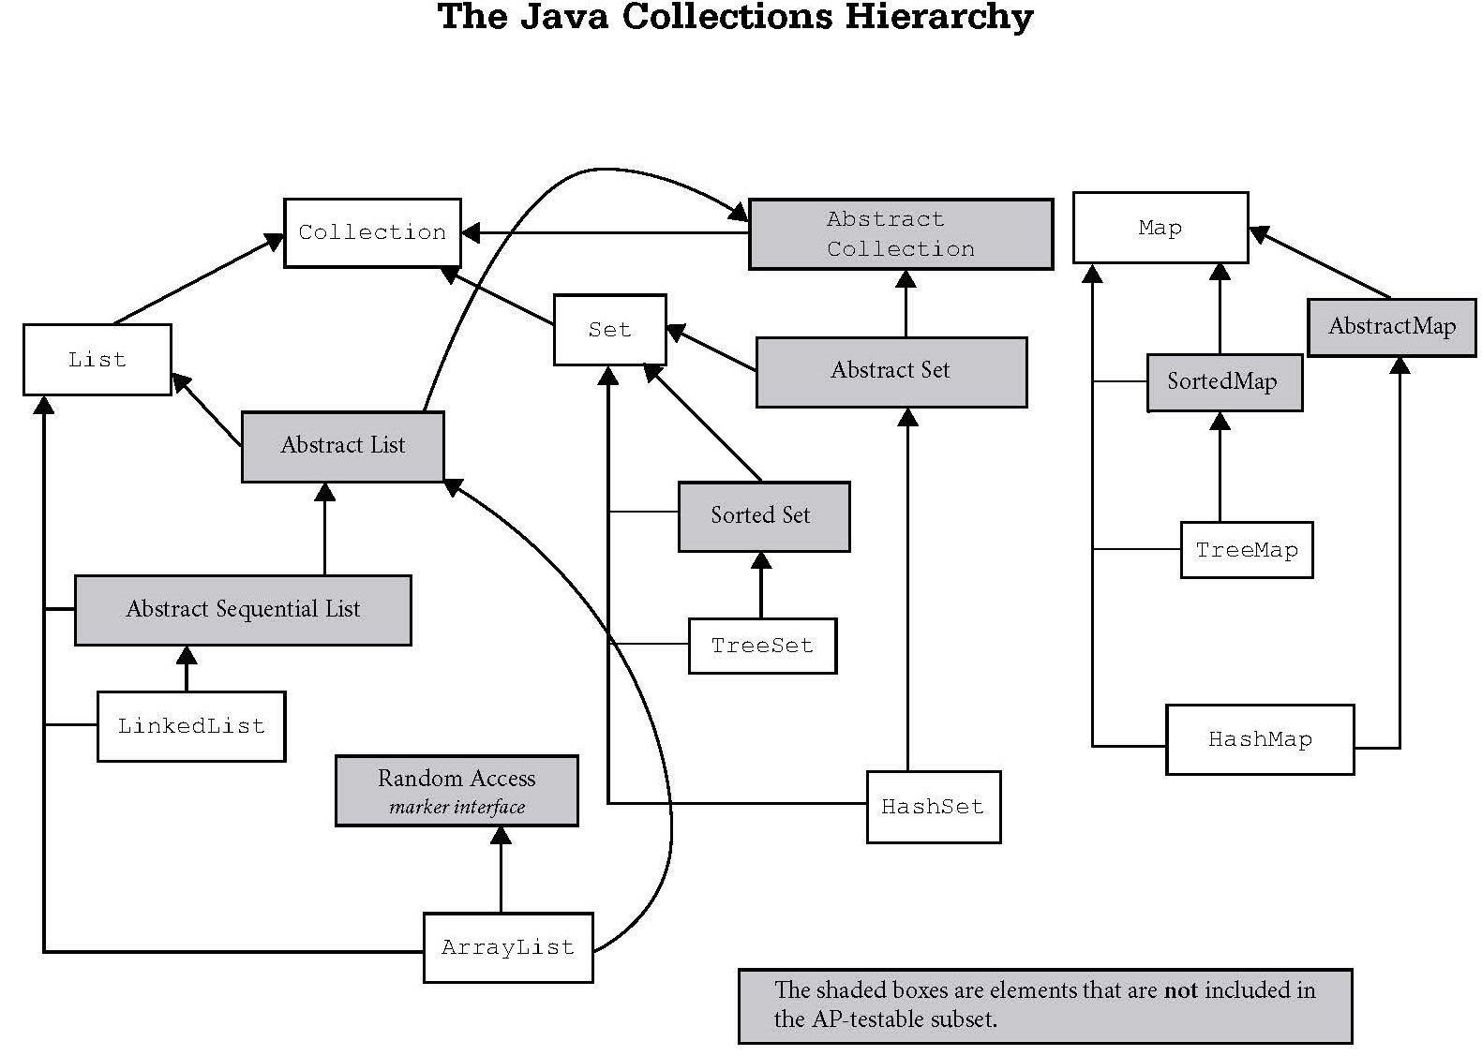
Iterable
Vector
Stack

Slide 12
Stack frequently used methods
Name | Use
push(x) | adds item x to the stack
add(x) | add() is inherited from the Vector class. Use push() instead.
pop() | removes and returns an item
peek() | returns the top item with no remove
size() | returns the # of items in the stack
isEmpty() | checks to see if the stack is empty
import java.util.Stack;

Slide 13
push
Stack<Integer> s;
s = new Stack<Integer>();
s.push(88);
s.push(23);
s.push(11);
out.println(s);
OUTPUT
[88, 23, 11]

Slide 14
Open
stackpush.java

Slide 15
pop
Stack<Integer> s;
s = new Stack<Integer>();
s.push(88);
s.push(23);
s.push(11);
out.println(s.pop());
out.println(s);
out.println(s.pop());
out.println(s);
OUTPUT
11
[88, 23]
23
[88]

Slide 16
Open
stackpop.java

Slide 17
peek
Stack<Integer> s;
s = new Stack<Integer>();
s.push(88);
s.push(23);
s.push(11);
out.println(s.peek());
out.println(s);
OUTPUT
11
[88, 23, 11]

Slide 18
Open
stackpeek.java

Slide 19
isEmpty
Stack<Integer> s;
s = new Stack<Integer>();
s.push(88);
s.push(23);
s.push(11);
while(!s.isEmpty())
{
out.println(s.pop());
}
OUTPUT
11
23
88

Slide 20
Open
stackisempty.java

Slide 21
Iterable
Vector
Stack

Slide 22
A Stack class Stack again
Stack<Integer> s;
s = new Stack<Integer>();
s.push(88);
s.push(23);
s.push(11);
out.println(s);
out.println(s.pop());
out.println(s);
OUTPUT
[88, 23, 11]
11
[88, 23]

Slide 23
A LinkedList Stack
LinkedList<Integer> s;
s = new LinkedList<Integer>();
s.push(88);
s.push(23);
s.push(11);
out.println(s);
out.println(s.pop());
OUTPUT
[11, 23, 88]
11
[23, 88]

Slide 24
Testing Expressions
With a Stack

Slide 25
Expression Tester
Expressions are made up of values
and symbols. Many symbols come
in pairs.
( )
{ }
A stack can be used to match up
opening and closing symbols.

Slide 26
Expression Tester
{ ( [ ] ) } is a valid expression
{ ( } ) is an invalid expression
{ ( ] ) is an invalid expression
Open and closing symbol pairs
have to occur in the proper sequence.

