Slide 1
SORTING AND
SEARCHING
Lab 22

Slide 2
Software Development Anecdote
In the very early days of Facebook, when it had fewer than 15 employees, a guy named Steve Chen decided after working there for only a few weeks that it just wasn't for him. He wanted to leave to found his own company, and his plan was to do a video startup.
Matt Cohler, the guy who had hired him in the first place, tried to convince him otherwise. "You're making a terrible mistake. Facebook is going to be huge! And there's already a ton of video sites. If you do this you're going to regret it for the rest of your life!“
Chen wasn't convinced, so he decided to do it anyway and left to start a company called YouTube.

Slide 3
Examples of sorting applications:
  a directory of files sorted by name or date
  bank checks sorted by account #
  addresses in a mailing list sorted by zip code
  hits found by a search engine sorted by relevance
  credit card transactions sorted by date
Notes:
At this point, a list is represented as an array. In general the term “sorting” can apply to any list (e.g., a linked list).

Slide 4
Sorting (cont’d)
Time
n²
n log n
n
N | 10 | 100 | 1000
N² | 100 | 10,000 | 1,000,000
N log N | 10 | 200 | 3000
Notes:
When n is large enough, An² eventually overtakes Bn⋅log n no matter how small A is and how large B.

Slide 5
Sorts
Quadratic ( N²)

Slide 6
The Bubble Sort

Slide 7
Bubble Sort
Bubble sort compares items that are
adjacent and has the potential to
swap a whole lot.
Bubble Sort is left in for historical purposes only!

Slide 8
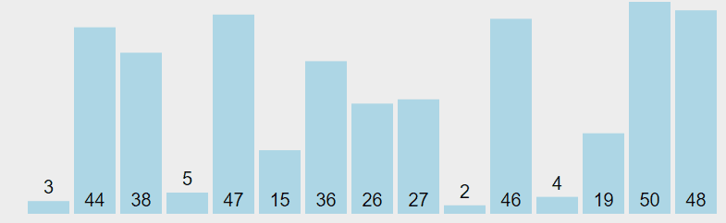
Bubble Sort Animation
8
This is an “improved” bubble sort that stops early if no swap is performed for an entire pass.
visualgo.net/bn/sorting

Slide 9
Bubble Sort W/Objects
void bubbleSort( Comparable[] stuff ){
for(int i=0; i<stuff.length-1; i++){
for(int j=0; j<stuff.length-1; j++){
if(stuff[ j].compareTo(stuff[ j+1]) > 0 ){
Comparable temp = stuff[ j];
stuff[ j] = stuff [ j+1];
stuff [ j+1] = temp;
}
}
}
}
Lots O Swaps!

Slide 10
Bubble Sort W/Objects
void bubbleSort(Comparable[] stuff) {
boolean changed = false;
do {
changed = false;
for (int a = 0; a < stuff.length - 1; a++) {
if (stuff[a].compareTo(stuff[a + 1]) > 0) {
Comparable tmp = stuff[a];
stuff[a] = stuff[a + 1];
stuff[a + 1] = tmp;
changed = true;
}
}
} while(changed);
}

Slide 11

The Selection Sort

Slide 12
Selection Sort
The selection sort does not swap each time
it finds elements out of position. Selection sort
makes a complete pass while searching for the
next item to swap. At the end of a pass once
the item is located, one swap is made.

Slide 13
Selection Sort Explained
  1. Find the min among the first n elements:
  2. Swap it with the “first” element (i.e., list[0]) :
  Increment first by 1 and repeat from Step 1
  ( while first < n - 1)
  1. Find the min among the first n elements:
  Given array [6,13,8,5,2,1,3], the minimum value is 1.
  2. Swap it with the “first” element (i.e., list[0]) :
  Swap the 1 with the 6. No other elements move!
  Increment first by 1 and repeat from Step 1
  ( while first < n - 1)
  In the next iteration, we’ll be finding the smallest of the elements AFTER the 1, which will be the 2.
6
13
8
5
2
1
3
first
n
1
13
8
5
2
6
3
n
1
13
8
5
2
6
3
first
n

Slide 14
Selection Sort Trace
0 1 2 3 4
pass 0
9 | 2 | 8 | 5 | 1
pass 1
1 | 2 | 8 | 5 | 9
pass 2
1 | 2 | 8 | 5 | 9
pass 3
1 | 2 | 5 | 8 | 9
pass 4
1 | 2 | 5 | 8 | 9
Notes:
Selection sort is pretty effective for small lists, but pretty horrible is used on large lists.
Selection sort consists of two loops.
The outer loops run based on the number of items in the list.
The inner loop runs to find the items that need to be moved. The inner loop either locates the spot with the smallest value or the spot with the largest value. After the inner loop completes, a swap may occur if needed. At most, selection sort will make one swap per pass. A pass is one complete execution of the inner loop.

Slide 15
Selection Sort Code for Array of Primitives
void selectionSort( int[] ray )
{
for(int i=0; i< ray.length-1; i++){
int min = i;
for(int j = i+1; j< ray.length; j++)
{
if(ray[j] < ray[min])
min = j; //find location of smallest
}
if( min != i) {
int temp = ray[min];
ray[min] = ray[i];
ray[i] = temp; //put smallest in pos i
}
}
}
Notes:
Selection sort is pretty effective for small lists, but pretty horrible is used on large lists.
Selection sort consists of two loops.
The outer loops run based on the number of items in the list.
The inner loop runs to find the items that need to be moved. The inner loop either locates the spot with the smallest value or the spot with the largest value. After the inner loop completes, a swap may occur if needed. At most, selection sort will make one swap per pass. A pass is one complete execution of the inner loop.

Slide 16
public void selSort(Comparable[] ray){
for(int i=0; i<ray.length-1; i++)
{
int min=i;
for(int j=i; j<ray.length; j++){
if(ray[j].compareTo(ray[spot])<0)
min=j;
}
if(min==i) continue;
Comparable save = ray[i];
ray[i]= ray[min];
ray[min]=save;
}
}
How many swaps
per pass?
Selection Sort of
Arrays of Objects

Slide 17
public void selSort(List<Comparable> list) {
for(int i=0; i<list.size()-1; i++)
{
int min = i;
for(int j=i; j<list.size(); j++){
if(list.get(i).compareTo(list.get(j))<0)
min = j;
}
if(min == i) continue;
Comparable save = list.get(i);
list.set(i, list.get(min));
list.set(min, save);
}
}
How many swaps
per pass?
Selection Sort of
Lists of Objects

Slide 18
Selection Sort in Action
Original List
Integer[] ray = {90,40,20,30,10,67};
pass 1 - 90 40 20 30 10 67
pass 2 - 90 67 20 30 10 40
pass 3 - 90 67 40 30 10 20
pass 4 - 90 67 40 30 10 20
pass 5 - 90 67 40 30 20 10
pass 6 - 90 67 40 30 20 10

Slide 19
Selection Sort (cont’d)
Finding the min takes n-1 comparisons.
The total number of comparisons is always
(n-1) + (n-2) + ... + 1 = n (n-1) / 2
No average, best, or worst case —
always the same.

Slide 20
People
Sort
Demo
Line up some students and selection sort them.

Slide 21
The Insertion Sort

Slide 22
Insertion Sort
The insertion sort first selects an item and
moves items up or down based on the
comparison to the selected item.
The idea is to get the selected item in proper
position by shifting items around in the list.

Slide 23
Insertion Sort Explained
  1. Keep the first k elements in order.
  2. Take the (k+1)-th element and insert among the
  first k in the right place.
  3. Increment k and repeat from Step 2 (while k < n)
  1. Keep the first k elements in order.
  In array [1,3,5,2,13,1,8], the first three elements have already been sorted.
  2. Take the (k+1)-th element and insert among the
  first k in the right place.
  To insert the 2, we copy it into a temporary variable, shift the 5 and 3 right one, and place the 2 as the second number in the array, in place of the 3.
  3. Increment k and repeat from Step 2 (while k < n)
  Thus, we’ll be placing the 13 in the next iteration.
1
3
5
2
13
1
8
k
1
2
3
5
13
1
8
k

Slide 24
Insertion Sort in Action
Original List
Integer[] ray = {90,40,20,30,10,67};
pass 1 - 40 90 20 30 10 67
pass 2 - 20 40 90 30 10 67
pass 3 - 20 30 40 90 10 67
pass 4 - 10 20 30 40 90 67
pass 5 - 10 20 30 40 67 90

Slide 25
void insertionSort(int[] ray)
{
for (int i=1; i< ray.length; ++i)
{
int val = ray[i];
int j=i;
while(j>0 && ray[j-1]>val) {
ray[j] = ray[j-1];
j--;
}
ray[j] = val;
}
}
Insertion Sort of
Arrays of Primitives

Slide 26
void insertionSort(Comparable[] ray) {
for (int i=1; i< ray.length; ++i) {
int val = ray[i];
int j = i;
while(j>0 && ray[j].compareTo(val) > 0)
{
ray[j] = ray[j-1];
j--;
}
ray[j] = val;
}
}
Insertion Sort of
Arrays of Objects

Slide 27
void insertionSort(List<Comparable> list) {
for (int i=1; i< list.size(); ++i) {
Comparable val = list.get(i);
int j = i;
while(j>0 && list.get(i).compareTo(val) > 0)
{
list.set(i, list.get(i));
j--;
}
list.set(i, val);
}
}
Insertion Sort of
Lists of Objects

Slide 28
Insertion sort
with a
Binary search
void insertionSort( int[] ray){
for (int i=1; i< ray.length; ++i){
int bot=0, top=i-1;
while (bot<=top){
int mid=(bot+top)/2;
if (ray[mid] < ray[ i ])
bot=mid+1;
else top=mid-1;
}
Comparable temp = ray[i];
for (int j=i; j>bot; --j)
ray[ j]=ray[ j-1];
ray[bot]=temp;
}
}

Slide 29
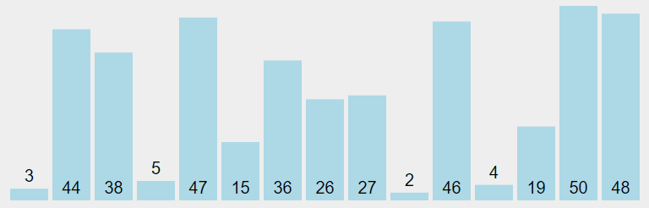
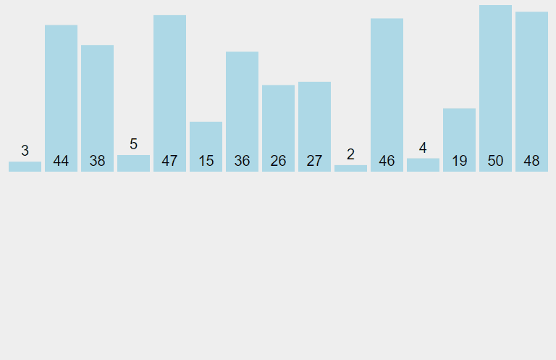
Animation of Selection and Insertion Sorts
Selection Sort
Insertion Sort
visualgo.net/bn/sorting

Slide 30
Bubble Sort is distinguished by frequent swapping
This is an “improved” bubble sort that stops early if no swap is performed for an entire pass
visualgo.net/bn/sorting

Slide 31
Selection Sort is distinguished a single swap after each pass
visualgo.net/bn/sorting

Slide 32
Insertion Sort is distinguished by how the elements “slide” to make room for the insertion
visualgo.net/bn/sorting

Slide 33
Insertion Sort (cont’d)
Finding the right place takes anywhere from 1 to k comparisons.
The average number of comparisons is
2/2 + 3/2 + 4/2 + ... + n/2 = (n+2) (n-1) / 4
— roughly half of Selection Sort.
The worst case is n (n-1) / 2 when the array is sorted in reverse order.
The best case is when the array is already sorted: takes only (n-1) comparisons.

Slide 34
People
Sort
Demo
Line up some students and insertion sort them.

Slide 35
O(n²) Sorting Algorithms
Characterized by nested loops
  Bubble Sort
  Selection Sort
  Insertion Sort
2 x the data → 4 x the time to sort
10 x the data → 100 x the time to sort

Slide 36
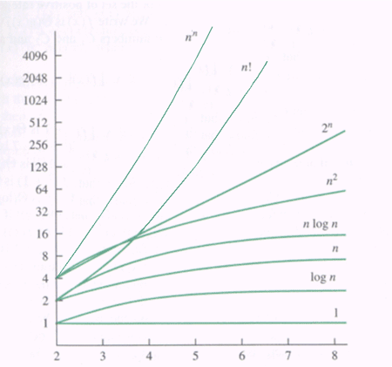
Big O Chart

