Slide 1
Linked Lists

Slide 2
Java
LinkedList

Slide 3
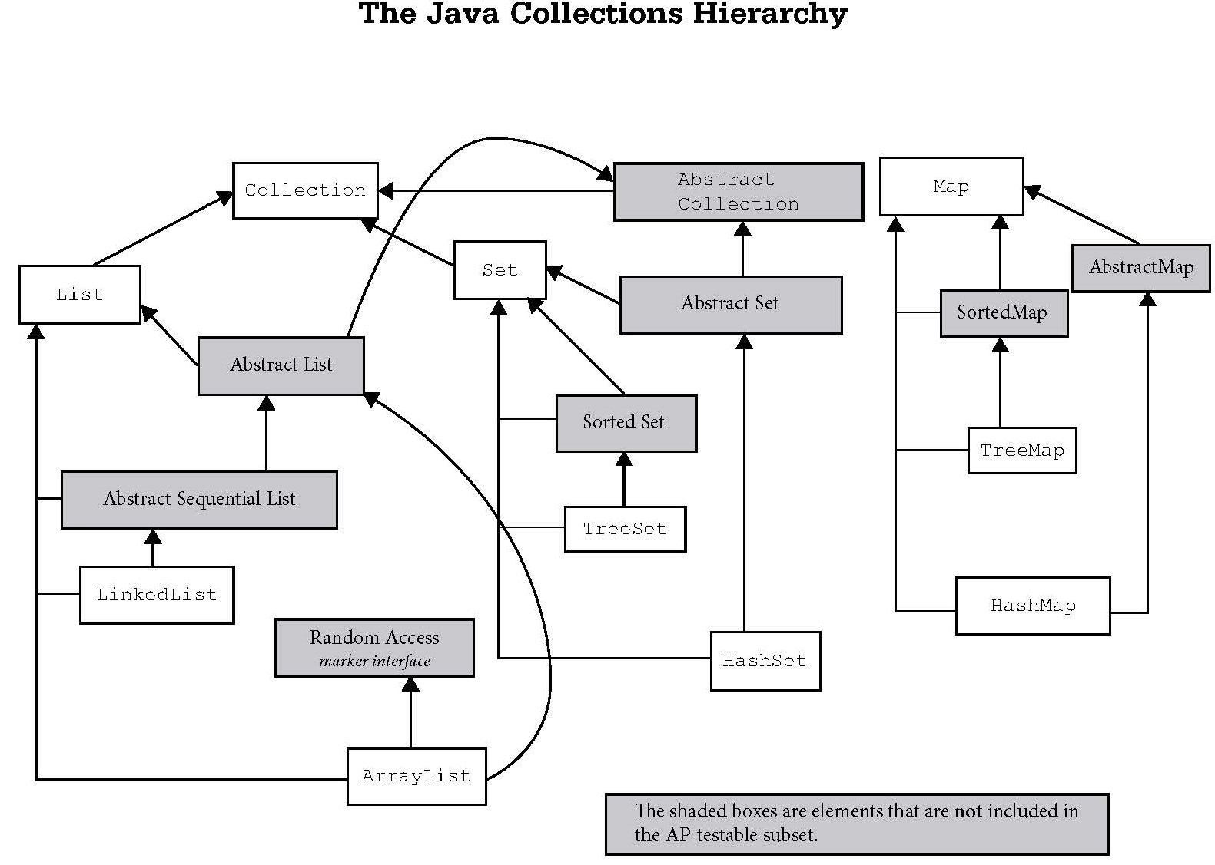
Iterable
Vector
Stack

Slide 4
LinkedList
Methods

Slide 5
LinkedList frequently used methods
Name | Use
add(x) | adds item x to the list
set(x,y) | set location x to the value y
get(x) | get the item at location x
size() | returns the # of items in the list
remove() | removes an item from the list
clear() | removes all items from the list
import java.util.LinkedList;

Slide 6
add()
LinkedList<String> list;
list = new LinkedList<String>();
list.add("c");
list.add("b");
list.add("a");
list.add(1, "d");
out.println(list);
OUTPUT
[c, d, b, a]

Slide 7
get()
LinkedList<String> list;
list = new LinkedList<String>();
list.add("c");
list.add("b");
list.add("a");
list.add(1, "d");
out.println(list.get(0) );
out.println(list.get(1) );
out.println("first " + list.getFirst());
out.println("last " + list.getLast());
OUTPUT
c
d
first c
last a

Slide 8
public interface RandomAccess
Marker interface used by List implementations to indicate that they support fast (generally constant time) random access.
The primary purpose of this interface is to allow generic algorithms to alter their behavior to provide good performance when applied to either random or sequential access lists.
The best algorithms for manipulating random access lists (such as ArrayList) can produce quadratic behavior when applied to sequential access lists (such as LinkedList).
Notes:
Generic list algorithms are encouraged to check whether the given list is an instanceof this interface before applying an algorithm that would provide poor performance if it were applied to a sequential access list, and to alter their behavior if necessary to guarantee acceptable performance.

Slide 9
Looping via indices:
for (int i=0, n=list.size(); i < n; i++)
list.get(i);
is O(n) for RandomAccess lists such as ArrayLists,
but is O(n²) for LinkedLists:
Notes:
As a rule of thumb, a List implementation should implement the RandomAccess interface if, for typical instances of the class, the first loop runs faster than the second loop.

Slide 10
ArrayList get() method
public E get(int index) { Objects.checkIndex(index, size); return (E) elementData[index]; }

Slide 11
LinkedList get() method
public E get(int index) { if (index < 0 || index >= size) throw new IndexOutOfBoundsException(
"Index: " + index + ", Size: " + size ); Entry<E> e = header; if (index < (size >> 1)) { for (int i = 0; i <= index; i++) e = e.next; } else { for (int i = size; i > index; i--) e = e.previous; } return e.element; }

Slide 12
private static class Entry<E> { E element; Entry<E> next; Entry<E> previous;
Entry(E element,
Entry<E> next,
Entry<E> previous) { this.element = element; this.next = next; this.previous = previous; } }
Note that you don’t interact with a LinkedList’s nodes directly. You have to use the public methods.

Slide 13
Looping using an iterator:
Iterator i=list.iterator();
while (i.hasNext())
i.next();
is O(n) for ANY list:
Notes:
As a rule of thumb, a List implementation should implement the RandomAccess interface if, for typical instances of the class, the first loop runs faster than the second loop.

Slide 14
ArrayList | LinkedList
Uses a dynamic array to store the elements. | Uses a doubly linked list to store the elements.
Manipulation is slow since when any element is removed, all following bits are shifted in memory. | Manipulation is faster because no bit shifting is required in memory.
Can only act as a list since it only implements List. | Can act as a list or queue (including a stack) because it implements List and Deque interfaces.
ArrayList is better for storing and accessing data. | LinkedList is better for manipulating data.

Slide 15
Linked Lists
A linked list is a group of nodes. Each node contains a value and a
reference to the next node in
the list.

Slide 16
Simple Node Class
public class Node
{
private Comparable data;
private Node next;
public Node(Comparable dat, Node nxt)
{
data=dat;
next=nxt;
}
}

Slide 17
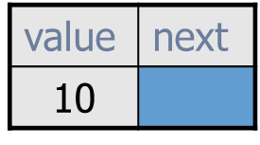
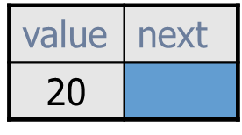
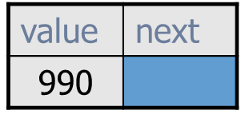
Typical Linked List
list is a reference variable that stores a reference to the first node. It does not store 10!
Each node stores a value AND a reference to the node that follows it.
list
...
A more streamlined representation:
10
20
990
list
...

Slide 18
A Single Node
0xF2
node
B
null
0xF2
A node typically has a data
component and a reference
to the next node.

Slide 19
Some draw the null reference this way!
0xF2
node
B
null
0xF2
This leads to the misconception that the “B” node points to a node that stores a null value, but there simply is no node after the “B” node.

Slide 20
Linkable Interface
public interface Linkable
{
Comparable getValue();
Linkable getNext();
void setNext(Linkable next);
void setValue(Comparable value);
}

Slide 21
public class ListNode implements Linkable
{
private Comparable listNodeValue;
private ListNode nextListNode;
public ListNode(){
listNodeValue = null;
nextListNode = null;
}
public ListNode(Comparable value, ListNode next)
{
nextListNode = next;
listNodeValue = value;
}
//other methods not shown
//refer to the Linkable interface
}
The
ListNode
Class

Slide 22
A Single Node
Linkable node = new ListNode("10", null);
out.println(node);
out.println(node.getValue());
out.println(node.getNext());
out.println(node.getNext().getNext()); ←NPE!!!
OUTPUT ListNode@0xFA 10 null
0xFA
node
null
10
0xFA
Notes:
NPE == NullPointerException

Slide 23
Linking Nodes

Slide 24
Linking Nodes
OUTPUT10 12 11
ListNode x = new ListNode("10",
new ListNode("11",
new ListNode("12",null)));
out.println(x.getValue());
out.println(x.getNext().getNext().getValue());
out.println(x.getNext().getValue());

Slide 25
Linking Nodes
ListNode x = new ListNode("10", null);
ListNode y = new ListNode("11",x);
ListNode z = new ListNode("12",y);
0x12
0x15
0x17
z
12
0x15
11
0x17
10
null
0x12
y
x
0x15
0x17

Slide 26
Linking Nodes
ListNode x = new ListNode(10.3, null);
ListNode y = new ListNode(11.0, x);
ListNode z = new ListNode(12.5, y);
z
12.5
11.0
10.3
null
y
x

Slide 27
Linking Nodes
ListNode x = new ListNode(10.3, null);
ListNode y = new ListNode(11.0, x);
ListNode z = new ListNode(12.5, y);
out.println(z.getValue());
out.println(z.getNext().getNext().getValue());
out.println(z.getNext().getValue());
OUTPUT12.5
10.3
11.0

Slide 28
Using Loops
With Lists

Slide 29
Printing All Nodes
ListNode x = new ListNode("10",
new ListNode("11",
new ListNode("12",null)));
while( x != null )
{
out.println( x.getValue() );
}
OUTPUT10 10 10 . . .
Infinite Loop == Very Bad

Slide 30
Printing All Nodes
ListNode x = new ListNode("10",
new ListNode("11",
new ListNode("12",null)));
while( x != null )
{
out.println( x.getValue() );
x = x.getNext();
}
OUTPUT10 11 12
Better, but what is x storing after the loop?

Slide 31
Printing All Nodes
ListNode x = new ListNode("10",
new ListNode("11",
new ListNode("12",null)));
ListNode temp = x;
while( temp != null )
{
out.println( temp.getValue() );
temp = temp.getNext();
}
OUTPUT10 11 12
x still points to the first node after the loop.

Slide 32
Summing All Nodes
ListNode x = new ListNode(11,
new ListNode(8,
new ListNode(5,null)));
int sum=0;
while( x != null )
{
sum = sum + (Integer)x.getValue();
x = x.getNext();
}
out.println(sum);
OUTPUT24

Slide 33
Adding
Nodes

Slide 34
add
0xF2
front
cat
null
0xF2
front = new ListNode("cat", null);

Slide 35
add
0xF33
0xF2
front
dog
cat
null
0xF2
0xF33
front = new ListNode ("dog", front);

Slide 36
add
0xF17
0xF33
0xF2
front
pig
0xF33
dog
0xF2
cat
null
0xF17
front = new ListNode ("pig", front);

Slide 37
add
OUTPUT
12 10 11
OUTPUT
12 10 11
OUTPUT
12 10 11
OUTPUT
12 10 11
ListNode front=null;
front = new ListNode("10", front);
front = new ListNode("11",front);
front = new ListNode("12",front);
out.println(front.getValue());
out.println(front.getNext().getNext().getValue());
out.println(front.getNext().getValue());

Slide 38
Finding A
Node

Slide 39
Finding a Node
ListNode list = front;
while ( there are more nodes to check )
{
if( a node containing the value was found )
return true;
move to the next node to check
}
return false;

Slide 40
Removing
Nodes

Slide 41
Removing the
First Node

Slide 42
Removing the first node
pig is to be removed.
0xB3A
0x2CB
0xFEA
front
0xB3A
pig
0x2CB
dog
0xFEA
cat
null
front refers to the 1st node in the list.

Slide 43
Removing the first node
front = front.getNext();
front
0xB3A
0x2CB
0xFEA
0xB3A
pig
0x2CB
dog
0xFEA
cat
null
front moves up one node.

Slide 44
Removing any Node

Slide 45
Removing any node
dog is to be removed. current = front;
0xF17
0xF21
0xFEA
front
0xF17
pig
0xF21
dog
0xFEA
cat
null
current
0xF17
front and current store the same memory address.
Notes:
The linked list:
front = current = 0xF17
0xF17 --> pig, 0xF21
0xF21 --> dog, 0xFEA
0xFEA --> cat, null
Normal representation of original list:
front --> pig --> dog --> cat --> null
current also points to pig

Slide 46
Removing any node
previous = current;
0xF17
0xF21
0xFEA
front
0xF17
pig
0xF21
dog
0xFEA
cat
null
current
0xF17
previous
0xF17
front, current, and previous all store the same memory address.
Notes:
The linked list:
front = current = previous = 0xF17
0xF17 --> pig, 0xF21
0xF21 --> dog, 0xFEA
0xFEA --> cat, null
Normal representation of original list:
front --> pig --> dog --> cat --> null
current and previous also points to pig

Slide 47
Removing any node
current=current.getNext();
0xF17
0xF21
0xFEA
front
0xF17
pig
0xF21
dog
0xFEA
cat
null
current
0xF17
current
previous
0xF21
0xF17
current moves forward one node.
Notes:
The linked list:
front = current = previous = 0xF17
0xF17 --> pig, 0xF21
0xF21 --> dog, 0xFEA
0xFEA --> cat, null
After running:
current = current.getNext();
current stores 0xF21, which is the memory location of the "dog" node:
front = previous = 0xF17
current = 0xF21
0xF17 --> pig, 0xF21
0xF21 --> dog, 0xFEA
0xFEA --> cat, null

Slide 48
Removing any node
previous.setNext(current.getNext());
0xF17
0xF21
0xFEA
front
0xF17
pig
0xF21
dog
cat
null
0xFEA
0xFEA
current
previous
0xF21
0xF17
Found dog. Removed dog from the list.
Notes:
The linked list:
front = previous = 0xF17
0xF17 --> pig, 0xF21
Current = 0xF21
0xF21 --> dog, 0xFEA
0xFEA --> cat, null
After running:
previous.setNext(current.getNext());
The “pig” node now stores a reference to the “cat” node. Current still stores a reference to the “dog” node that we’re removing.
front = previous = 0xF17
0xF17 --> pig, 0xFEA
current = 0xF21
0xF21 --> dog, 0xFEA
0xFEA --> cat, null

Slide 49
Removing any node
current = previous.getNext();
0xF17
0xF21
0xFEA
front
0xF17
pig
0xFEA
dog
0xFEA
cat
null
previous
current
0xF17
0xF21
Found dog. Removed dog from the list.
Notes:
The linked list:
front = previous = 0xF17
0xF17 --> pig, 0xFEA
current = 0xF21
0xF21 --> dog, 0xFEA
0xFEA --> cat, null
After running:
current = previous.getNext();
Since the “pig” node now stores a reference to the “cat” node, now current does, too. So we’ve lost all access to the “dog” node.
front = previous = 0xF17
0xF17 --> pig, 0xFEA
current = 0xFEA
0xFEA --> cat, null

Slide 50
Removing any node
Some things you must account for!
What if the linked list is null?
2. How do I remove the 1st node?
3. How do I remove other nodes?
4. Do I remove more than 1 occurrence
of the given value or just the 1st one?

Slide 51
Doubly
Linked Lists

Slide 52
DoublyNode Class
class DoublyNode
{
private Comparable data;
private DoublyNode next;
private DoublyNode prev;
public DoublyNode(Comparable dat,
DoublyNode prv, DoublyNode nxt)
{
data=dat;
prev=prv;
next=nxt;
}
//other methods not shown
}

Slide 53

A DoublyNode
0xF2
null
null
A doubly node typically has a data
component and a reference to the
next node and the previous node.

Slide 54
A DoublyNode
0xF2
0xF3
0xF4
 | A
 | B
 | C
0xF4
0xF3
0xF2
0xF4
0xF3
0xF2
Doubly nodes can be used to make
a circular linked list where the front
points at the back and vice versa.

Slide 55
Comparing Runtimes
of Arrays & Lists

Slide 56
Big-O Notation
Big-O notation is an assessment of an
algorithm’s efficiency. Big-O notation
helps gauge the amount of work that
is taking place.
Common Big O Notations :
O(1) O(Log₂N)
O(2^{N}) O(N²)
O(N Log₂N) O(N)
O(Log₂N) O(N³)

Slide 57
Arrays
traverse all spots O(N)
search for an item O(N) or O(Log₂N)
remove any item O(N) location unknown
get any item O(1) location known
add item at the end O(1)
add item at the front O(N)
If sorted, use binary search
An array is a collection of like variables.
1 | 5 | 8 | 9 | 11

Slide 58
Java Collections – ArrayList
traverse all spots O(N)
search for an item O(N) or O(Log₂N)
remove any item O(N) location unknown
get any item O(1) location known
add item at the end O(1)
add item at the front O(N)
ArrayList is implemented with an array.
If sorted, use binary search

Slide 59
Single Linked Lists
traverse all nodes O(N)
search for an item O(N)
remove any item O(N) location unknown
get any item O(N) location unknown
add item at the end O(1) (if tail is stored)
O(N) (if no link to tail)
add item at the front O(1)
A single linked node has a reference to the next node only.
A single linked node has no reference to the previous node.
10
null
null

Slide 60
Double Linked Lists
Java’s LinkedList class is a doubly-linked list.
traverse all nodes O(N)
search for an item O(N)
remove any item O(N) location unknown
get any item O(N) location unknown
add item at the end O(1)
add item at the front O(1)
null
10
null

Slide 61
Java Collections – LinkedList
Java’s LinkedList class is a doubly linked list.

