Slide 2
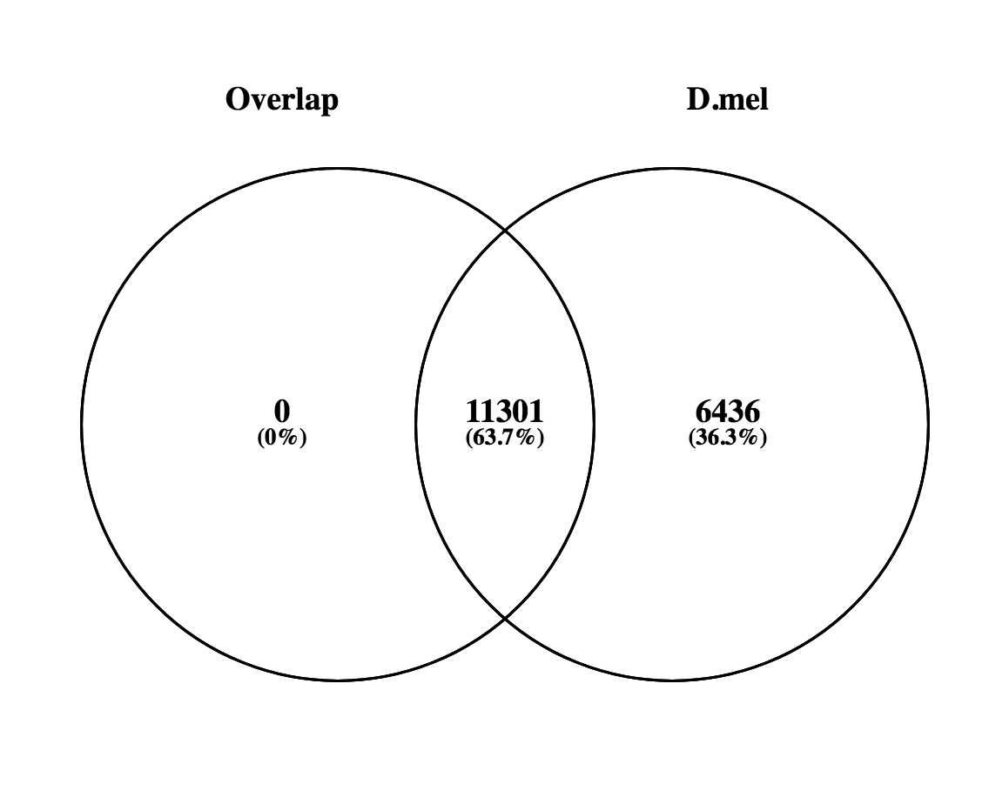
GO biological process complete
cellular process | 6420 | 411 | 1149.88 | 0.36 | - | 6.77E-213
biological regulation | 4065 | 238 | 728.08 | 0.33 | - | 1.82E-123
regulation of biological process | 3674 | 208 | 658.05 | 0.32 | - | 1.40E-112
cellular metabolic process | 3631 | 207 | 650.34 | 0.32 | - | 4.61E-110
developmental process | 2968 | 137 | 531.59 | 0.26 | - | 1.15E-105
anatomical structure development | 2797 | 120 | 500.97 | 0.24 | - | 1.28E-104
multicellular organism development | 2431 | 83 | 435.41 | < 0.2 | - | 2.27E-104
system development | 1828 | 31 | 327.41 | < 0.2 | - | 7.56E-104
regulation of cellular process | 3384 | 192 | 606.1 | 0.32 | - | 2.75E-101

