Slide 1
LL(k) Parsers
Parsing strings one K of tokens at a time.

Slide 2
What are LL(k) Parsers?
LL stands for left to right and leftmost derivation. A LL(k) parser reads an input string left to right following the rules in a CFG. K is the number of characters it reads ahead before making a decision on what rule to follow when parsing the input.

Slide 3
LL(k) Parsing Table
A LL parsing table represents a CFG. The column headers represent permutations of terminals up to K length and the row headers represent the rules in a CFG.
 | a | b
S | aBa | -
B | ab | b

Slide 4
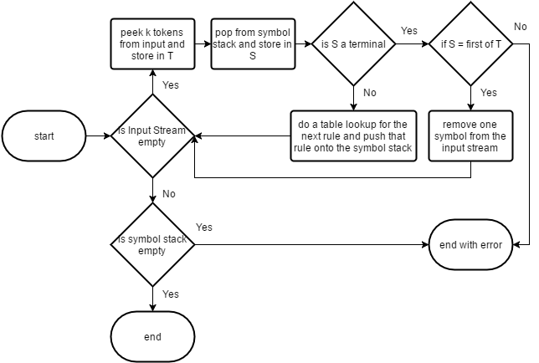
LL(k) Parsing Algorithm

Slide 5

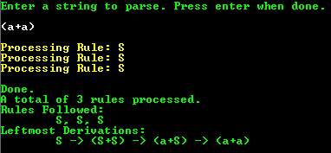
LL(k) Parsing Program (as LL(1))

Slide 6

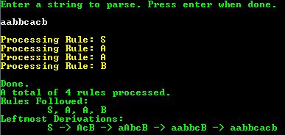
LL(k) Parsing Program (as LL(2))

Slide 7
Things to Know
Not all CFGs can be parsed with LL parsers.
Some CFGs can be parsed as LL(a) but not LL(b).
Some CFGs are too complex to fit inside the memory of one computer.
A hash table can be used to improve look up times instead of a 2 dimensional table.

Slide 8
Any questions?

