Slide 1

NETWORK ANALYZER
NILABHRA ROY

Slide 2
WHAT IS NETORK ANALYZER
A network analyzer, also known as a protocol analyzer or packet sniffer, is a tool used to capture, analyze, and interpret network traffic. It allows users to examine the flow of data packets across a network, identifying any errors or performance issues.
Network analyzers can capture a wide range of information about network traffic, including the source and destination addresses of packets, the type of protocol being used, the size of packets, and the timing of packets. This information can be used to troubleshoot network problems, monitor network performance, and detect security threats.

Slide 3
TYPES OF NETWORK ANALYZER
THERE ARE BASICALLY TWO TYPES OF NETWORK ANALYZER:
HARDWARE-BASED NETWROK ANALYZER
SOFTWARE-BASED NETWORK ANALYZER

Slide 4

WHAT ARE HARDWARE-BASED NETWORK ANALYZERS ?
These are dedicated devices that are designed to capture and analyze network traffic. Hardware-based network analyzers are typically more expensive than software-based options, but they offer advanced features such as deep packet inspection, real-time analysis, and advanced filtering capabilities. Examples of hardware-based network analyzers include the Fluke Networks OptiView XG, the Netscout InfiniStream, and the Viavi Observer.

Slide 5
WHAT ARE SOFTWARE-BASED NETWORK ANALYZERS ?
These run on a computer or server and use the computer's network interface card (NIC) to capture and analyze network traffic. Software-based network analyzers are commonly used by network administrators and security professionals to troubleshoot network issues, monitor performance, and detect security threats. Software-based network analyzers are available in both commercial and open source versions. Some popular software-based network analyzer tools include Wireshark, tcpdump, and Microsoft Message Analyzer.

Slide 6
SOME EXAMPLES OF NETWORK ANLAYZER
Wireshark: This is a popular open source network analyzer tool that allows users to capture and analyze network traffic in real-time. It supports a wide range of protocols and features advanced filtering, statistics, and graphing capabilities.
tcpdump: This is a command-line tool that is available on most Unix-based operating systems. It allows users to capture and analyze network traffic in real-time and can be used in conjunction with other command-line tools for more advanced analysis.
Microsoft Message Analyzer: This is a commercial network analyzer tool from Microsoft that allows users to capture and analyze network traffic in real-time. It is designed to work with Microsoft products and technologies and features advanced filtering and analysis capabilities.
SolarWinds Network Performance Monitor: This is a commercial network monitoring tool that includes a network analyzer component. It allows users to monitor network performance and identify issues in real-time.

Slide 7
A GLIMPSE OF WIRESHARK
Wireshark is a popular, open-source network analyzer tool that allows users to capture, analyze, and monitor network traffic in real-time.
Wireshark can capture and display a wide range of network protocols, including Ethernet, TCP/IP, HTTP, and DNS, among others. It allows users to view network traffic at the packet level, which can be helpful for troubleshooting network issues, analyzing performance, and detecting security threats.
Wireshark offers many advanced features, such as the ability to filter captured traffic based on specific criteria, create custom display filters, and decode encrypted traffic. It also offers advanced statistics and graphing capabilities to help users analyze network performance and identify trends over time.

Slide 8
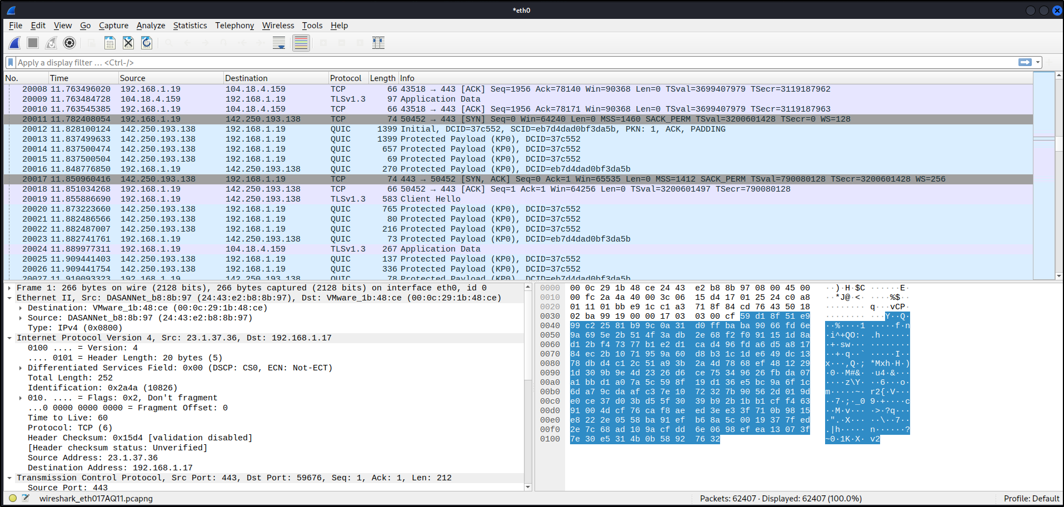
SCREENSHOT OF WIRESHAKRK
PACKET CAPTURING IN WIRESHARK

Slide 9
HOW TO USE WIRESHARK
Download and Install Wireshark: You can download Wireshark from the official website and follow the installation instructions provided.
Choose the Interface to Capture Traffic: Wireshark allows you to choose the interface you want to capture traffic from. This could be a wired or wireless network interface. Once you have selected the interface, click on the Start button to begin capturing traffic.
Capture Traffic: Wireshark will capture all the network traffic that passes through the selected interface. You can stop the capture at any time by clicking the Stop button.
Analyze Captured Traffic: Once you have captured the traffic, you can analyze it in Wireshark. The captured packets will be displayed in the main window, and you can use filters and other tools to focus on specific packets or protocols.
Interpret Results: After analyzing the captured traffic, you can use the results to identify network issues, troubleshoot problems, and detect security threats. Wireshark offers many features to help you interpret the results, such as statistics, graphs, and expert analysis.

Slide 10
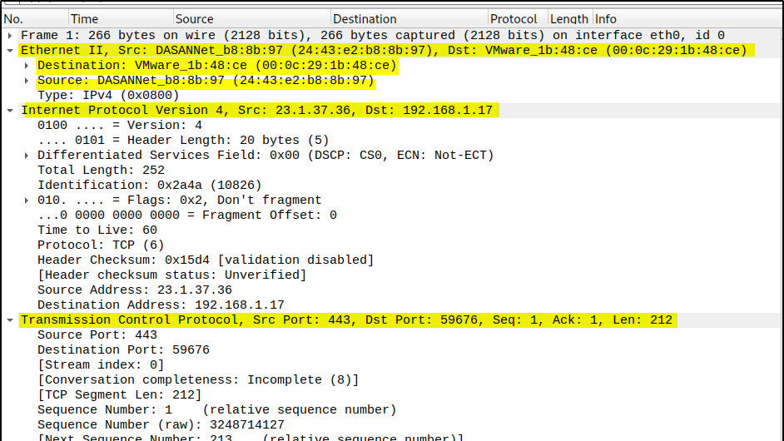
There is a screenshot of wireshark, where you can see it shows very minute details of the packet for better understanding.

Slide 11

Some tips for using Wireshark effectively include:
Familiarize yourself with basic networking concepts and protocols.
Use filters to narrow down the captured traffic to specific packets or protocols.
Use the packet details pane to inspect the contents of individual packets.
Use the color coding of packets to quickly identify potential issues.
Experiment with different display options and settings to customize the view of the captured traffic.

Slide 12
NETWORK ANALYZER ACCURACY
The accuracy of a network analyzer depends on various factors, such as the type of analyzer used, the quality of the captured traffic, and the user's knowledge and skill in analyzing the results.
Hardware-based network analyzers tend to be more accurate than software-based analyzers because they offer more advanced features, such as deep packet inspection and real-time analysis. However, the accuracy of a hardware-based analyzer can also be affected by the quality of the captured traffic and the specific protocols being analyzed.
Software-based network analyzers, such as Wireshark, can also be highly accurate if used correctly. However, the accuracy of a software-based analyzer can be affected by factors such as the quality of the captured traffic, the user's understanding of the protocols being analyzed, and the user's ability to interpret the results correctly.
In general, the accuracy of a network analyzer depends on the user's knowledge and expertise in network analysis, as well as the quality and type of the analyzer used. It is important to use the appropriate tools and techniques to ensure accurate and meaningful results when analyzing network traffic.

Slide 13
CONCLUSION
In conclusion, a network analyzer is a powerful tool that allows users to capture, analyze, and monitor network traffic in real-time. It is an essential tool for network administrators, security professionals, and developers, as it can be used to troubleshoot network issues, detect security threats, and analyze network performance.
Each type of analyzer has its own set of features and capabilities, and the choice of analyzer will depend on the specific requirements and use case of the user.
Overall, a network analyzer is an essential tool for anyone who needs to monitor and analyze network traffic. With its advanced features and capabilities, it can help users detect and troubleshoot network issues, identify security threats, and optimize network performance.

Slide 14

THANK YOU
MADE BY :- NILABHRA ROY

