Slide 1

Digital Design Final Project
CASHIER
15-0616225 張承遠

Slide 2
Motivation
Buying food in convenience store
Seems like similar to handout.(ex: 7-segment displayer, keypad scanner……)
Close to life

Slide 3
Problem Description
Design a cashier that simulate the real cashier.
Use a text file to store input data.
Output in CLI(command line interface)

Slide 4
Features
Simulate the rough process of a real cashier.
User input what customer buy, number, and price.
Screen(computer CLI) will show the final result.
Some extra feature like password, clear, back……

Slide 5
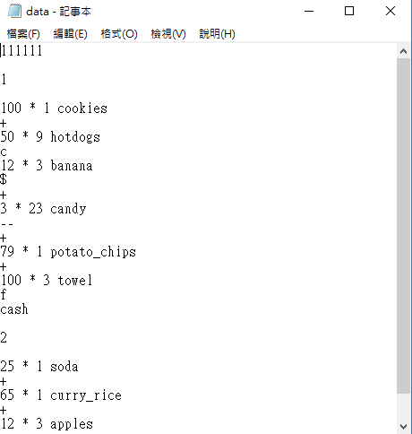
How to execute?
First step:
open “data.txt” in folder. Then, you can start to work
by typing in this file!
After typing

Slide 6
Must know before input
When typing, if you find some mistake in previous input, don’t directly go to previous line and delete it, please use special feature to modify.(I’ll tell you soon)
Reason: We want to simulate the real process of cashier.

Slide 7
Input Format
First, input 6-bit password in the first line.(default 111111)
Customer sequence (an integer from zero)
“Price” * “number” “commodity name” ex: 20 * 1 milktea
“+”
“f” (indicate finish)
“way to pay” ex: cash
Keep input until no other commodity
Serve next customer

Slide 8
Input Format
Below are some special feature:
“--”(feature: clear the previous one input)
“c” (feature: clear all input record user have typed, sum=0)
If you type the wrong input, get “Input error”

Slide 9
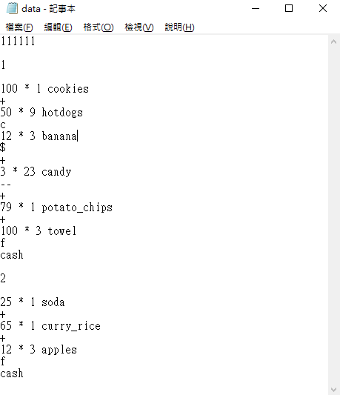
Input Example

Slide 10
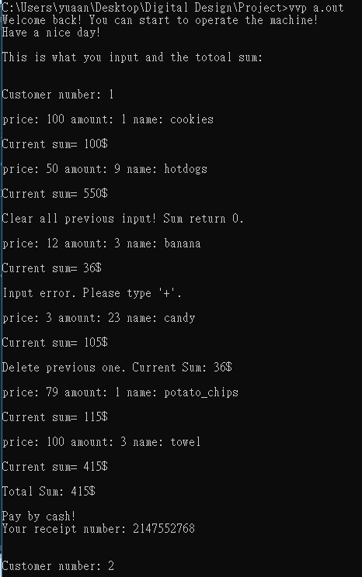
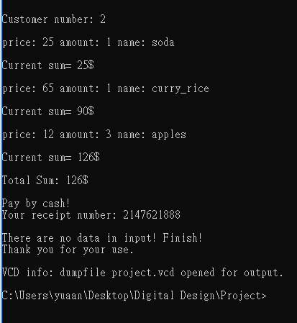
Output Example

Slide 11
Output Example
Show current sum
Clear
Show input error
Delete previous input
Show receipt number(random)

Slide 12
How to execute?
After input, the cashier start to function.
Cashier State Diagram:
Input Signal:
St = 1 after Fileio finishing executing .
Open = 1 when pressing the open buttom.
Output Signal:
Open_cashier = 1 cause the cashier open.
Generate_receipt = 1 cause the cashier to print receipt
Fileio
St’
open’
S0
St
S1
Open/open_cashier
/generate_receipt
S3d
S2
Open’
open

Slide 13
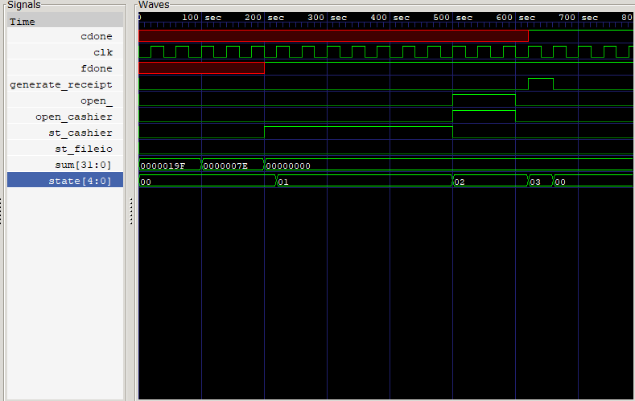
WaveForm

Slide 14
Summary
Simulate the process of real cashier
With the help of computer , data.txt, and Verilog code
Rough Concept

Slide 15
END
Thanks for listening!

Slide 16
Q&A

