Slide 1
Cytoscape and CI
Create long running API in Cytoscape
Serialize view and full network to CX & NDEx
Create NDEx network panel
Create Cytoscape apps {Heat diffusion, NBS, new layouts}
Document Command in cyREST
Add CI to master mindmap

Slide 2
NAV (& Cytoscape Main!) List
Filtering from node and edge table
Tooltip on nodes and edges in graph
Improved legend and part of export
Choice of network selection {NDEx, GeneMANIA, GIANT} … sensitive to type of network (e.g., protein or gene), workflow, organism, or existing subnets
Choice of network processing {NBS, Heat}
NDEx fetch/store
Clustering algorithms
Start Cytoscape from NAV or NDEx
Get top 10 recommendations from NDEx (per net select choice)
Consider standardizing on Ensemble IDs for read networks
BridgeDB to guess species and type of ID

Slide 3
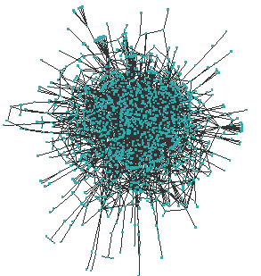
Cytoscape’s 3 Wishes
More …
memory for networks
cores for analysis
code reusability
languages/libraries for coding
Better browser presence
Access to long running calculations
Quicker/cheaper novel workflows
Higher quality, more shareable code
Even more vibrant NB community
Notes:
For example, a run of CliXO’s¹² GO alignment phase on 15 interaction datasets at 8 checkpoints requires 12,000 core hours – or 3,000 hours on a typical 4 core workstation. Executing the same workload on 1,024 cores finished the alignment in less than 12 hours

Slide 4
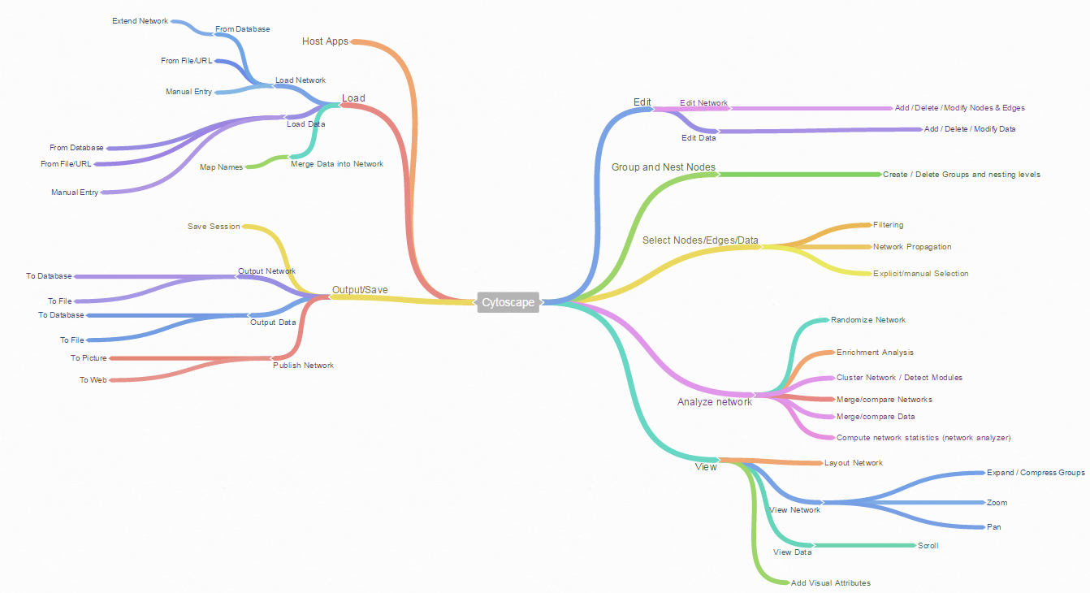
Cytoscape Structure
https://coggle.it/diagram/VZHl-g25xwx35xv4

Slide 5
Cytoscape Workflows
Cytoscape main
Network analysis of mass spec
Functional enrichment
Pathway analysis of gene expression data
n.b. #2 & #4 overlap with #1

Slide 6
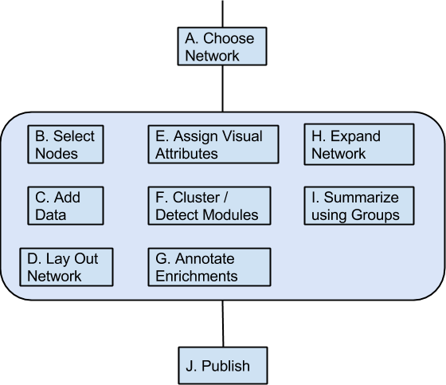
Cytoscape Main Workflow
Start with a network that relates to the organism and domain of interest, then annotate with matching data, analyze the network, and visualize the result. The objective is to identify enriched functions/processes.

Slide 7
Roadmap
Release | Date | Themes | Features
3.3 | Sept ’15 | High frequency improvements Automation Shareability Customizability Consistent operation/appearance Core workflow fidelity | App bundles (both user and system) Panel-based NDEx integration Network panel facelift Improved default views Unified network/ data import
3.4 | Feb ’16 | Targeted versions CI integration Core workflow fidelity GPU integration | Theme delivery Fast layout/draw Track web-based long running jobs

Slide 8
Workflow Deficiencies
Cytoscape Main
Integrate BridgeDB during data import
Identify label propagation algorithms explicitly
Automatic key matching & data type guessing
Identify clustering algorithms explicitly
Bulk table import
More meaningful initial/welcome networks (HumanNet)
Filter on properties of adjacent nodes

