Slide 1
PREVENTION OF PHISHING ATTACK
GUIDED BY SUBMITTED BY
J.JEBA EMILYN M.ASMATH (1012106702)
M.HEMALATHA (1012106704)
G.MANOJ KUMAR(1012106706)

Slide 2
OBJECTIVE
The main objective of the phishing attack is to steal the information’s of the user. The project describes how hacking can be done in the banking website and helps the user to find the phish page using the URL verification by which the user can secure the confidential information from the hacker

Slide 3
EXISTING SYSTEM
In the existing system, they had referred the few papers which helps us to made as the references. Specifically, they proposed CANTINA+, the most comprehensive feature-based approach in the literature including eight novel features, which exploits the HTML Document Object Model (DOM), search engines and third party services with machine learning techniques to detect phish. In this, we have studied that the phishing will made hack the personalized and secure information of the user .

Slide 4
PROPOSED SYSTEM
This Project is all about hacking the information where hacker terminal track the activity of user and detect the phishing pages and detect the phishing pages which prevents the user from phish URL. This project contain two different modules such as
Hacking information
Detection of phishing

Slide 5
DETECTION OF PHISHING
In this project, we have proposed the anti-phishing programs known as phish net as like phish tank sitechecker which detect the phishing attacks through URL from phish tank
PhishNet is technique which predicts malicious URLs from the user request. In this module, using the search engine, the user can detect the defected phish page which matches the URL from the phish tank database.
The phish tank is the database for phishing web pages. Its gives some regular service to the API developer.
We made a link between the phish tank servers to the search engine. The phish tank web databases are storing the URL of the phish page.

Slide 6
SOFTWARE REQUIREMENTS
Operating System : Windows XP
Database : Mysql 5.0
Tools : Xampp (1.8)
User Interface : Html, CSS and PHP.

Slide 7
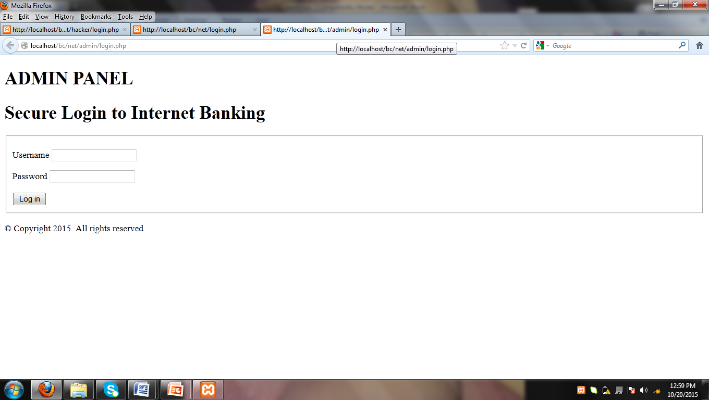
IMPLEMENTATION OF SCREENSHOTS

Slide 8
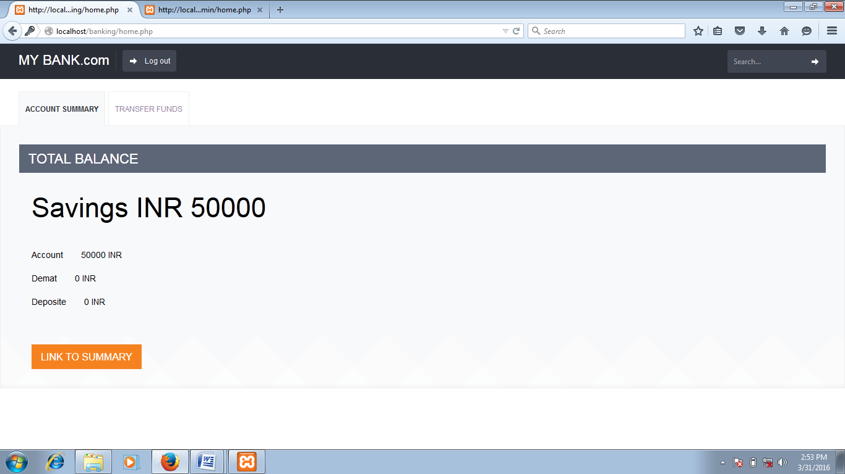

Slide 9
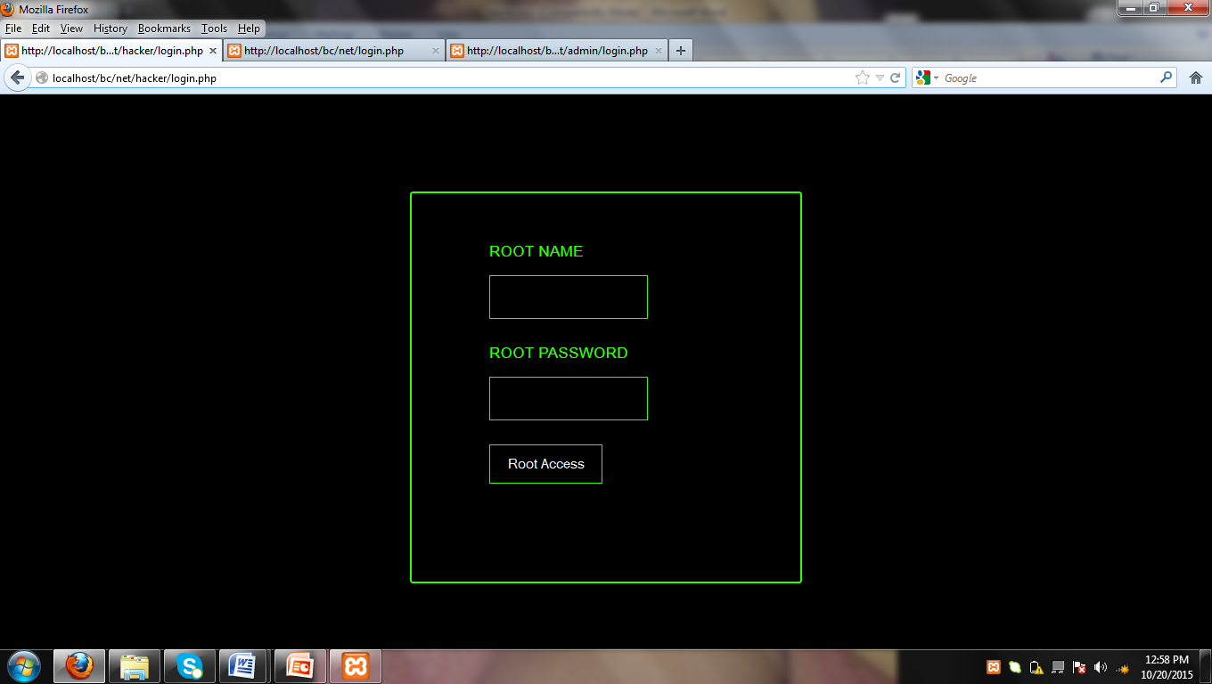

Slide 10
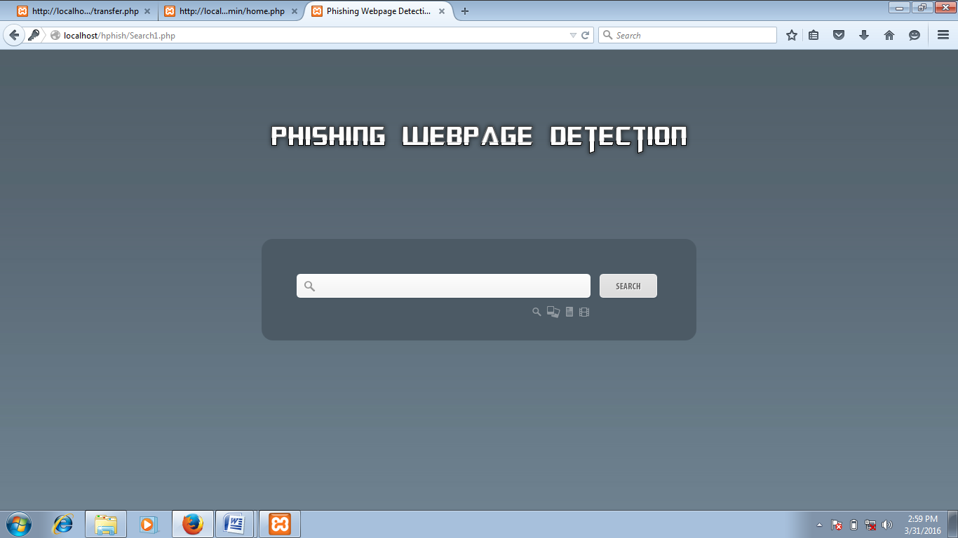

Slide 11
CONCLUSION
Most phishing sites prompt user to update sensitive information by logging in with a password or verifying personal information such as credit card number or social security number. Currently most anti-phishing techniques function in a similar manner in detecting viruses. Manual verification of a few phishing sites shows that the anti-phishing program is effective at detecting the new phishing site. If the user attempts to visit a URL in the phish tank then the user is prevented from visiting the site or warned that the site is a known phishing site

Slide 12
FUTURE ENHANCEMENT
Unfortunately, the usefulness of online services has been overshadowed by large-scale phishing attacks launched against Internet users .Online services have become important part of our lives as they allow anytime, anywhere access to information. Phishing is a never-ending battle like most security related problems. New detection methods will be introduced and then the Phishers will find ways around the detection methods.
In future enhancements, the phish attacks on the online services can be prevented such as net banking, online shopping, and social networks. Major technologies and encrypted algorithms have to be used for providing more secure information’s.

Slide 13
REFERENCES
Sophisticated Phishers Make More Spelling Mistakes: Using URL Similarity against Phishing published by Max-Emanuel Maurer and Lukas Hofer from University of Munich Media Informatics Group, Germany
Techniques for detecting zero day phishing websites published by Michael Blasi from Iowa state university
http://www.hackeracademy.com
http:// www.w3school.com

