Slide 1
MalOSS: Detecting Malware in Package Managers
Presented By David “Ryan” ELder
Special thanks to Ruian Duan and Brendan D. Saltaformaggio, PhD

Slide 2
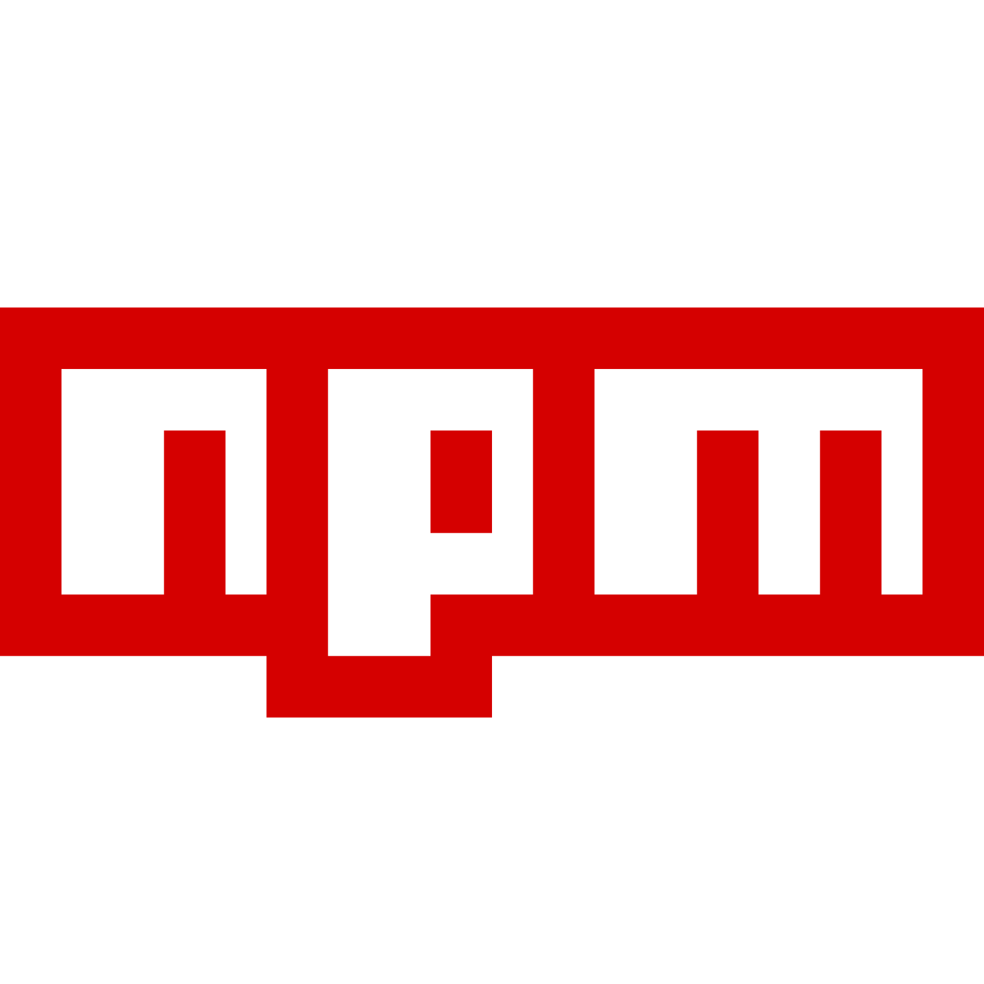
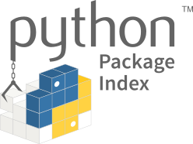
What are Package Managers
Software repositories for code building blocks
Normally open source
Allow for easy code sharing and dependency managing
Notes:
2011 study has shown that 33% of
electronic crimes in companies are committed by insiders [19].
60% of these attacks use a compromised account, in the
remaining cases the attacker uses their own account

Slide 3
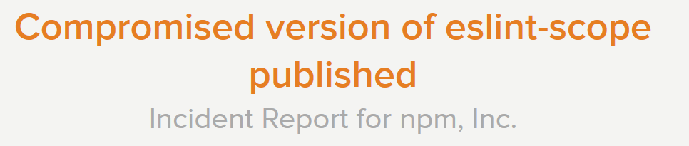
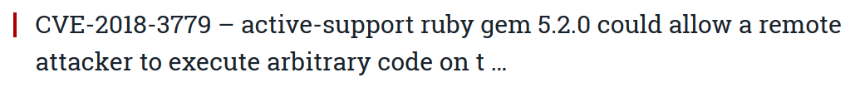
Examples of Malicious Packages
Notes:
2011 study has shown that 33% of
electronic crimes in companies are committed by insiders [19].
60% of these attacks use a compromised account, in the
remaining cases the attacker uses their own account

Slide 4
Threat Model Of Malicious Packages
Stealer
Various types of information can be leaked. From non-sensitive machine setups (tracking) to credentials.
Backdoor
Invoke some unexpected process or write to unexpected locations
Sabotage
Deletes files in order to damage
Notes:
2011 study has shown that 33% of
electronic crimes in companies are committed by insiders [19].
60% of these attacks use a compromised account, in the
remaining cases the attacker uses their own account

Slide 5
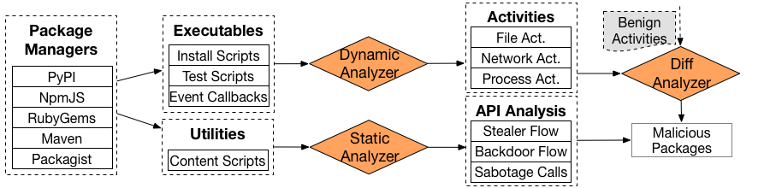
What we Propose to do
MalOSS
Identify malware in repositories
Provide a tool/framework for the review process of repositories

Slide 6
Package Managers to analyze
Popular package managers for JIT-compiled or interpreted languages.
 | Language | Package Count
PyPI | Python | 149K
npm | JavaScript | 828K
RubyGems | Ruby | 149K
Maven | Java | 194K
Packagist | PHP | 231K
Notes:
2011 study has shown that 33% of
electronic crimes in companies are committed by insiders [19].
60% of these attacks use a compromised account, in the
remaining cases the attacker uses their own account

Slide 7
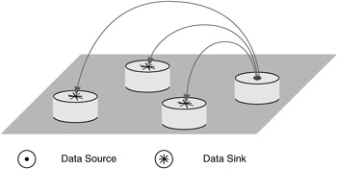
Static Analysis (API Analysis)
Attempt to prefilter potential malware before running taint analysis
Examine APIs for potential malicious behavior
Sources ex. network read, file read.
Sinks ex. compile, network write.
Other dangerous APIs ex. rmdir, encrypt.
Identify problem combinations within
packages
Notes:
Shows that repetition can mimic attackers

Slide 8
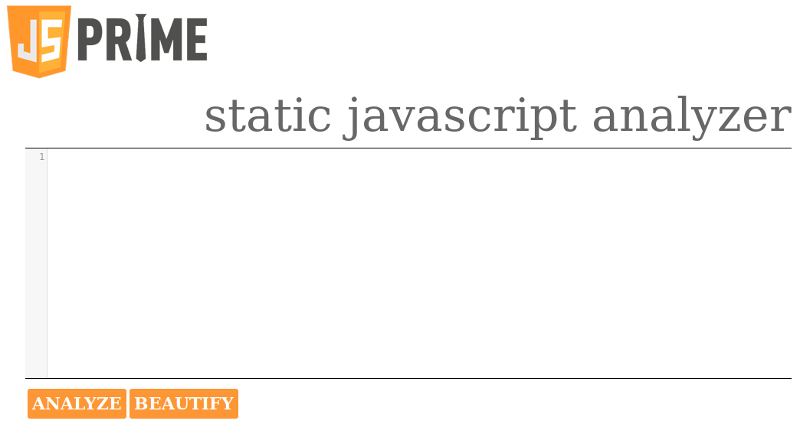
Static Analysis (Taint analysis)
Using previously developed tools to analyze the flagged packages and determine whether or not they are actually malware
Example: JSPrime
Existing JavaScript tools presented at BlackHat 2013
Adapted from a web interface into command line
Notes:
Shows that repetition can mimic attackers

Slide 9
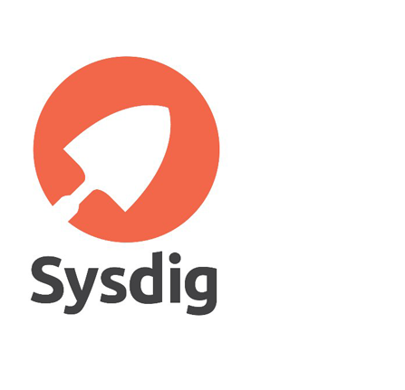

Dynamic Analysis
Focuses on installation process
Write rules using sysdig and falco
Looking for Process, socket, and file access
Notes:
Shows that repetition can mimic attackers

Slide 10
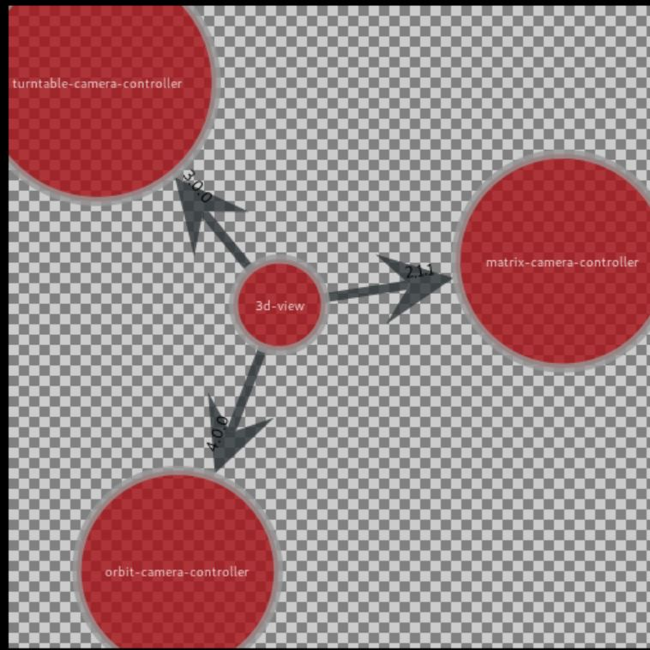
Metadata Analysis
After malicious packages are found, it is necessary to find related packages
Metadata analysis via Graph-tool
Relate packages to other packages (between package managers)
Analyzes dependencies
Notes:
Shows that repetition can mimic attackers

Slide 11
Preliminary Results
Notes:
a FRR of 0 is possible when using
the full feature set, in order to achieve this a FAR of 19.2%

Slide 12
Questions?

Slide 13
References
https://docs.npmjs.com/getting-started/what-is-npm
https://status.npmjs.org/incidents/dn7c1fgrr7ng
https://www.bleepingcomputer.com/news/security/ten-malicious-libraries-found-on-pypi-python-package-index/
https://www.secnews24.com/2018/08/10/cve-2018-3779-active-support-ruby-gem-5-2-0-could-allow-a-remote-attacker-to-execute-arbitrary-code-on-t/
https://flylib.com/books/en/2.809.1.52/1/
https://proxy.duckduckgo.com/iur/?f=1&image_host=http%3A%2F%2Fwww.avoiderrors.net%2Fwp-content%2Fuploads%2F2017%2F05%2FSYSDIG.png&u=https://www.avoiderrors.com/wp-content/uploads/2017/05/SYSDIG.png
https://upload.wikimedia.org/wikipedia/commons/thumb/4/4e/Docker_%28container_engine%29_logo.svg/610px-Docker_%28container_engine%29_logo.svg.png

