Slide 1
Creating PowerShell Projects and More with Plaster
Let’s Get Plastered!

Slide 2
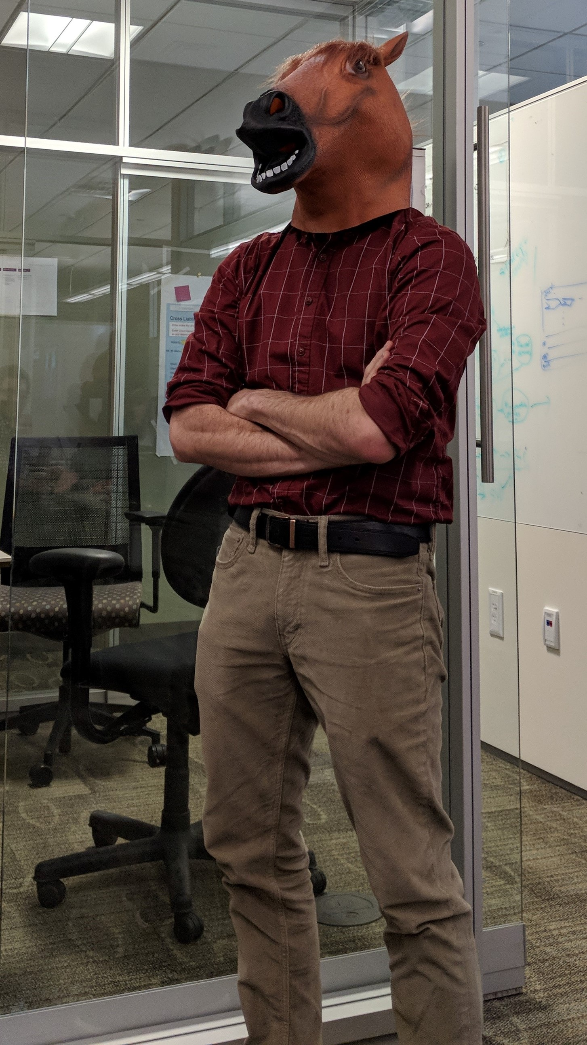
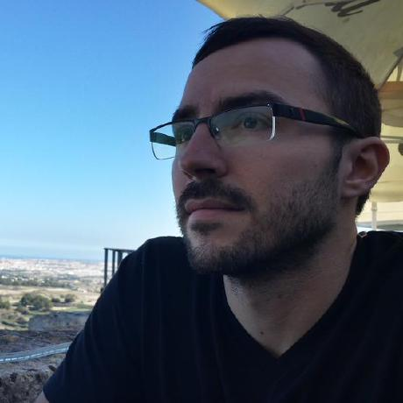
Who Am I?
Rob
Twitter: @rjpleau
Blog: https://ephos.github.io/
Presentation: https://github.com/ephos/PSSummit2018-Plaster
Likes Mechanical Keyboards

Slide 3
Agenda
What is Plaster?
Create a PowerShell module with Plaster
Plaster Manifests / What magic made this work?
Create a better PowerShell module with Plaster!
Create non PowerShell things with Plaster (whoa!)
Possibly extra goodies / questions time permitting!

