Slide 1
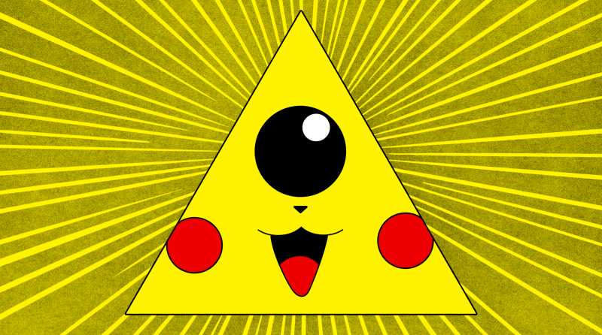
Intro To Threat Modeling
CryptoSquad NYC

Slide 2
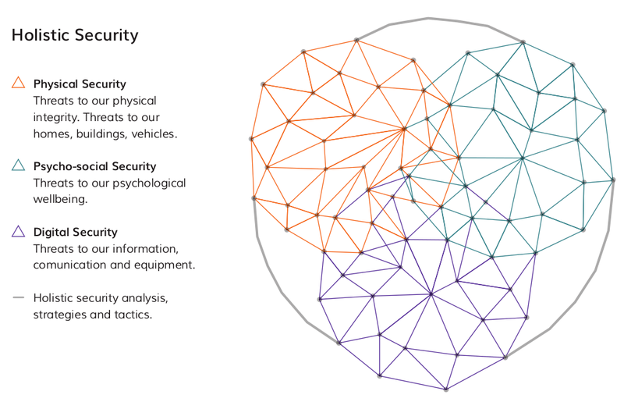
Overview
Threat Modeling?
Holistic Security – Tactical Tech Collective
Image from Holistic Security by Tactical Tech Collective

Slide 3
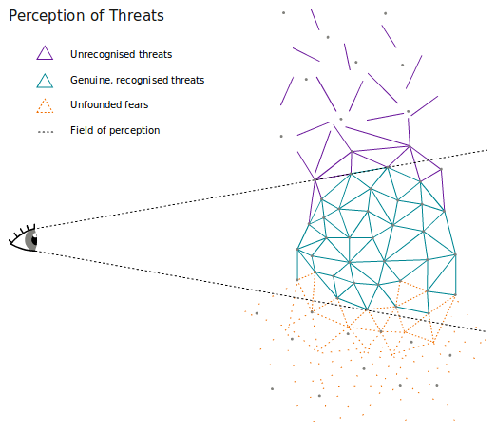
Part I: Threat Is Valid
Image from Holistic Security by Tactical Tech Collective
Notes:
Security is personal and subjective – we define it for ourselves.
Our well-being should be the fundamental reference for security.
We already have many existing tactics and considerable resilience in order to continue our work despite the challenges we face.
Understanding our individual and group reactions to stress

Slide 4
Part I: Threat Is Valid
Individual Response to Threat
  Freeze
  Fight
  Flight
  Comply
  Tend
  Befriend
  Posture
Group Response to Threat
  Harder Group Boundaries
  Authoritarianism
  Fixed Patterns
Notes:
Define Threat
Security is personal and subjective – we define it for ourselves.
Our well-being should be the fundamental reference for security.
We already have many existing tactics and considerable resilience in order to continue our work despite the challenges we face.
Understanding our individual and group reactions to stress

Slide 5
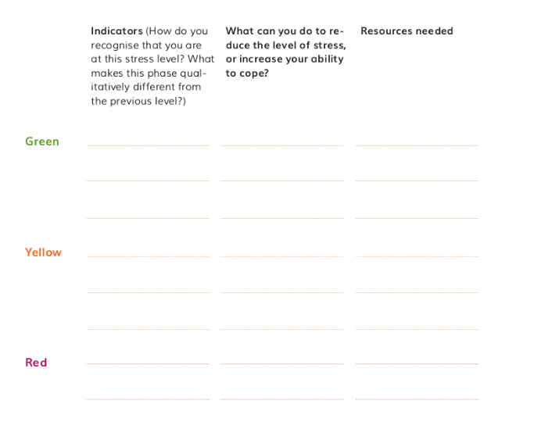
Image from Holistic Security by Tactical Tech Collective
Notes:
A space needs to be created where group members can express and explore how threats impact their work and communicate non-violently about it, without fear of reprisals from higher-ranking or privileged group members. It is only after recognising potentially negative patterns that they can then be addressed appropriately.
Once a safer space within the organisation has been established, it will be much easier to weave security practices into the organisation's work.

Slide 6
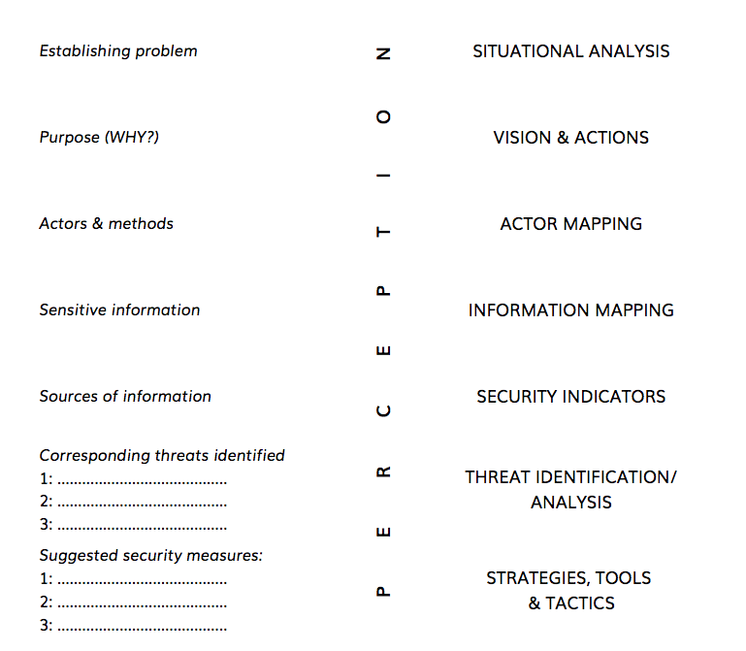
Part II: Threat Analysis
Image from Holistic Security by Tactical Tech Collective
Notes:
Each of these steps can be an exercise that we should carry out regularly in order to update our security strategies, plans and tactics according to the changing context in which we're operating
One of the biggest challenges we face is related to our perception and well-being. If we are stressed or very tired, we may find this process very difficult to do. We need strategies both for managing stress and exhaustion, as well as checking our perceptions with trusted colleagues or partners. We may discover that we have unfounded fears (which some call 'paranoia') or unrecognised threats (i.e., verifiable threats that we didn't perceive before)

Slide 7
Step 1: Situational Analysis & Vision
PESTLE
  Political
  Economic
  Scientific
  Technological
  Legal
  Environmental
Vision
  What do I want to change?
  How do I want to change it?

Slide 8
Step 2: Actor & Information Mapping
Actor Mapping
  Strong Allies
  Allies
  Neutral Parties
  Opponents
  Strong Opponents
  Getting Technical
    Map out relationships between allies, opponents and neutral parties
Info Mapping
  Where is all my info? Where do I put it?
  Info at Rest
    Documents, meeting minutes, finances, legal docs
  Info in Motion
    Email, text
Notes:
Understanding the actors around us helps us to develop strategies which will open a space for us to continue our work, through protecting ourselves and building networks with our allies, or raising the costs (material, reputational or other) of attacks against us for adversaries.
A key element we must now look towards, however, is information. Information about ourselves and our work is a valuable asset to our adversaries, and much of it now lives in digital devices, so we must consider how it is stored and moves between us, and which new actors we must add to our map.
Information is one of our most important assets. It often has a lot to do with our allies, and is of great interest to our adversaries, who want to gather as much information about us as possible.

Slide 9
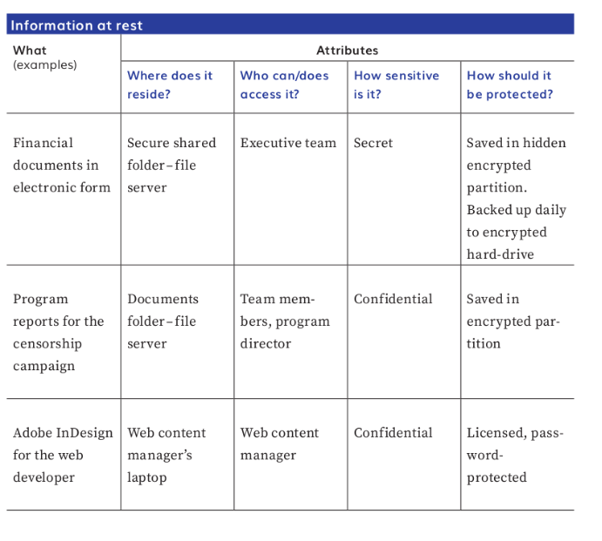
Image from Holistic Security by Tactical Tech Collective

Slide 10
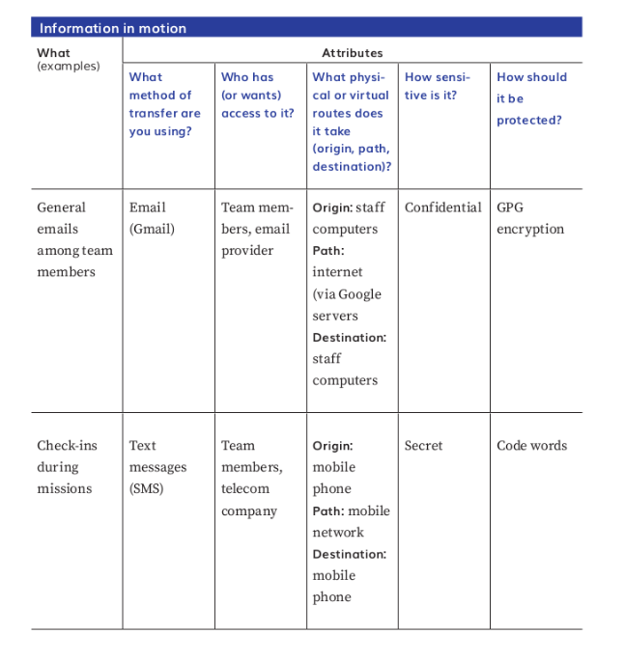
Image from Holistic Security by Tactical Tech Collective
Notes:
Is there a large dependence on one device or another?
Is much of the information online? If so, on whose property (or whose server) is it being stored?

Slide 11
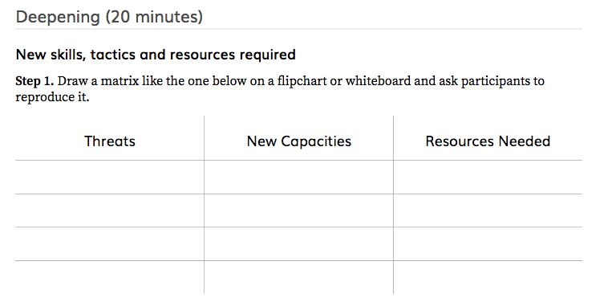
Image from Holistic Security by Tactical Tech Collective
Notes:
Process of checking perception. We should check our perceptions with trusted friends and colleagues, or try to find more information.
Peace of Mind
Our plans should be living documents and correspond to our changing contexts.
We constantly need to learn new tools and tactics as our context changes. This demands time and resources and, if possible, should be built into our strategic planning.

Slide 12
Step 3: Security Indicators
Security indicator vs. Threat
  Indicator is the instance
  Threat is the feeling that an instance will bring harm, or that a series of instances will bring harm
Something out-of-the-ordinary?
  Negative: I’m being followed by a van
  Positive: a strong ally just gave us some funds!!!!!!!!!
Making space to share
Keeping track

Slide 13
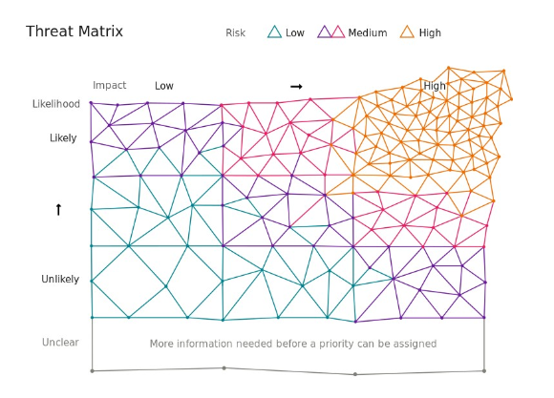
Step 4: Threat Analysis
Image from Holistic Security by Tactical Tech Collective
Notes:
Define Threat
How to Brainstorm Threat
The threats that we have identified can be used as entry points to building strategies, plans and tactics for us to keep working and be safe and well.
In our strategic planning, it's important to consider the potential threats that may arise from our activities. In the first instance, they help us decide whether or not the activities are a good idea, and if so, how to carry them out more safely.

Slide 14
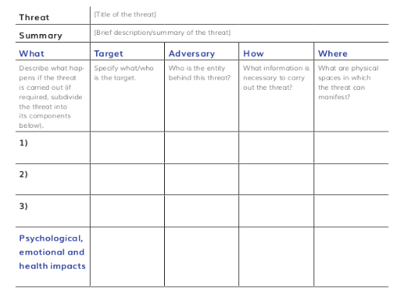
Image from Holistic Security by Tactical Tech Collective

Slide 15
Step 5: Security Planning
What’s working already?
What needs work? Gaps? Vulnerabilities?
Strategies
  Acceptance-raising support
  Deterrence-raising cost of attack
  Protection-building strength to make attack harder
What to include in security plan
  Objective of activity
  Threat identified
  Preventative actions/resources
  Response to emergency situation (how you define emergency)
  Communication and devices
  Self-care and well-being

Slide 16
Further Resources
Holistic Security – Tactical Tech Collective
An Introduction to Threat Modeling – SSD by EFF
CyberSecurity Training
  Online
    Tactical Tech Collective, Cutealism, SSD by EFF
  In-Person
    CryptoSquad NYC, CryptoParty, ResistorNYC, Brooklyn Public Library
Self-Defense/Fitness
  Fight Training @ The Base, Masterskya, Traditional Okinawan Karate School, Rev Fitness, Physical Culture Collective

