Slide 1
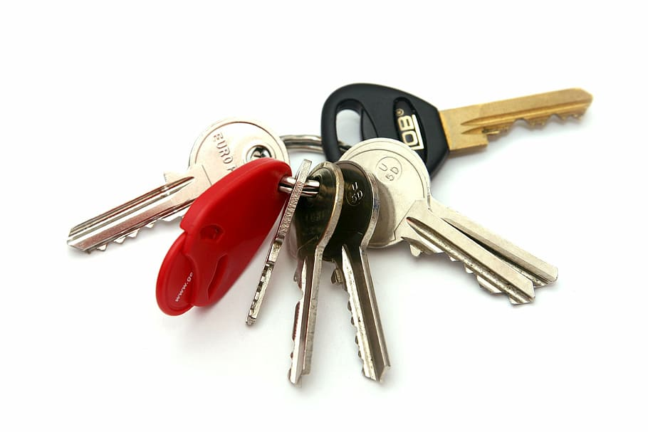
Automatic Encryption Breaker Tool Identifying and decrypting with frequency analysis
Matthew Stroble and Hannah Reinbolt

Slide 2
What is the Automatic Encryption Breaker (AEB) Tool?
A tool to help identify and decrypt encrypted data automatically
Built to help forensic analysts or cyber enthusiasts
Automate complex decryption tasks
Currently works with shift and substitution encrypted data
Built in a modular way to promote easy future enhancements

Slide 3
Problems AEB Addresses
Workers performing forensic analysis having to perform encryption identification manually, this can take hours
Workers performing forensic analysis having to decrypt encryption manually or in a round-robin style, this can be messy and confusing
Workers performing forensic analysis not knowing what the encryption type is and never correctly decrypt it, evidence not being brought to light, can end in an incorrect sentence
Main problems simplified:
Saves man hours and money by automating complex tasks
Decrypts data that may not be otherwise solved
More correct than other manual processes and some tools that require many steps

Slide 4
AEB Tool Overview
Meant for large selections of encrypted data, books are used, because frequency analysis requires more data to recognize patterns and create a valid profile
Accepts Shift and Substitution encrypted data, additional types can be added easily, modular design
Frequency analysis decryption tool can decrypt multiple types of encryption, not just one at a time
Keyspace includes English letters, spaces and periods but can be easily adapted for more or less.
Dynamic menu system that allows the programmer a lot of flexibility with creating and adding to the user interface, promoting ease of execution for user and programmer
A frequency analysis modeler that will build a dynamic frequency analysis table based off of 209 books and the cipher text to determine key strength of the text. This will identify the encryption type used.

Slide 5
Frequency Analysis Encryption Identification
A large amount of English characters are needed so 209 English text books were used to create a reliable frequency table
Fingerprinting module builds a second frequency analysis table off of the cypher text
Distance between the first character and the second character in the frequency map is measured to build a table of key offsets. This creates a table of highest and lowest strength score for each key.
A shift cipher key strength score could be around 10-11 which would mean a high probability that the shift cipher needs a rotation of 10-11 to be solved.
Key strength indicators for shift are always above 10 while substitution it is around 3.
We found that different ciphers have different key strengths and this can be used to identify 1:1 ciphers. We suspect that 1:many ciphers like Hill will have a higher strength indicator but lower than shift.

Slide 6
Automatic Decryption
Two forms of automatic decryption are used. Round-robin brute force and frequency analysis. Both forms completely solve the two recognized encryption types. (shift and substitution) Entire encrypted books are used. Only takes a few seconds. Anything decrypted 75% of the way is human readable.
Round –robin: - shift cipher only, keyspace is all English letters, spaces and periods, all solutions are checked against an English dictionary and the result with the most confirmed valid words is the solution
Frequency analysis: - substitution and shift ciphers, a frequency table is built off of the cipher text - We know that the space is the most used character and the first character in the table, with this knowledge and the 209 book analysis this will give us a 67% success rate of decrypting the current ciphertext - key patterns are looked for next, like URLs, numbers, etc. - Finally word pattern analysis will crack the results with a 96% accuracy

Slide 7
Dynamic Menu System
The menu system is created to be dynamic to allow the programmer and user the ability to add custom menus easily
Four main types of menus: welcome screen, exit, custom with mutl-choice, and custom with single choice. All choices can be custom built by programmer.
Saves time when programmer needs a specific menu type
The main menu system executes all the encryption and decryption functions at the correct time and place. It also executes all frequency analysis functionality.
The user only needs to give the program a correct encrypted plaintext file path and the menu system will guide the user through the decryption and identification process.

Slide 8
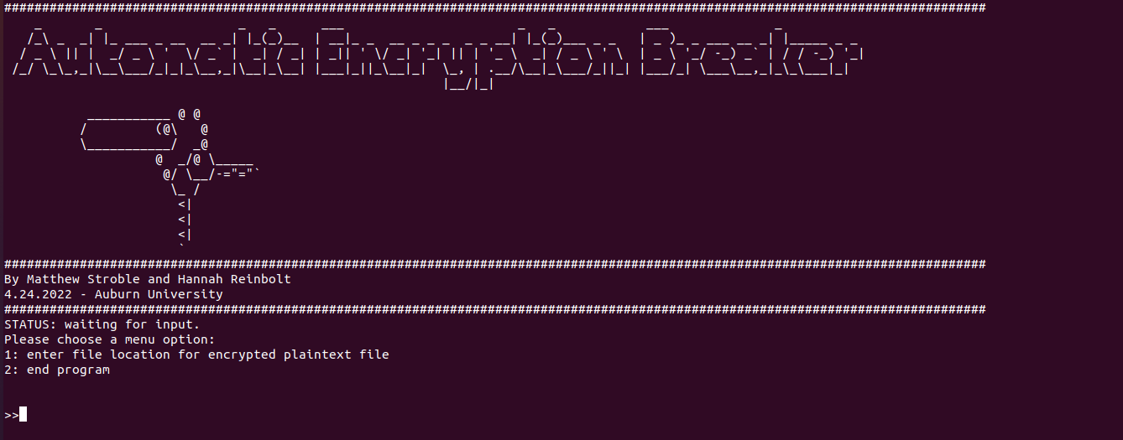
Demo
Sit back and relax for a demo of the AED tool.

Slide 9

Questions?
This Photo by Unknown Author is licensed under CC BY

