Slide 1
Introduction to Game Programming
Course introduction
Instructor: Dung, Dinh Nguyen Anh
Email: dungdna@uit.edu.vn

Slide 2
Who is you instructor
Born 1975, married, one son, one daughter
I have been dreaming on making games since I was a kid playing Mario, Zelda,…
20+ years in software development – real projects: Coder, Tech Lead, PM, Director
Been in US for around 12 months, worked for Nortel Networks
Travel US quite often until this year (Covid-19)
Teaching since 1997, including RMIT

Slide 3

Ủn Ỉn

Slide 4
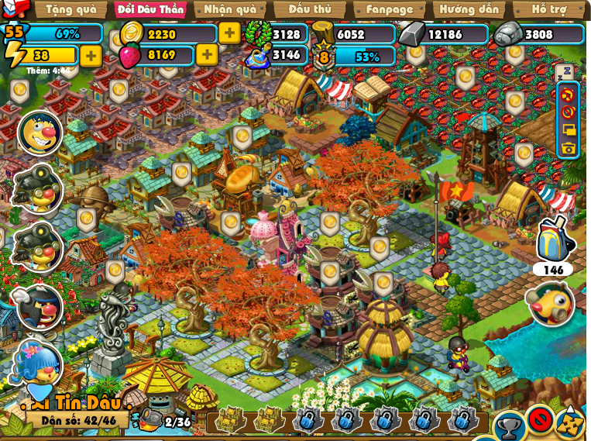
Chip&Zin

Slide 5
Course overview
DirectX & Sprite
Animation
Collision handling
Simple space partitioning + Camera
Scene Manager ^{(New)}
Sample source:
https://github.com/dungdna2000/gamedev-intro-tutorials

Slide 6
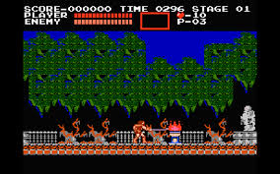
Project
NES Castlevania

Slide 7
How to pass?
Do NOT “reference” other’s code
Start from the sample code. It has everything you need to finish your project.
Attend class and understand what I want first !
Invest at least 160 hrs
code … code … code
code CODE CODE and CODE

