Slide 1
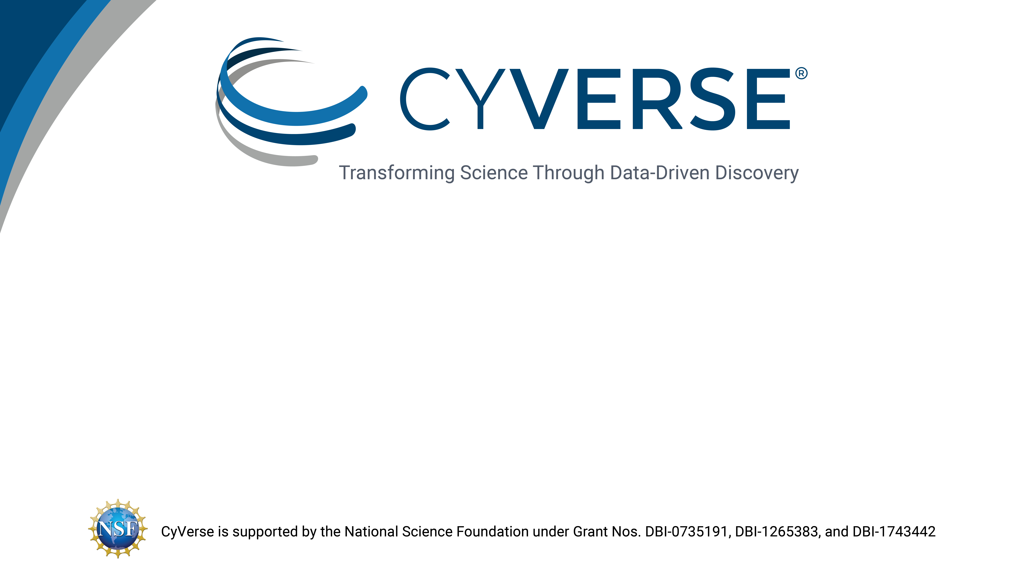
CyVerse Data Store
Notes:
Can be used as a first slide or for the end of the presentation.

Slide 2

Welcome to the Data Store

Slide 3


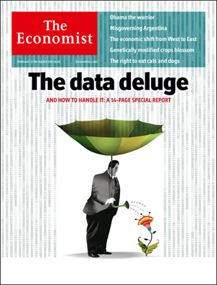

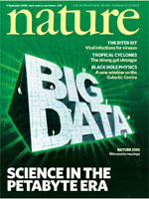
Working with Big Data
Big data a term applied to data sets whose size is beyond the ability of commonly used software tools to capture, manage, and process the data within a tolerable elapsed time
Big data sizes are a constantly moving target currently ranging from a few dozen terabytes (TB) to many petabytes of data in a single data set.
“‘Big Data': Big gaps of knowledge in the field of Internet". International Journal of Internet Science 7: 1–5.
Notes:
These slide backgrounds have footer bars of different colors, this can be used to divide your presentation into sections. For example, topic one slides have blue, topic two have dark blue, and conclusion slides have grey.

Slide 4
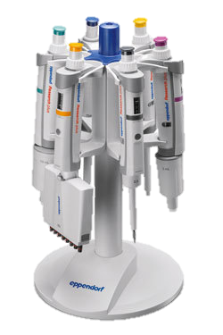
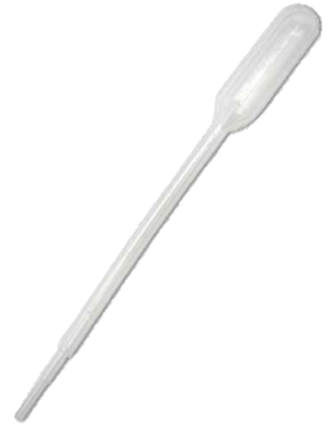

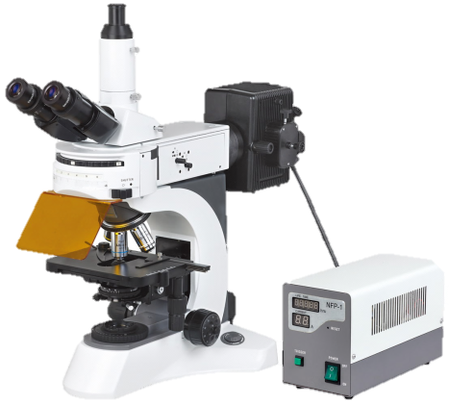
Working with Big Data
Difficult / slow transfers
Expense for storage / backup
Difficult to share and publish
Analysis
Metadata (What Is metadata?)
Changes in scale introduce quantitative and qualitative complications
Notes:
These slide backgrounds have footer bars of different colors, this can be used to divide your presentation into sections. For example, topic one slides have blue, topic two have dark blue, and conclusion slides have grey.

Slide 5
Working with Big Data
Discovery
Upload
Data Commons Repository (DCR), Elasticsearch
Discovery Environment, iCommands, Cyberduck
Metadata
Publication
Add, delete, copy; metadata templates; bulk metadata
Analysis
Data Commons Repository (DCR), NCBI-SRA
Discovery Environment, Atmosphere, Agave API, BisQue, DNA Subway
Sharing
Community Data folders, Data Commons, quick share links
Notes:
These slide backgrounds have footer bars of different colors, this can be used to divide your presentation into sections. For example, topic one slides have blue, topic two have dark blue, and conclusion slides have grey.

Slide 6

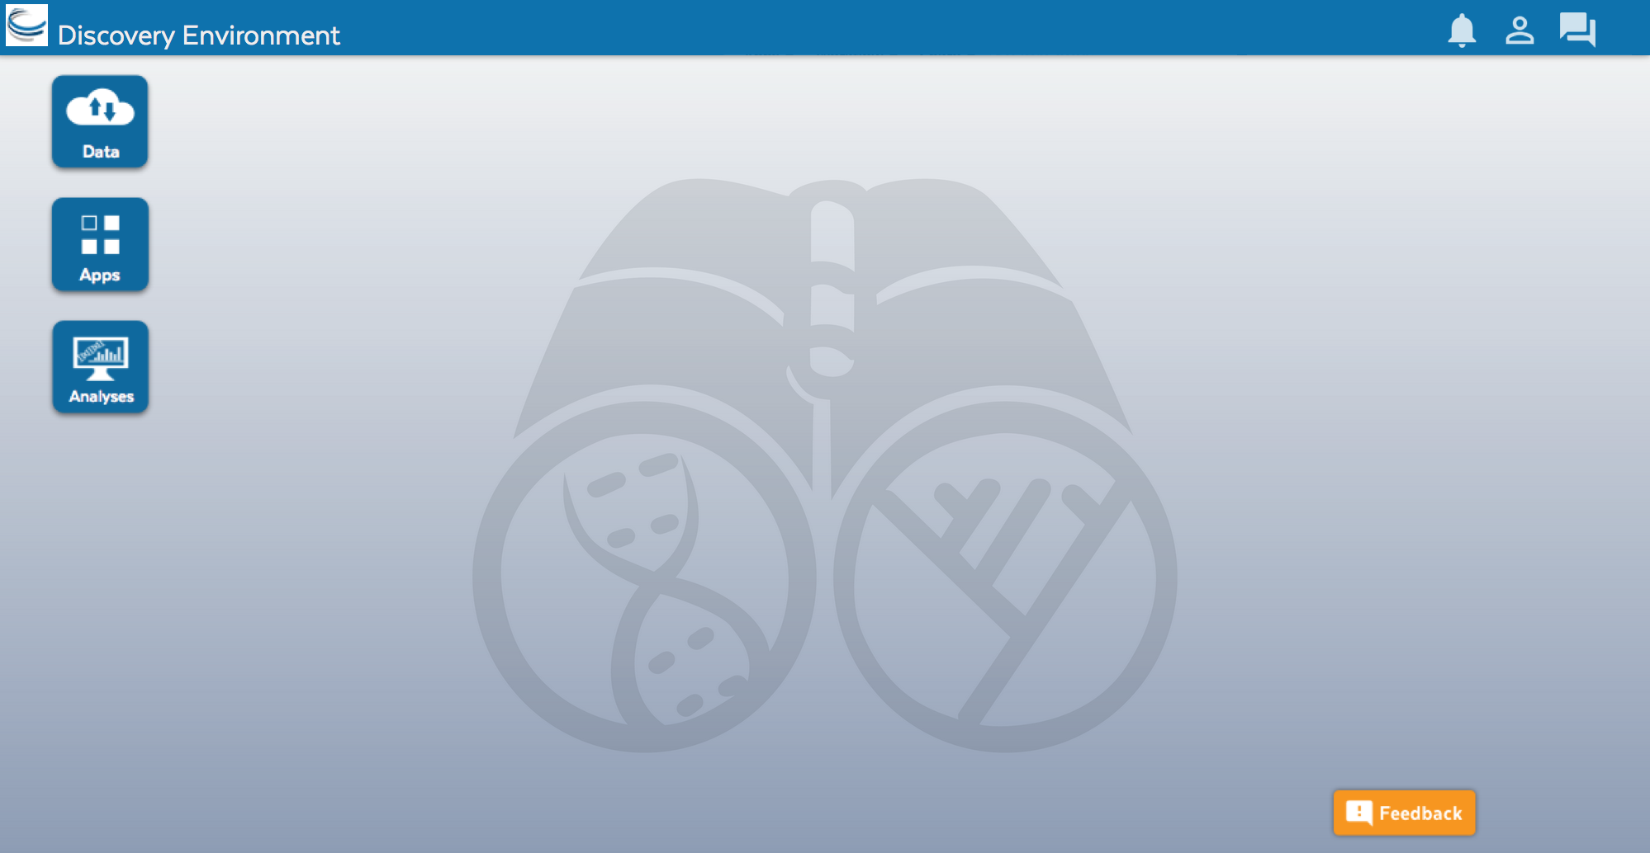
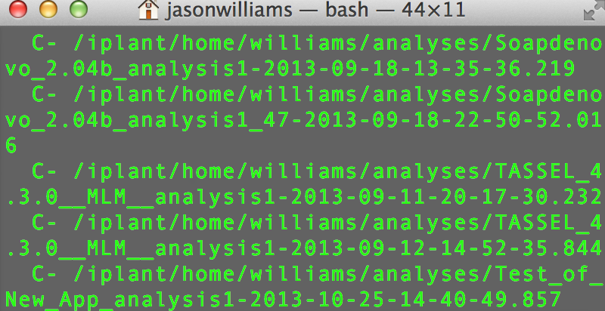
Data Store access
Point-and-click
Command line
Cyberduck Discovery Environment
iCommands
Notes:
These slide backgrounds have footer bars of different colors, this can be used to divide your presentation into sections. For example, topic one slides have blue, topic two have dark blue, and conclusion slides have grey.

Slide 7
Discovery Environment interface
Simple upload/download for small files
Bulk upload files and folders (<10GB)
Import from URL (no size limit)
Advantage + Disadvantage -
Covers most upload/download sharing needs
Some size/speed limitations
Notes:
These slide backgrounds have footer bars of different colors, this can be used to divide your presentation into sections. For example, topic one slides have blue, topic two have dark blue, and conclusion slides have grey.

Slide 8
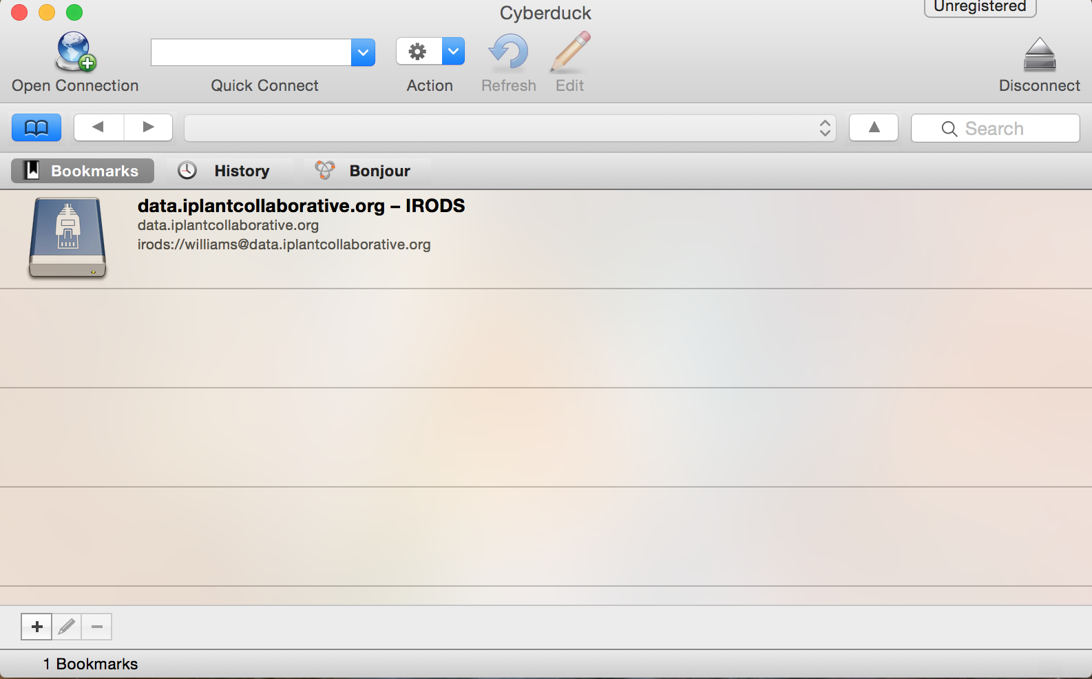
Cyberduck
Drag and drop files and folders
No size limit, file editing/previews
Easy Desktop functionality
Advantage + Disadvantage -
More like desktop file systems
No permissions/metadata control
Notes:
These slide backgrounds have footer bars of different colors, this can be used to divide your presentation into sections. For example, topic one slides have blue, topic two have dark blue, and conclusion slides have grey.

Slide 9
Cyberduck
Drag and drop files and folders
No size limit, file editing/previews
Easy Desktop functionality
Advantage + Disadvantage -
More like desktop file systems
No permissions/metadata control
Notes:
These slide backgrounds have footer bars of different colors, this can be used to divide your presentation into sections. For example, topic one slides have blue, topic two have dark blue, and conclusion slides have grey.

Slide 10
iCommands
Full flexibility
Ability to script and automate
Access from terminal/server
Advantage + Disadvantage -
Customizability
Requires some command line expertise
Notes:
These slide backgrounds have footer bars of different colors, this can be used to divide your presentation into sections. For example, topic one slides have blue, topic two have dark blue, and conclusion slides have grey.

Slide 11
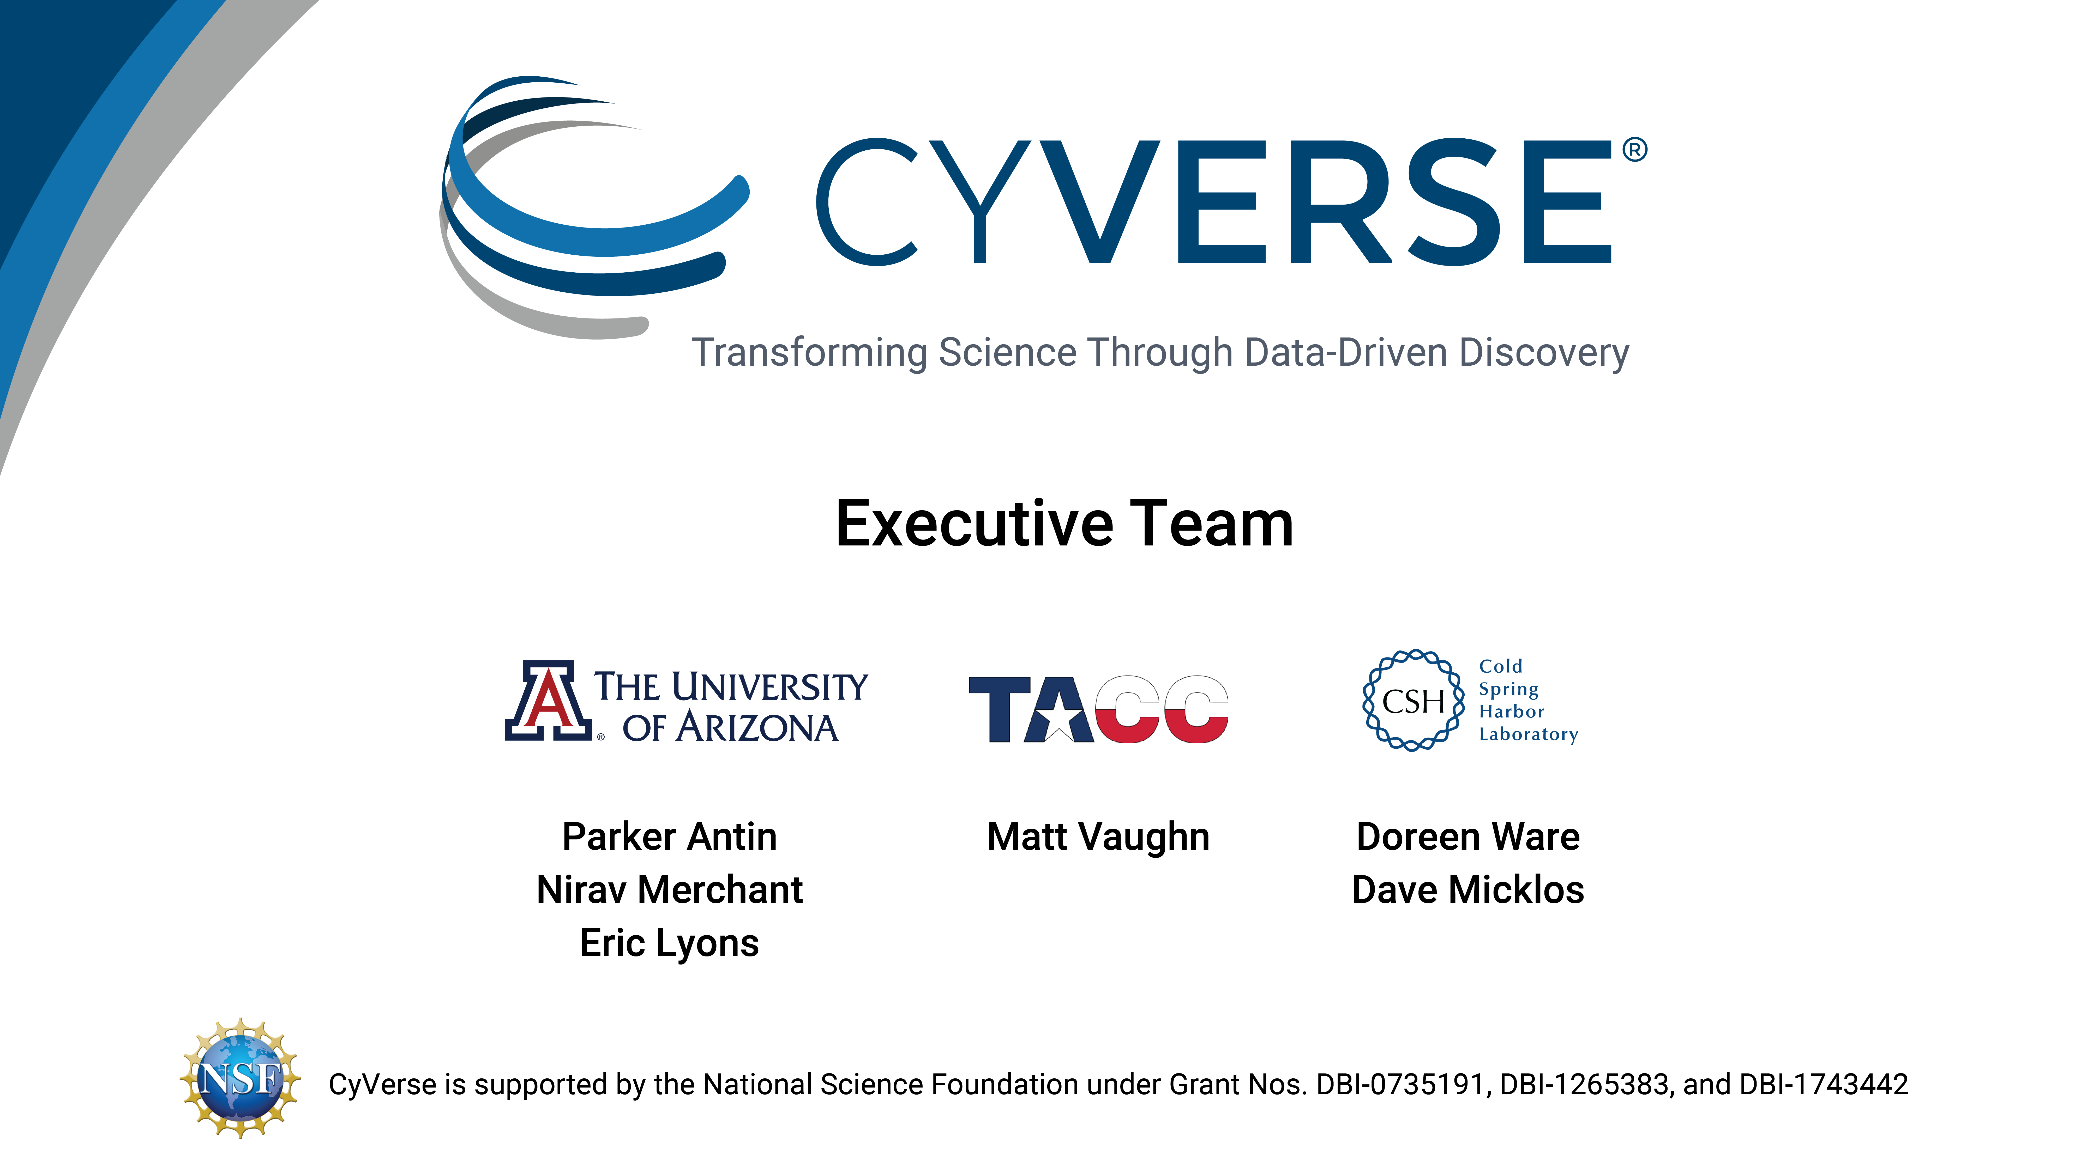
Notes:
Executive team slide.

