Slide 1
Tools and Services Workshop
Atmosphere – On Demand Cloud Computing

Slide 2

Welcome to Atmosphere
Custom Cloud Computing for Life Sciences

Slide 3
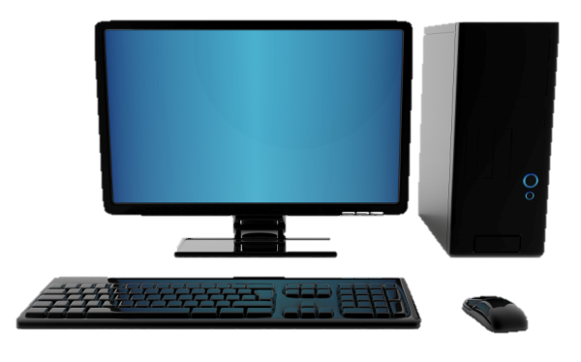


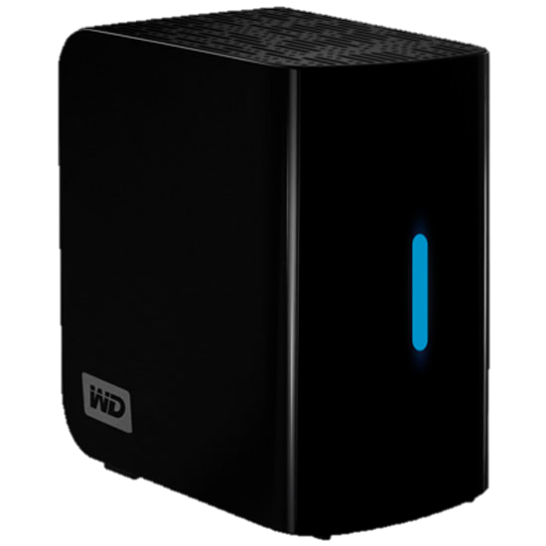
What is Cloud Computing?
Important concepts: Image
Image (file)
Complete clone (files/data)
Original system
Document(s) (file)
Copied Document(s) (file)

Slide 4

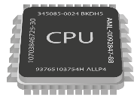
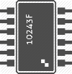
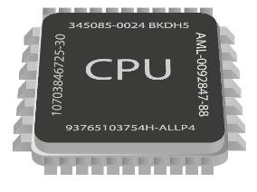

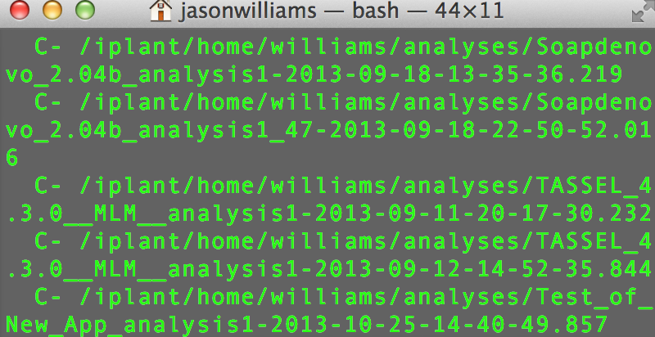
On-demand Cloud
(Disk + CPU + Memory) + (Image)
128.196.34.158
CyVerse Cloud
Atmosphere Instance
(virtual machine)

Slide 5
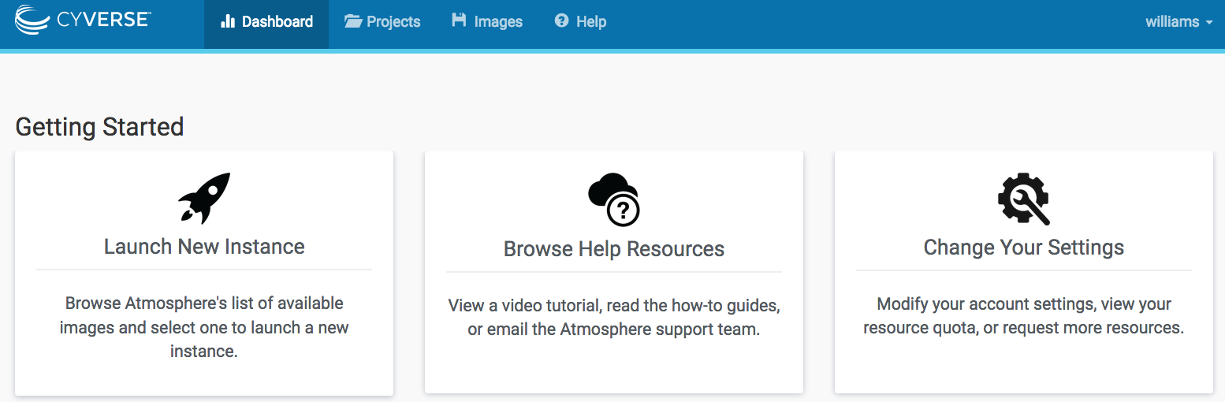
Atmosphere Overview
Largest, easiest to use for Life Sciences
Choose an existing image or customize
Instances up to 16-Core / 128 GB RAM
Access via shell or VNC
Share you image with selected users, or make them public

Slide 6



Atmosphere Overview
Benefits
Get Science Done
Work in an on-demand Linux environment (most bioinformatics)
Collaborate with students and colleagues on the same instance
Reproducibility
Make data, workflows, and analyses available in a public image
Access previous software version and images
Productivity
Multicore high memory images to run multithreading applications
Move your analyses from your laptop to the cloud

Slide 7
Atmosphere Overview
Key things to remember when you try this yourself
Images do not have automatic access to your Data Store
Use Cyberduck to access the Data Store
Use iCommands
Users have monthly allocation limits
Terminate, or stop instances not in use
If a larger allocation is needed, contact support
All data on terminated instances will be destroyed
Use Cyberduck or iCommands to transfer data off the instance
You may also create an EBS Volume (see documentation)
Notes:
What is EBS?

