Slide 1

CyVerse Workshop
Discovery Environment Overview

Slide 2

Welcome to the Discovery Environment
A Simple Interface to Hundreds of Bioinformatics Apps, Powerful Computing, and Data

Slide 3
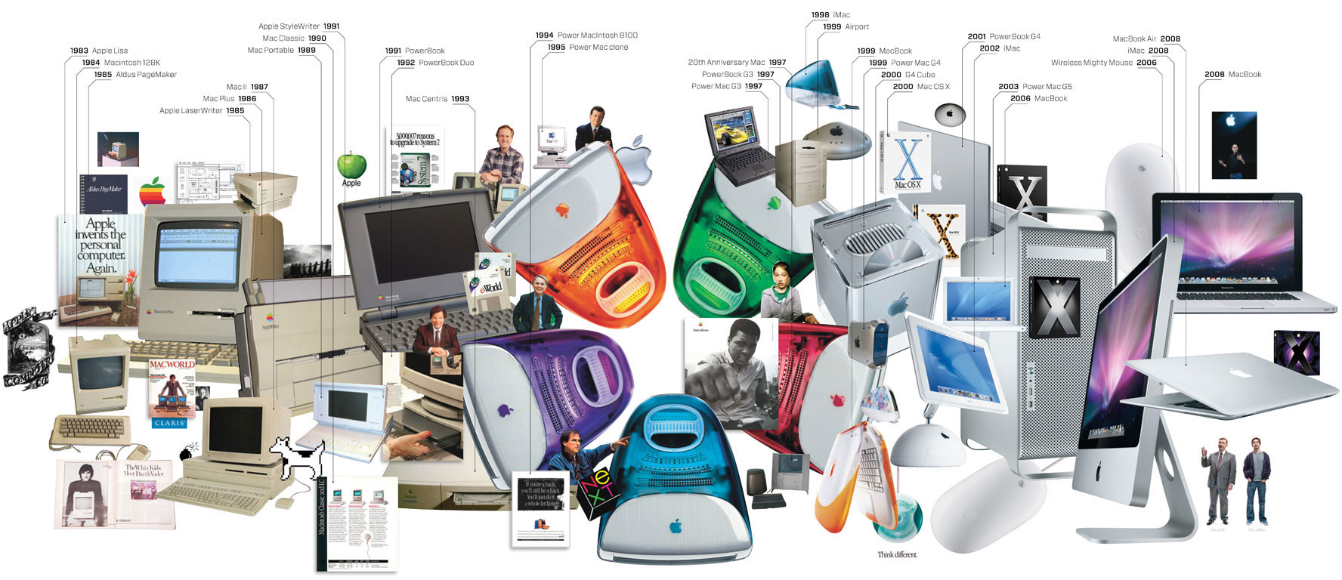
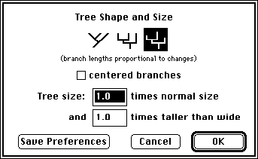

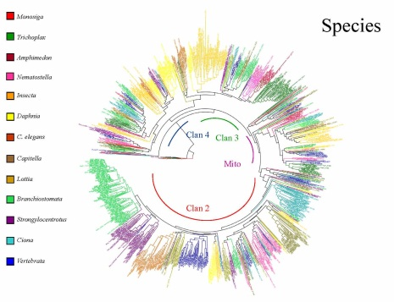
Discovery Environment Overview
A bench-biologist’s view on the evolution of computing
It can be difficult to keep up!
Investing in newer ‘better’ tools and resources is expensive.
?
Image From: http://www.wired.com/wired/archive/17.01/ff_mac_viewer.html

Slide 4
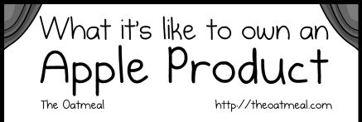
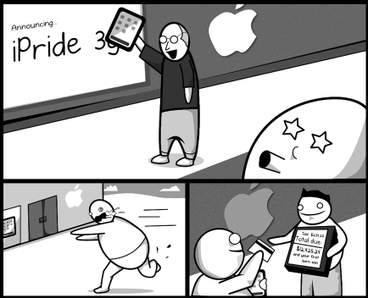
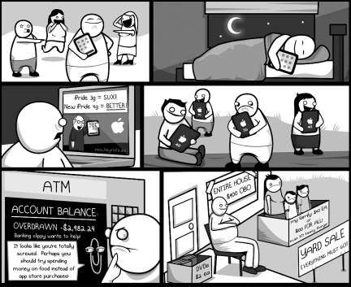
Discovery Environment Overview
The costs of keeping up with technology
Image From: http://theoatmeal.com/comics/apple

Slide 5
Discovery Environment
Hundreds of bioinformatics apps in an easy-to-use interface
A platform that can run almost any bioinformatics application
Seamlessly integrated with data and high performance computing
User extensible – add your own applications
bioinformatics workflow—data management, analysis, sharing large datasets
Notes:
Focus here is on genomics data, but not restricted to genomics data

Slide 6
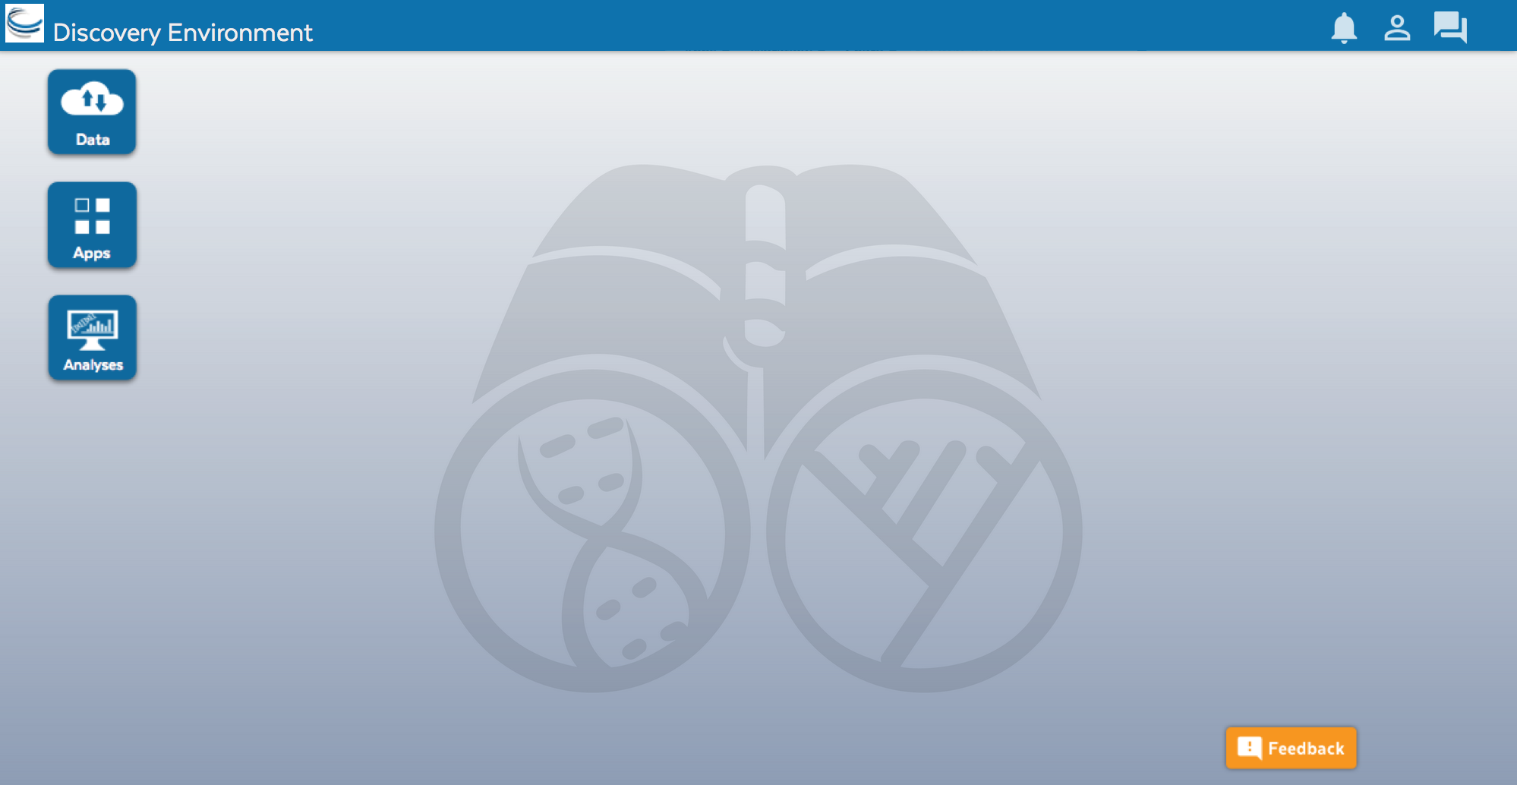
Discovery Environment Overview
Access your computational science through a single portal

Slide 7



Discovery Environment Overview
Benefits
Get Science Done
Use hundreds of bioinformatics Apps without the command line
Add your own applications – an extensible, scalable platform
Create and publish Apps and workflows so anyone can use them
Analysis history and provenance – “avoid forensic bioinformatics”
High-performance computing – not dependent on your hardware
Manage a secure data repository and share data easily
Reproducibility
Productivity

Slide 8
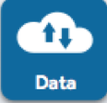
Discovery Environment Overview
Manage data
Data
Upload / Download files and folders
Share files via URL (Public Links)
Share files/folders with other users

Slide 9
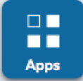
Discovery Environment Overview
Analyze data and customize Applications
Apps
Run hundreds of bioinformatics Apps
Build automated workflows
Modify Apps or integrate new ones

Slide 10

Discovery Environment Overview
View history, find results, reproduce analyses, optimize parameters
Analyses
Monitor job status and find results
Cancel jobs or re-launch jobs
Detailed job history

