Slide 1
FOSS
BioContainers
June 7, 2019
Amanda Cooksey

Slide 2
What we will cover
BioContainers
Bioconda
Where to get a BioContainer
How to use a BioContainer on the command line

Slide 3
Review of terminology
Image: self-contained, read-only ‘snapshot’ of your applications and packages, with all their dependencies
Container: a running instance of your image
Image registry: a storage and content delivery system, holding named images, available in different tagged versions
Docker: a program that runs and handles life-cycle of containers and images
CyVerse tool: Software program that is integrated into the back end of the DE for use in DE apps
CyVerse app: graphic interface of a tool made available for use in the DE

Slide 4
Dockerfiles and recipes
Images are built from files that specify software, environmental variables, files to add, metadata
Two containerization programs
Docker--images are built from Dockerfiles
Singularity--images are built from Singularity recipes
Not to be confused with Bioconda recipes
Used to build Bioconda packages (not containers)
Consists of two files: meta.yaml, build.sh

Slide 5

a channel of the conda package manager
a repository of recipes hosted on GitHub
over 600 contributors and 450 members who add, modify, update and maintain the recipes
a repository of more than 6000 bioinformatics packages
Each package added to Bioconda also has a corresponding Docker BioContainer automatically created and uploaded to Quay.io
Notes:
Not sure i need this slide

Slide 6

Community-driven project
Infrastructure and basic guidelines to create, manage and distribute Bioinformatics containers
Focus in proteomics, genomics, transcriptomics and metabolomics
Provide containers ready to be used by the bioinformatics community

Slide 7
Where to get BioContainers
Three major image registries
DockerHub
Biocontainers Registry
Quay.io

Slide 8
Docker Hub
Most popular and well-known registry for Docker containers
Has some BioContainers but fewer than other registries
Good option if you want to build your own BioContainer
Has the BioContainers ‘base image’
Dockerfiles also available for these images
https://hub.docker.com/

Slide 9
BioContainers Registry
Contains every BioContainer
Container descriptions are searchable too
Also finds conda packages that match your search
Conda packages are not containers
https://biocontainers.pro/#/registry

Slide 10

Registry of container images
You can create your own free public repositories
Account not necessary to use BioContainers
Integrated with Bioconda GitHub repository for automated builds
Every Bioconda package (more than 6000) has a BioContainer here
BioContainers are Docker-based
All BioContainers are publicly available and free
https://quay.io/
Next step

Slide 11
How to request a container
If you search the BioContainers registry and don’t find what you need
Request a package (and by default, an image) in the Biocontainers GitHub repository using the ‘container request’ label
Build your own container--see Bioconda documentation

Slide 12
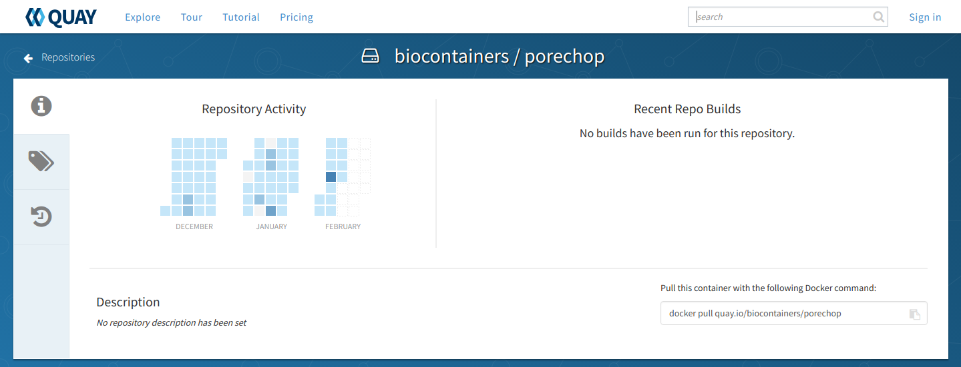

Slide 13
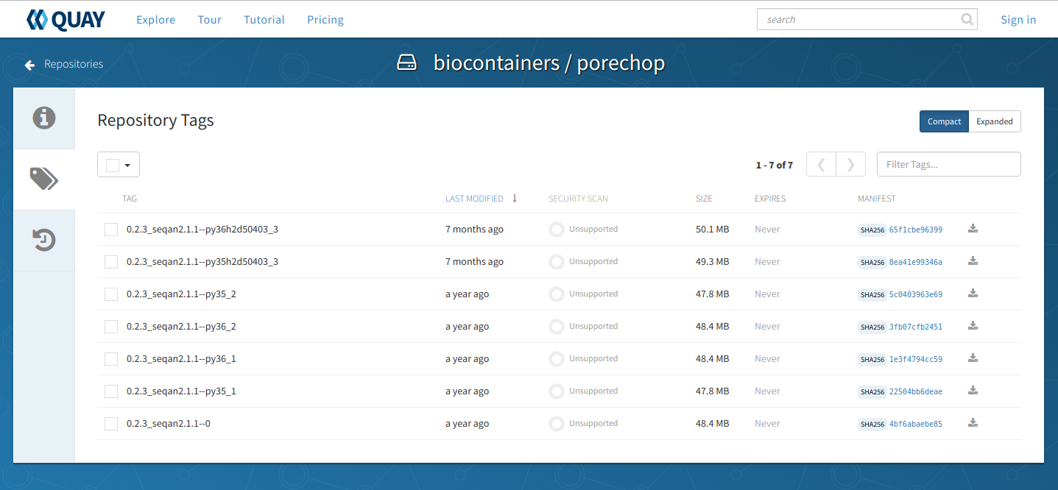

Slide 14
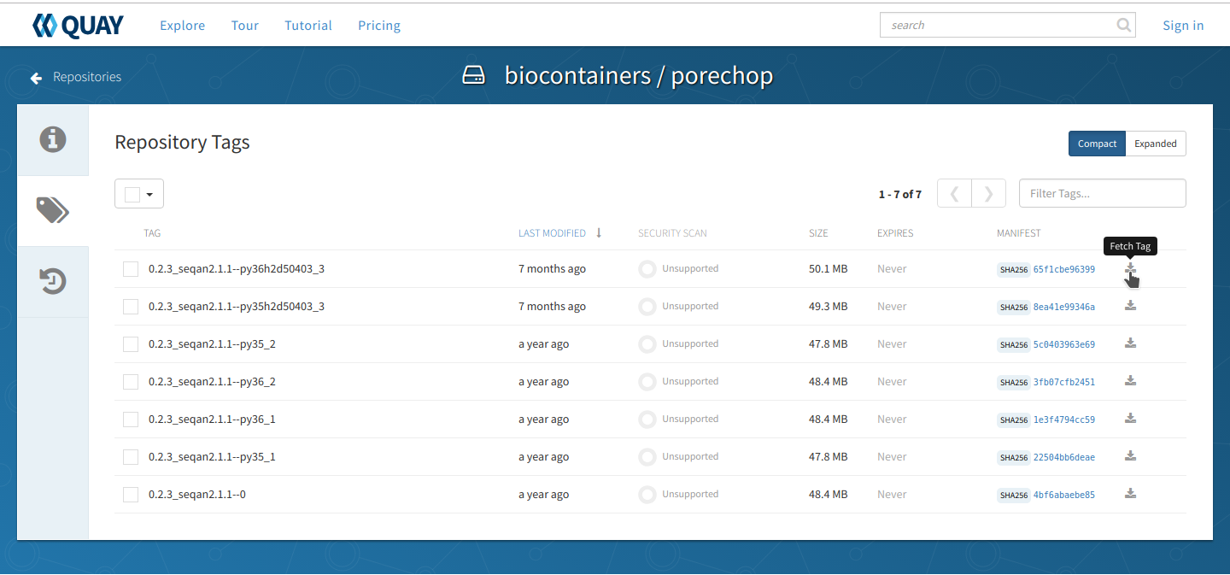

Slide 15
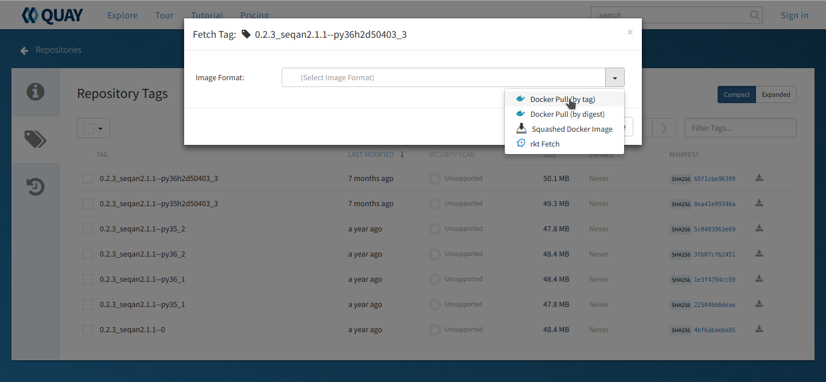

Slide 16
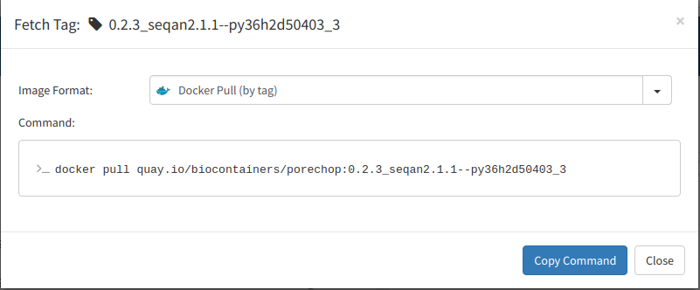

Slide 17
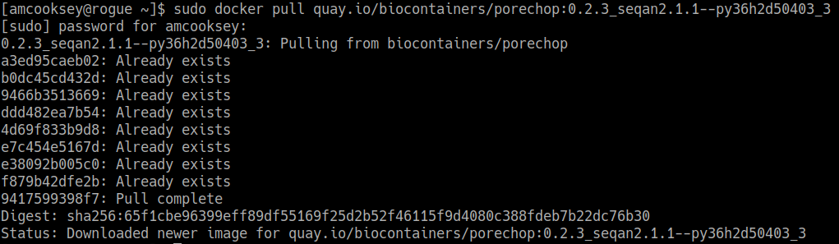
Pull the image

Slide 18
Run the container
sudo \
docker run \
--rm \
-v $(pwd):/working-dir \
-w /working-dir \
--entrypoint="porechop" \
quay.io/biocontainers/porechop:0.2.3_seqan2.1.1--py36h2d50403_3 \
-h
‘entrypoint’ is very important:
BioContainers don’t have built-in entrypoints
It tells the container what to run

Slide 19
Run the container
sudo \
docker run \
--rm \
-v $(pwd):/working-dir \
-w /working-dir \
--entrypoint="porechop" \
quay.io/biocontainers/porechop:0.2.3_seqan2.1.1--py36h2d50403_3 \
-i SRR6059710.fastq \
-o porechop_out.fastq
‘entrypoint’ is very important:
BioContainers don’t have built-in entrypoints
It tells the container what to run

Slide 20

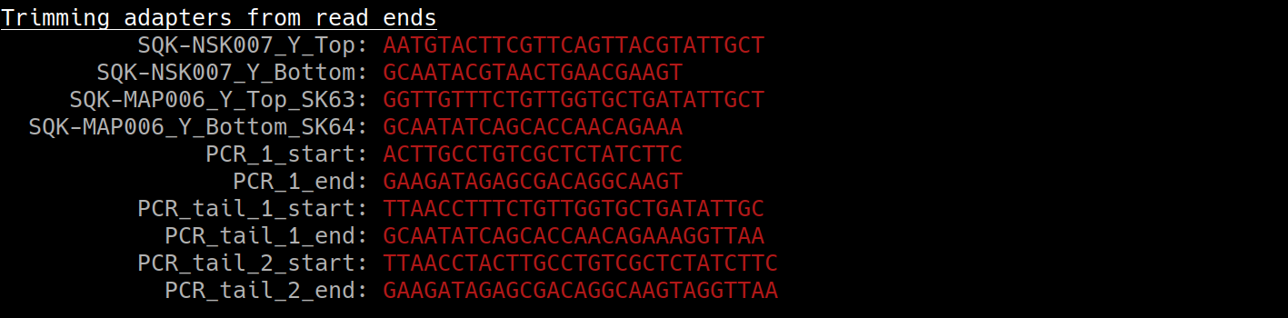

Container is running
...

Slide 21
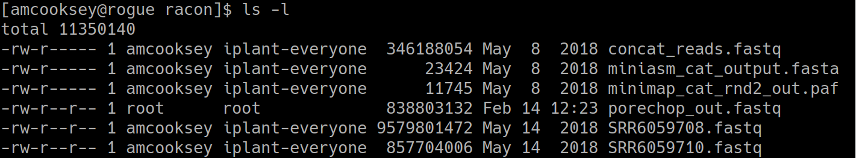
List contents of working directory

Slide 22
At this point
Run your BioContainer anywhere you can run Docker
Laptop
CyVerse Atmosphere (or other cloud service)
HPC systems (with Singularity)

Slide 23
CyVerse is supported by the National Science Foundation under Grants No. DBI-0735191, DBI-1265383 and DBI-1743442.

