Slide 1

Foundations of Open Science
CyVerse Learning Institute - FOSS Camp 2019

Slide 2
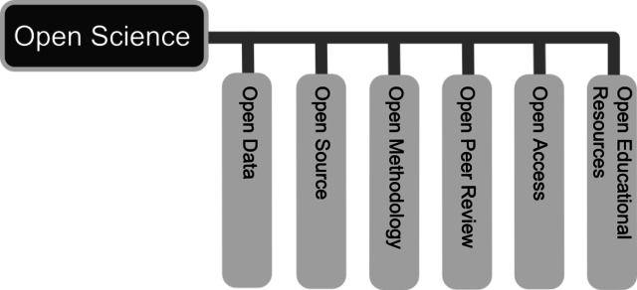
What is open science?
http://openscienceasap.org/open-science/

Slide 3
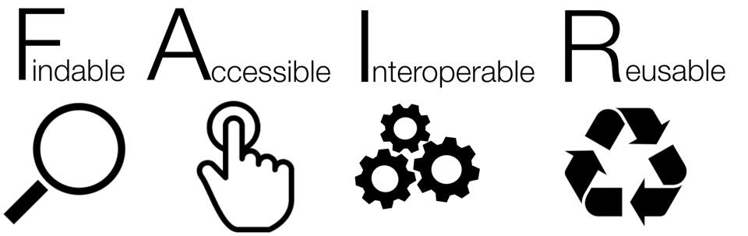
FAIR data

Slide 4
To be Findable:
F1. (meta)data are assigned a globally unique and persistent identifier
F2. data are described with rich metadata (defined by R1 below)
F3. metadata clearly and explicitly include the identifier of the data it describes
F4. (meta)data are registered or indexed in a searchable resource
To be Accessible:
A1. (meta)data are retrievable by their identifier using a standardized communications protocol
A1.1 the protocol is open, free, and universally implementable
A1.2 the protocol allows for an authentication and authorization procedure, where necessary
A2. metadata are accessible, even when the data are no longer available
To be Interoperable:
I1. (meta)data use a formal, accessible, shared, and broadly applicable language for knowledge representation.
I2. (meta)data use vocabularies that follow FAIR principles
I3. (meta)data include qualified references to other (meta)data
To be Reusable:
R1. meta(data) are richly described with a plurality of accurate and relevant attributes
R1.1. (meta)data are released with a clear and accessible data usage license
R1.2. (meta)data are associated with detailed provenance
R1.3. (meta)data meet domain-relevant community standards

Slide 5
Why do open science?

Slide 6
Why FOSS?
Open Science requires skills that aren’t usually taught in grad school:
Command line
Coding
FAIR data management
Communication and collaboration
HPC and cloud computing
Build an Open Science community

Slide 7
Open Science Introductory Activity
Introductions in pairs
Describe your work or research area
Draw a picture about your partner
Introduce your partner

