Slide 1
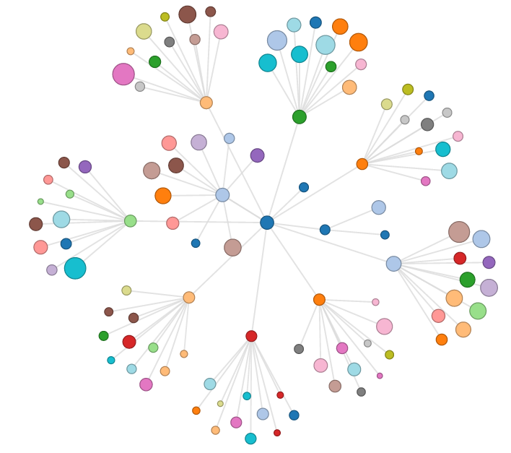
Cyber Visualization
University of Tennessee Computer Science and Electrical Engineering
Visualization (COSC 494/557) - Professor Chad Steed
Daniel Baldwin, John Cotham, Joseph Raetano, George Rhinehart
Visualizing computer networks for:
- pattern analysis
- network characterization
- vulnerability detection
- and so much more...

Slide 2
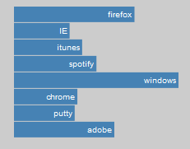
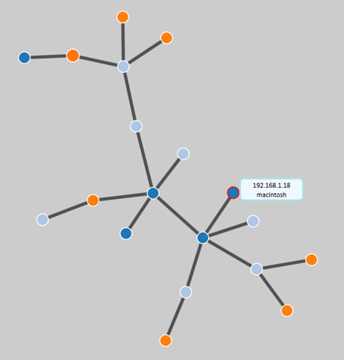
Cloud CyVis
Cyber Visualization
Cloud Scanner
Lightweight Scanner to identify nodes and services running on each instance.
Scanner is written in Java
Portable to any instance
Can run as a service on app server
Lightweight Cyber Visualization (CyVis) capability for use in cloud SOC dashboard
Uses HTML, javascript and D3
Can visualize from any browser
Cloud VulnInfo
System to retrieve up to date Vulnerability Information (VulnInfo) to correlate scanner information
Retrieves information from National Vulnerability Database (NVD)
is used to correlate vulnerability information with scanner results
CyVis will render vulnerability information on SOC dashboard

