Slide 1
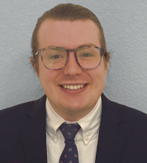



1st Annual Undergraduate Quantitative Biology Summer School
Module 0: Introduction to Python w/ Example notebooks
Instructor: William Raymond
e-mail: wsraymon@rams.colostate.edu

Slide 2
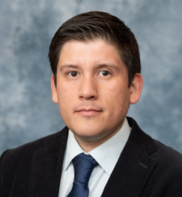
1st Annual Undergraduate Quantitative Biology Summer School
Module 1: Bootcamp Basics to get Started with Scientific Computing in Python
Instructor: Luis Aguilera
e-mail: luis.aguilera@colostate.edu

Slide 3
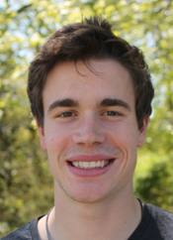
1st Annual Undergraduate Quantitative Biology Summer School
Module 2: Introduction to Single-Cell Optical Microscopy Experiments and Image Processing
Instructor: Zach Fox
e-mail: email@lanl.gov

Slide 4
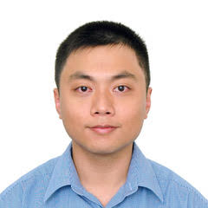
1st Annual Undergraduate Quantitative Biology Summer School
Module 3: Introduction to Multivariable Statistics and Machine Learning for Single-Cell Data
Instructor: Huy Vo
e-mail: Huy.Vo@colostate.edu

Slide 5
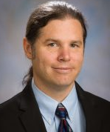
1st Annual Undergraduate Quantitative Biology Summer School
Module 4: Introduction to Stochastic Simulations of Single-Cell Gene Regulatory Processes
Instructor: Brian Munsky
e-mail: Brian.Munsky@colostate.edu

Slide 6

1st Annual Undergraduate Quantitative Biology Summer School
Module 5: Introduction to Master Equation Analyses of Single-Cell Gene Regulatory Processes
Instructor: Michael May
e-mail: michaelpmay@live.com

Slide 7
1st Annual Undergraduate Quantitative Biology Summer School
Module 5: Introduction to Monte Carlo Methods to Infer Models for Noisy Single-Cell Processes
Instructor: Huy/Luis/Zach
e-mail: email@email.edu

Slide 8
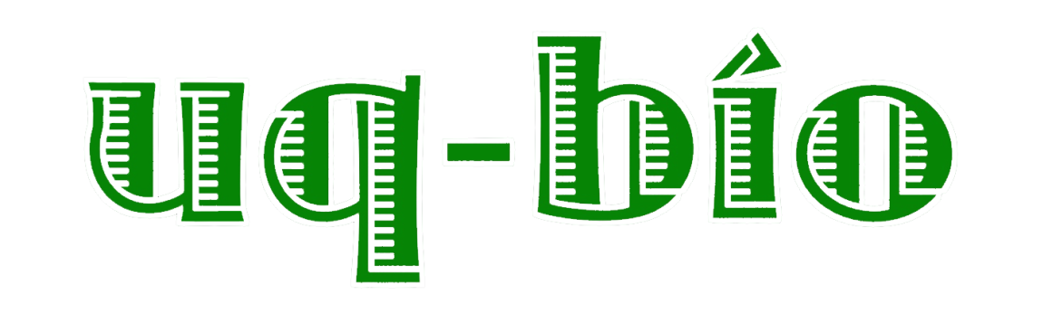
Title
Outline
Bullet one
Bullet 2

Slide 9

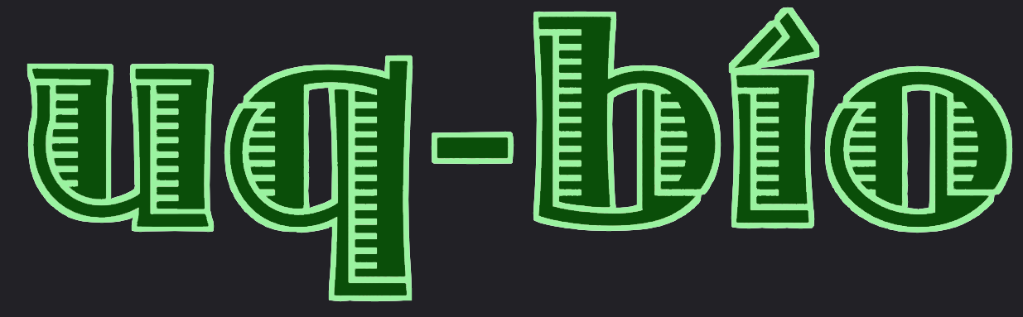
Title – Arial Nova
Outline
Bullet one
Bullet 2

