Slide 1
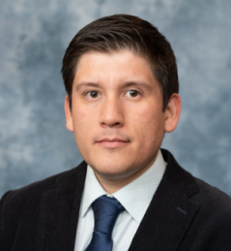



1st Annual Undergraduate Quantitative Biology Summer School
Module 1: Bootcamp Basics to get Started with Scientific Computing in Python
Instructor: Luis Aguilera
e-mail: luis.aguilera@colostate.edu

Slide 2

Title
Outline
Bullet one
Bullet 2

Slide 3

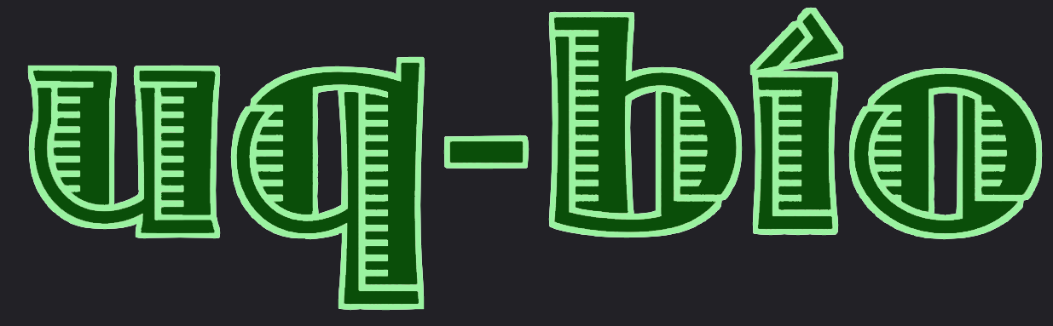
Title – Arial Nova
Outline
Bullet one
Bullet 2

Slide 4
Title – Arial Nova
Outline
Bullet one
Bullet 2

Slide 5
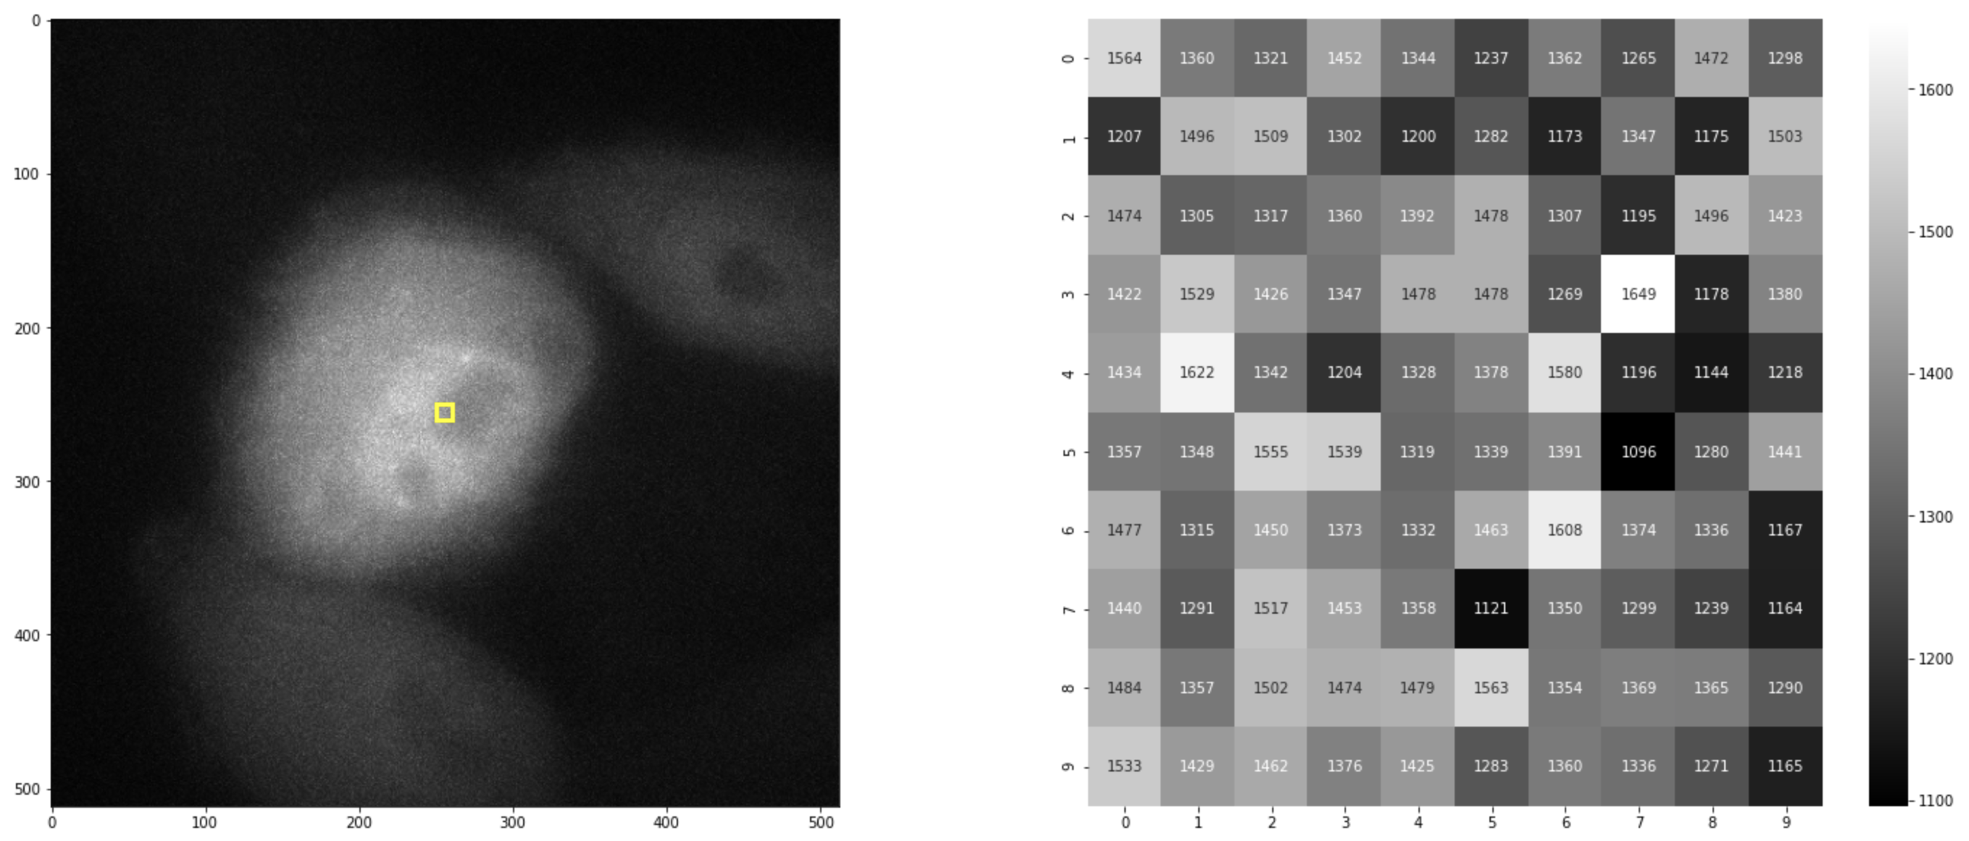
Title
Outline
Bullet one
Bullet 2

