Slide 1

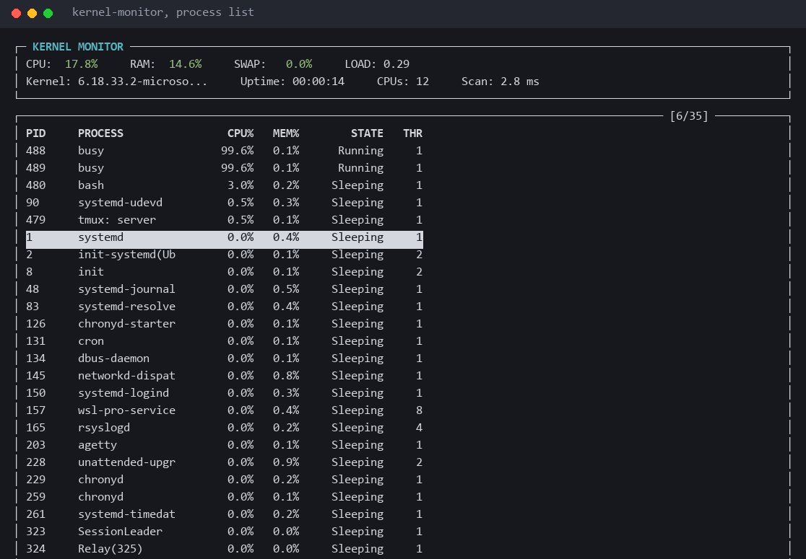
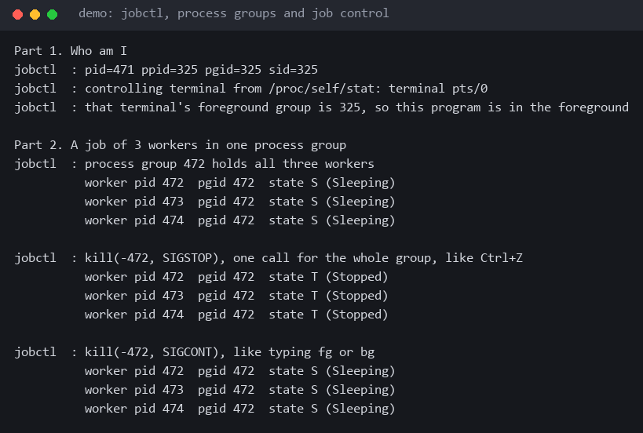

Kernel Monitor A user-space Linux system and process monitor
Team ID: 19 | Section: S02 | Guide: Dr. K. Anusha
Members: Aniketh Pani Kakanur – 2520030184, Rohaan Jacob Variganti – 2520030558, V. Karthik – 2520030053
Operating Systems and Systems Programming (OSSP) | KLH Bachupally Campus, CSE | PBL 2026–27
Abstract
Tools & Technologies
Kernel Monitor is a terminal tool in C that shows live CPU, memory and process activity on Linux by reading the /proc filesystem directly: no kernel module, no driver, no root. It is built for OS students who want to see how top-style figures are computed.
Outcome: a 60 KB binary using 0.30% CPU and 3.6 MB of RAM that lists, inspects and signals processes, plus nine demo programs covering CO-1 to CO-6.
Programming: C (gnu11); shell scripts for build, install and tests
Platform: Linux / Ubuntu, native or under WSL2
OS Concepts: processes and states, scheduling accounting, signals, pipes, FIFOs, job control, virtual memory, VFS, threads and locks
System Calls / APIs: open, read, opendir, readdir, kill, sigaction, sysinfo, pthread mutex and condvar; fork, execvp, waitpid, pipe, dup2, mkfifo, mmap in the demos
Tools: GCC, Make, ncursesw, GDB, Valgrind, AddressSanitizer, Git & GitHub
Problem Statement & Objectives
Problem: the kernel tracks every process's state, CPU time and memory, yet none of it is visible without tools, and tools such as top and htop never show how their numbers come from raw kernel counters.
Objective 1: report CPU, memory, swap, load and uptime live, computing rates from two timed /proc samples.
Objective 2: list, inspect and tree all processes, log their creation and exit, and control them with four signals.
Objective 3: demonstrate processes, IPC, memory, files and threads in demo programs mapped to CO-1 to CO-6.
Scope: one Linux host (native or WSL2), unprivileged user; monitoring and signals only; no kernel code, history or network statistics.
System Workflow / Architecture
User at the terminal
keys ↑ ↓ Enter T E K X S C + − · four ncurses views
■ main thread
■ collector thread
draw
keys
ui.c
ncurses, four views, redraws changed cells
main.c
event loop, keys, sigaction() handler
collector.c
2nd thread, mutex and timed condvar
K X S C
sweep /proc
process_control.c
kill(): SIGTERM, SIGKILL, SIGSTOP, SIGCONT
proc_reader.c + parser.c
open, read, close, opendir, readdir
system_monitor.c
process_monitor.c
CPU%, memory, tree, events
system calls
Existing vs Proposed System
Linux kernel
/proc through the VFS: stat, meminfo, loadavg, [pid]/stat, statm, status, fd · signal delivery
Aspect | Basic / Existing Approach | Proposed Project
Process handling | ps prints one snapshot; reading /proc by hand takes a cat per PID | Rescans all of /proc/[pid] every refresh; PPID tree; log of creation and exit
Communication | A separate kill command, with the PID copied by hand | kill() on the selected process, K, X and S after a y/n prompt; sigaction() handles SIGINT, SIGTERM
Resource handling | Cumulative jiffy counters; CPU% has to be worked out by hand | CPU% and fault rates over the measured interval; scans run on a collector thread
Error handling | A process exits between two reads, leaving stale output | Every read checked; vanished PIDs skipped; EPERM and ESRCH reported
Key gap | Results are shown, the computation is hidden | Readable C with each concept tagged [CO-n]; nine runnable demos
Process, IPC & Resource Design
COLLECTOR THREAD
SHARED RESOURCE
MAIN THREAD
wait: cond_timedwait until the interval ends or R / + − wakes it
R or + − signals the condvar
getch() with a timeout, never holding the lock
sweep /proc with no lock held (about 2.8 ms)
Shared sample
process list and system stats under one mutex, so no lock-order deadlock
handle the key; K X S C go to kill()
lock · swap in new sample · generation + 1 · unlock
lock · copy what is needed · draw · unlock
SIGNALS ACROSS PROCESSES
Key K, X, S or C; the first three ask y/n
kill(pid, SIGTERM | SIGKILL | SIGSTOP | SIGCONT)
Target stops (T), resumes or exits
SIGINT or SIGTERM sent to the monitor
sigaction() handler sets a volatile sig_atomic_t flag
Main loop exits, joins the collector, restores the terminal
Feasibility Study
Implementation Screenshots
Technical: needs only GCC (C11), GNU Make, ncursesw and a kernel with /proc, all standard on Ubuntu and WSL2.
Economic: no cost: open-source compiler, libraries and GitHub hosting on our own laptops; no extra hardware.
Operational: one-command install, runs unprivileged and keyboard-driven; K, X and S ask for confirmation, and a refused signal says why.
Schedule: Aug: core monitor and installer. Sep: C port, CPU% and redraw fixes, collector thread, nine demos. Oct: report, presentation and poster.
Main interface: processes sorted by CPU%
jobctl: one kill() stops a whole group
Results & Testing
Conclusion
Future Scope
Observed: a busy loop reads 100.0% CPU at 2, 3 and 4 s intervals; /proc scan 2.82 ms for 37 processes.
Testing: run_tests.sh passes 23 of 23 checks; manual cases cover EPERM, ESRCH and SIGSTOP/SIGCONT.
A working /proc monitor in C: two threads, four views, signal control and nine demos.
Meets all three objectives, and every course outcome from CO-1 to CO-6 maps to code that runs.
Live per-core CPU rates and per-process disk I/O from /proc/[pid]/io.
Process search and filters, history sparklines, and an overhead benchmark against top and htop.
References: [1] Linux man-pages: proc(5), kill(2), sigaction(2), pthreads(7) [2] OSSP (25CS2104E) course material [3] GCC and GNU Make manuals [4] ncurses(3X)
Repository: github.com/Cyanexani/2520030184_053_558-OSSP (scan the QR code)

