Slide 1

OPERATING SYSTEMS AND SYSTEMS PROGRAMMING · 25CS2104E
Kernel
TEAM 19 · SECTION 02
Aniketh Pani Kakanur
2520030184
Monitor
Rohaan Jacob Variganti
2520030558
V. Karthik
2520030053
A user-space Linux system and process monitor, built directly on the /proc filesystem and POSIX APIs.
GUIDE Dr. K. Anusha
DEPT. CSE · KL University (KLH)
TERM I · 2026–27
TITLE SHEET
01 / 23

Slide 2

FIG. 01 / INTRODUCTION
A running system is
a black box by default
The kernel already knows everything. The problem is reaching it.
An operating system constantly schedules CPU time, accounts for memory and manages hundreds of processes. Almost none of that is visible to a user without tooling. Linux, however, publishes its own internal state as ordinary files under /proc, so reading it needs nothing more privileged than open() and read().
01
Kernel state is already exposed
/proc and POSIX APIs publish CPU, memory and per-process data as readable text.
02
Reading it directly is the point
Building the reader, rather than running top, is how these concepts get studied.
03
It makes the syllabus concrete
Process states, scheduling accounting and signals become live values, not diagrams.
INTRODUCTION
02 / 23

Slide 3
FIG. 02 / ABSTRACT
What the project is
One paragraph, then the four things that define its boundaries.
Kernel Monitor is a Linux system monitoring application written in C and built entirely in user space. It reads the /proc filesystem and POSIX system calls to report CPU, memory and process activity in real time, and lets the operator control processes through Linux signals, all inside one interactive ncurses terminal interface.
PROBLEM
SOLUTION
Kernel-level activity is invisible without tooling, and the standard tools do not explain how they work.
A terminal monitor that reads /proc directly and stays readable line by line.
INPUTS
OUTPUT
/proc/stat, /proc/meminfo, /proc/uptime and per-process /proc/[pid]/stat, statm and status.
Live CPU and memory readouts, a sortable process list, a process tree, an event log and signal control.
ABSTRACT
03 / 23

Slide 4
FIG. 03 / EXISTING SYSTEM
The tools that already do this
All three work well. All three are compiled binaries you cannot read.
top
htop
ps
Live CPU, memory and a process list, refreshed on a timer.
Adds colour, a tree view, mouse support and signal sending.
Snapshots process state on demand, scriptable and precise.
LIMITATION
LIMITATION
LIMITATION
No process tree, no event history, and its internals are not written to be read.
Still a black box at the point of use: you see the output, never the computation.
No live view and no built-in control, so it answers one question at one instant.
Kernel Monitor is not proposed as a replacement. It is proposed as the readable one.
EXISTING SYSTEM
04 / 23

Slide 5
FIG. 04 / SYLLABUS MAPPING
Course outcomes CO-1 to CO-6
Every claim below points at a specific part of the program.
CO | SYLLABUS TOPIC | WHERE IT APPEARS IN THE PROJECT
CO-1 | User space and kernel space; system calls | The whole tool is user space. It crosses the boundary only via open, read, close and kill.
CO-1 | Linux architecture and system software stack | /proc is a kernel filesystem surfaced through the VFS, read with ordinary file I/O.
CO-2 | Process abstraction, lifecycle and states | PID, PPID and field 3 of /proc/[pid]/stat drive the list, the tree and the STATE column.
CO-2 | Scheduling concepts and process pitfalls | CPU% is a delta of two jiffy samples. zombie.c and orphan.c create both pitfalls.
CO-3 | Signals, handlers and POSIX signal code | kill() sends four signals; a sigaction handler catches SIGINT and SIGTERM.
CO-3 | Pipes, FIFOs, groups, sessions, job control | pipeline.c, fifo.c, jobctl.c; group, session and foreground show in the detail view.
CO-4 | Virtual memory, page tables, demand paging | Minor and major fault rates in the detail view; vmem.c shows pagemap and demand paging.
CO-4 | Address space, malloc, copy-on-write, errors | vmem.c: /proc/self/maps, fork copy-on-write, SIGSEGV codes, leak and overflow under ASan.
CO-5 | VFS, inodes, directory entries and ext4 | fileio.c: statfs magic numbers, hard and soft links, unlink, ext4 journal mode.
CO-5 | Descriptors, buffered I/O, memory mapping | fileio.c: dup and offsets, 4081 times fewer system calls with stdio, mmap and msync.
CO-6 | Threads, mutexes and condition variables | The collector thread: one mutex, a timed condition variable, a generation counter.
CO-6 | Races, semaphores, deadlock, advanced locks | threadsync.c: lost updates, semaphore, deadlock, read-write lock, barrier.
CO-4 to CO-6 are applied in the vmem, fileio and threadsync demo programs, and in the monitor's page fault fields and collector thread. Each demo is a single C file.
SYLLABUS MAPPING
05 / 23

Slide 6
FIG. 05 / CO-1 · THE OS AS A SERVICE LAYER
Crossing from user space
into the kernel
A handful of system calls is the entire width of the interface.
kernel-monitor
user space
SYSTEM CALLS THE PROJECT USES
open() read() close()
glibc · POSIX wrappers
user space
Pull text out of /proc files
opendir() readdir()
system call boundary
Enumerate numeric /proc entries as PIDs
kill()
Deliver a signal to a target PID
VFS · procfs
kernel space
sigaction()
Install our handler for SIGINT and SIGTERM
scheduler · memory · signals
kernel space
sysinfo()
Uptime and total memory for percentage maths
No kernel module, no driver, no root. Everything above is reachable from an unprivileged process, which is the point CO-1 makes.
CO-1 · SERVICE LAYER
06 / 23

Slide 7
FIG. 06 / CO-2 · PROCESS LIFECYCLE
Every state the monitor
can actually show you
Read from field 3 of /proc/[pid]/stat, one character per state.
NEW
fork()
scheduled
READY
RUNNING
STATE CHARACTERS
R
Running
preempt
S
Sleeping
STOPPED
SLEEPING
D
Disk sleep
exit()
T
Stopped
wait()
Z
Zombie
ZOMBIE
REAPED
I
Idle
ZOMBIE is the only state a correct program can leave behind by accident, which is why CO-2 lists it under process management pitfalls.
CO-2 · LIFECYCLE
07 / 23

Slide 8
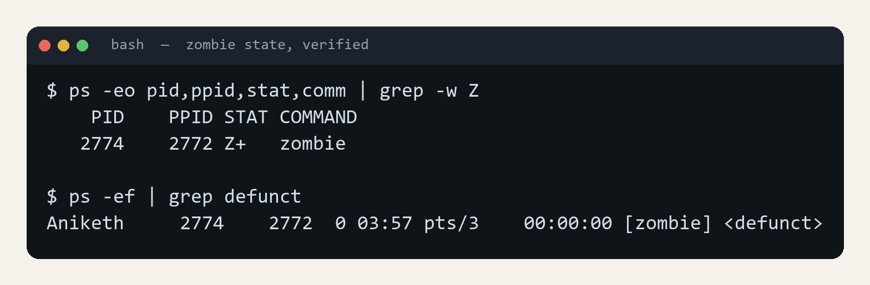
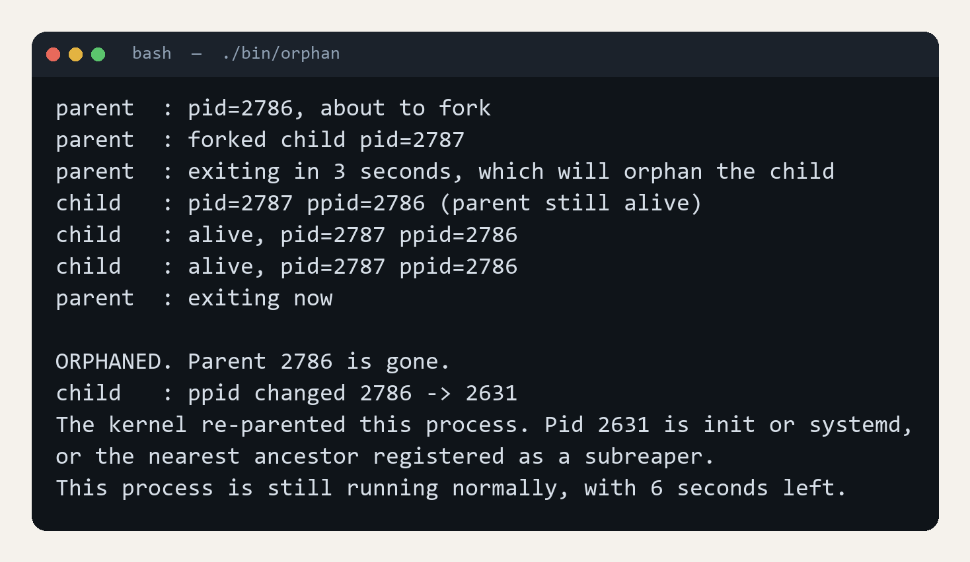
FIG. 07 / CO-2 · PROCESS MANAGEMENT PITFALLS
Zombie and orphan, created on purpose
Two demo programs, so both conditions can be shown live.
 | ZOMBIE | ORPHAN
Child | has terminated | still running
Parent | alive, never called wait() | has terminated
Kernel holds | exit status and the PID | nothing unusual
Resolved by | parent calling wait() | re-parenting, automatic
A defect? | yes, it leaks PIDs | no, kernel handles it
A zombie is dead with a live negligent parent. An orphan is alive with a dead parent. The zombie is the bug.
MEASURED CAVEAT · WSL
The textbook answer is that an orphan is re-parented to PID 1. The kernel actually gives it to the nearest ancestor registered as a child subreaper, and only falls back to PID 1 if there is none. Under WSL that ancestor is Relay, so the observed PPID is not 1. On a bare-metal Linux install it is.
CO-2 · PITFALLS
08 / 23

Slide 9
FIG. 08 / CO-3 · SIGNALS AND ASYNCHRONOUS NOTIFICATION
Signals are the kernel's
interrupt for processes
One kill() call, four different contracts.
SIGTERM
no. 15
[K]
SIGKILL
no. 9
[X]
Asks the process to stop. It can catch the signal, release resources and exit on its own terms.
Cannot be caught, blocked or ignored. The process gets no chance to clean up, so it is a last resort.
SIGSTOP
no. 19
[S]
SIGCONT
no. 18
[C]
Suspends the process without killing it. Also uncatchable. This is job control, not termination.
Resumes a stopped process. Pairs with SIGSTOP for pause and resume workflows.
SIGKILL and SIGSTOP are the two a process cannot refuse, because the kernel acts on them without ever delivering them to the process.
CO-3 · SIGNALS
09 / 23

Slide 10
FIG. 09 / CO-3 · HANDLERS, GROUPS AND JOB CONTROL
The monitor is also a
signal-handling program
It does not only send signals. It receives them correctly.
static volatile sig_atomic_t g_running = 1;
static void signal_handler(int signal) {
if (signal == SIGINT || signal == SIGTERM) {
g_running = 0;
}
}
Process groups
A signal can address a whole group, which is how Ctrl+C reaches every process in a pipeline at once.
Sessions
The tree view shows real session leaders. Under WSL, SessionLeader and Relay are the ancestors of every shell.
A handler can interrupt at any machine instruction, so the flag it writes must be written atomically and never cached in a register. That is exactly what volatile sig_atomic_t guarantees. The handler does no work itself: it sets the flag and returns, and the main loop exits on its next pass.
Job control
SIGSTOP and SIGCONT on the S and C keys are the same mechanism a shell uses for Ctrl+Z, bg and fg.
CO-3 · HANDLERS
10 / 23

Slide 11
FIG. 10 / CO-4 · MEMORY MANAGEMENT
Memory arrives
one fault at a time
vmem.c watches the kernel hand out pages one fault at a time.
64 MiB = 16384 pages of 4096 bytes
step faults RSS
mmap(64 MiB) 0 +0 KiB
read a byte per page 16384 +0 KiB
write a byte per page 16384 +65536 KiB
pagemap: page 0 present, page 1 absent,
page 3 present, page 5 absent
Copy-on-write
After fork() the child reads 4096 pages with 0 faults, then writes them with 4096 faults, one copy each. The parent still sees its own data.
Memory errors
Writing a read-only page raises SIGSEGV with SEGV_ACCERR. Writing through NULL gives SEGV_MAPERR. A handler recovers from both.
Mapping costs nothing. The first read of each page maps the kernel's shared zero page, so memory stays flat. Only the first write gives a page its own frame. The same minor fault counter, per process, is in the monitor's detail view.
Debugging tools
A leak and a one-element overflow never fault. AddressSanitizer reports 1000 bytes leaked and a heap-buffer-overflow, 0 bytes past the array.
CO-4 · MEMORY
11 / 23

Slide 12
FIG. 11 / CO-5 · FILE SYSTEMS
One interface for
every file system
fileio.c runs the same open, read and close on four kinds of file.
/ 0x0000ef53 ext4
/proc 0x00009fa0 proc
/sys 0x62656572 sysfs
/tmp 0x01021994 tmpfs
/dev/pts 0x00001cd1 devpts
/mnt/c 0x01021997 9p
statfs() names each by its magic number
Inodes and links
A hard link is a second name for the same inode. After unlink() of the original, the hard link still reads and the symbolic link dangles.
Descriptors
Two open() calls get independent offsets, while dup() shares one. After reading 6 bytes the offsets are 6, 0 and 6. /proc/self/fd lists them.
The Virtual File System lets one set of system calls reach ext4, /proc, /sys, tmpfs and device files. The monitor depends on it: /proc is read with the same open and read as any text file.
Buffered I/O and mmap
200,000 one-byte writes: 141 ms with write(), 0.8 ms with stdio, about 4081 times fewer system calls. mmap() edits a file with no write().
CO-5 · FILES
12 / 23

Slide 13
FIG. 12 / CO-6 · CONCURRENCY
The monitor runs on
two threads
A slow /proc scan never delays a keypress.
while (!stopping && !refresh_requested)
if (pthread_cond_timedwait(&wake, &lock,
&deadline) == ETIMEDOUT) break;
pthread_mutex_unlock(&lock);
km_process_monitor_collect(proc); /* slow */
pthread_mutex_lock(&lock);
km_process_monitor_publish(proc);
One lock, no deadlock
One mutex and a CLOCK_MONOTONIC condition variable. Signals are blocked around pthread_create so they reach the main thread.
Race, mutex, atomic
threadsync.c: 4 threads add 1 a million times. With no lock about 2.6 million updates are lost. A mutex and an atomic both reach 4,000,000.
The sweep takes about 2.8 ms and runs without the lock. The lock is held only to swap in the new sample and to draw. The wait sits in a loop because a wakeup only means look again.
Deadlock and semaphores
Opposite lock order makes both threads give up after 1 s. A fixed order removes the cycle. A semaphore of 2 never lets more than 2 in.
CO-6 · CONCURRENCY
13 / 23

Slide 14
FIG. 13 / PROPOSED SYSTEM
What Kernel Monitor does
Five stages, repeated for as long as it runs.
01
Read live kernel state
Continuously read /proc/stat, /proc/meminfo, /proc/uptime and every /proc/[pid]/ entry.
02
Parse and compute metrics
Turn cumulative jiffy counters into CPU% and memory% by differencing two timed samples.
03
Track processes and events
Maintain the live list, rebuild the parent and child tree, and log creation and exit events.
04
Control through signals
Send SIGTERM, SIGKILL, SIGSTOP or SIGCONT to the selected process using kill().
05
Render the ncurses UI
Draw only the cells that changed, so the display updates without flicker.
PROPOSED SYSTEM
14 / 23

Slide 15
FIG. 14 / SYSTEM FLOW
One refresh cycle, start to finish
Default interval two seconds, adjustable live from 500 ms to 10 s. The sweep runs on its own thread.
Read /proc
Parse fields
Compute rates
Update list
and tree
Detect events
Render changed
cells only
the cycle repeats · the display, list and event log all stay live
USER INPUT · HANDLED WHILE THE LOOP RUNS
arrows
move the selection
ENTER
open process detail
T / E
tree and event views
K / X
SIGTERM and SIGKILL
S / C
SIGSTOP and SIGCONT
+ / -
change the interval
Input is read with a bounded timeout rather than a busy poll, so a keypress is handled immediately while an idle loop costs nothing.
SYSTEM FLOW
15 / 23

Slide 16
FIG. 15 / IMPLEMENTATION
From kernel file to screen
3,209 lines of C across eight modules, one responsibility each.
proc_reader
344 lines
Raw /proc access. Opens, reads and closes; knows nothing about meaning.
parser
313 lines
Turns /proc text into values. Handles names containing spaces and parentheses.
system_monitor
273 lines
CPU, memory, swap, load average and uptime for the whole machine.
process_monitor
706 lines
Per-process model, rates, the PID to PPID tree, and creation and exit events.
process_control
166 lines
The only module that calls kill(). Validates the signal and the target.
collector
211 lines
The second thread: a mutex, a timed condition variable and a generation counter.
ui
860 lines
ncurses rendering, four views, input handling and the confirmation dialog.
main
336 lines
Installs signal handlers and runs the key, redraw and shutdown loop.
IMPLEMENTATION
16 / 23

Slide 17
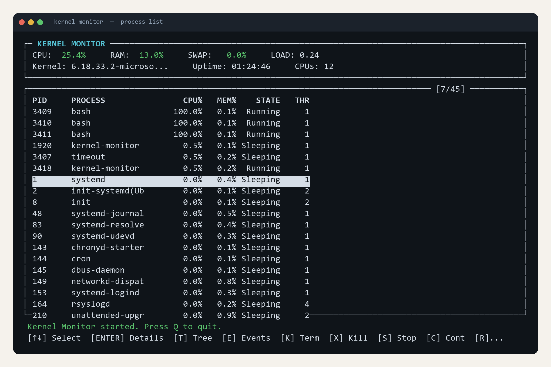
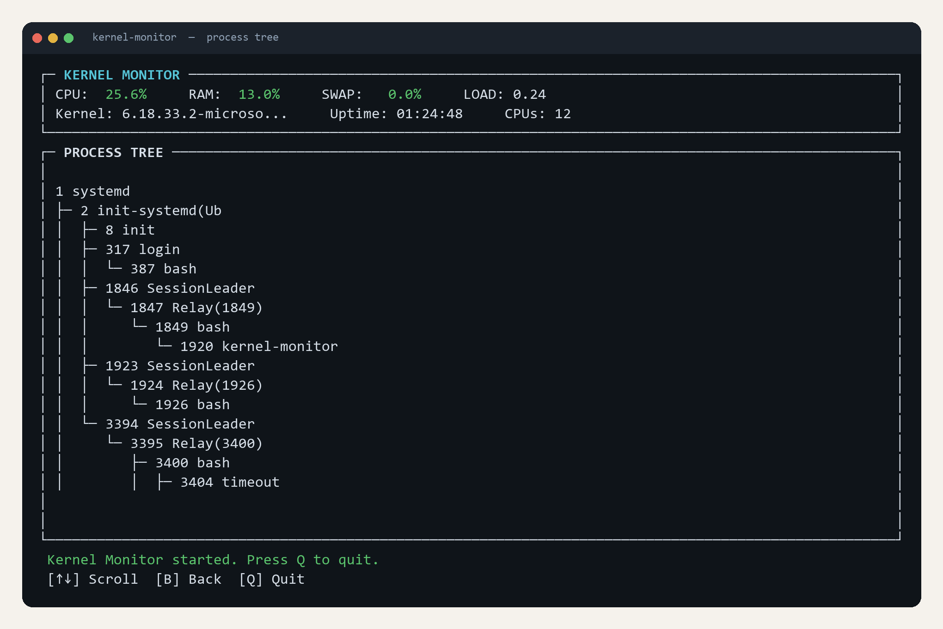
FIG. 16 / OUTPUT
The running program
Captured from the build in this repository, not mocked up.
PROCESS TREE
Rebuilt each refresh from every process's PPID. The corner glyph marks the final child of a parent, so subtrees are separable by eye.
PROCESS LIST
Sorted by CPU%, ties broken by PID so idle rows hold position. The highlighted row follows its process, not its row number.
OUTPUT
17 / 23

Slide 18
FIG. 17 / RESULTS
Measured, not estimated
Taken from the running binary under four busy-loop processes.
0.30
3.6
2.82
3.9
2
60
PERCENT
MEGABYTES
MILLISECONDS
MILLISECONDS
THREADS
KILOBYTES
Own CPU use, sampled over 10 s
Resident memory, 77.5 MB virtual
Mean /proc scan, 37 processes
Worst scan in 20 runs
Main plus collector, 3 descriptors
Binary on disk
DERIVED, NOT MEASURED
CONFIRMED BEHAVIOUR
The scan divides to 0.076 ms per process, so a 200-process desktop extrapolates to roughly 15 ms and a 500-process server to roughly 38 ms. Both figures are arithmetic, not observations: this test environment runs 37 to 49 processes, so a larger machine has not been measured.
Event log retains the last 100 entries
Refresh interval adjustable 500 ms to 10 s
A single-threaded busy loop reads exactly 100.0%
That reading is unchanged at 2 s, 3 s and 4 s intervals
RESULTS
18 / 23

Slide 19
FIG. 18 / ENGINEERING NOTE
Two defects worth reporting
Found by measuring the program rather than by reading it.
The display was unreadable
Every CPU% was doubled
ncurses keeps a virtual screen and a record of the physical one, and writes only the differing cells. The code called clear() every frame, which sets clearok and discards that diff, then refreshed stdscr after its four subwindows, painting blank over the content just drawn. Blank, content, blank, ten times a second.
CPU percentage is a rate, but the divisor was the literal constant 1.0 second with a comment conceding it should track real time. Once the interval became adjustable, a single-threaded busy loop reported 206%, and at a 10 s interval it would have read ten times over. It now measures the actual gap between samples.
HOW THE SORT FIX WAS PROVEN · TWO FRAMES, THREE SECONDS APART
422 bash 100.0% 422 bash 100.0%
423 bash 100.0% 423 bash 100.0%
1 systemd 0.0% 1 systemd 0.0%
2 init 0.0% 2 init 0.0%
48 systemd-j 0.0% 48 systemd-j 0.0%
qsort is not stable, and /proc returns processes in readdir order, so the dozens of rows sitting at 0.0% swapped places on every tick. Breaking ties by PID holds them still, and the two frames above are then identical except for the values that genuinely moved. The same instability moved the highlight onto the wrong process, so K could have signalled something the operator was not pointing at.
ENGINEERING NOTE
19 / 23

Slide 20
FIG. 19 / ADVANTAGES AND APPLICATIONS
Why this is more than a class exercise
ADVANTAGES
APPLICATIONS
01
Makes scheduling and process behaviour directly observable
01
Teaching aid for OS labs, with nine runnable demonstrations
02
Every metric traces to a readable line of code, nothing is opaque
02
Live demonstration of zombie and orphan conditions
03
Monitoring and control in one lightweight tool
03
Quick diagnostic for spotting a runaway or stuck process
04
Measured overhead of 0.30% CPU and 3.6 MB resident
04
Reference implementation for /proc-based systems programming
05
No privileges required: no module, no driver, no root
05
Starting point for more advanced monitoring utilities
ADVANTAGES
20 / 23

Slide 21
FIG. 20 / CONCLUSION
A small tool that makes
the kernel legible
CO-1 2
Reads kernel state through open and read, and reports every process state
The project implements a working Linux process and system monitor in C. It reads live kernel state through /proc, computes CPU, memory and load metrics from timed samples on a collector thread, tracks process lifecycle events, and gives the operator direct signal-based control, all through one interactive terminal interface.
CO-3
Sends four signals, handles two, and runs pipes, FIFOs and job control
CO-4 5
Shows page faults, demand paging, copy-on-write, inodes and mmap
CO-6
Runs a collector thread with a mutex, and shows races and deadlock
CONCLUSION
21 / 23

Slide 22
FIG. 21 / FUTURE SCOPE
Where it goes next
Ideas that follow directly from the current design.
01
Live per-core rates
02
Network and disk I/O
Per-core figures are averages since boot; keep a previous sample per core for live rates.
Extend the same /proc reading to per-process io and net statistics.
03
Historical series
04
Search and filtering
Retain samples over a session and draw trend sparklines per process.
Filter the list by name, state or user, and target signals more precisely.
05
Process memory map
06
Overhead comparison
Show each region of /proc/[pid]/maps for the selected process.
Benchmark this monitor's own cost against top and htop on equal footing.
FUTURE SCOPE
22 / 23

Slide 23
Thank you
Questions and discussion
KERNEL MONITOR · TEAM 19 · SECTION 02
OPERATING SYSTEMS AND SYSTEMS PROGRAMMING · 25CS2104E
github.com/Cyanexani/2520030184_053_558-OSSP
END
23 / 23

