Slide 1
Session #1 – Getting Started
Character Encoding, Linux (Shell)
Notes:
As we said, the challenges are often specific in category such as web challenge or crypto challenge, and we will get into this. In the meantime, we want to cover some basics.

Slide 2
Character Encoding
“Translation” of data
F | T | C | ASCII text
0100 0110 | 0101 0100 | 0100 0011 | Binary
70 | 84 | 67 | Decimal
0x46 | 0x54 | 0x43 | Hexadecimal
L | L | U | N | ASCII text
0100 1100 | 0100 1100 | 0101 0101 | 0100 1110 | Binary
76 | 76 | 85 | 78 | Decimal
0x4C | 0x4C | 0x55 | 0x4E | Hexadecimal
Notes:
We can think of computer encoding as different ways to think of data. It all comes down to 0 and 1 in the end, but there are multiple ways to get there.
ASCII – There are 128 specific characters encoded to seven bit integers.

Slide 3
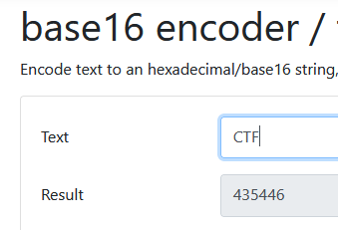
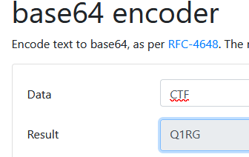
Character Encoding
ASCII text
C
T
F
ASCII to Hex
43
54
46
ASCII to Binary
01000011
01010100
01000110
ASCII to Binary
010000110101010001000110
6-bit Base64
010000
110101
010001
000110
Base64 Encoding
Q
1
R
G
Notes:
Base 16 encoding – hex - https://simplycalc.com/base16-encode.php
Base 64 encoding - https://simplycalc.com/base64-encode.php

Slide 4
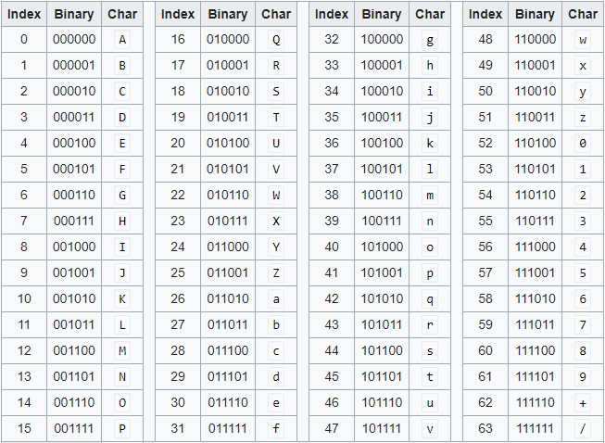
Base64
Notes:
https://en.wikipedia.org/wiki/Base64

Slide 5
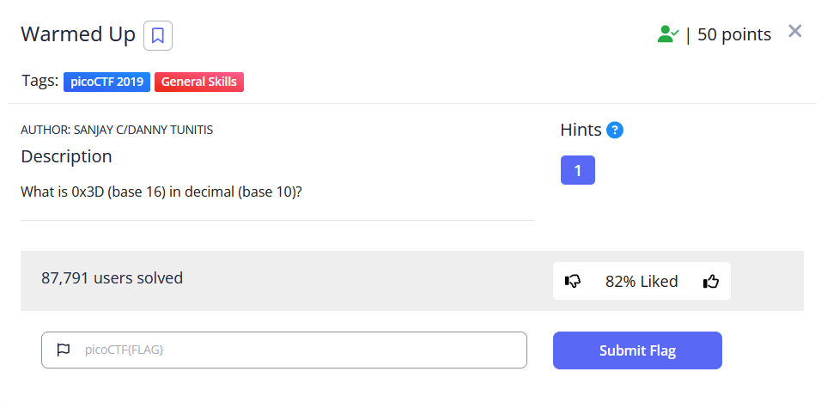
Example - Encoding
Notes:
Answer: 0x3D = 61 in decimal
This is an exercise challenge. We can come across encoding in many CTF challenges.

Slide 6
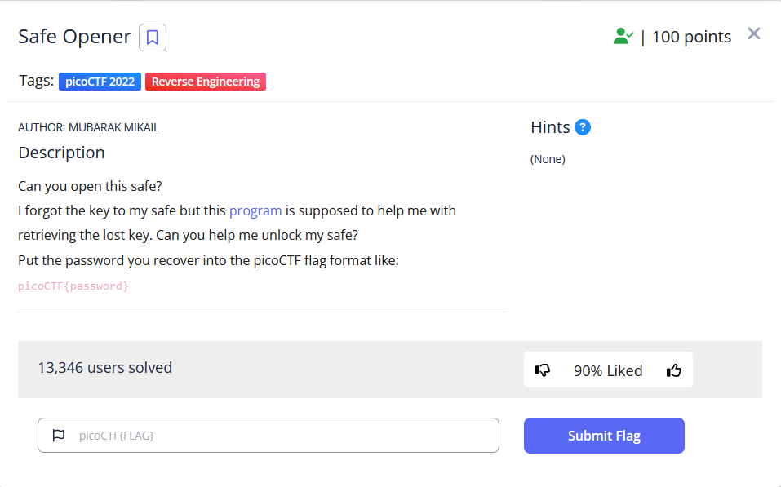
Example - Encoding

Slide 7
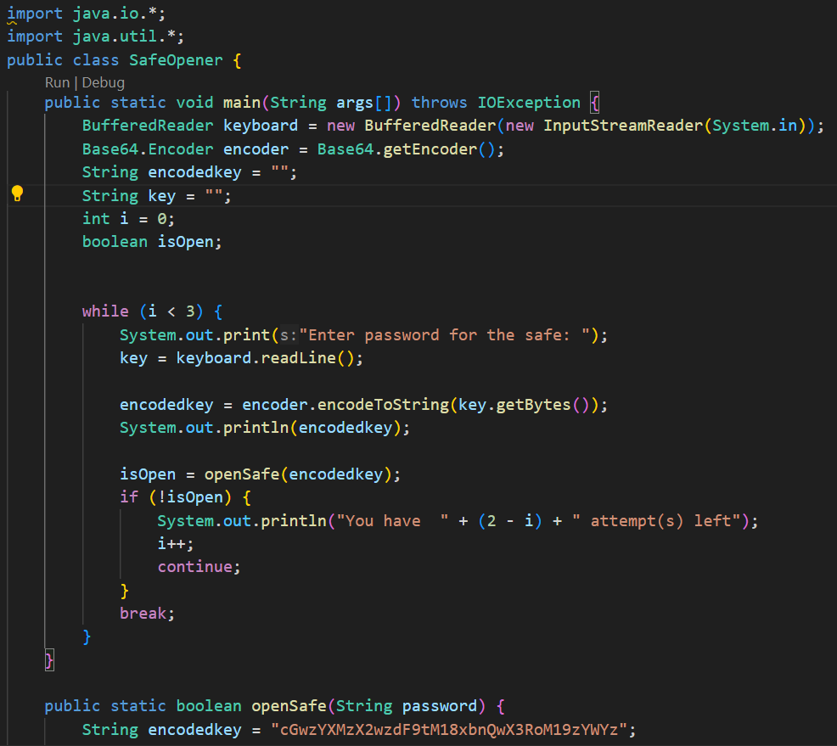
Notes:
This is the program we get. We can see the encoder is Base64 encoder. And we have the encoded key in method “openSafe”.

Slide 8
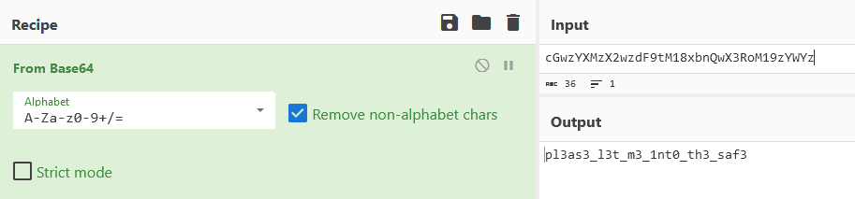
Notes:
https://gchq.github.io/CyberChef/

Slide 9
Linux
Linux is open source and free to use
A lot of tools are only available on Linux
Notes:
We won’t teach you Linux; but we want you to be comfortable using it.
CS Courses: Introduction to Systems Programming, Operating Systems, Computer Organization

Slide 10
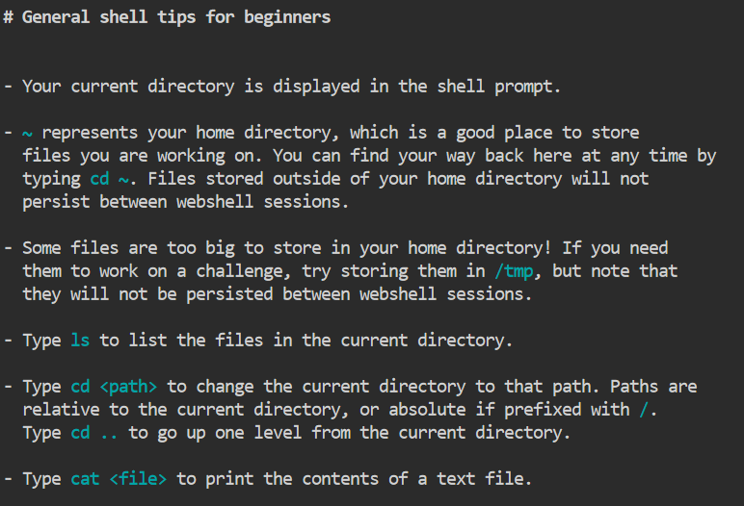
Linux Shell
Notes:
We won’t teach you Linux; but we want you to be comfortable using it.
CS Courses: Introduction to Systems Programming, Operating Systems, Computer Organization
We don’t want you to install anything yet; for now we recommend using the webshell in picoCTF.
https://webshell.picoctf.org/
Common commands: pwd, cd, ls, cat, file, grep, chmod, wget

Slide 11
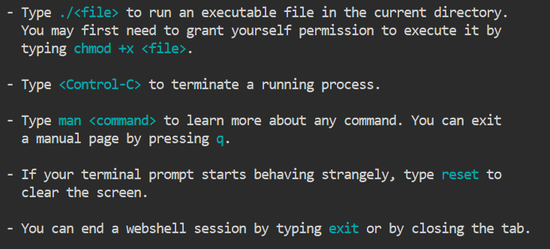
Linux Shell
Notes:
We don’t want you to install anything yet; for now we recommend using the webshell in picoCTF.
https://webshell.picoctf.org/
Common commands: pwd, cd, ls, cat, file, grep, chmod, wget

Slide 12
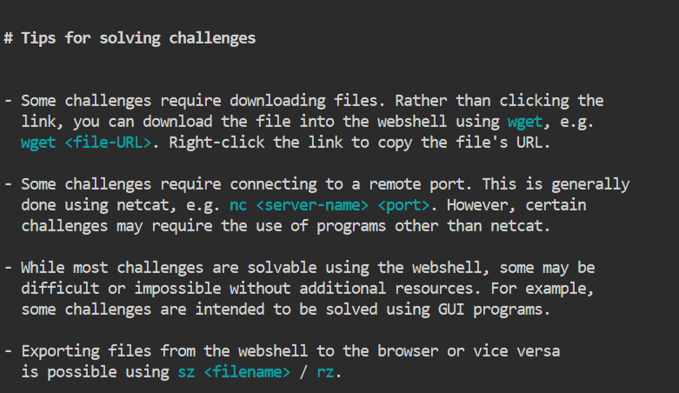
Linux Shell
Notes:
We don’t want you to install anything yet; for now we recommend using the webshell in picoCTF.
https://webshell.picoctf.org/
Common commands: pwd, cd, ls, cat, file, grep, chmod, wget

Slide 13
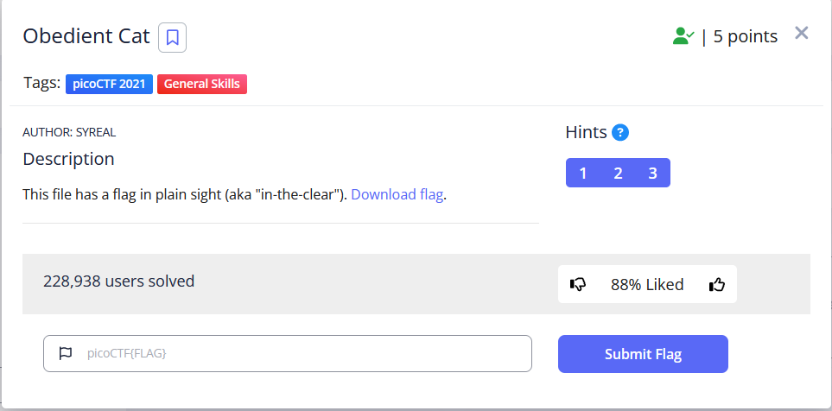
Example

Slide 14
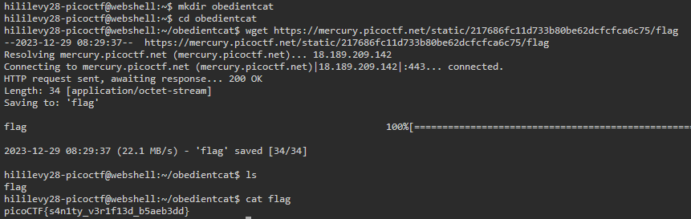
Example
Notes:
https://webshell.picoctf.org/
https://play.picoctf.org/practice/challenge/147?page=1
Will try to do live, this is backup in case it fails.

Slide 15




Let’s practice!
https://picoctf.org/
https://overthewire.org/wargames/bandit/
Notes:
Each session, we will suggest one or more resources for you to practice.
Picogym – sign up to the picoCTF website; go to “practice”. Filter to the event “Beginner picoMini 2022” and go through the challenges (or filter to category “General Skills”).
Bandit – go on the website and follow the instructions. You can use ssh on powershell without having to install anything.

Slide 16
Let’s practice!
Temporary logo placeholder
https://cyanivde.github.io/technion-ctf/
Notes:
Each session, we will suggest one or more resources for you to practice.
Picogym – sign up to the picoCTF website; go to “practice”. Filter to the event “Beginner picoMini 2022” and go through the challenges (or filter to category “General Skills”).
Bandit – go on the website and follow the instructions. You can use ssh on powershell without having to install anything.

