Slide 1
Session #3 – Forensics and Networks

Slide 2
Kali Linux
Cybersecurity-focused operating system
Designed for network analysts, penetration testers, etc.
Has lots of useful tools for CTFs
We’ll start using it today! ☺
Installation guide:
https://technionctf.com/installation/

Slide 3
Digital Forensics
Typical forensics challenges in CTFs revolve around…
Finding hidden information in files
Analyzing digital traces (system logs, network traffic, browser history, etc.)
🕵️

Slide 4
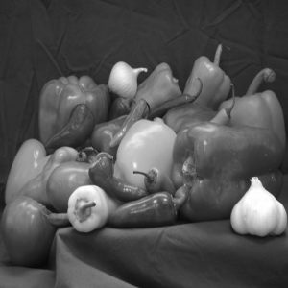

Can you spot the difference?
This is Least Significant Bit (LSB) steganography
The LSB of each pixel is modified to hide a message

Slide 5
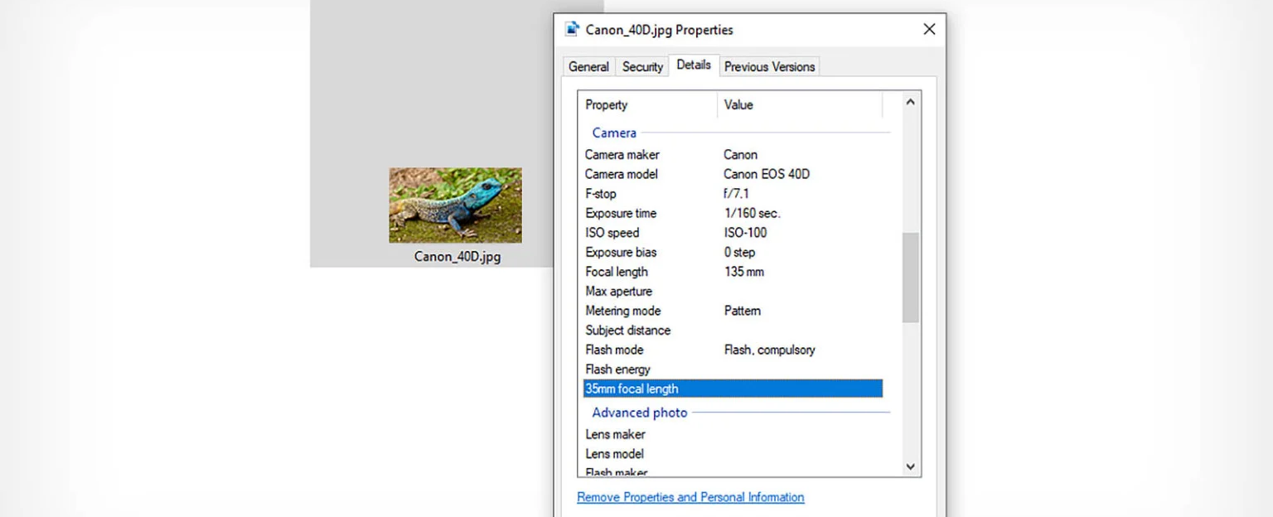
File metadata
Additional data about a file, stored within the file
Example: EXIF – image metadata

Slide 6

The “file” command
Identify a file’s format
According to “magic bytes” – for example, zip files begin with “50 4B 03 04”
More reliable than file extensions
Could still be misleading

Slide 7
Other useful tools
strings – print all strings in a file
At least 4 consecutive printable characters
binwalk – search for embedded files in a file
exiftool – print EXIF data of a file

Slide 8
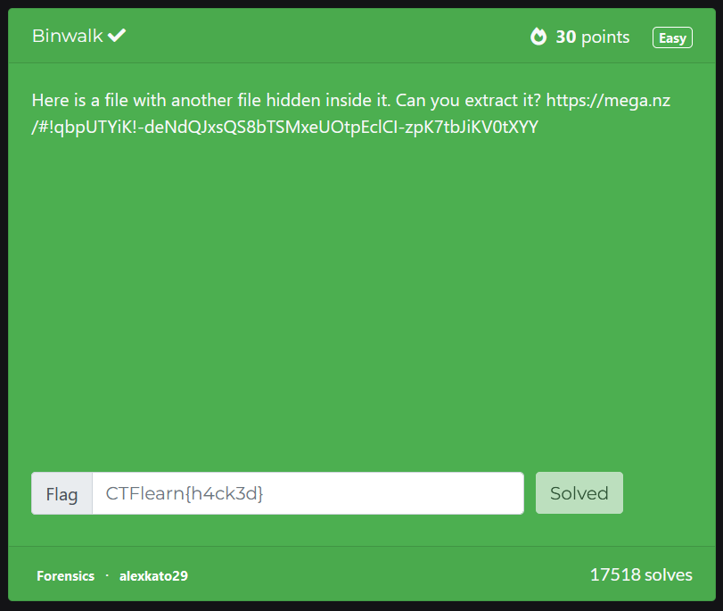
Demo
Notes:
https://ctflearn.com/challenge/108

Slide 9
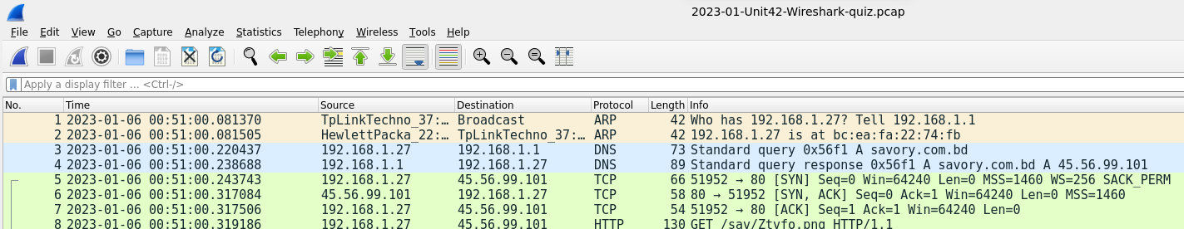
Packet capture analysis
Some forensics challenges present packet capture (.pcap) files
These are recordings of network traffic
Can be analyzed in Wireshark
Each row represents a single packet sent/received

Slide 10
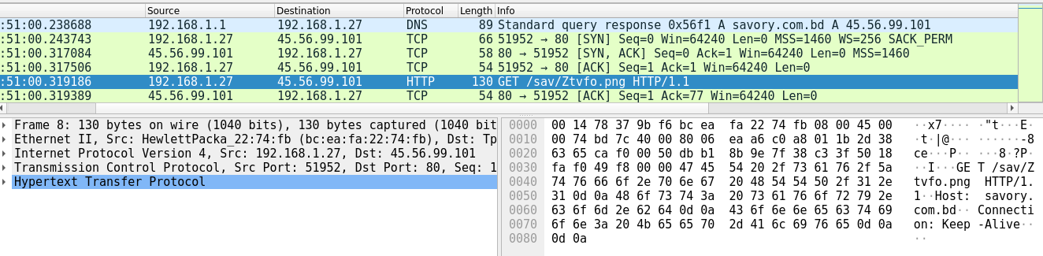
Computer Networks 101
Devices communicates in packets
Packets are written according to protocols in numerous layers
The selected packet is HTTP (over TCP over IP over Ethernet)

Slide 11
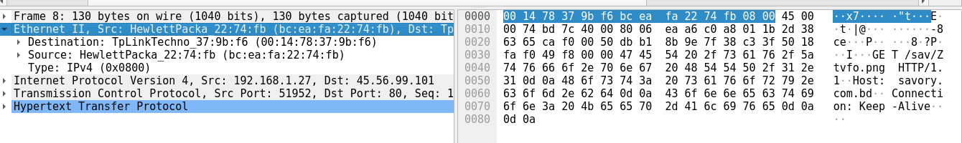
Computer Networks 101 – Layer 2
Enables transferring data between adjacent devices
Uses MAC addresses
Each device* has a fixed, permeant, unique MAC address
Common layer 2 protocols: Ethernet, 802.11 (Wi-Fi)
* Actually, each network interface controller (NIC). Therefore, a device can have more than one MAC address.

Slide 12
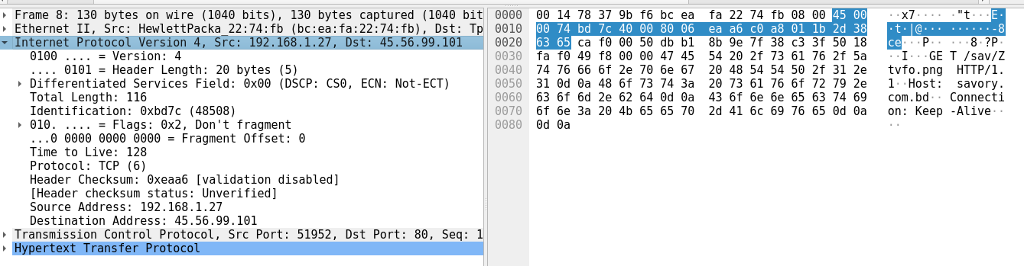
Computer Networks 101 – Layer 3
Enables transferring data between distant devices
Uses IP addresses
Each device* has a (potentially) non-unique, temporary IP address
Common layer 3 protocol: IP
* Same here: each network interface controller (NIC), and a device can have more than one IP address.

Slide 13
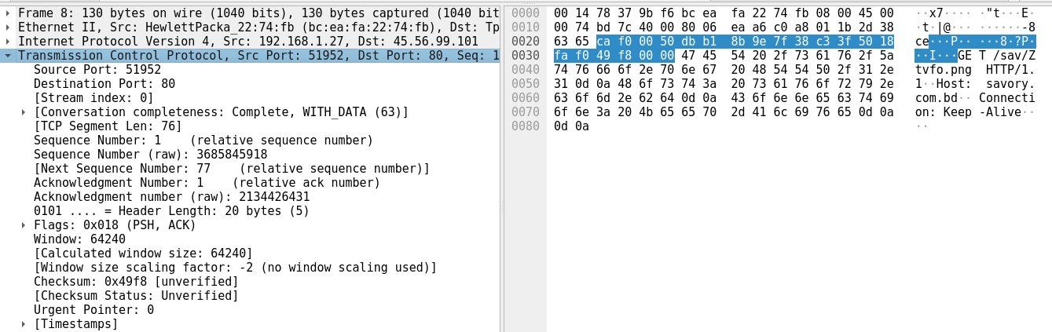
Computer Networks 101 – Layer 4
Enables having separate conversations between two devices
Uses ports
Common layer 4 protocols: TCP, UDP

Slide 14
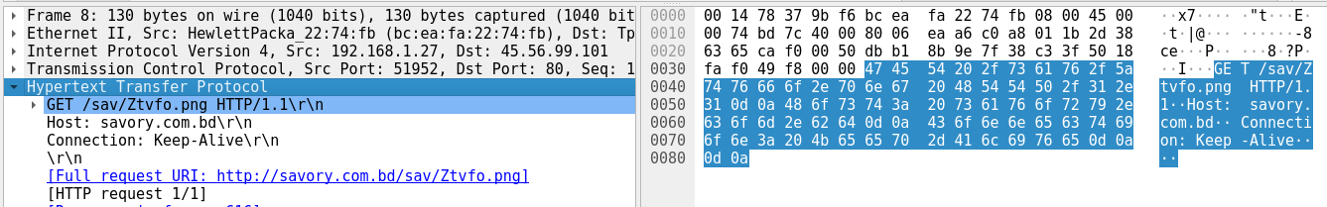
Computer Networks 101 – Layer 5
The application itself
Common layer 5 protocols: HTTP, DNS, SSH, SMTP, FTP, …

Slide 15
Let’s practice!

