Slide 1


Session #1
Introduction
Winter 2024/25

Slide 2
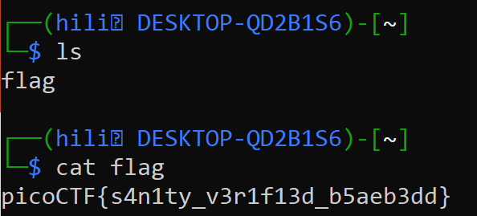
What is CTF?
“Capture The Flag” - Cybersecurity competition
Objective – find "flags" (strings of text) that are hidden in different and creative ways.
Highly technical
01 Introduction

Slide 3
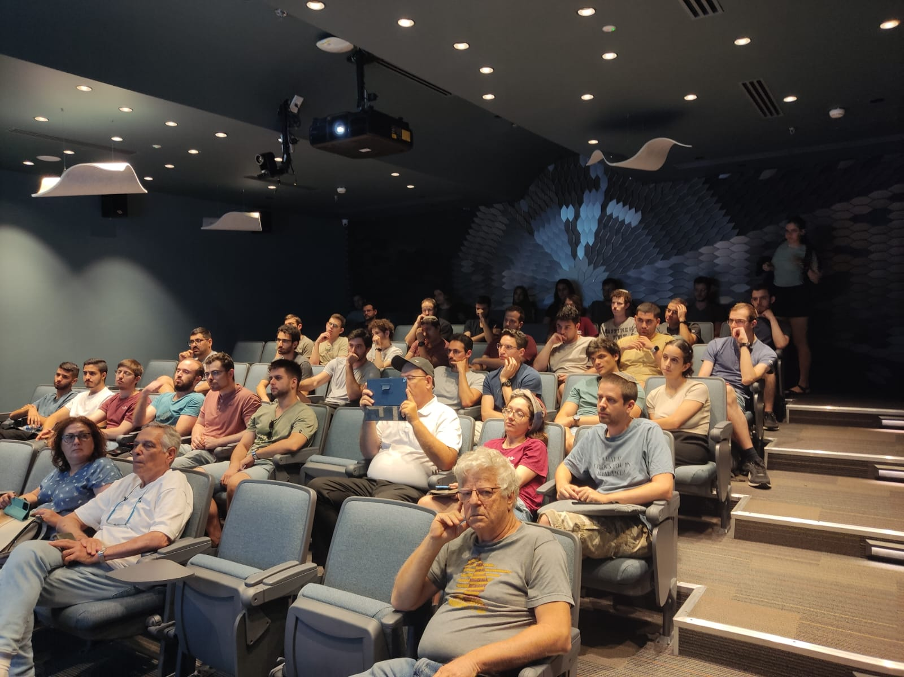

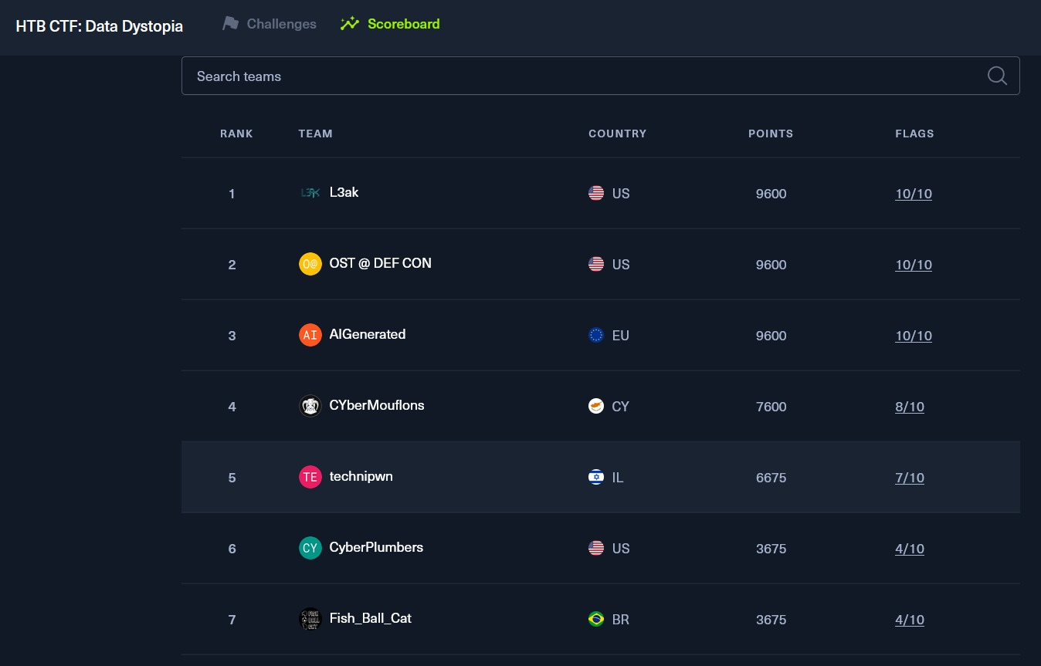
Meeting, Competitions, FUN
01 Introduction

Slide 4


Schedule
Weekly meetings! Every Tuesday, 18:30-20:00
Competitions
Topics Up Head
Web
Cryptography
Reverse Engineering
Binary exploitation (pwn)
Guest lectures
And MORE!
02 Introduction

Slide 5


Website
technionctf.com
01 Introduction

Slide 6
Keynote – Prof. Avi Mendelson & Prof. Eli Biham
03 Introduction

Slide 7

Practice Time
Beginners

Slide 8
picoCTF
https://play.picoctf.org/classrooms
Classroom code: CyqXSMIoR
Press on 'Practice' -> 'Assignments' -> 'Week 1'
Do 'wget' in PicoCTF Webshell if download doesn't work
03 Introduction

Slide 9
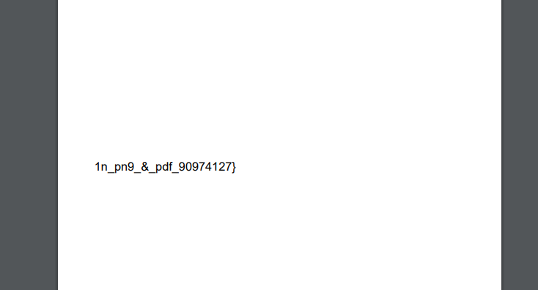
Secret of the Polyglot - Problem
You are presented with a file that functions as a polyglot
Meaning it is designed to be interpreted by multiple programming languages
The challenge is to analyze this file and extract the hidden flag embedded within it
03 Introduction

Slide 10
Secret of the Polyglot - Solution
Examine the File Content
Open the file in a text editor to identify which programming languages are present
Check for the file data and format using the terminal
03 Introduction

Slide 11
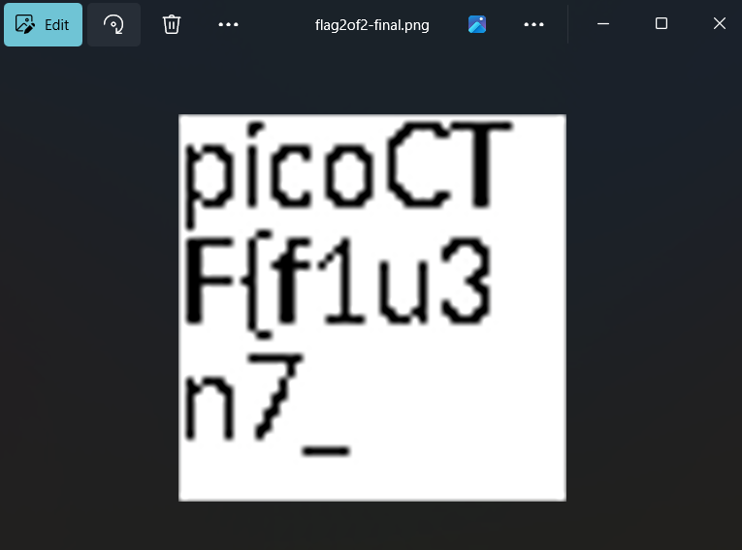
Secret of the Polyglot - Solution
Update the format of the file according to meta-data.
Locate the Flag:
Search for text matching the flag format picoCTF{...}.
03 Introduction

Slide 12
Binary search
Problem
Guess the chosen number
Solution
Connect to the server via ssh
Start guessing numbers using binary search
Success!
03 Introduction

Slide 13
CanYouSee
Problem
Connect via ssh and find the flag
Solution
Use exiftool to read meta-data of flag file
Decode suspicious field 'AttributionURL' from base64
How did we know it is base64? The field had the char '=', which is common is base64 encodings. It is worth a try.
03 Introduction

Slide 14
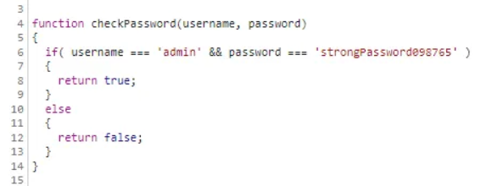
Local Authority
Problem
Find the flag!
Solution
The login check is in the browser, and the credentials are being checked there.
03 Introduction

Slide 15
Big Zip
Link to a solution – using grep
https://medium.com/@technolifts/picoctf-big-zip-walkthrough-general-skills-8b44f37d0990
03 Introduction

Slide 16
Super SSH
Link to a solution -
https://medium.com/@technolifts/picoctf-big-zip-walkthrough-general-skills-8b44f37d0990
03 Introduction

Slide 17
Practice Time
Advanced

Slide 18
SansAlpha
Problem: We are given a shell that only accepts characters and numbers, and we need to find a flag file and somehow print it.
Solution: Use bash wildcards (?, *, [], [!]) to gain information about the files and directories in the system, find the flag, and find a way to print it. We try different of ?'s in every directory that we find interesting.
03 Introduction

Slide 19
Operation orchid
Problem: We are given a disk image and our task is to find the flag hidden inside of it.
Solution: Using tools from the SleuthKit collection, we can examine the disk's partitions to find the offset of the relevant partition, copy the encrypted flag file to our machine based on it's inode, and find out the encryption key in the commands history file.
03 Introduction

Slide 20
Next Week...
web exploitation

