Slide 1


Session #2
Web Exploitation
SQL Injection
Winter 2024/25

Slide 2
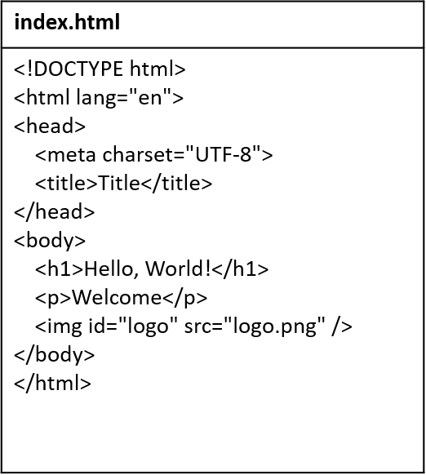
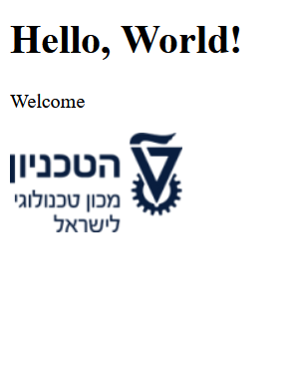
HTML
The language for the content of websites
02 Understanding Cross-Site Scripting (XSS)

Slide 3
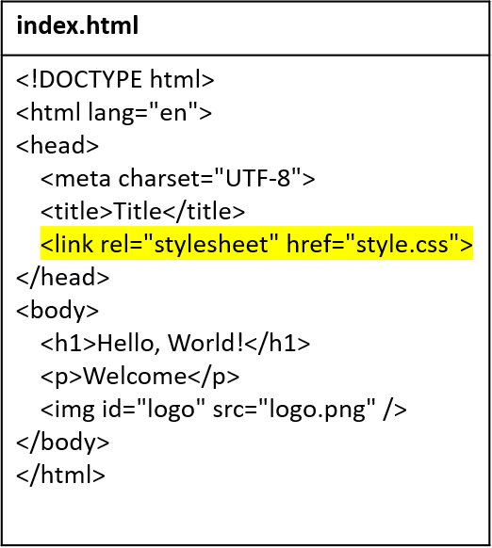
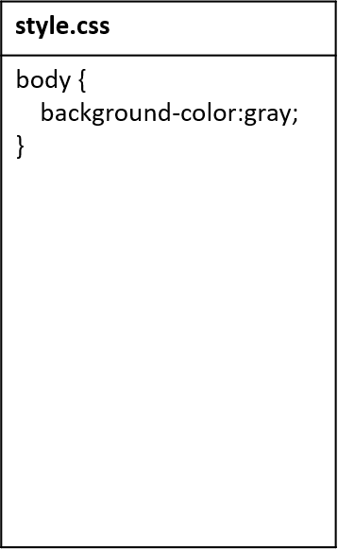
CSS
The language for the style of websites
02 Understanding Cross-Site Scripting (XSS)

Slide 4
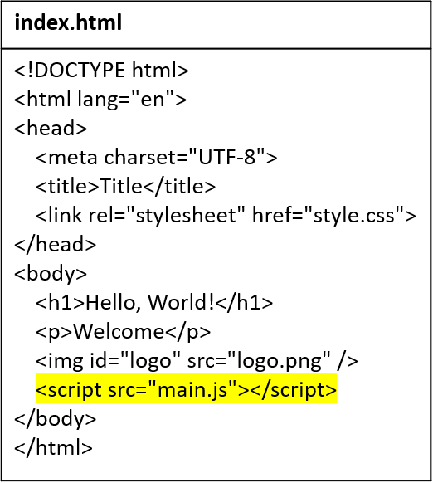
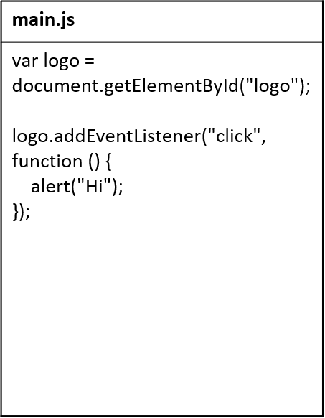
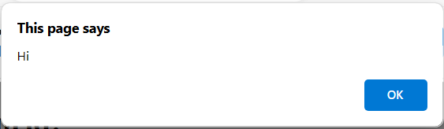

JavaScript
The language for the behavior of websites
02 Understanding Cross-Site Scripting (XSS)

Slide 5

Web browser
An application for browsing websites
Knows how to…
Display web files (HTML, CSS, JS) on the user’s screen
Request web files from web servers
Store the user’s information (bookmarks, passwords, cookies, …)
02 Understanding Cross-Site Scripting (XSS)

Slide 6
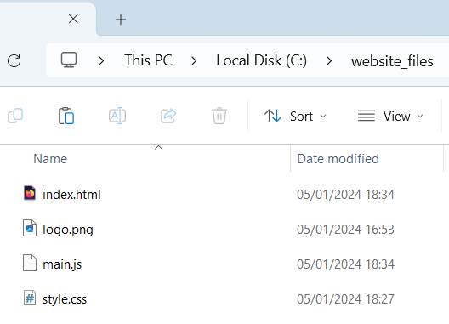


Web server
A server that provides a website’s files (HTML, CSS, JS, …) to clients
Example: starting a web server in Python
python -m http.server -d c:\website_files
This web server simply provides whichever file the client requests
GET /main.js
main.js
02 Understanding Cross-Site Scripting (XSS)

Slide 7
HTTP
The main protocol for communication with web servers
Basic aspects:
Client sends HTTP request → server sends HTTP response
HTTP is stateless
Requests and responses have headers and body
02 Understanding Cross-Site Scripting (XSS)

Slide 8

What is Web Exploitation?
The process of exploiting vulnerabilities in web applications.
A major risk to data integrity, privacy, and user trust.
01 Introduction

Slide 9
Common Web Exploitation Techniques
SQL Injection (SQLi): Manipulating database queries through user input (this week).
Cross-Site Scripting (XSS): Injecting malicious scripts into web pages (next week).
Cross-Site Request Forgery (CSRF): Forcing users to execute unwanted actions.
File Inclusion: Gaining unauthorized access via file paths.
01 Introduction

Slide 10
SQL Injection - Intro
SQL is a query language, which can use user's input.
Example SQL query – returns all the users that have 'foo' username and 'bar' password:
SELECT * FROM Users
WHERE username = 'foo' AND password = 'bar'
Malicious users can exploit that and break the logic of the query.
01 Introduction

Slide 11
SQL Injection - Attack
Example SQL query:
SELECT * FROM Users
WHERE username = Param1 AND password=Param2
If a user submits:
username: ' OR 1=1 --
password: Anything
Then the query will be:
SELECT * FROM Users
WHERE username = '' OR 1=1 -- AND password = Anything
01 Introduction

Slide 12
SQL Injection - Results
The injected query:
SELECT * FROM Users
WHERE username = '' OR 1=1 -- AND password = Anything
Now, the query will return all users, because 1=1 is always true.
The malicious user can use it to login, steal information, or access and delete the database.
01 Introduction

Slide 13
SQL Injection – More information
You can use '--' sign for commenting the rest of the query in most SQL versions.
SQL injections can get very complex and do a lot of things. In this meeting we would only beginner's level labs.
SQL Injection Cheast Sheet
01 Introduction

Slide 14
SQL Injection – More information
Demo 1 – Hack into admin account
Demo 2 – Get hidden information
01 Introduction

Slide 15

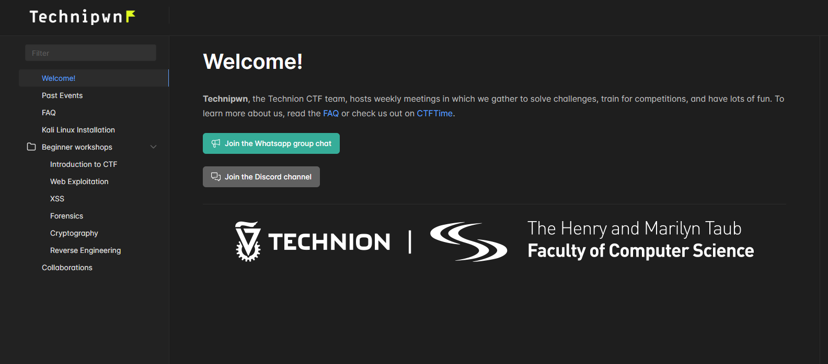
Website
technionctf.com
01 Introduction

Slide 16

Practice Time
Beginners | Advanced

Slide 17
Next Week...
web exploitation

