Slide 1


Understanding Cross-Site Scripting (XSS)
What It Is, How It Works, and How to Prevent It
Winter 2024/25

Slide 2
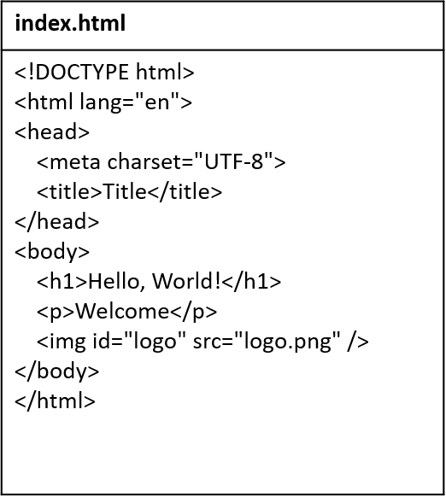
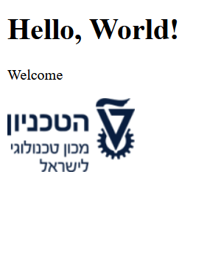
HTML
The language for the content of websites
02 Understanding Cross-Site Scripting (XSS)

Slide 3
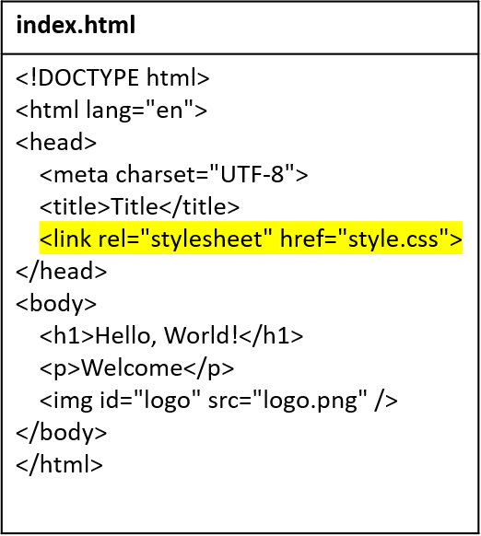
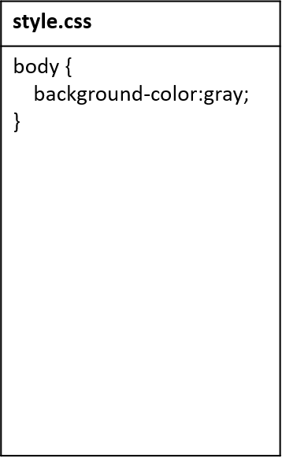
CSS
The language for the style of websites
02 Understanding Cross-Site Scripting (XSS)

Slide 4
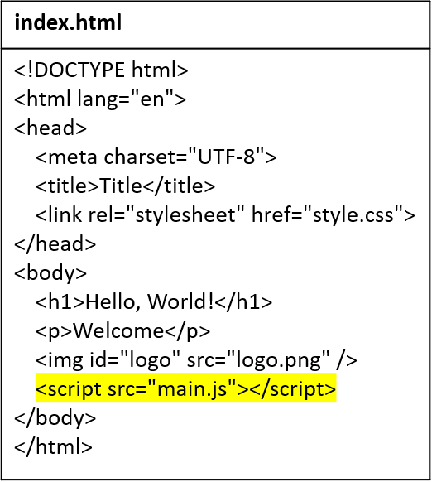
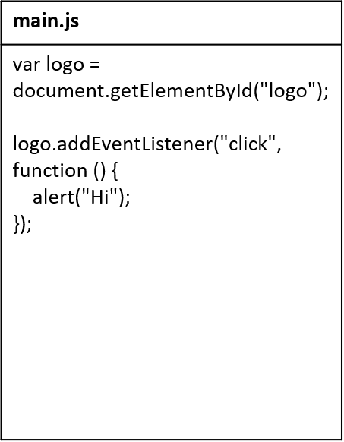
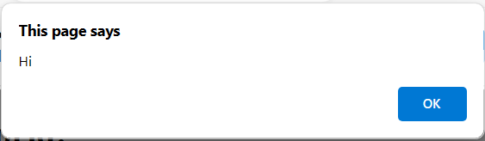

JavaScript
The language for the behavior of websites
02 Understanding Cross-Site Scripting (XSS)

Slide 5

Web browser
An application for browsing websites
Knows how to…
Display web files (HTML, CSS, JS) on the user’s screen
Request web files from web servers
Store the user’s information (bookmarks, passwords, cookies, …)
02 Understanding Cross-Site Scripting (XSS)

Slide 6
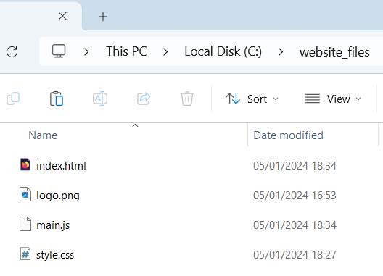


Web server
A server that provides a website’s files (HTML, CSS, JS, …) to clients
Example: starting a web server in Python
python -m http.server -d c:\website_files
This web server simply provides whichever file the client requests
GET /main.js
main.js
02 Understanding Cross-Site Scripting (XSS)

Slide 7
HTTP
The main protocol for communication with web servers
Basic aspects:
Client sends HTTP request → server sends HTTP response
HTTP is stateless
Requests and responses have headers and body
02 Understanding Cross-Site Scripting (XSS)

Slide 8

What is XSS?
XSS – cross-site Scripting
Cross-Site Scripting (XSS) is a type of security vulnerability commonly found in web applications.
It allows attackers to inject malicious scripts into webpages viewed by other users.
These scripts can steal sensitive information, hijack user sessions, and more.
02 Understanding Cross-Site Scripting (XSS)

Slide 9
Types of XSS
Stored XSS
The malicious script is permanently stored on the target server.
For example, A script injected into a comment field that is saved to the database.
Reflected XSS
The malicious script is reflected off a web server.
For example. A script included in a URL parameter and reflected in an error message.
02 Understanding Cross-Site Scripting (XSS)

Slide 10
How XSS Works?
1. Injection
Attacker inputs malicious script: <script>alert('XSS Attack!');</script>
2. Storage\Reflection
Either stored or reflected XSS script
3. Execution
User visits the page, and the script runs in their browser.
4. Impact
Script can steal cookies, redirect users, display fake forms, etc.
02 Understanding Cross-Site Scripting (XSS)

Slide 11
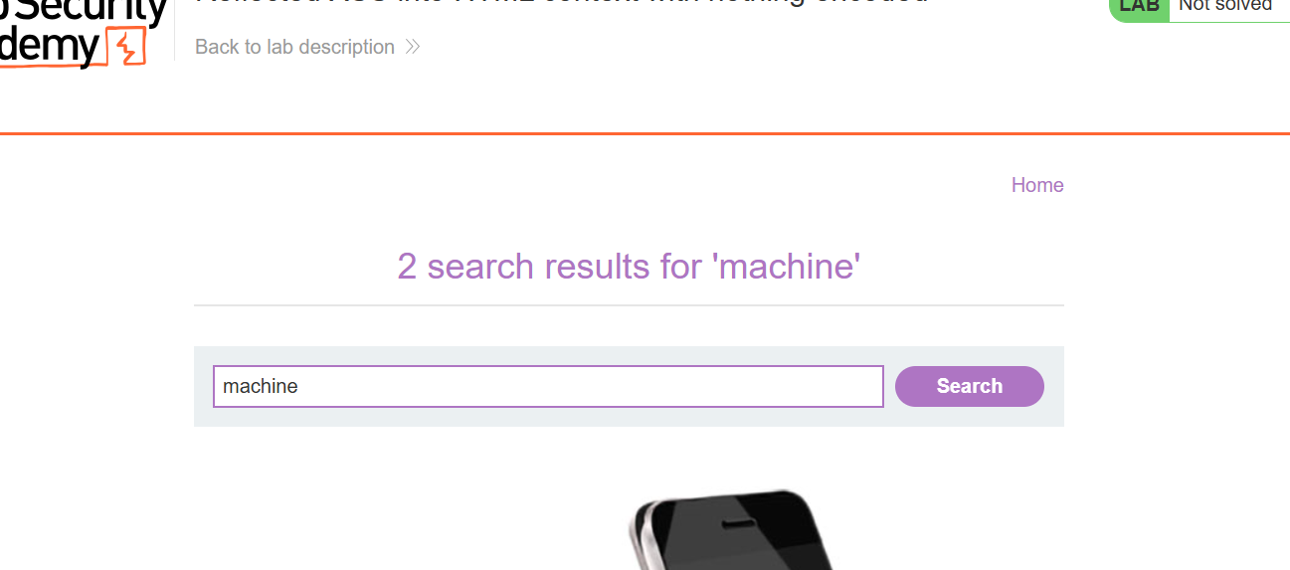
Demo – Reflected XSS Challenge
https://portswigger.net/web-security/cross-site-scripting/reflected/lab-html-context-nothing-encoded
02 Understanding Cross-Site Scripting (XSS)

Slide 12
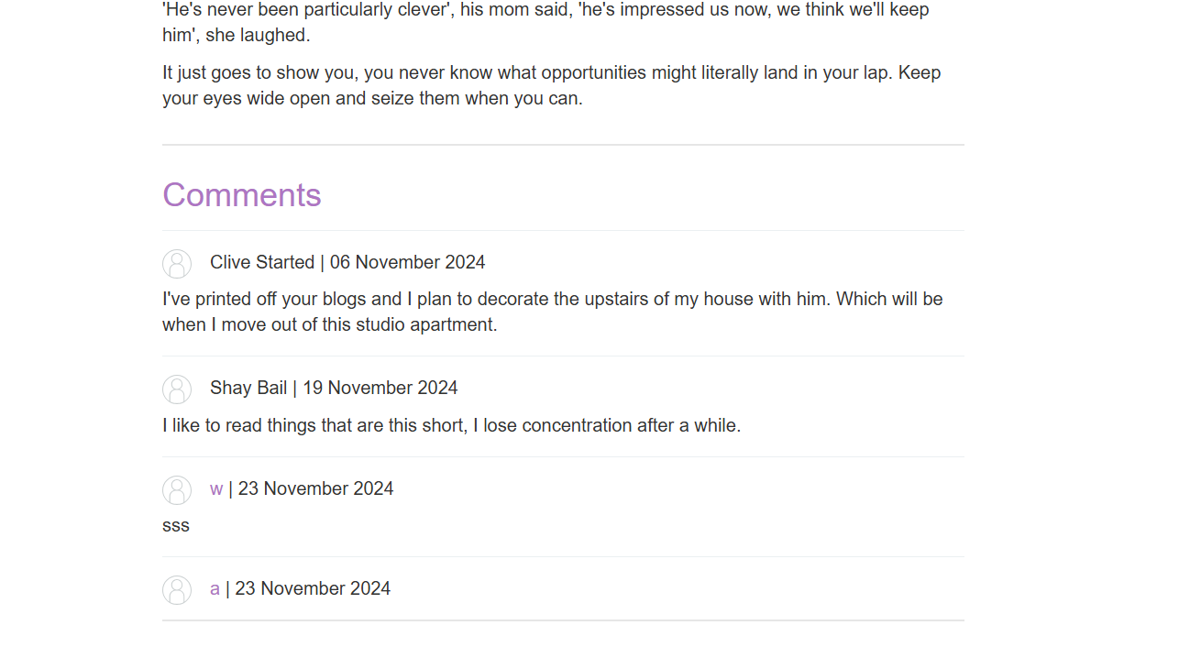
Demo – Stored XSS Challenge
https://portswigger.net/web-security/cross-site-scripting/stored/lab-html-context-nothing-encoded
02 Understanding Cross-Site Scripting (XSS)

Slide 13
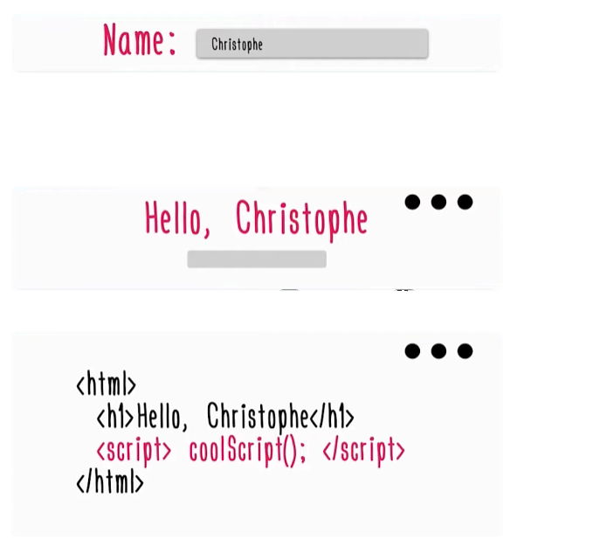
Example
GET http://website.com/page?name=christophe
01 Understanding Cross-Site Scripting (XSS)

Slide 14
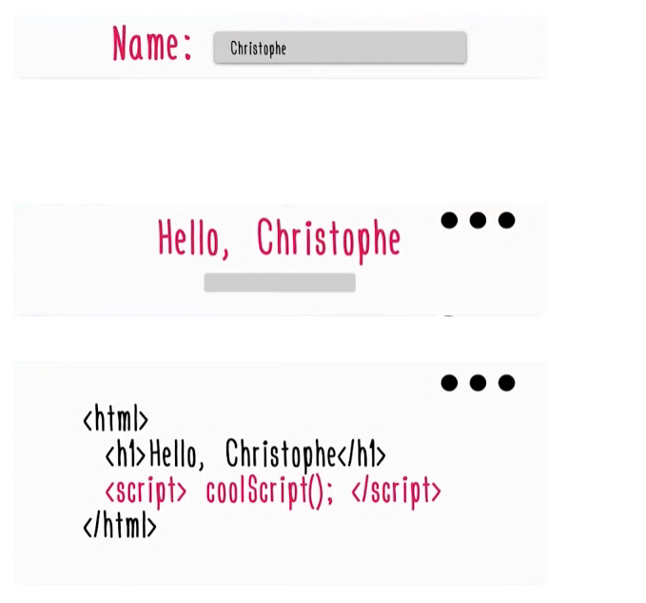
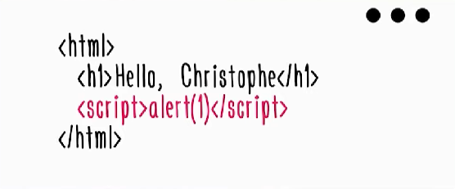
Example
GET http://website.com/page?name=Christophe
</h1><script>alert(1)</script<
Another option:
<img src=x onerror=“alert(1)”>
01 Understanding Cross-Site Scripting (XSS)

Slide 15



Join our whatsapp group!
Join our Discord channel!
Let’s practice!

