Slide 1


Session #6
Forensics
December 2024

Slide 2
What is Forensics?
The art of extracting, analyzing, and interpreting digital evidence from various sources like files, disk images, and memory dumps
Importance:
Understand what happened.
Trace back activities and evidence.
Solve CTF challenges and real-world cases.
🕵️
06 Forensics & Networks

Slide 3
Common Forensics Techniques and Tools
File Analysis
Examine metadata and content of files for clues.
Tools: file, strings, binwalk, exiftool
Memory Forensics
Analyze memory dumps for sensitive data.
Tools: volatility, Rekall
Disk Forensics
Study disk images to recover deleted files and analyze partitions.
Tools: dd, Autopsy
06 Forensics & Networks
Notes:
Fille - Identify a file’s format
According to “magic bytes” – for example, zip files: “50 4B 03 04”
More reliable than file extensions
Could still be misleading
strings – print all strings in a file (Extract readable strings from binary files to find hidden text)
a string = at least 4 consecutive printable characters
binwalk – Analyze binary files for embedded data and firmware extraction
exiftool – print EXIF data of the file (Retrieve metadata from image and document files)
volatility: Framework for analyzing memory dumps and identifying artifacts.
Rekall: Advanced memory analysis and forensics toolkit.
dd: Create exact copies of disk drives for analysis.
Autopsy: Open-source forensic suite for analyzing disk images.

Slide 4
Common Forensics Techniques and Tools
Network Forensics
Trace and analyze packet captures (PCAP files)
Tools: Wireshark
Steganography
Discover hidden data within files or images.
Tools: steghide, zsteg
06 Forensics & Networks
Notes:
Some forensics challenges present packet capture (.pcap) files
Can be analyzed in Wireshark
Wireshark: Capture and analyze network packets for suspicious activity.
Each row represents a single packet sent/received
steghide: Tool to embed and extract data in image and audio files.
zsteg: Analyze PNG and BMP files for hidden information.

Slide 5
Forensics Workflow
Identify Evidence:
Recognize and collect relevant files.
Extract Data:
Use appropriate tools to extract hidden or encoded data.
Analyze Evidence:
Look for patterns, strings, and metadata.
Solve Challenges:
Use findings to answer questions or progress in CTFs.
06 Forensics & Networks

Slide 6
Forensics Workflow
Identify Evidence:
Recognize and collect relevant files.
Extract Data:
Use appropriate tools to extract hidden or encoded data.
Analyze Evidence:
Look for patterns, strings, and metadata.
Solve Challenges:
Use findings to answer questions or progress in CTFs.
06 Forensics & Networks

Slide 7
Example 1 - Metadata Analysis
Task: Examine an image file for hidden information
Tool: exiftool
Sol:
Command: exiftool ./suspicious_image.jpg
Outcome: Reveals metadata like creation time, software used, or embedded comments
06 Forensics & Networks

Slide 8
Example 2 - Steganography
Task: Extract hidden text from an image.
Tool: steghide
Sol:
Command: steghide extract -sf ./_larger_hidden_image.jpg
passphrase: ctfpass
Outcome: Extracts hidden text or files if the correct password is provided
06 Forensics & Networks

Slide 9

Let’s practice!

Slide 10
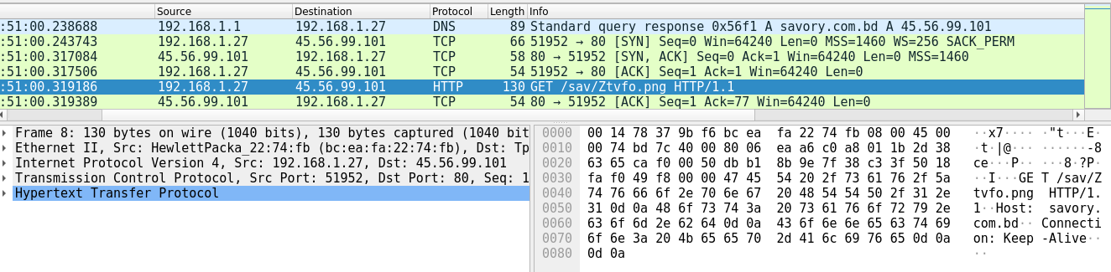
Computer Networks 101
Devices communicates in packets
Packets are written according to protocols
This packet is in HTTP protocol (over TCP, IP, Ethernet)
03 Forensics & Networks

Slide 11
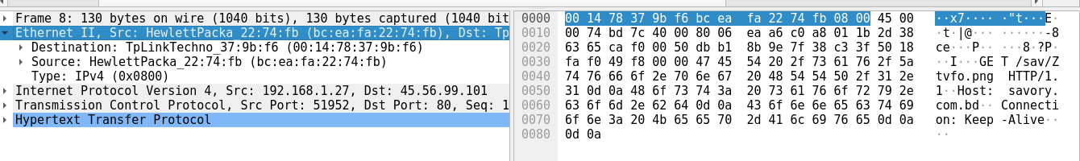
Computer Networks 101 – Layer 2
Provides the ability to transfer data between adjacent devices
Uses MAC addresses
Each device* has a fixed, permanent, unique MAC address
Common layer 2 protocols: Ethernet, 802.11 (Wi-Fi)
03 Forensics & Networks
Notes:
* Actually, each network interface controller (NIC). Therefore, a device can have more than one MAC address.

Slide 12
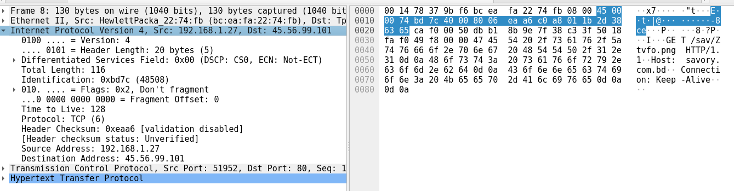
Computer Networks 101 – Layer 3
Provides the ability to transfer data between distant devices
Uses IP addresses
Each device* has a (potentially) non-unique, temporary IP address
Common layer 3 protocol: IP
03 Forensics & Networks
Notes:
* Same here: each network interface controller (NIC), and a device can have more than one IP address.

Slide 13
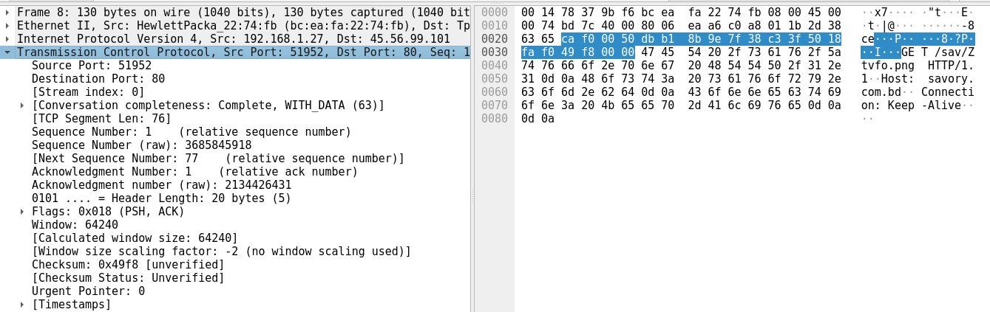
Computer Networks 101 – Layer 4
Provides the ability to have multiple conversations between devices
Uses ports
Common layer 4 protocol: TCP, UDP
03 Forensics & Networks

Slide 14
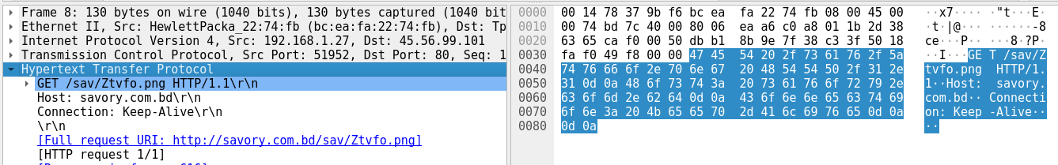
Computer Networks 101 – Layer 5
The application itself
Common layer 5 protocols: HTTP, DNS, SSH, SMTP, FTP
03 Forensics & Networks

