Slide 1
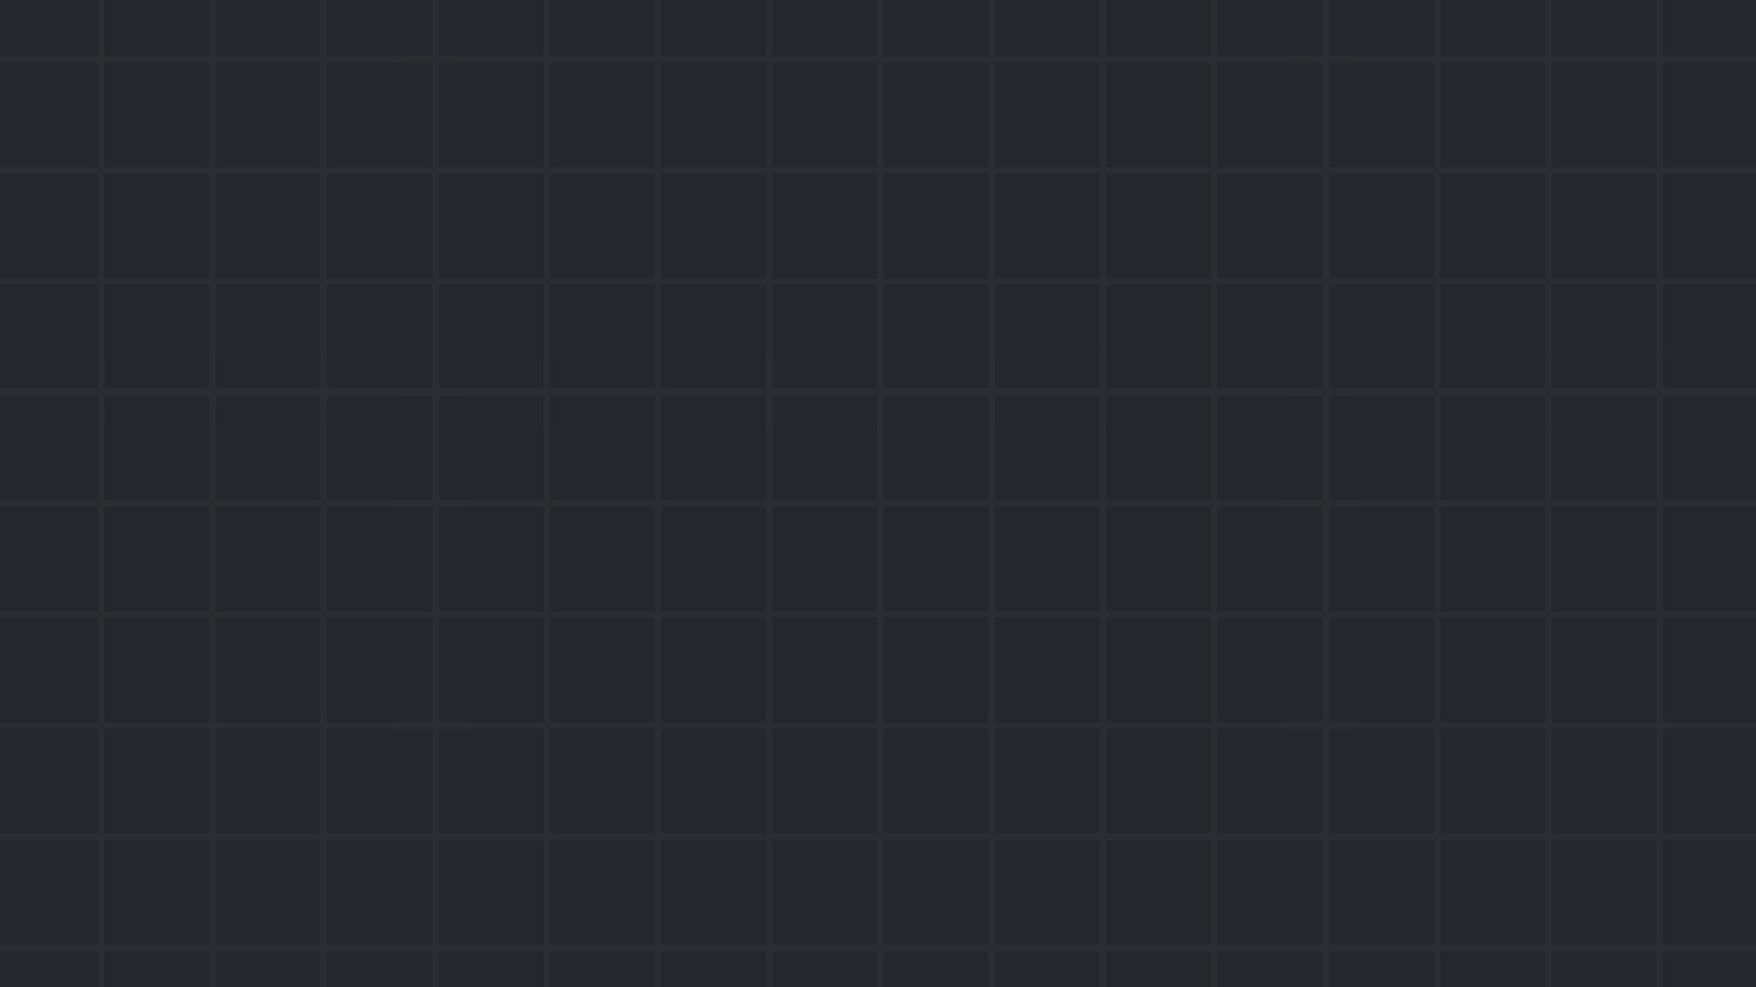

Reverse Engineering
Winter 24/25

Slide 2

Introduction
In reverse engineering challenges, you will usually analyze/modify an executable to reveal the flag.
No source code; only binary
These challenges are designed in such a way that forces the players to understand what the program does.
Common tools
Disassemblers & Decompilers. Used for static analysis - IDA/Ghidra/Radare2/objdump.
Debuggers. Used for dynamic analysis - WinDbg/x64dbg/gdb.
Hex editors. Used for patching or finding patterns - 010 editor/ImHex.
Format specific tools – dnSpy for .NET programs, JADX for android .apk files…
Emulators/Virtual machines – QEMU.
Challenges often require you to find and use a bizarre/absurdly specific tool. Example at the end.
Introduction

Slide 3
Common challenges
Most of the time, as said before, we are given an executable files.
The task is usually to understand the specific input to give to the program in order to receive the flag. This is often called a “flag checker”.
Obviously, in challenges that respect themselves, the flag will not be written in plain text inside the executable.
Instead, the input you enter (after performing a through analysis and understanding the program) will be used as the “key” for the decryption of an encrypted flag.
Common challenges

Slide 4
More common challenges
Keygenme’s – Understand the algorithm a program uses to generate valid keys
Obfuscation – analyze heavily obfuscated code
Patching – modify an executable’s code/data to bypass restriction
More common challenges

Slide 5
Workflow
There is no general path for every specific challenges, but usually reversing can be broken into a couple of steps:
Run the program to get a feel of what is does
Initial insights – file, strings & grep, ltrace (trace library function calls) & strace (trace system calls)
Static analysis – drop the executable file into a disassembler or a decompiler and start reading the code, looking for functions that might be directly related to what the program is trying to do.
Dynamic analysis – After finding some POIs, pop a debugger, set breakpoints and start examining the program start.
Repeat and profit.
Initiation

Slide 6
Examples
A simple crackme
Challenge from HTB CTF @ DC32
Memory forensics - example
Notes:
MSB script

Slide 7

Practice time

Slide 8
Class practice:
https://picoctf.org classroom – assignment “Reverse – Advanced”
https://minesweepergame.com/download/windows-xp-minesweeper.php - Hack minesweeper! Patch the program so when it starts up, all mines are marked with flags.
https://crackmes.one
http://reversing.kr/
https://flare-on.com (There are DigitalWhisper articles (in Hebrew!) that cover the 2021-2024 challenges)
The usual ones, app.hackthebox.com, https://picoctf.org, root-me.org also contain modern CTF style reversing challenges.

