Slide 1


Session #1
Basics
January 2024

Slide 2
Basics – What is CTF?
Common categories:
Web exploitation
Cryptography
Reverse Engineering
Binary Exploitation
Forensics
01 Basics

Slide 3
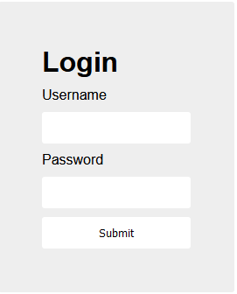
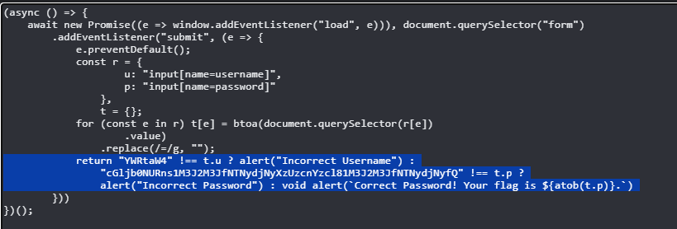
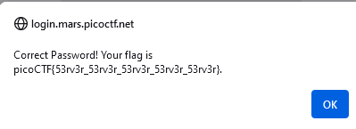
Basics – Web exploitation
02 Basics
Notes:
Picoctf “login”

Slide 4

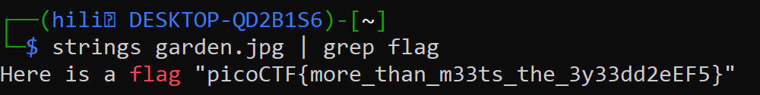
Basics – Forensics and Networks
03 Basics
Notes:
Picoctf “glory of the garden”

Slide 5
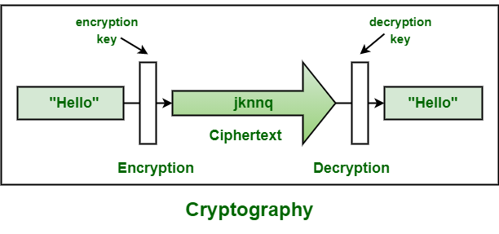
Basics – Cryptography
04 Basics
Notes:
https://www.geeksforgeeks.org/cryptography-tutorial/

Slide 6
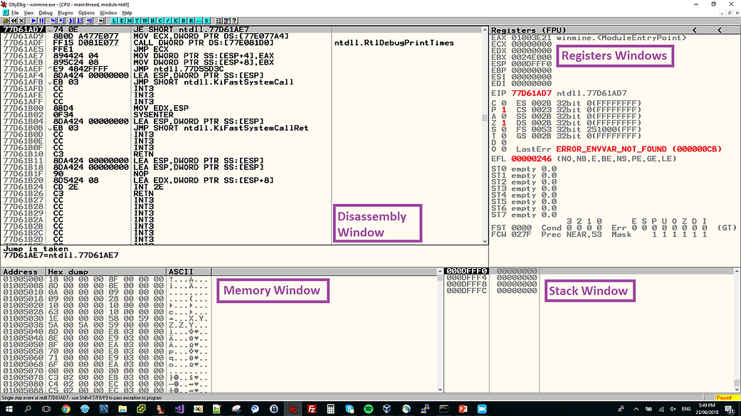
Basics – Reverse Engineering
05 Basics
Notes:
https://www.begin.re/hacking-minesweeper

Slide 7
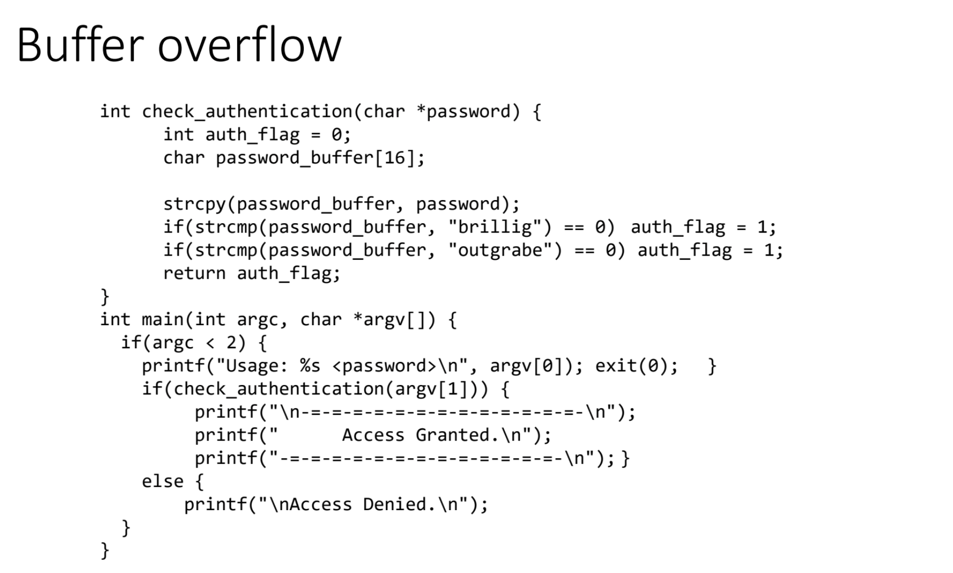
Basics – Binary Exploitation
06 Basics
Notes:
https://stackoverflow.com/questions/68262172/example-of-buffer-overflow

Slide 8
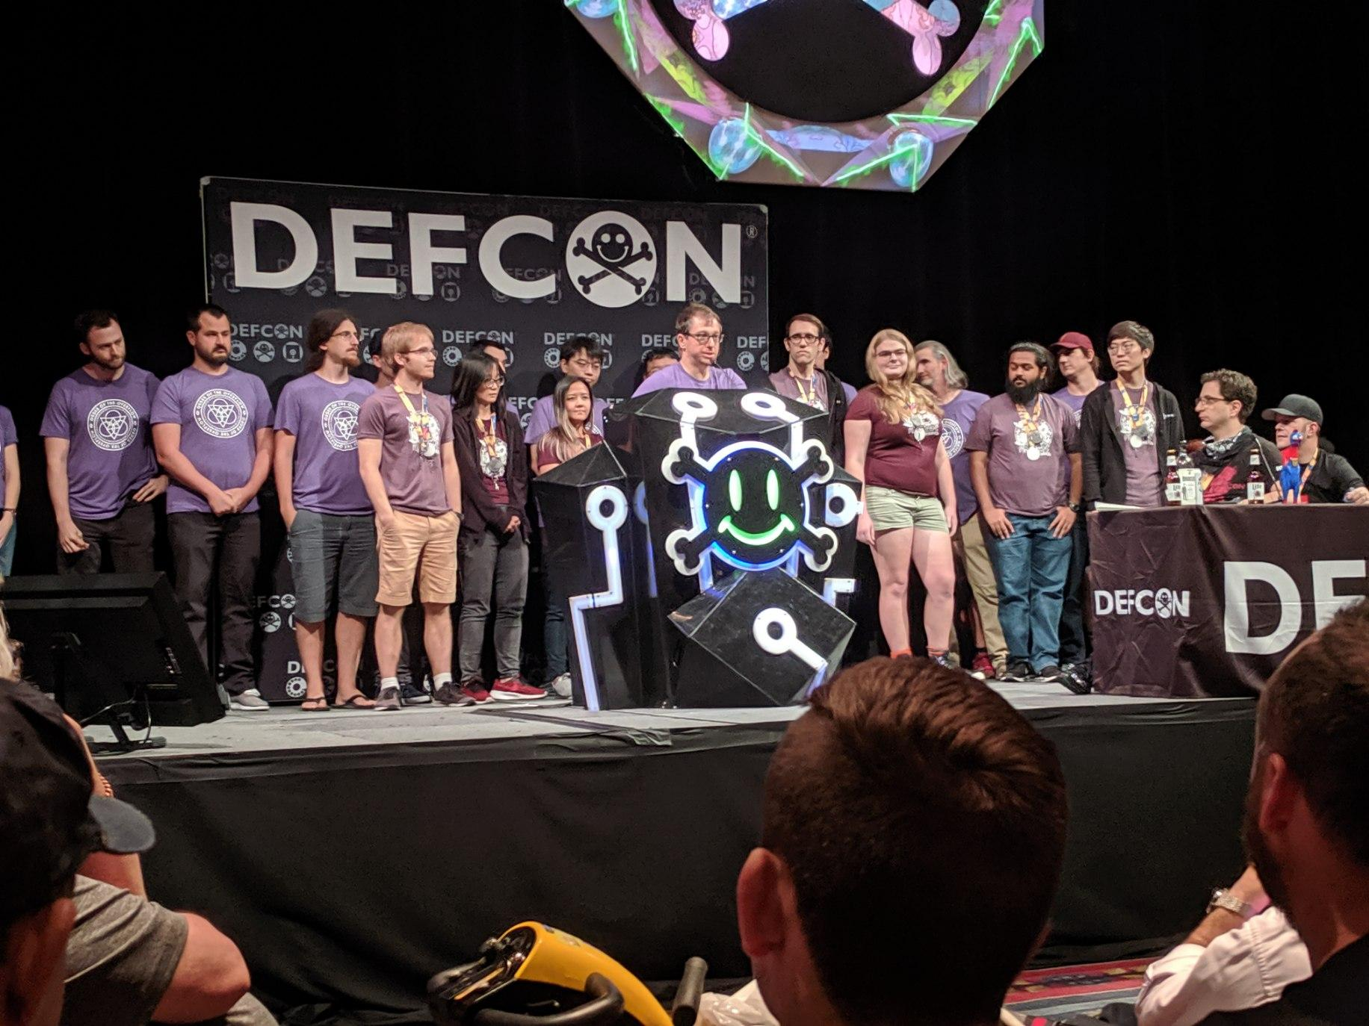
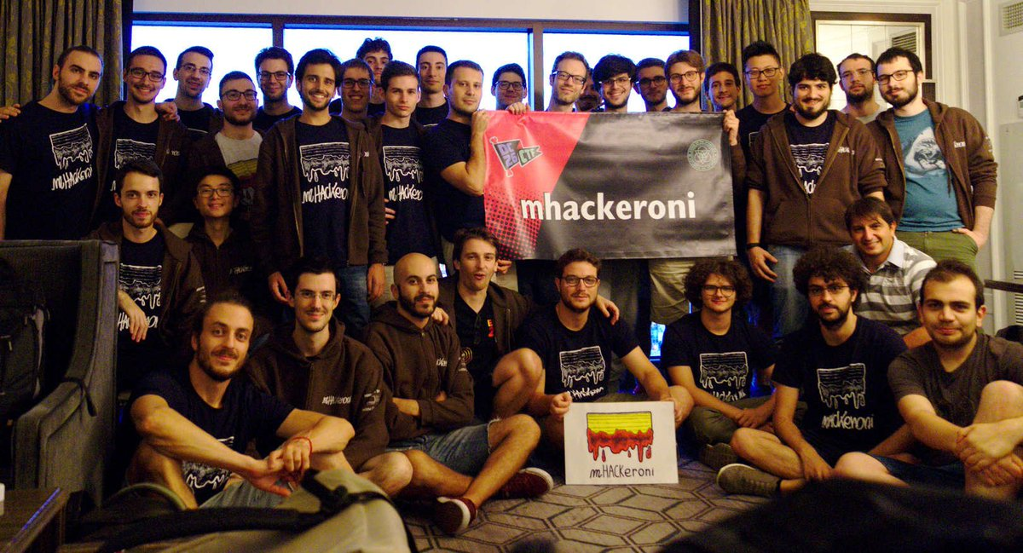
Basics – Why CTF?
Practical skills
Meet new people
Fun!
07 Basics

Slide 9
Schedule
Meeting | Date | #
Introduction | 23/1/2024 | 1
Web | 30/1/2024 | 2
Forensics + Networks | 6/2/2024 | 3
Cryptography | 13/2/2024 | 4
Reverse Engineering | 20/2/2024 | 5
Binary Exploitation | 27/2/2024 | 6
08 Introduction

Slide 10
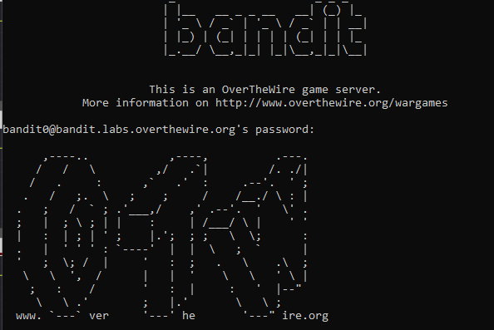
Basics – How to start?
09 Basics
Notes:
Link to bandit on the website

Slide 11
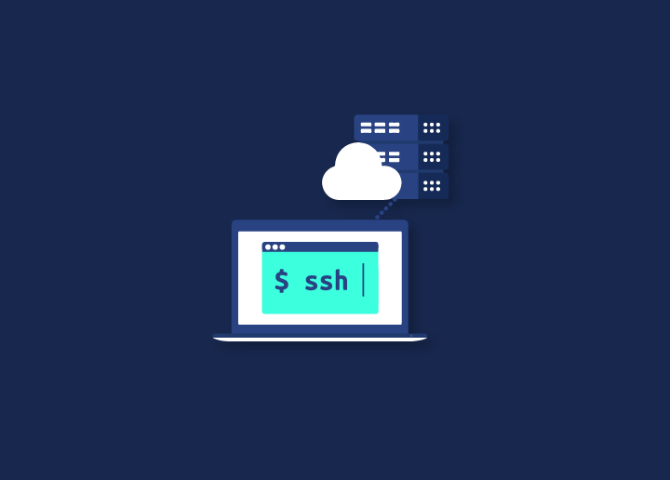
Basics – How to start?
10 Basics
Notes:
https://seahawkmedia.com/hosting-glossary/what-is-ssh/
https://learn.microsoft.com/en-us/windows-server/administration/openssh/openssh_install_firstuse?tabs=gui

Slide 12
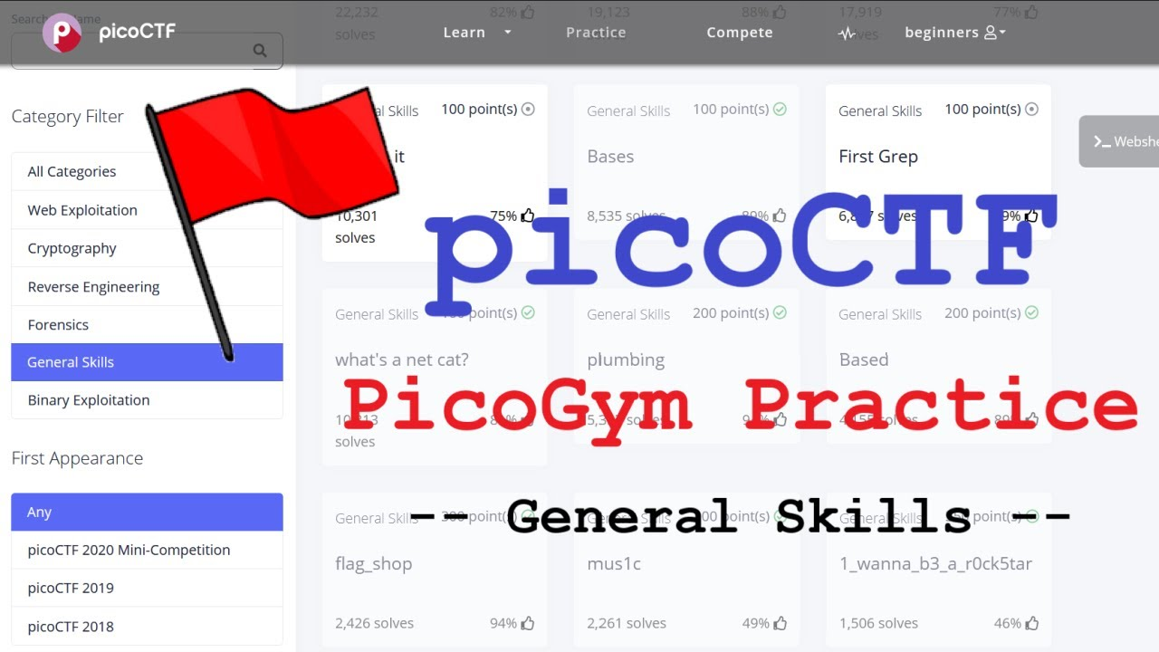
Basics – How to start?
11 Basics
Notes:
Link to bandit on the website

Slide 13

Thank You

