Slide 1
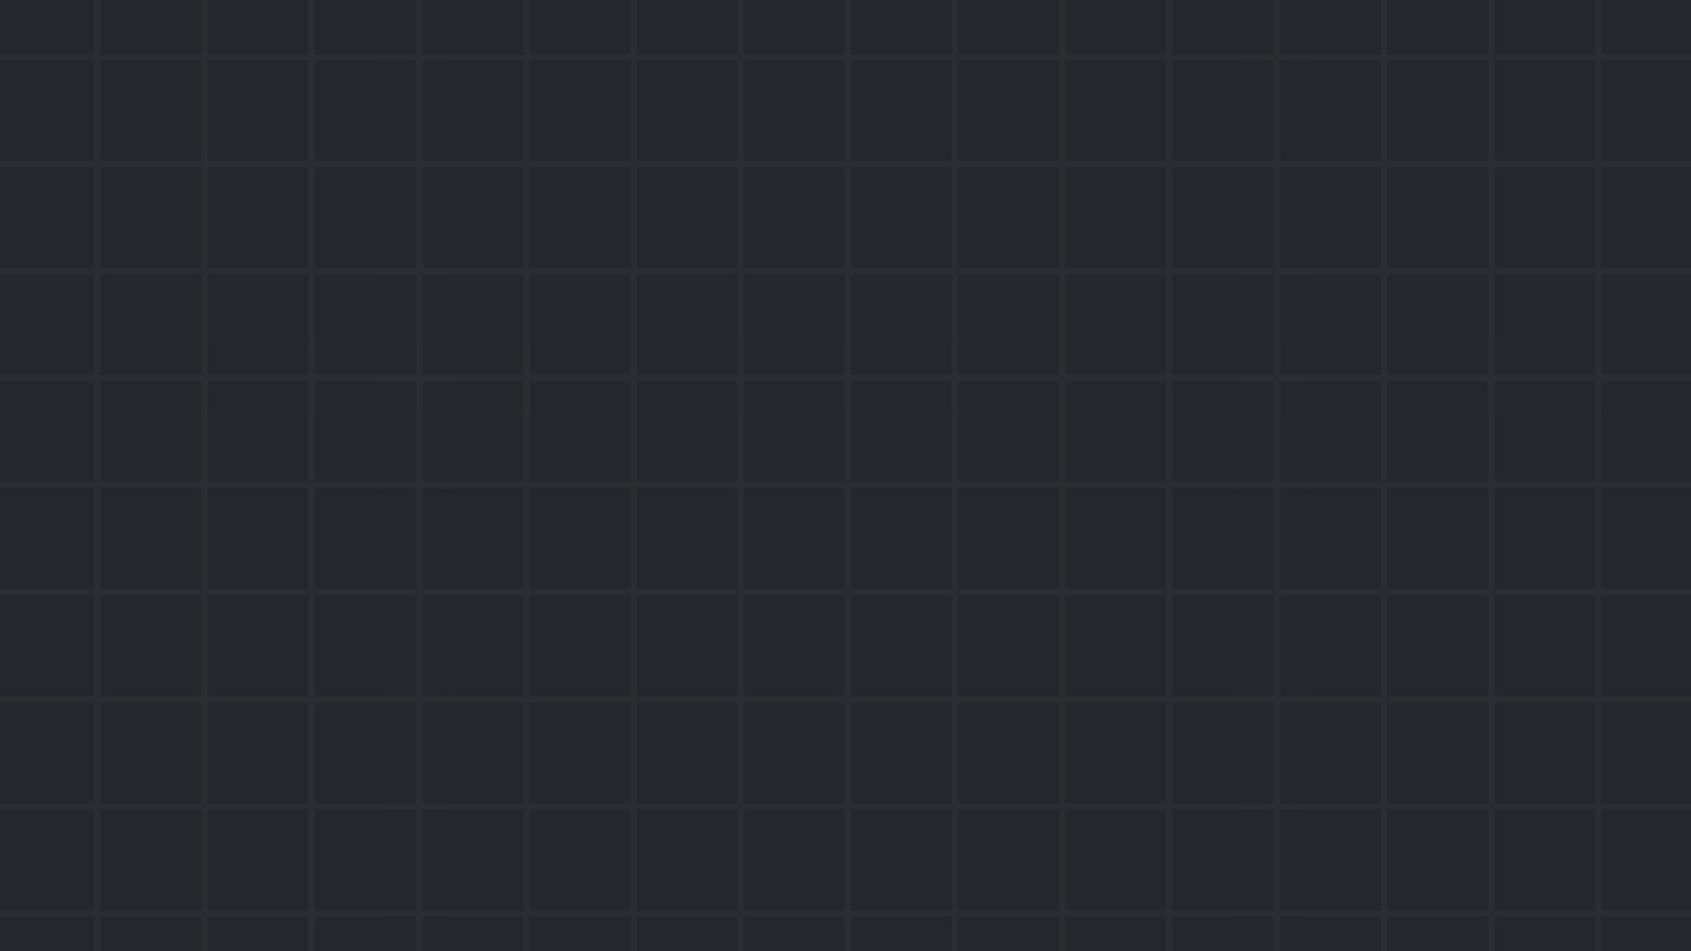

Session #1
Introduction
January 2024

Slide 2
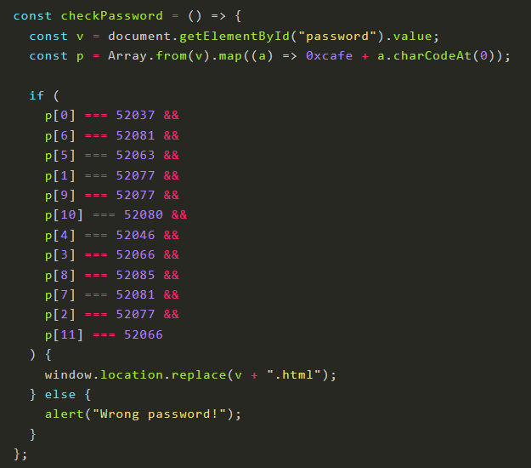
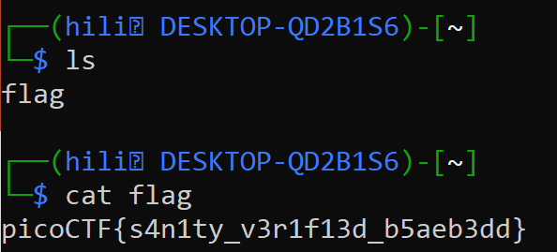
What is CTF?
“Capture The Flag” - Cybersecurity competition
Categories: web exploitation, cryptography,
reverse engineering and more
01 Introduction

Slide 3
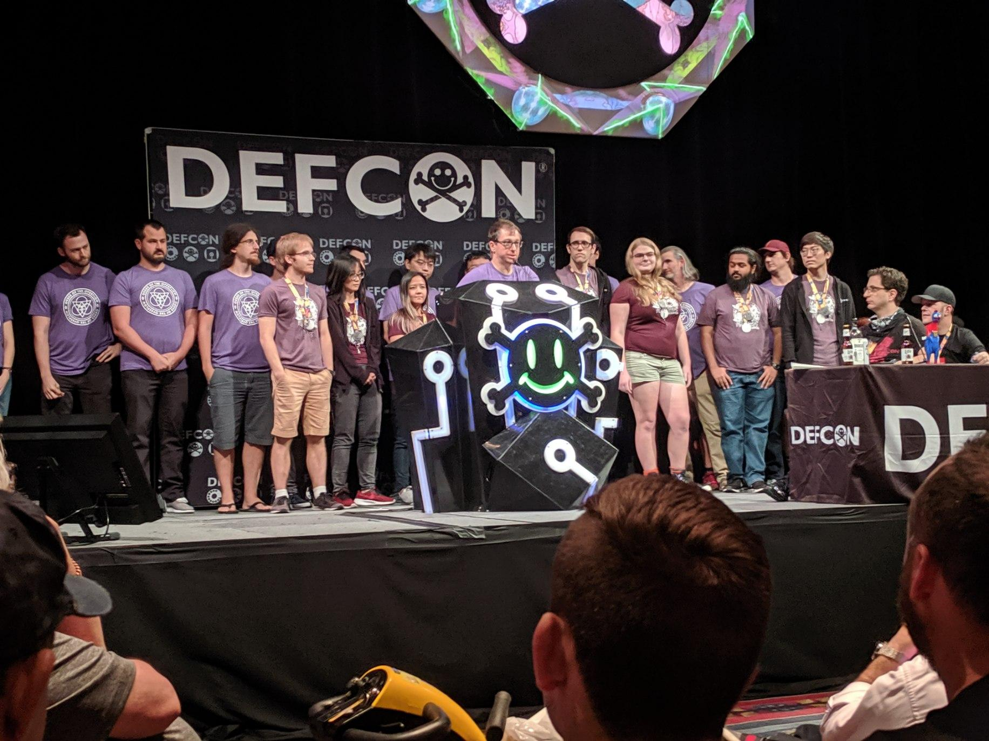
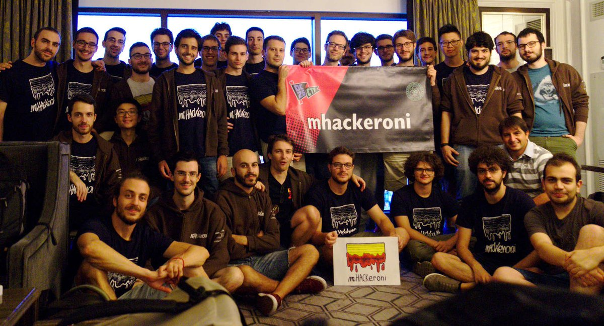
Competitions, International, FUN
01 Introduction

Slide 4


Schedule
Weekly meetings! Every Tuesday, 18:30-20:00
Competitions
Meeting | Date | #
Introduction | 23/1/2024 | 1
Web | 30/1/2024 | 2
Forensics + Networks | 6/2/2024 | 3
Cryptography | 13/2/2024 | 4
Reverse Engineering | 20/2/2024 | 5
Binary Exploitation | 27/2/2024 | 6
02 Introduction

Slide 5
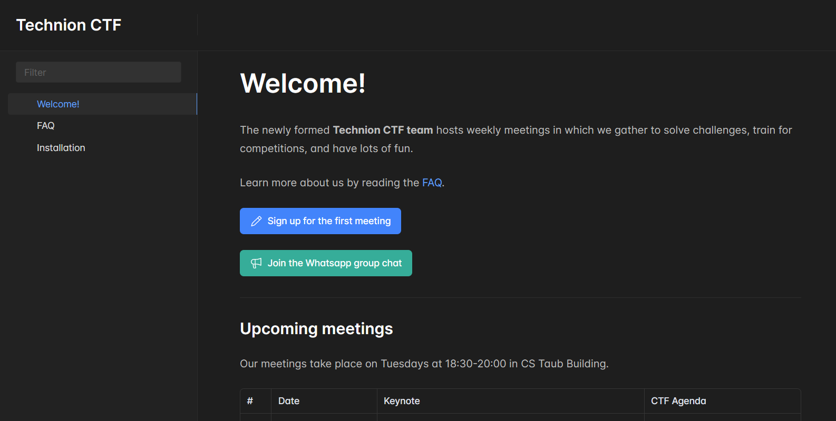
Website
technionctf.com
01 Introduction

Slide 6
Keynote – Prof. Eli Biham and Prof. Avi Mendelson
03 Introduction

Slide 7

Practice Time
Beginners1 | Beginners2 | Advanced

