Slide 1
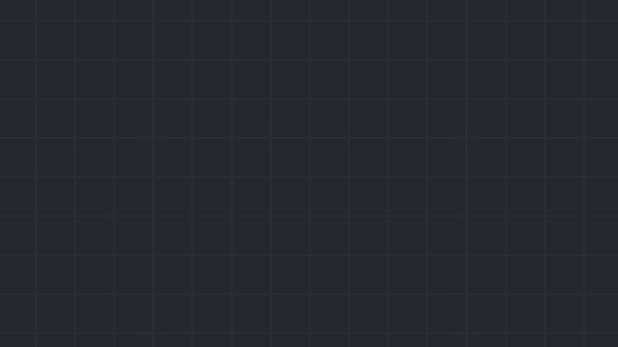

Binary Exploitation
The real pwn
Winter 24/25

Slide 2

Introduction
Binary exploitation (pwn) is the process of finding vulnerabilities in programs, usually executables, and utilizing them to do as you wish.
It can result in authentication bypass or leak of classified information, but occasionally, it can also result in RCE.
In CTFs, a pwn challenge usually consists of:
A remote server, running a vulnerable program.
The executable the server runs every time you connect.
Sometimes – source code of that executable.
Other configuration files to ensure you can reproduce the same environment to run the exe as the server.
The end goal usually is to get the program to print you the flag, or make it execute a shell, and use it to read the flag yourself.
Introduction

Slide 3
Tools
Must have:
A linux machine.
A disassembler.
A debugger (gdb is by far the most recommended choice).
Pwntools (python exploit development library).
Optional:
A decompiler (it is optional but it is highly, highly recommended. Reading assembly is sometimes a nightmare). Popular options are IDA Freeware or Ghidra.
gdb-peda/gef/pwndbg – gdb extensions which makes debugging challenges easier.
Pwninit – a tool that automates setting up binary exploitation challenges.
Tools

Slide 4
Stack basics
The most basic forms of binary exploitation occur on the stack.
This is due to the fact that the entire mechanism of function calling and returning revolves around the stack (at least when talking about x86_64 arch).
Specifically, when a new function is called, the address of the next instruction is pushed on the stack, and popped and jumped to when that new function finishes.
Attackers take advantage of this idea by targeting that return address, aiming to overwrite it with their own address.
Lower addresses….
Junk, or remnants from calls to other functions
rsp
Local variables
Saved rbp (of previous frame)
rbp
Return address
Previous function stack frame
Higher addresses….
Stack basics

Slide 5
Buffer overflow
The most common type of exploit that occurs on the stack is called stack buffer overflow. This happens when we are able to write more bytes to a buffer than was allocated to it.
It is especially dangerous when it occurs on the stack because, as said before, one of the things an attacker can overwrite by overflowing the buffer is the return address, in turn redirecting program execution flow.
The simplest example (often seen in CTFs) is a ret2win challenge, where a “win” function exists in the executable and the attacker has to redirect execution flow to it.
https://ropemporium.com/challenge/ret2win.html
Buffer overflow

Slide 6
Shellcode
Most executables won’t have a specially designed win function just for you.
We’d want to find a way to execute our own custom code.
That’s where shellcode comes into play. A shellcode is basically just a small snippet of machine code instructions designed to do something very specific, which we ourselves write in the program (for example in the buffer where we write our input).
Combining it with a buffer overflow, we can use the same idea from before - but this time we put the address of the shellcode.
https://ir0nstone.gitbook.io/notes/binexp/stack/shellcode
Shellcode

Slide 7
No ret2win, no shellcode
A simple defense against shellcode is called NX (no eXecute). When the NX bit is set, areas of memory can be either writeable or executable, but never both. This eliminates stack shellcodes entirely.
So what do we do now?
We still have control over RIP, but seemingly no idea of where to return to.
Our only choice is to utilize existing parts of the program in order achieve our own custom code execution.
Introducing: Return Oriented Programming (ROP)
Server Side Template Injection (SSTI) - Templates

Slide 8
Return Oriented Programming (ROP)
The basis of ROP is chaining together small chunks of code already present within the executable itself in such a way to do what you wish.
A common example is returning to a function already present within libc – specifically the system function, which executes any shell command you wish.
If we manage to make a call to something like system(“cat flag.txt”), we will win.
But first we have to understand how calling functions with parameters works.
Common server side vulnerabilities

Slide 9
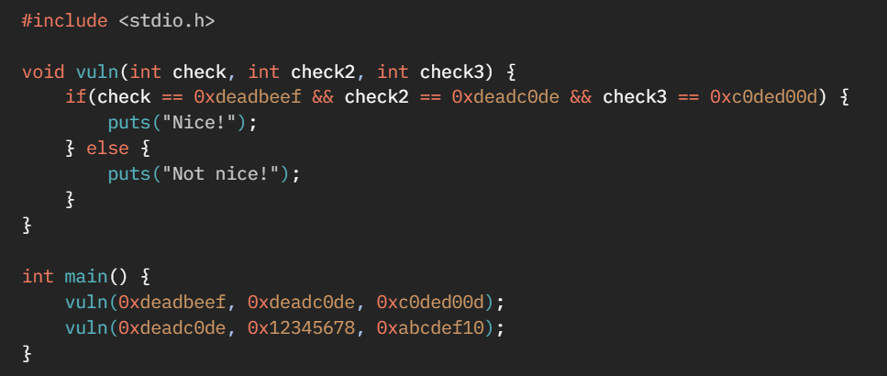
x86_64 calling conventions
Can you guess what the assembly of main will look like?
Common server side vulnerabilities

Slide 10
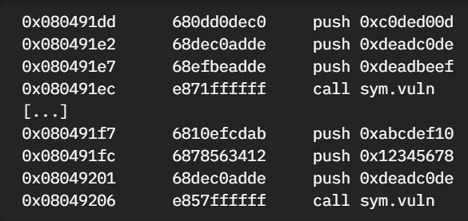
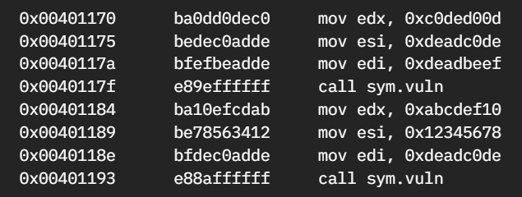
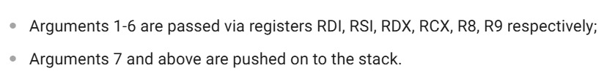
x86_64 calling conventions
Answer: it depends. That was a trick question.
32 bit:
64 bit:
Common server side vulnerabilities

Slide 11
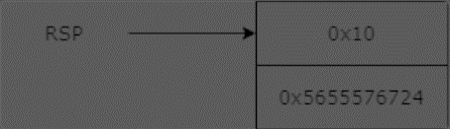
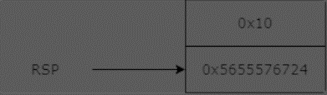
ROP Gadgets
Gadgets are small snippets of code followed by a ret instruction, e.g. pop rdi; ret. We can manipulate the ret of these gadgets in such a way as to craft together a large chain of them to do what we want.
Let’s imagine the stack looks like this when executing pop rdi; ret:
What happens is fairly obvious - 0x10 gets popped into rdi as it is at the top of the stack during the pop rdi. Once the pop occurs, rsp moves:
And then we return to 0x5655576724.
ROP Gadgets

Slide 12
ROP Gadgets
When we overwrite the return pointer, we overwrite the value pointed at by rsp when the ret instruction is executed.
Once that value is popped and jumped to by the ret instruction, rsp points at the next value at the stack. But wait, we can overwrite the next value on the stack.
We can utilize this fact to chain multiple gadgets together.
ROP Gadgets

Slide 13
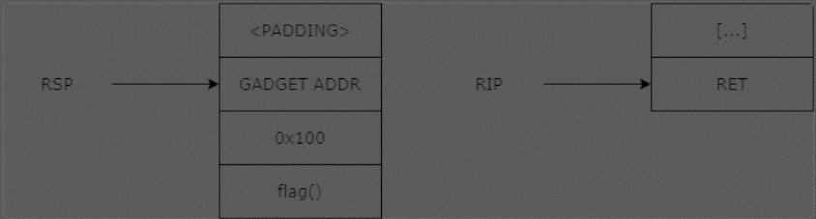
ROP Gadgets - example
Let's say that we want to exploit a binary to pop 0x100 into rdi then jump to flag(). The simplest way (although not always present) isa pop rdi; ret gadget.
On the original ret, which we overwrite the return pointer for, we put the gadget address in. After the original ret is executed, rip moves to point to the gadget, and rsp moves to the next word.
Server Side Template Injection (SSTI) - Templates

Slide 14
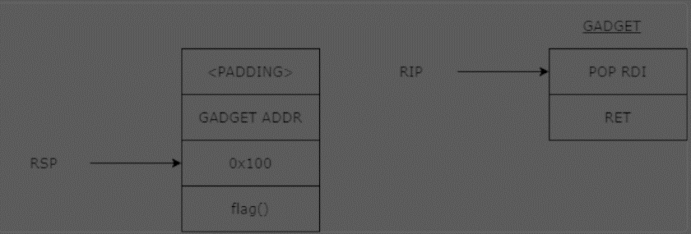
ROP Gadgets - example
As said, rsp moved to the 0x100; rip to the pop rdi. Now when we pop, 0x100 gets moved into rdi.
Server Side Template Injection (SSTI) - Templates

Slide 15
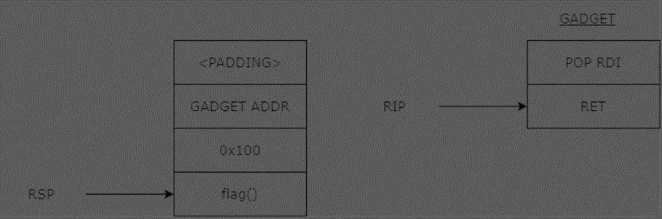
ROP Gadgets - example
RSP moves onto the next word on the stack, the address of flag(). The ret is executed and flag() is called.
Server Side Template Injection (SSTI) - Templates

Slide 16
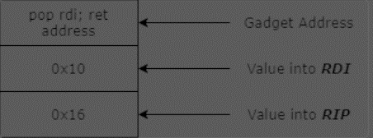
ROP Gadgets - summary
Essentially, if the gadget pops values from the stack, simply place those values afterwards. If we want to pop 0x10 into rdi and then jump to 0x16, our payload would look like this:
We can chain different gadgets like this. For example, 0x16 might be a gadget that contains pop rdi; ret (second parameter)
How do we find such gadgets? There are plenty of tools. my favorite is ROPgadget.
Server Side Template Injection (SSTI) - Templates

Slide 17
Returning with parameters
Let’s put what we’ve learned about ROP to the test.
https://ir0nstone.gitbook.io/notes/binexp/stack/return-oriented-programming/exploiting-calling-conventions
Exploiting with parameters

Slide 18
Mitigations
ROP is a well known technique, and therefore several mitigations for it have developed over the years. We will talk about the linux ones. We can find out what protections a binary uses with a program like checksec.
Stack canaries: a sequence of bytes that is placed on the stack before the return address, and is compared with a it’s original value before the function returns.
PIE (Position Independent Executable): The executable is loaded at a different memory address every time.
ASLR (Address Space Layout Randomization): Shared libraries and other dynamically imported objects are loaded into random addresses.
All of these can be bypassed by a simple leak, for example if a format string bug exists as well.
Mitigations

Slide 19

Practice time

Slide 20
Practice today’s concepts:
https://ropemporium.com/ - Practice different kinds of ROP, and even different archs.
https://pwn.college/software-exploitation/return-oriented-programming - really well made ROP lab. I recommend. pwn.college in general.
Other places to practice pwn:
Our picoCTF classroom contains a week 4 – advanced assignment with challenges I thought were cool and not too brainf*ck.
https://app.hackthebox.com/ - pwn category, start with very easy – easy.
https://www.root-me.org/fr/Challenges/App-Systeme/ - Challenges that introduce various useful techniques.
pwnable.xyz - modern CTF-style pwn challenges.
https://pwnable.co.il/ - Israeli site! (hard).
Some specific challenges:
https://github.com/uclaacm/lactf-archive/tree/main/2024/pwn/52-card-monty - Requires leaking canary and PIE.
https://github.com/uclaacm/lactf-archive/tree/main/2024/pwn/sus - (Harder) challenge from that same CTF.

