Slide 1
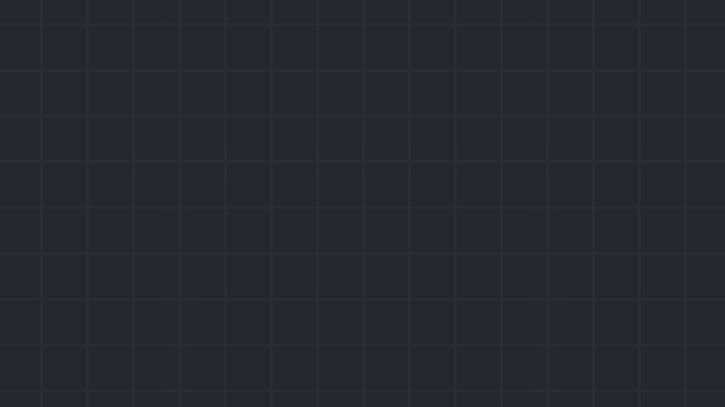

Web exploitation
Part 2
Server side vulnerabilities
Winter 24/25

Slide 2
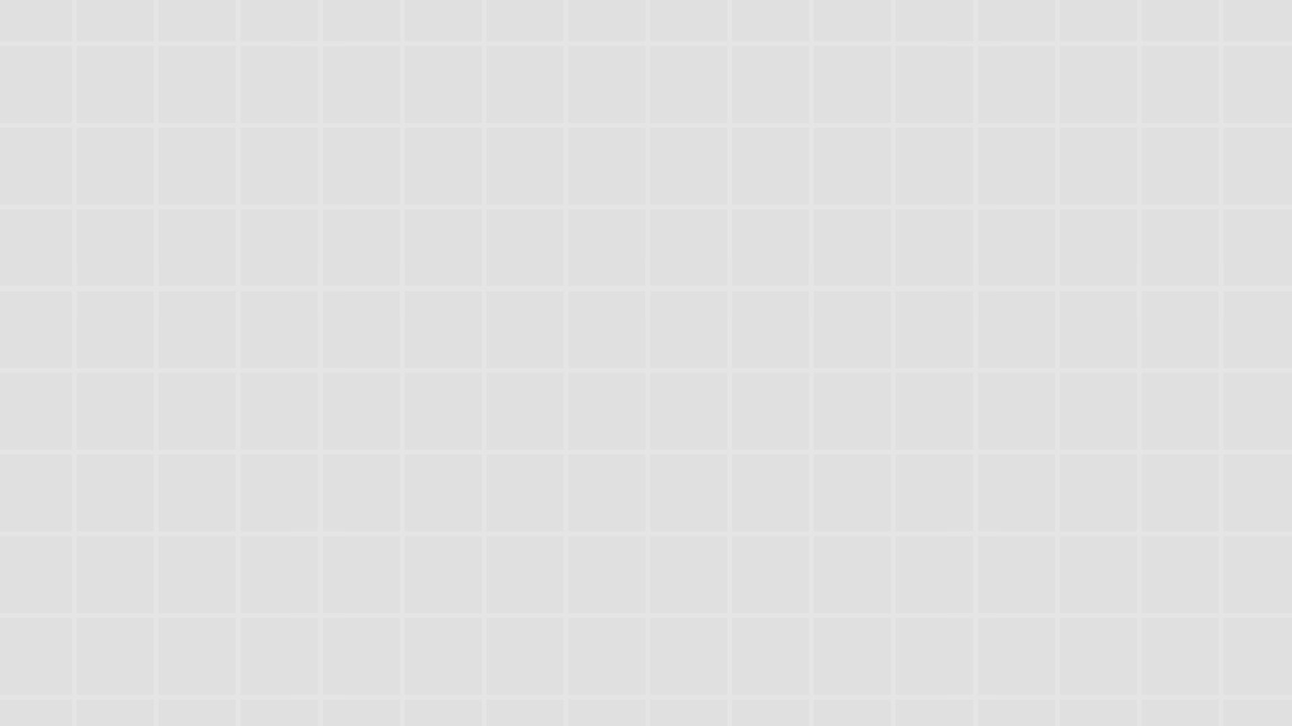
Reminder – Server side
Server side refers to the backend server of the application which the front end sends requests to and receives responses from.
It’s the side containing the core logic of the web application. It’s responsible for a wide range of tasks, such as serving dynamic content, interacting with databases, managing user sessions, handling API endpoints and more.
Reminder – Server side

Slide 3
Common server side vulnerabilities
Today we will explore:
Server Side Template Injection (SSTI): Injecting native syntax of the template engine the server uses, allowing the attacker to achieve evaluation of arbitrary expressions.
Insecure deserialization: Sending serialized data in a manner the application doesn’t expect, and without proper sanitization, can allow the deserialization and therefore instantiation of arbitrary objects.
Other server side vulnerabilities (which we will not discuss today) include: SQLi, SSRF, LFI, HTTP related attacks, JS prototype pollution and many more.
Common server side vulnerabilities

Slide 4
Server Side Template Injection (SSTI) - Templates
Predefined layouts of web pages that dictate how dynamic content should be inserted into the web page.
For example, a web page displaying a user’s profile might use a template where the name and bio are placeholders that will in turn get replaced by the actual data.
Removes the overhead and dangers of manually crafting the contents of the page by, for example, concatenating HTML tags with user input.
Server Side Template Injection (SSTI) - Templates

Slide 5
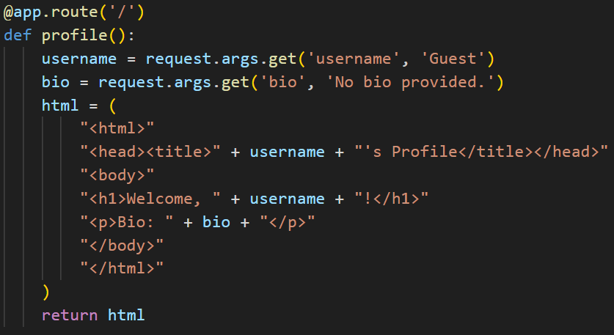
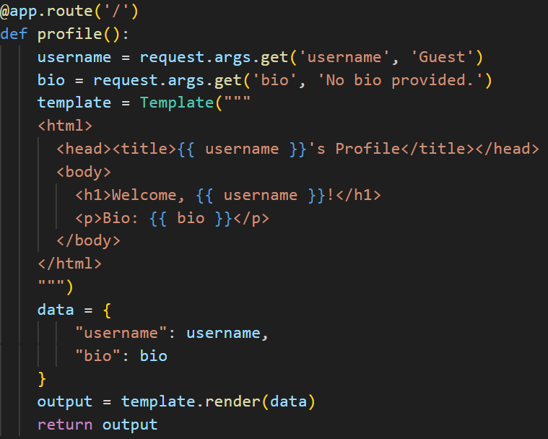
Server Side Template Injection (SSTI) - Templates
And code that leverages the power of templates will look something like this:
Code that doesn’t use templates might look something like this:
Dangerous!
Safe?
Jk, also dangerous
Server Side Template Injection (SSTI) - Templates

Slide 6
Server Side Template Injection (SSTI) – Causes & Impact
SSTI vulnerabilities arise when user input is concatenated into the template string itself rather than being passed to the rendering API as data.
Not vulnerable to SSTI:
Vulnerable to SSTI:
As a result, attackers can inject arbitrary expressions in the programming language used by the template engine, and force their evaluation.
Server Side Template Injection (SSTI) – Causes & Impact

Slide 7
Server Side Template Injection (SSTI) - Example
https://app.hackthebox.com/challenges/Spookifier
Server Side Template Injection (SSTI) - Example

Slide 8
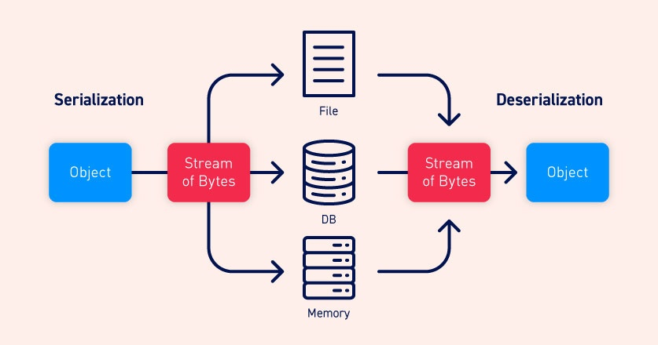
Insecure Deserialization – Serialization/Deserialization
Serialization is the process of converting complex data structures into a format, often a stream of bytes, that can be easily stored/transmitted. Web applications heavily rely on this idea since it enables them to efficiently handle and transmit complex data between the client side and the server side, or store data in a database, for example.
Deserialization is simply the reverse process – taking a stream of bytes and converting it back to the data structure it represents.
Insecure deserialization – Serialization/Deserialization

Slide 9
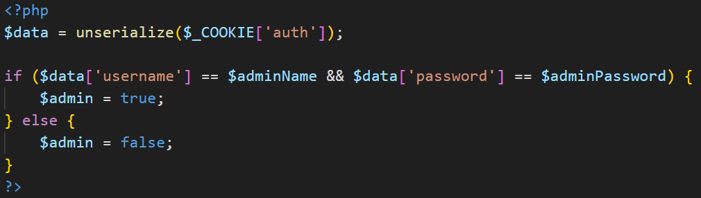
Insecure Deserialization – Causes & Impact
Insecure deserialization vulnerabilities occur when user controlled data is deserialized by application without proper sanitization, allowing the attacker to instantiate custom objects on the server side.
If an attacker can control the serialized object – they can often make the application execute normally unreachable code paths or even arbitrary code.
Insecure deserialization – Causes & Impact

Slide 10
Insecure Deserialization - Example
https://app.hackthebox.com/challenges/Spellbound%2520Servants
Insecure deserialization - Example

Slide 11

Practice time

Slide 12
Practice today’s concepts:
https://portswigger.net/web-security/all-labs#server-side-template-injection – SSTI labs
https://portswigger.net/web-security/all-labs#insecure-deserialization – Insecure deserialization labs
https://app.hackthebox.com/challenges/Spookifier
https://app.hackthebox.com/challenges/Spellbound%2520Servants
Other places to practice web:
https://app.hackthebox.com/ - Web category - most recommended
https://websec.fr/ - Also recommended but a bit guessy
https://www.root-me.org/fr/Challenges/Web-Serveur/ - Server side challenges, including SSTI & Insecure deserialization.
https://webhacking.kr/
https://overthewire.org/wargames/natas
Very useful resource: https://github.com/swisskyrepo/PayloadsAllTheThings

