Slide 1


Session #3
Forensics & Networks
February 2024

Slide 2
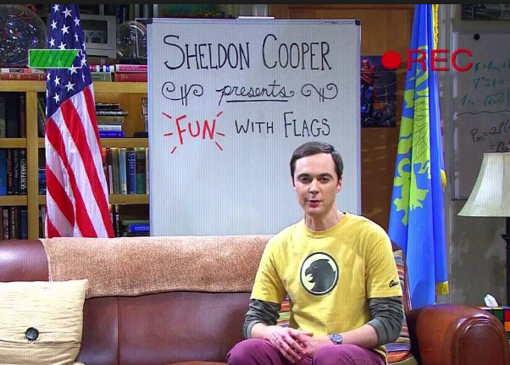
in images and audio
03 Forensics & Networks
03 Forensics & Networks

Slide 3
Digital Forensics
Typical forensics challenges in CTFs revolve around…
Finding hidden information in files
Analyzing digital traces
System logs
Network traffic
Browsing history
…
🕵️
03 Forensics & Networks

Slide 4
Example 1
03 Forensics & Networks
Notes:
(SOLVE IN UBUNTU)
LSB
cd technion/CTF/steg
Feh technion.png
Strings technion.png
print all strings in a file
At least 4 consecutive printable characters
exiftool Technion-Campus.jpg
file secret.jpg -
Wait, it is not jpg at all!
According to “magic bytes” – for example, zip files begin with “50 4B 03 04”
More reliable than file extensions
Could still be misleading
feh secret.png
Lets compare bits –
hexdump -C Technion-Campus.png | head
hexdump -C secret.png | head
See something different?
stegolsb steglsb -r -i secret.png -n 2 -o secre_output
get the lsb and put it together
Another option: https://www.aperisolve.com/
To insert the information :
stegolsb steglsb -h -i Technion-Campus.png -s flag.txt -o secret.png -n 2 -c 1

Slide 5
Example 2
03 Forensics & Networks
Notes:
(SOLVE IN KALI LINUX)
We have a file
Look-inside
exiftool look-inside
ELF File lets try to run
./look-inside
This is nothing
hexdump -C look-inside > a.txt
Look at hex dump – PK
the magic of a zip file
binwalk look-inside
search for embedded files inside a file
ohhhh we see both the ELF, but also zip inside…
mv look-inside look-inside.zip
unzip look-inside.zip
Ls
Cd inside
open you died
Lets look on CAPTURED_TRANSMISSION
Open in sonic visualizer
Add spectogram
cGluZ3tJX2Fsd2F5JF9jMG1lX2JAY2t9
Take it to cyberchef, from base64

Slide 6
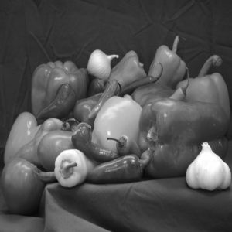

Can you spot the difference?
This is Least Significant Bit (LSB) steganography
The LSB of each pixel is modified to hide a message
03 Forensics & Networks

Slide 7

“file” command
Identify a file’s format
According to “magic bytes” – for example, zip files: “50 4B 03 04”
More reliable than file extensions
Could still be misleading
03 Forensics & Networks

Slide 8
Other useful tools
strings – print all strings in a file
a string = at least 4 consecutive printable characters
binwalk – search for embedded files in a file
exiftool – print EXIF data of the file
03 Forensics & Networks

Slide 9
Packet capture analysis
Some forensics challenges present packet capture (.pcap) files
Can be analyzed in Wireshark
Each row represents a single packet sent/received
03 Forensics & Networks

Slide 10
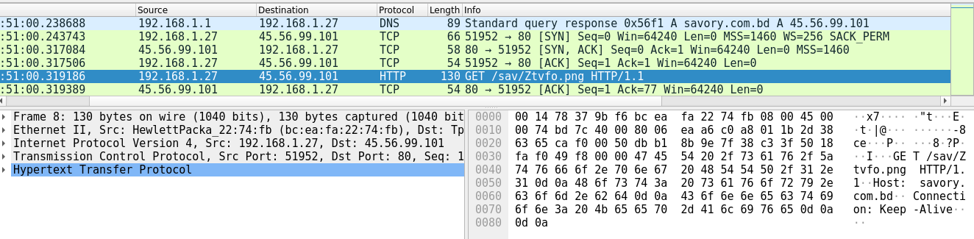
Computer Networks 101
Devices communicates in packets
Packets are written according to protocols
This packet is in HTTP protocol (over TCP, IP, Ethernet)
03 Forensics & Networks

Slide 11
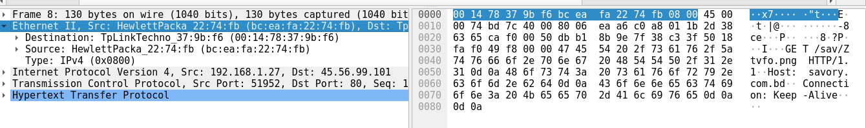
Computer Networks 101 – Layer 2
Provides the ability to transfer data between adjacent devices
Uses MAC addresses
Each device* has a fixed, permanent, unique MAC address
Common layer 2 protocols: Ethernet, 802.11 (Wi-Fi)
03 Forensics & Networks
Notes:
* Actually, each network interface controller (NIC). Therefore, a device can have more than one MAC address.

Slide 12
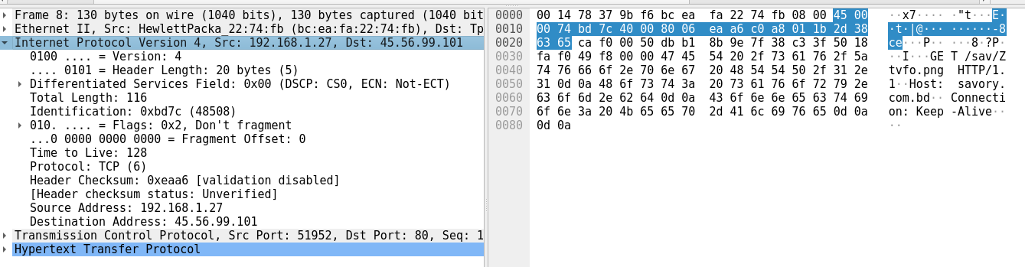
Computer Networks 101 – Layer 3
Provides the ability to transfer data between distant devices
Uses IP addresses
Each device* has a (potentially) non-unique, temporary IP address
Common layer 3 protocol: IP
03 Forensics & Networks
Notes:
* Same here: each network interface controller (NIC), and a device can have more than one IP address.

Slide 13
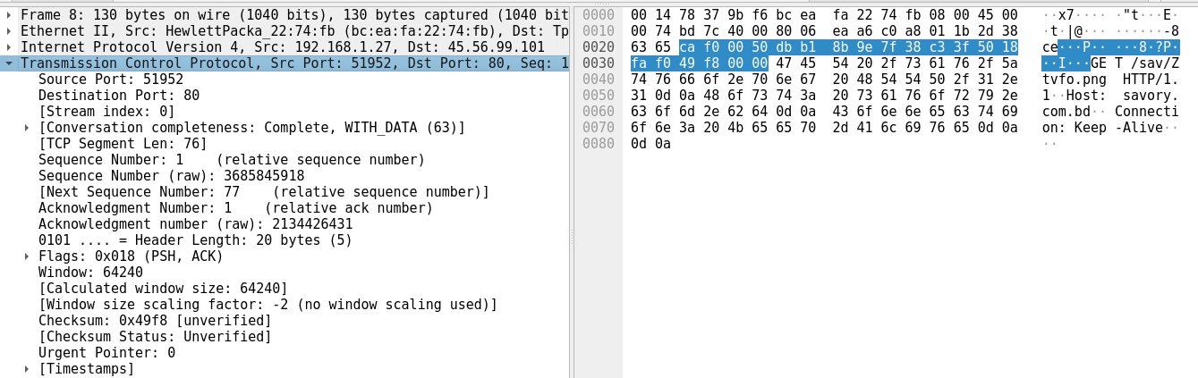
Computer Networks 101 – Layer 4
Provides the ability to have multiple conversations between devices
Uses ports
Common layer 4 protocol: TCP, UDP
03 Forensics & Networks

Slide 14
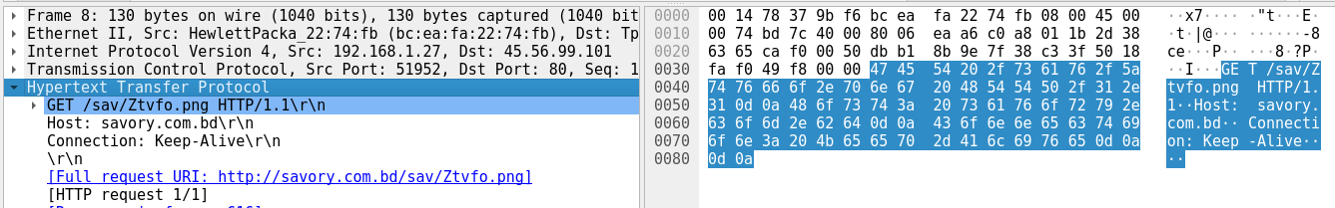
Computer Networks 101 – Layer 5
The application itself
Common layer 5 protocols: HTTP, DNS, SSH, SMTP, FTP
03 Forensics & Networks

Slide 15

Let’s practice!

