Slide 1
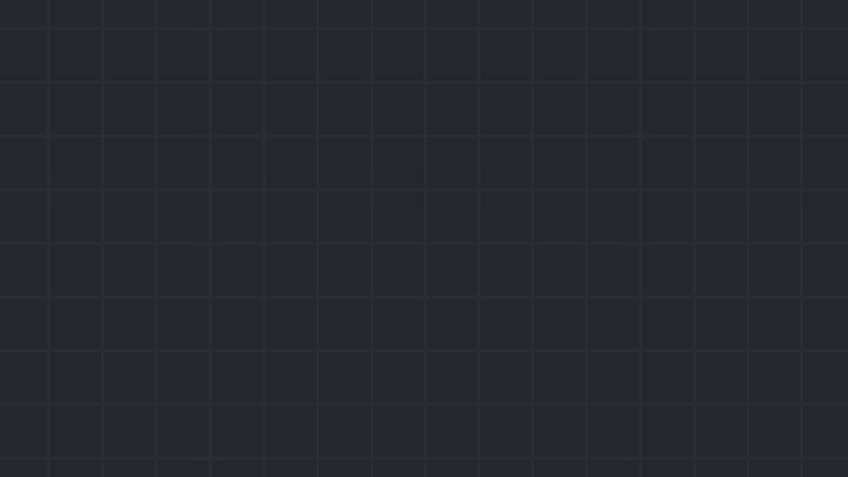

Session #2
Web Exploitation
January 2024

Slide 2
Before we get started…
Next week’s session will require Kali Linux
An installation guide is available on our website
02 Web Exploitation

Slide 3
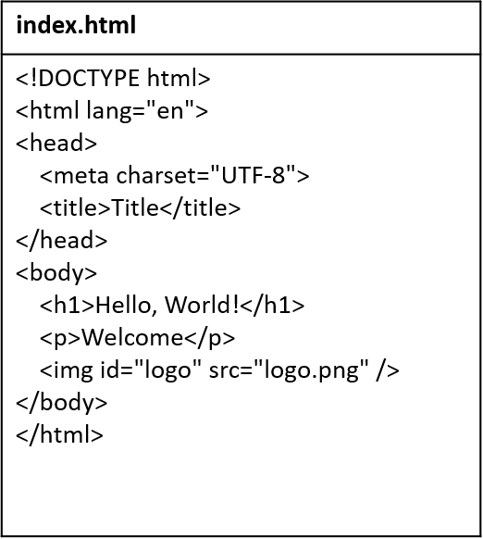
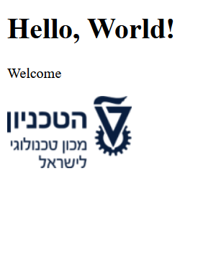
HTML
The language for the content of websites
02 Web Exploitation

Slide 4
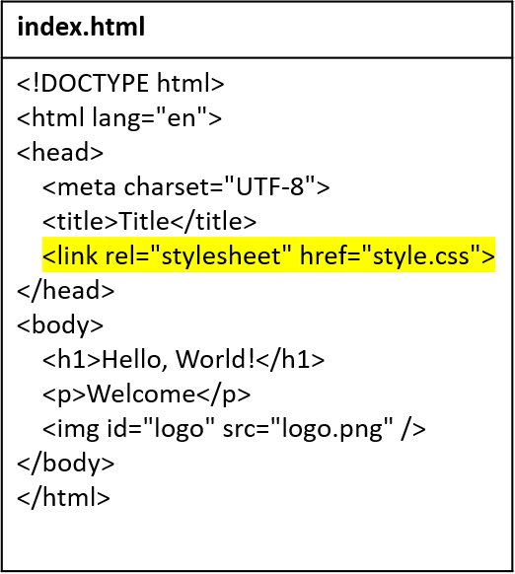
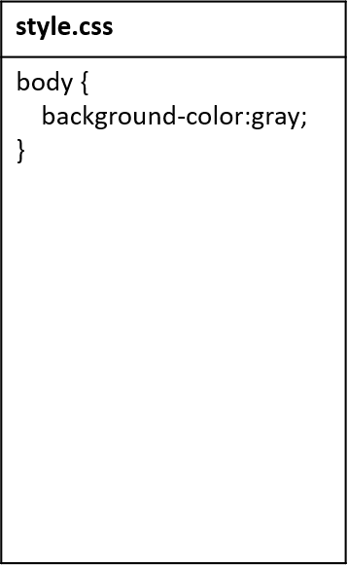
CSS
The language for the style of websites
02 Web Exploitation

Slide 5
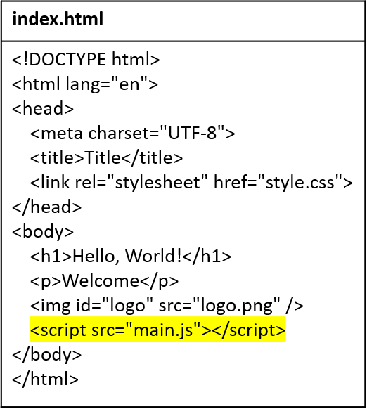
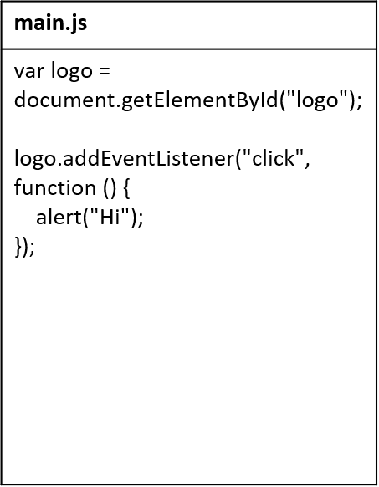
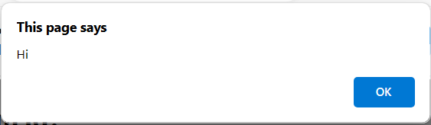

JavaScript
The language for the behavior of websites
02 Web Exploitation

Slide 6

Web browser
An application for browsing websites
Knows how to…
Display web files (HTML, CSS, JS) on the user’s screen
Request web files from web servers
Store the user’s information (bookmarks, passwords, cookies, …)
02 Web Exploitation

Slide 7
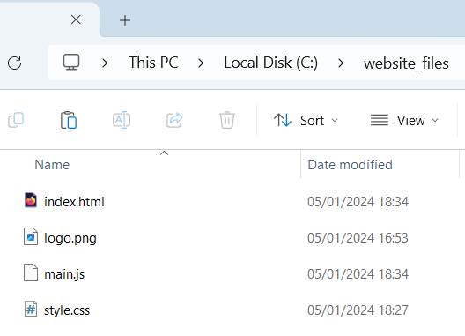
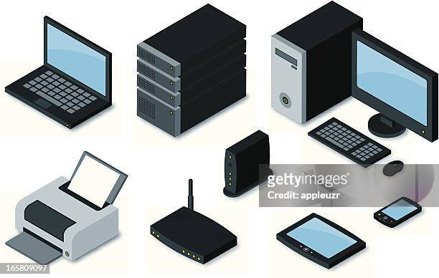

Web server
A server that provides a website’s files (HTML, CSS, JS, …) to clients
Example: starting a web server in Python
python -m http.server -d c:\website_files
This web server simply provides whichever file the client requests
GET /main.js
main.js
02 Web Exploitation

Slide 8
HTTP
The main protocol for communication with web servers
Basic aspects:
Client sends HTTP request → server sends HTTP response
HTTP is stateless
Requests and responses have headers and body
02 Web Exploitation

Slide 9
Developer Tools
All modern web browsers have a feature called Developer Tools
Accessible with F12
Some of its capabilities:
Inspector – inspect a website’s files (HTML, CSS, JS, …)
Network – analyze HTTP requests and responses
Storage – read/modify information that the browser stores
02 Web Exploitation

Slide 10
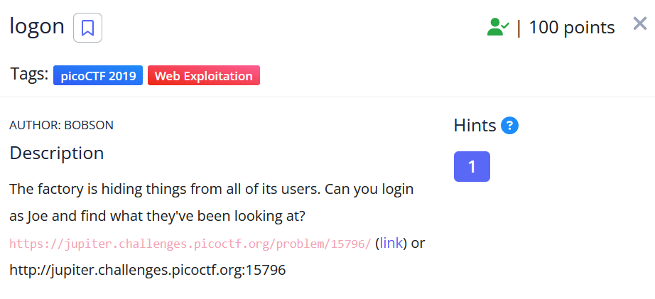
Demo: broken access control
https://play.picoctf.org/practice/challenge/46
02 Web Exploitation

Slide 11
Client-side / server-side
Client-side code…
Runs on the user’s browser
The user can access it
These are the HTML, CSS, JS files we’ve seen
Server-side code…
Runs on the web server
The user can’t access it
Determines how the server responds to each request
Does that by querying databases, considering permissions, etc.
Popular languages: PHP, Python, JavaScript (NodeJS), …
02 Web Exploitation

Slide 12
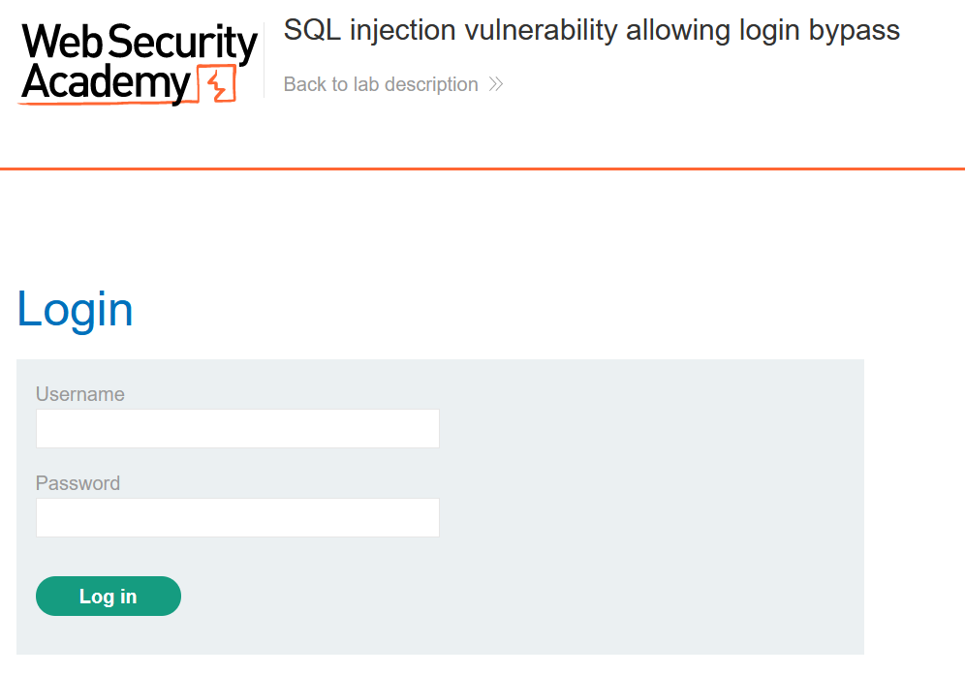
Demo: SQL Injection
https://portswigger.net/web-security/sql-injection/lab-login-bypass
02 Web Exploitation

Slide 13
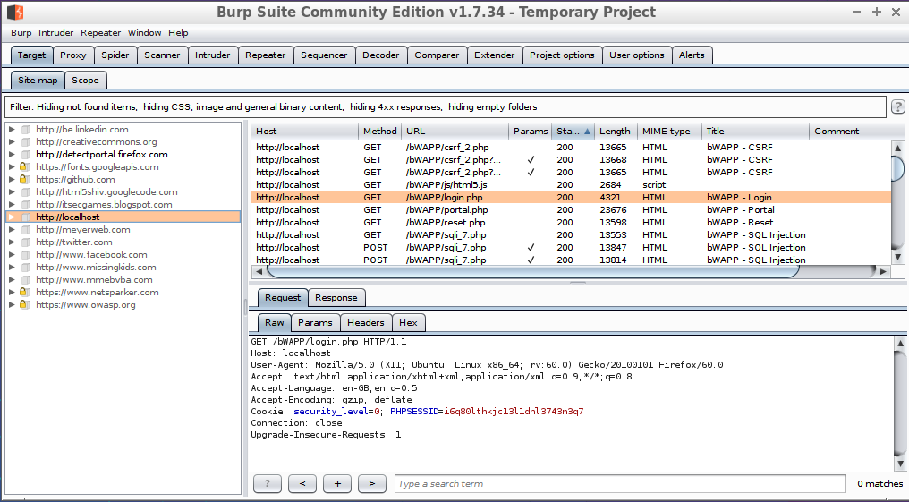
Burp Suite
A popular software for penetration testing of web applications
Useful for CTFs
02 Web Exploitation

Slide 14

Let’s practice!

