Slide 1
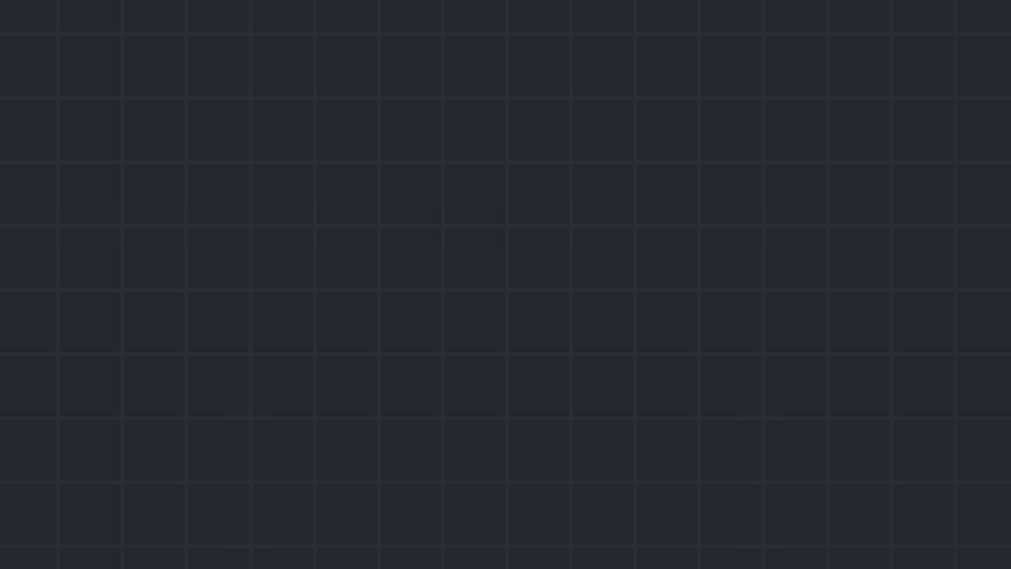

Session #6
Reverse Engineering
March 2024

Slide 2
Reverse Engineering
Given a computer program,
can we reconstruct its source code?
can we understand what it does?
06 Reverse Engineering

Slide 3
Example – C
secret.c
#include <stdio.h> int main() { int userInput; // Accept user input printf("Enter a number: "); scanf("%d", &userInput); if (userInput == 1234) { printf("Congratulations! You entered the magic number!\n"); } else { printf("Oops! That's not the magic number. Try again!\n"); } return 0; }
secret.out
Compile with: gcc secret.c -o secret.out
Given secret.out, how can we find the right input number?
06 Reverse Engineering
Notes:
secret.out is a compiled program; it no longer contains the source code.
In the demo, the output file is an ELF file. The inner workings of this file format are discussed in ATAM.

Slide 4
Example – C
Let use static analysis
fancy term for “read the compiled code”
Recommended tools:
Ghidra
IDA
objdump -S
06 Reverse Engineering

Slide 5
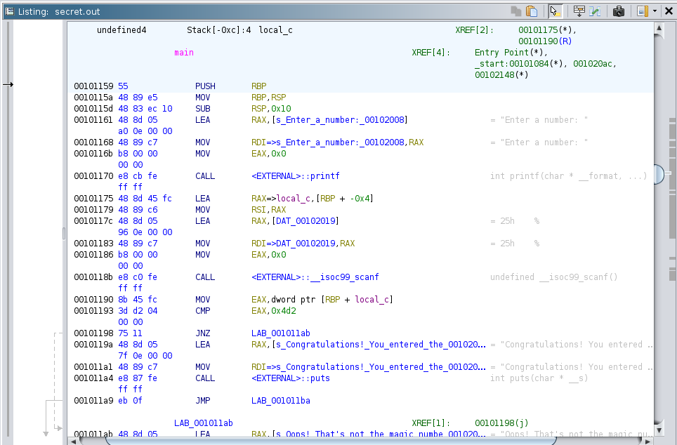
06 Reverse Engineering
Notes:
Demo:
Open secret.out in ghidra. Ghidra has lots of interesting panels, but we’ll focus on this one, that displays the program’s assembly code. We can see that just before printing “congratulations! …” it performs a comparison that determines if we jump over the printing instructions (skipping them).

Slide 6
Example – C
What if the source code was complicated?
(and therefore, the assembly code, too)
We could try to understand it, or…
Use dynamic analysis
fancy term for “debug the program”
Recommended tools:
Ghidra
IDA
gdb
secret.c
#include <stdio.h> int main() { int userInput; // Accept user input printf("Enter a number: "); scanf("%d", &userInput); int magicNumber = 1000; for(int i=0; i<20; i++) { magicNumber += 10; } if (magicNumber < 2000) { magicNumber += 34; } if (userInput == magicNumber) { printf("Congratulations! You entered the magic number!\n"); } else { printf("Oops! That's not the magic number. Try again!\n"); } return 0; }
06 Reverse Engineering

Slide 7
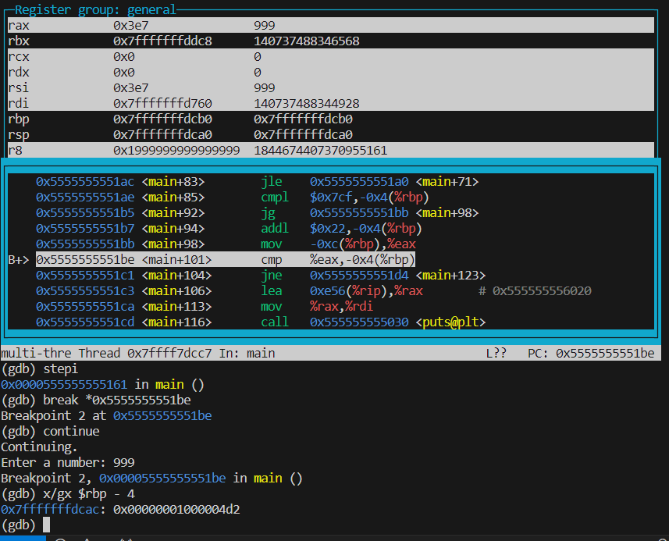
06 Reverse Engineering
Notes:
We’re seeing that the program compares our input (999) to 0x4d2 (1234) right before it decides which message to print. GDB demo:
gdb secret.out
break main
run layout asm layout regs
stepi
break *0x5555555551be
continue x/gx $rbp - 4

Slide 8
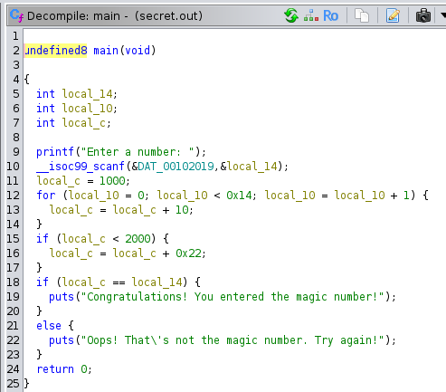
Example – C
Ghidra also has a decompilation feature
Note: it can make wrong assumptions!
secret.c
#include <stdio.h> int main() { int userInput; // Accept user input printf("Enter a number: "); scanf("%d", &userInput); // Check if input is 1234 int magicNumber = 1000; for(int i=0; i<20; i++) { magicNumber += 10; } if (magicNumber < 2000) { magicNumber += 34; } if (userInput == magicNumber) { printf("Congratulations! You entered the magic number!\n"); } else { printf("Oops! That's not the magic number. Try again!\n"); } return 0; }
06 Reverse Engineering

Slide 9
Learning Assembly
Lots of reverse engineering challenges require knowledge of Assembly
Intel x86 Assembly – used in Windows, Linux programs.
ARM Assembly – used in Android, iOS, Mac OS programs.
CS course: ATAM (234118)
Alternative resource: OST2 x86-64 Assembly Course
06 Reverse Engineering

Slide 10
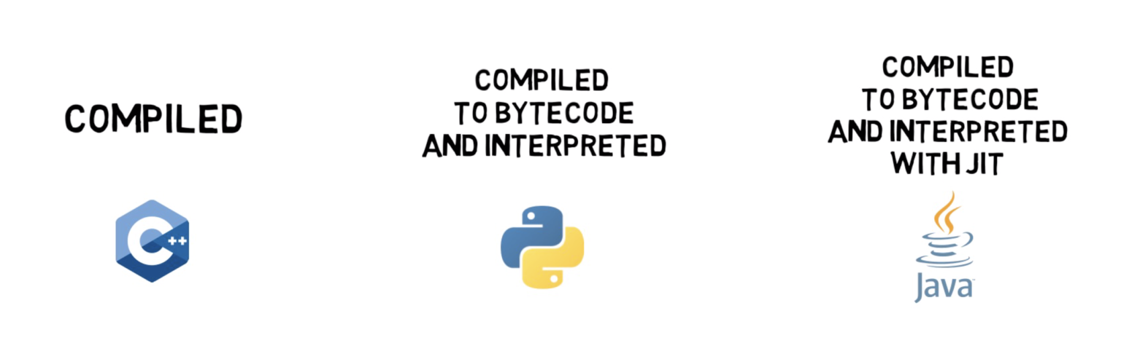
Compiled VS Interpreted Languages
06 Reverse Engineering
Notes:
Infographic source: https://finematics.com/compiled-vs-interpreted-programming-languages/ Learn more: https://www.youtube.com/watch?v=I1f45REi3k4

Slide 11
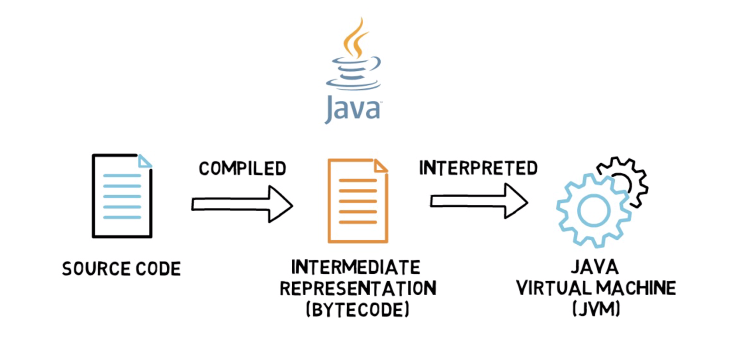
Compiled VS Interpreted Languages
Some CTF challenges involve bytecode
To solve them, we can…
Decompile the bytecode to source code
Interpret the bytecode (and do dynamic analysis)
06 Reverse Engineering
Notes:
Infographic source: https://finematics.com/compiled-vs-interpreted-programming-languages/ Learn more: https://www.youtube.com/watch?v=I1f45REi3k4

Slide 12

Let’s practice!

