Slide 1
The Effectiveness of Peer Tutoring Program
Jiner Zheng

Slide 2
Introduction
Most universities offer academic aid and tutoring through various avenues → peer tutoring!
Primarily inspired and based on existing research conducted by Vincent G. Munley, Eoghan Garvey, and Michael J. McConnel, published in the American Economic Review (May, 2010)
Aim to understand and evaluate the effectiveness of peer tutoring programs through an observational study

Slide 3
Literature Review
Vincent G. Munley, Eoghan Garvey, and Michael J. McConnel, American Economic Review, May 2010: “The Effectiveness of Peer Tutoring on Student Achievement at the University Level”
David J. Zimmerman, The Review of Economics and Statistics, February 2003: “PEER EFFECTS IN ACADEMIC OUTCOMES: EVIDENCE FROM A NATURAL EXPERIMENT”
Bruce Sacerdote, The Quarterly Journal of Economics, May 2001: “PEER EFFECTS WITH RANDOM ASSIGNMENT: RESULTS FOR DARTMOUTH ROOMMATES”
Notes:
Gathered empirical evidence to delve deeper into the effectiveness of peer tutoring programs at the university level. Conducted an observational study using existing data at Leigh University. The study concluded that “ peer tutoring does indeed produce a positive effect on student learning outcomes.” Using exogenous final grade as the response variable, the study found that participating in a tutoring program yields higher final grades. Additionally, number of hours spent participating in the program also has a positive causal relationship with final GPA.
Uses data from Williams College to implement a quasi- experimental empirical strategy aimed at measuring peer effects in academic outcomes by evaluating changes in academic behaviours of pairs of first year roommates. Whilst not directly about peer tutoring, the paper aims to understand the effect peers have on academic outcomes. The assumption is that students are not paired based on academic ability, and are randomly paired. Independent variables are SAT scores submitted to university. Outcome variable is individual grades (first semester). Author finds generally that peer effects have a greater impact on verbal reasoning scores than math scores. Additionally, students in the middle of the distribution are worse off living with students that are at the bottom of the distribution.
Sacerdote states that “peer quality and behaviour are among the most important determinants in student outcomes”, and aims to measure the effect of peer effects on academic and social outcomes amongst freshman roommates that were randomly assigned. Sample included doubles, triples, and quads. Results include, but are not limited to, roommate’s academic index having a statistically significant impact on individual’s year GPA. Contrastingly, individuals in the middle of the distribution are proven to be unaffected by their roommates’ academic index.

Slide 4
Data
Collected from Lehigh University’s Peer Tutoring program between 2003-2006
Collected from students enrolled in 18 specific courses
First semester freshmen and students who withdrew from the courses were excluded from the dataset
A total number of 13835 observations

Slide 5
Measurement
Demographics and courses characteristics were measured as binary variables indicating, for example, if the course was lab course or if the student was Hispanic, Varsity Athlete, and so on.
Academic ‘ability’ was measured through academic outcomes in highschool (SAT Math, Highschool Rank Index, etc)
Previous Academic Outcomes were primarily measured through Previous Term Cumulative GPA.
Response: Percentage change in GPA, Proportion Change in GPA, or (Exogenous) Final Grade
Participation in tutoring program: Binary variable with 0 and 1.

Slide 6
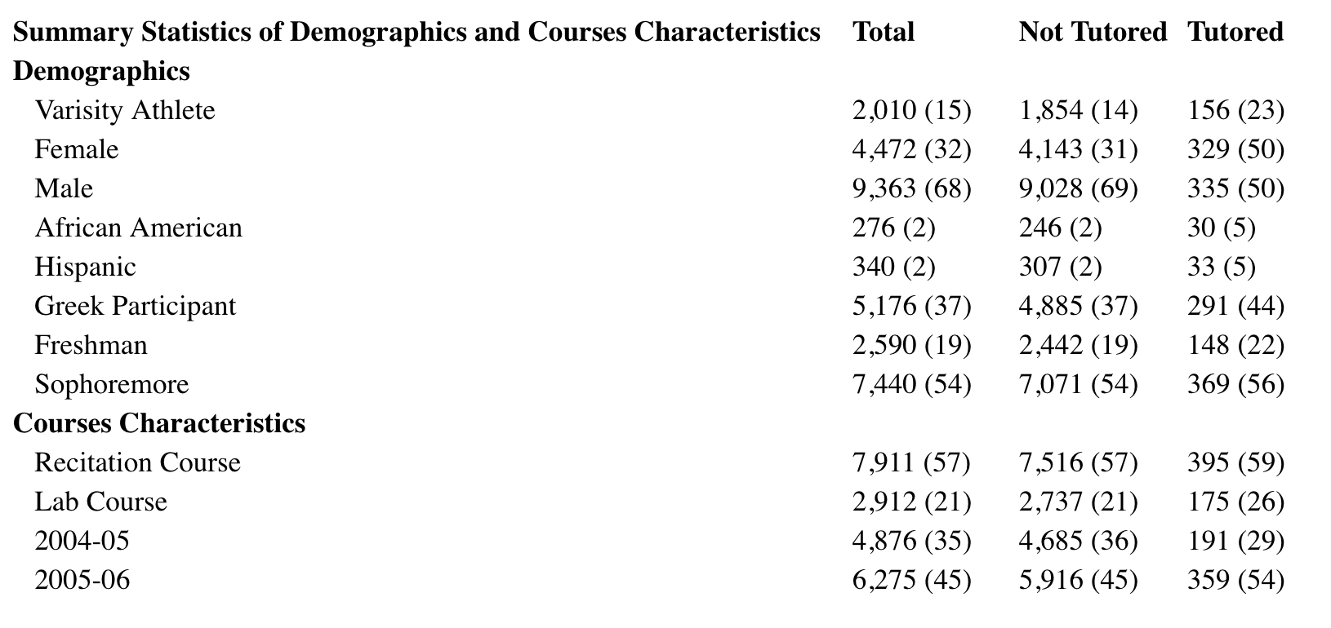

Slide 7
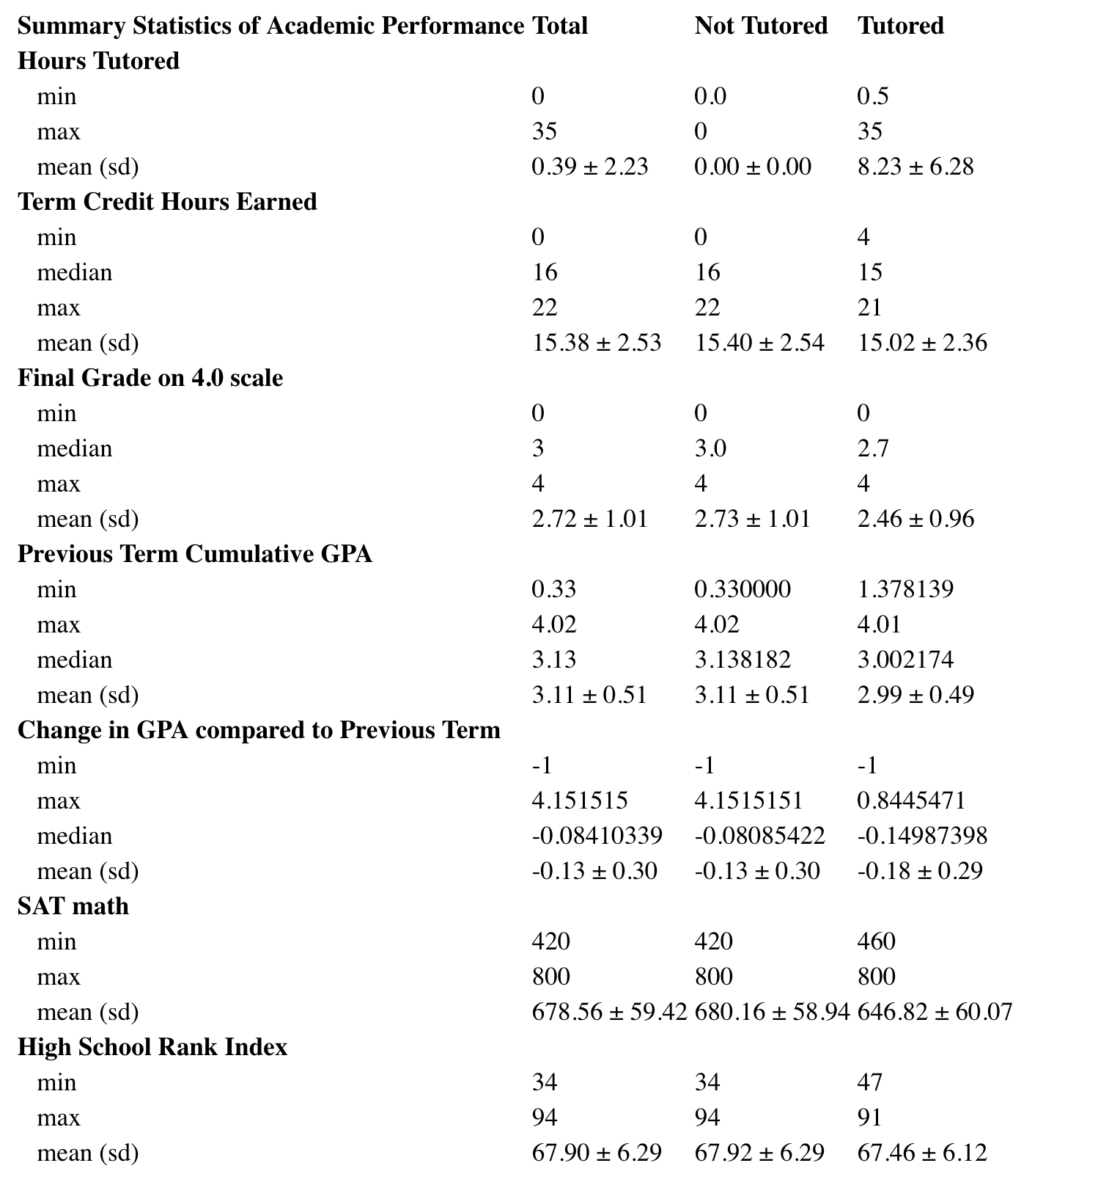
Summary Statistics of Academic Performance

Slide 8
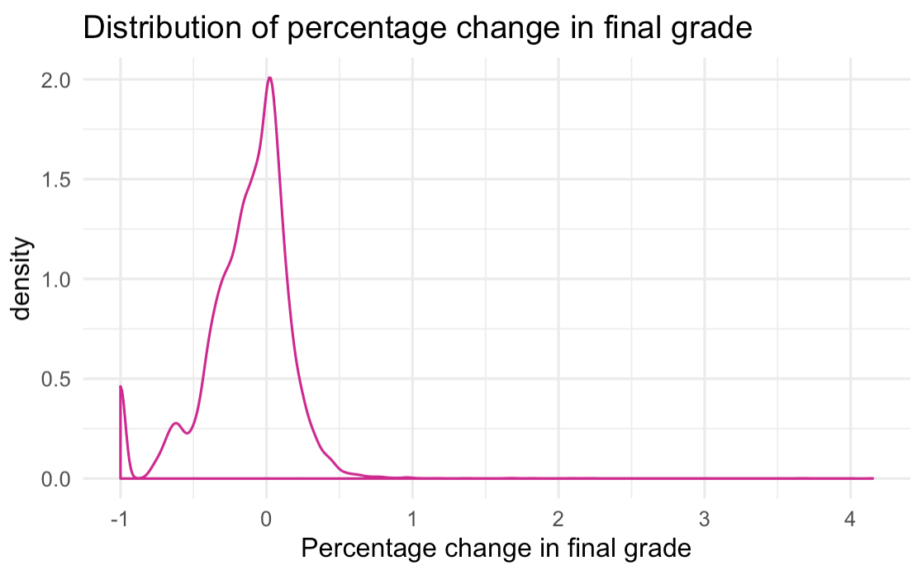
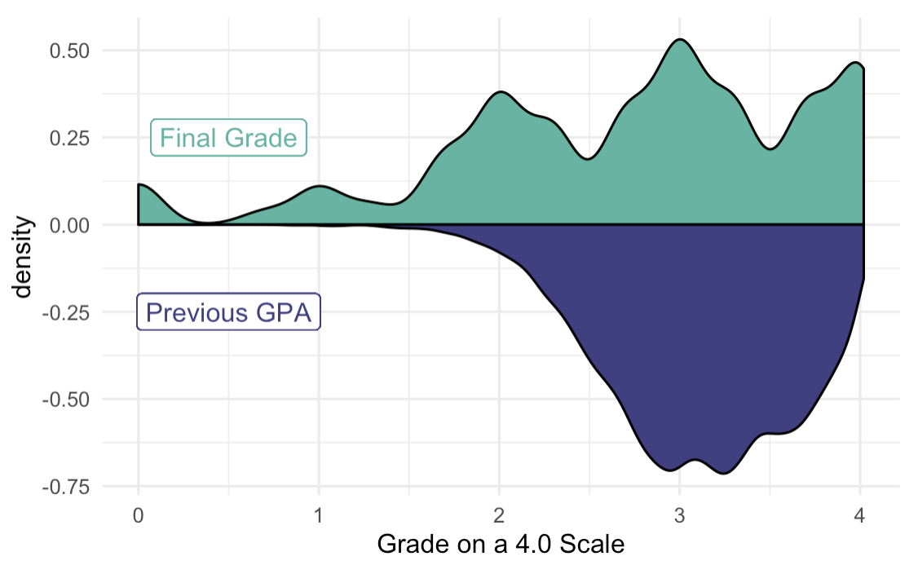

Slide 9
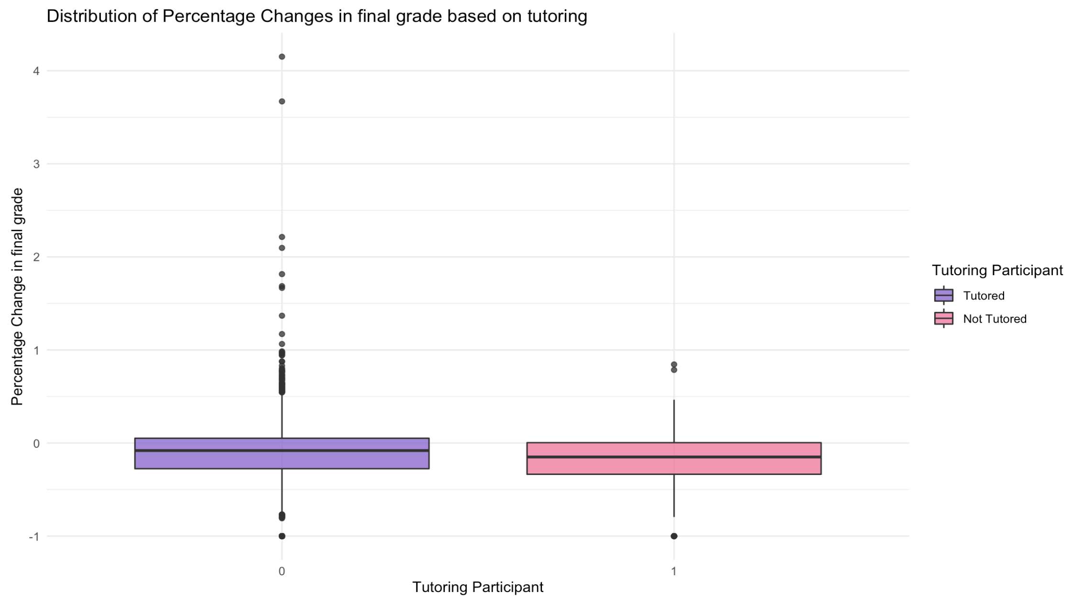
Distribution of Percentage Change in Final grade Based on Treatment

Slide 10
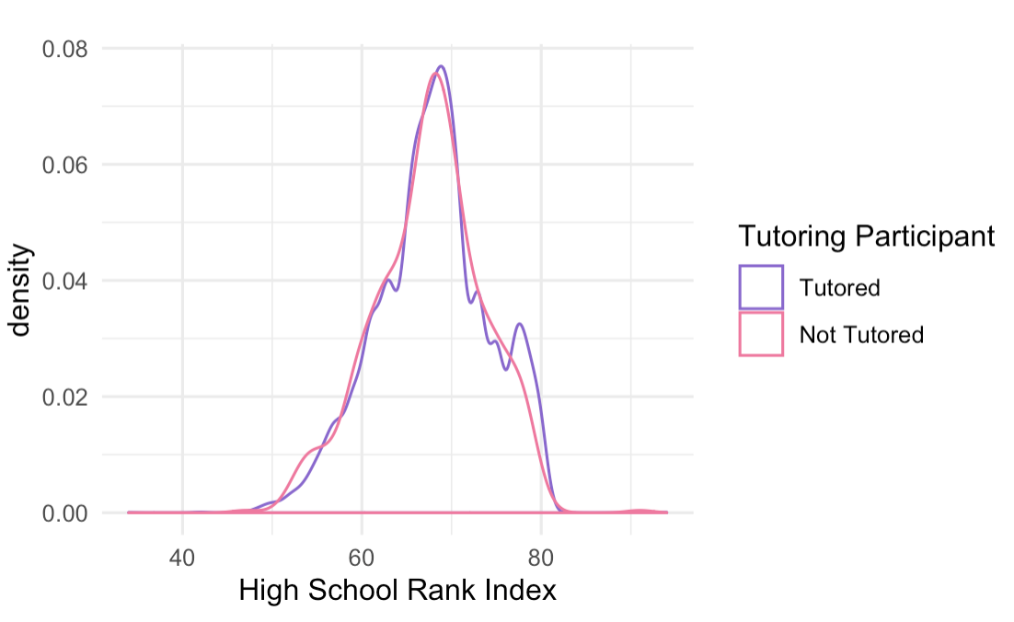
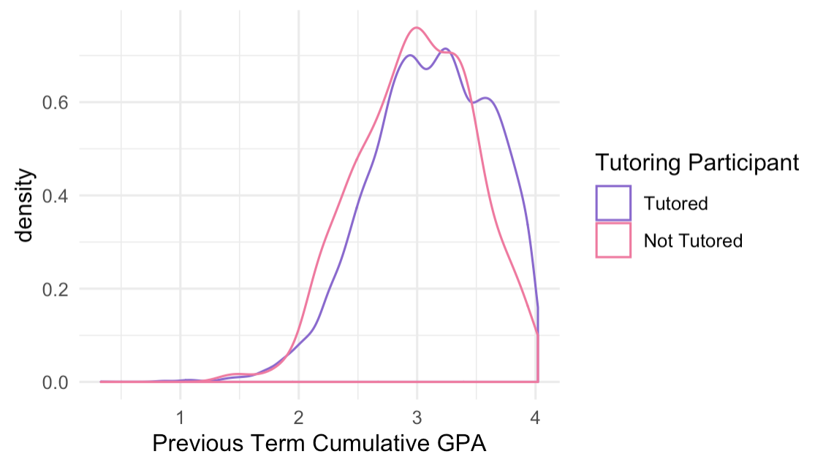
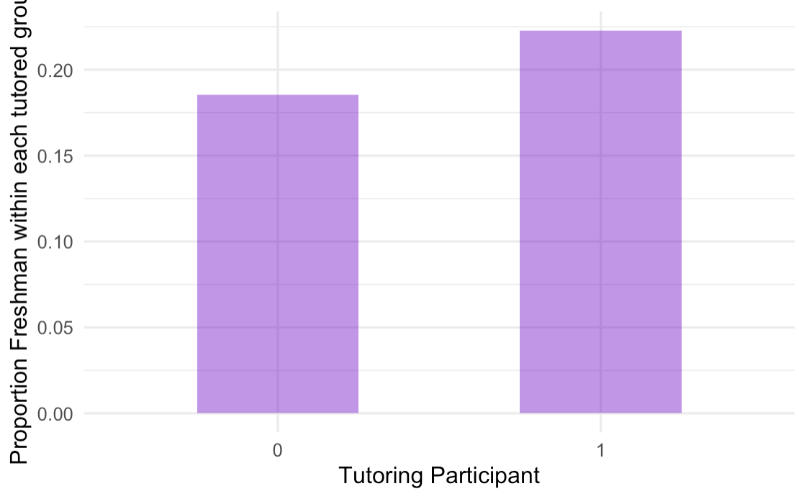
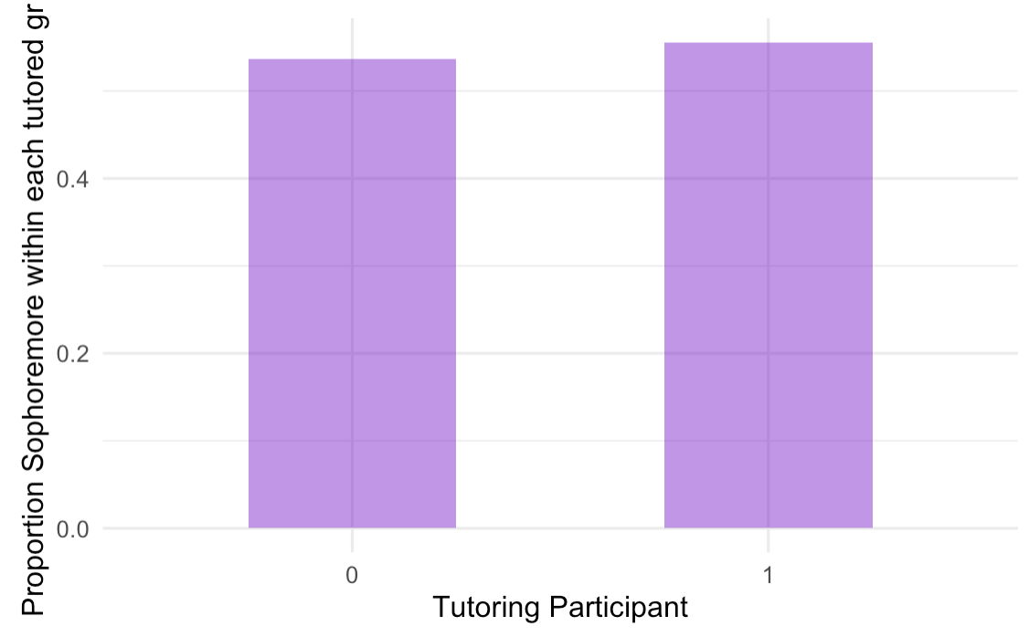

Slide 11
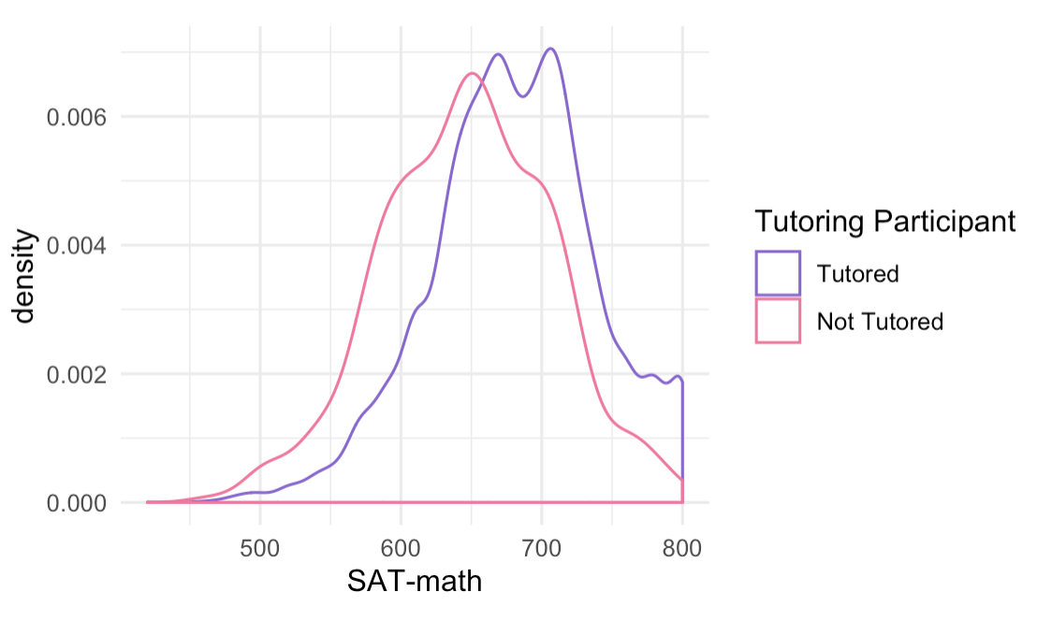
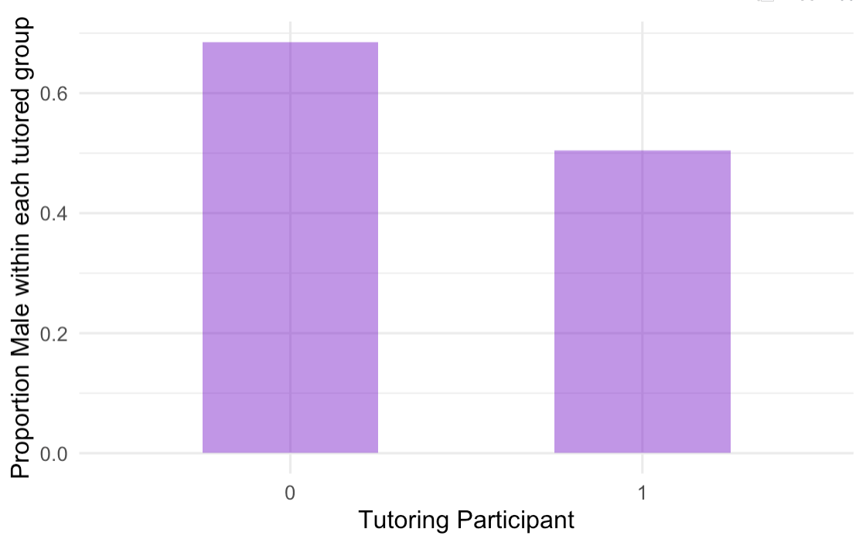
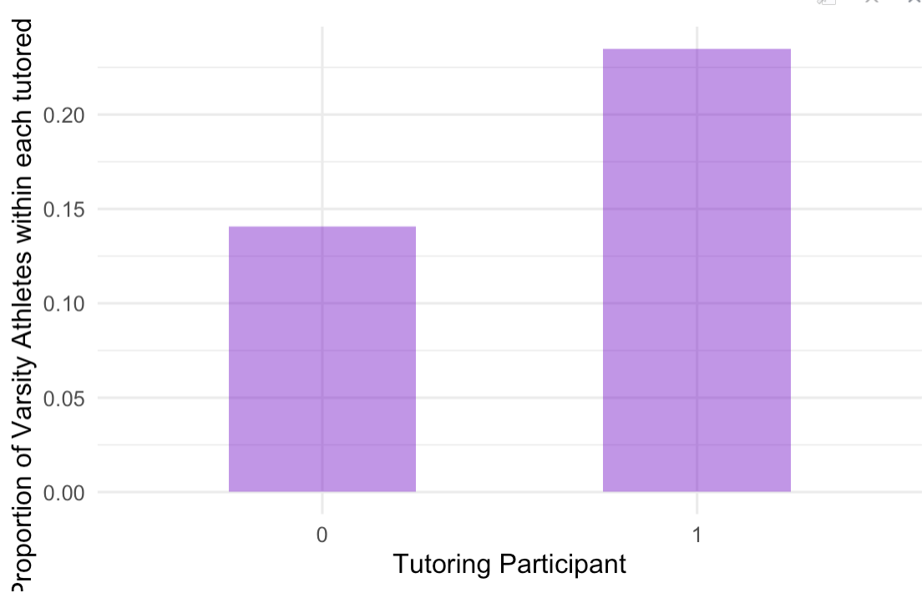
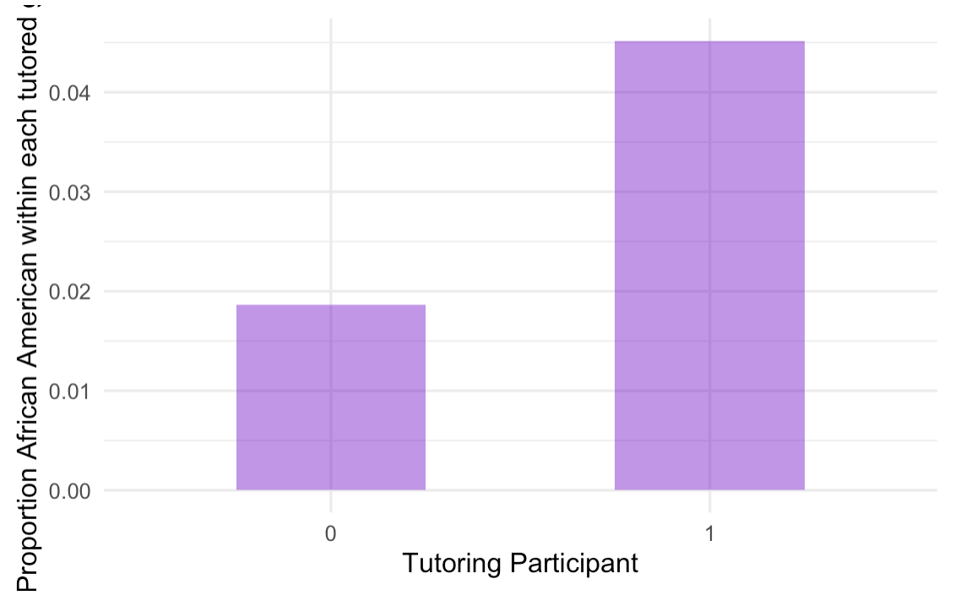

Slide 12
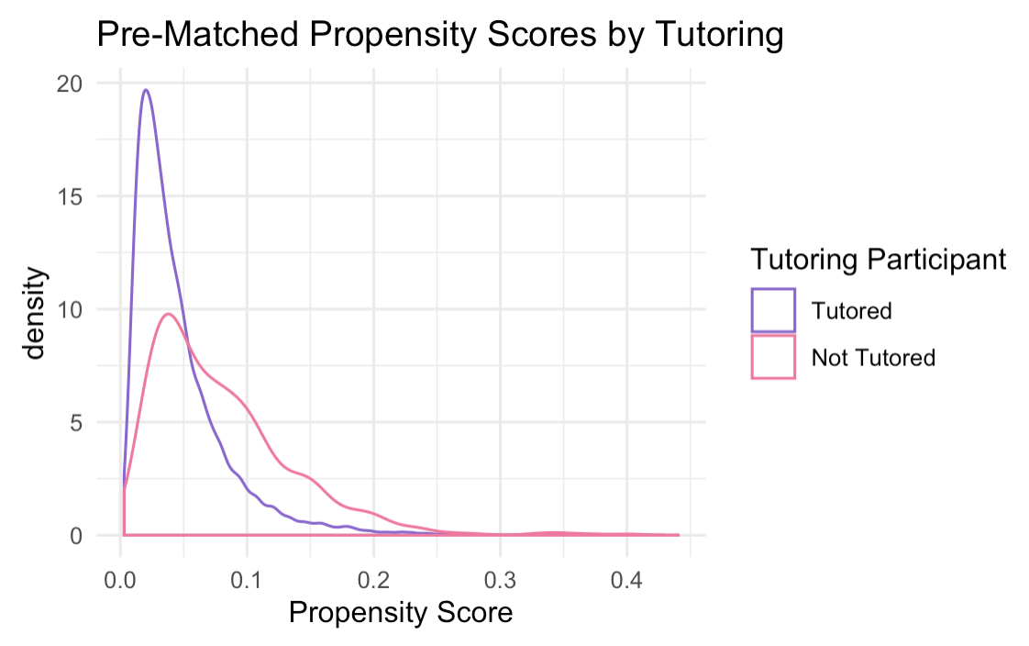
Propensity Scores Before Matching

Slide 13
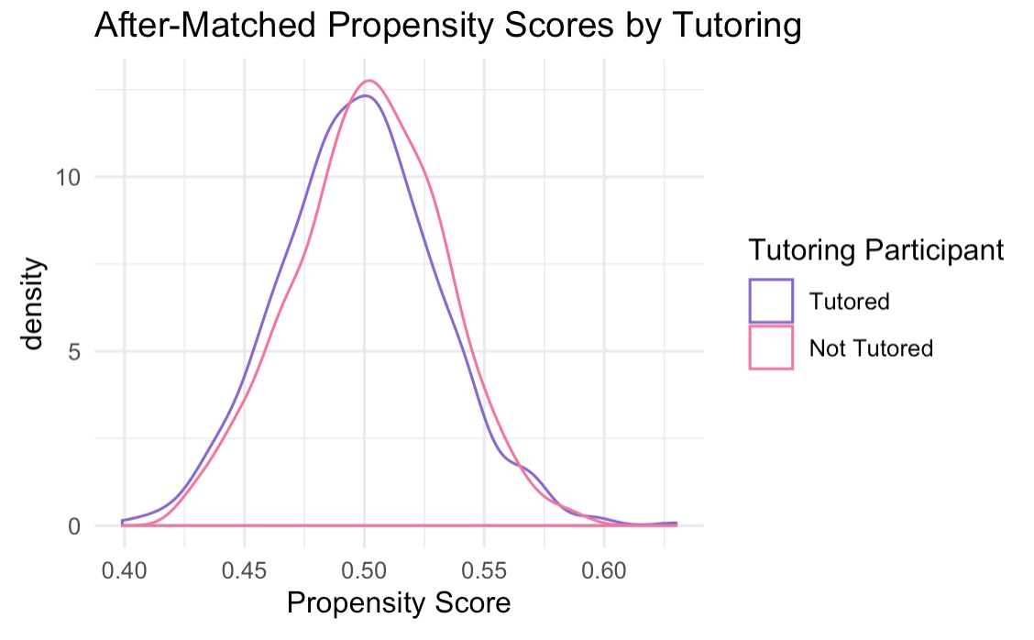
Propensity Scores after Matching

Slide 14
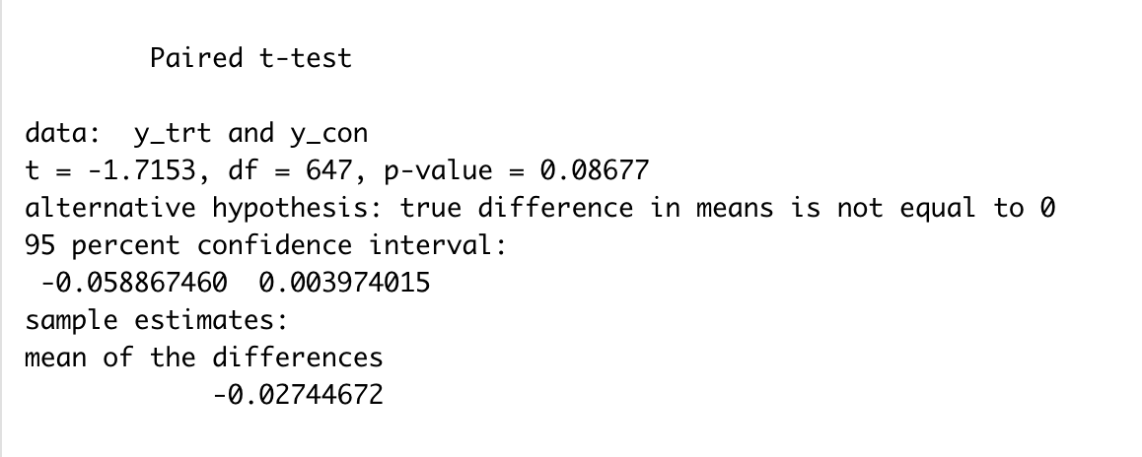
T-test result (Propensity match):
Notes:
Paired t-test results: The effect of the treatment leads to a difference of -0.0589 to +0.004 on the proportion change in GPA between previous term, and final grade. The confidence interval includes 0, so we can’t reject the alternative hypothesis. There is a statistically significant effect of the treatment on proportion change in GPA.

Slide 15
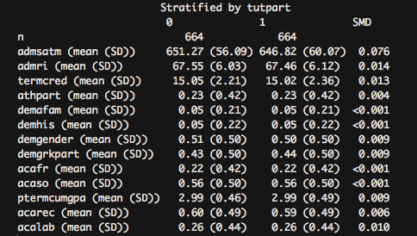
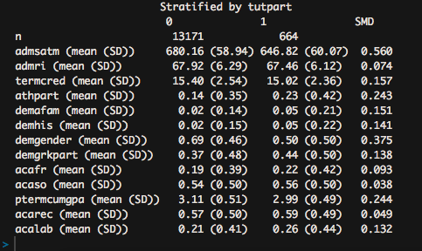
Greedy Matching
List of Covariates: SAT-Math, Term Credit Hours, High School Rank Index, Athlete, African-American, Hispanic, Gender, Greek Life, Class Year, # of Rec Courses, and # of Lab Courses
Before Matching
After Matching
Notes:
Standardized Mean Difference across all covariates are below 0.2, raising no particular red flags, establishing that matching infact worked, and global distance has been decreased? There is adequate balance after completing matching, hence, we can go ahead with our analysis.

Slide 16
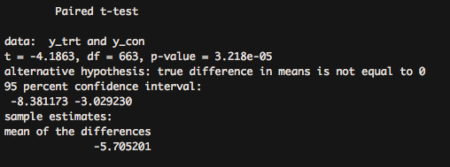
T-Test (Greedy Matching)
Outcome Variable: Change in GPA in percentage points

Slide 17
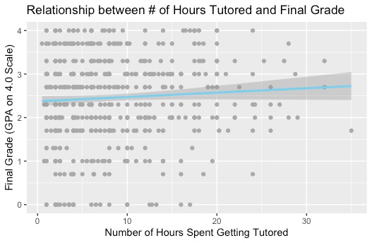

Slide 18
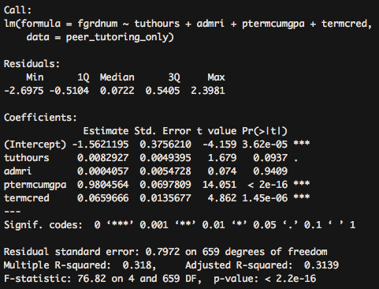
OLS Model (inspired by Munley et.al. (2010))
Basic Regression Model to measure effect of participation in tutoring in terms of hours spent getting tutored on exogenous final grade on subset of sample.
Model → βX + δT + ε Wherein, X = Vector of controlling variables (Prev Term GPA, Term Credit Hours, High School Rank Index) T = Tuthours = Number of hours spent tutoring

Slide 19
LIMITATIONS
Response variable calculated using final grade of one course and previous term cumulative GPA. (assumption: final grade in one course reflects term GPA)
We don’t know if students have participated in peer tutoring program or not prior to the study.
Data was highly skewed on percentage change in final grade.
Limited information about students’ other demographic characteristics and the levels of difficulty of the courses they were enrolled in.

Slide 20
IMPLICATIONS
An ideal study to examine the causal inference: a randomized experiment!
However, if we wanted to study this topic at Wesleyan, we could only conduct an observational study.

