Slide 1
The Connection:
Analyzing client behavior both in The Connection’s programming and after
By: Jiner Zheng, Keli Jiang, Leah Ewers
Notes:
LEAH

Slide 2



Meet the team:
LEAH EWERS ‘23
Economics major, Data Analysis Minor
KELI JIANG ‘22
Sociology & Psychology major, Data Analysis Minor
JINER ZHENG ‘22
Computer Science & Psychology major, Applied Data Science Certificate
Notes:
Leah speak, keli jiner wave

Slide 3
Research
questions:
Where do The Connection clients locate to after the programs and what are their characteristics?
What social and psychological factors are associated with an increased likelihood of behavioral incidents during clients’ participation in Connection programming?
Notes:
LEAH

Slide 4
Sample
3584 clients. 8 programs.
36% Black (n = 1304), 34% White (n=1249) , 28% Other (n = 1030)
Average age: 43 (all over 18)
Primarily male
**Data from past 50 years with the exception of some fields being recently added for tracking
Notes:
KELI

Slide 5
Significant Measures
Trauma History
Mesured by “yes” or “no” to whether or not client had a history of any traumatic experience such as domestic violence, physical/sexual abuse, etc.
Alcohol & Drug Score Participants’ alcohol and drug problem where 0 = no problem to 9 = severe problem
Incident Score
A composite measure of participants’ incident frequency and severity based on the number of incidents corresponding to its level of severity (i.e. the sum of count * incident level)
Suicide Risk Score composite measure of participants’ level of suicidal risk
Criminal History
A composite measure of the participants’ criminal history
Homicide Risk Score composite measure of participants’ level of homicidal risk
DP
IV
Life Functioning Problems
An overall measure of the client’s life-functioning problems in the areas of substance use, mood adjustment and community compliance.
AoD Problem in Last 6 Months
Measures the extent of involvement and disruption from AOD use in the past six months.
Incident Level
Discrete values 1,2,5 according to its type (5=most severe, i.e. [I] level incident)
Notes:
KELI

Slide 6
Our Analysis
Getting to know the Data
Regression Analysis
Latent Class Analysis
1
2
3
Notes:
KELI

Slide 7
Getting to know the Data
1
Notes:
KELI

Slide 8
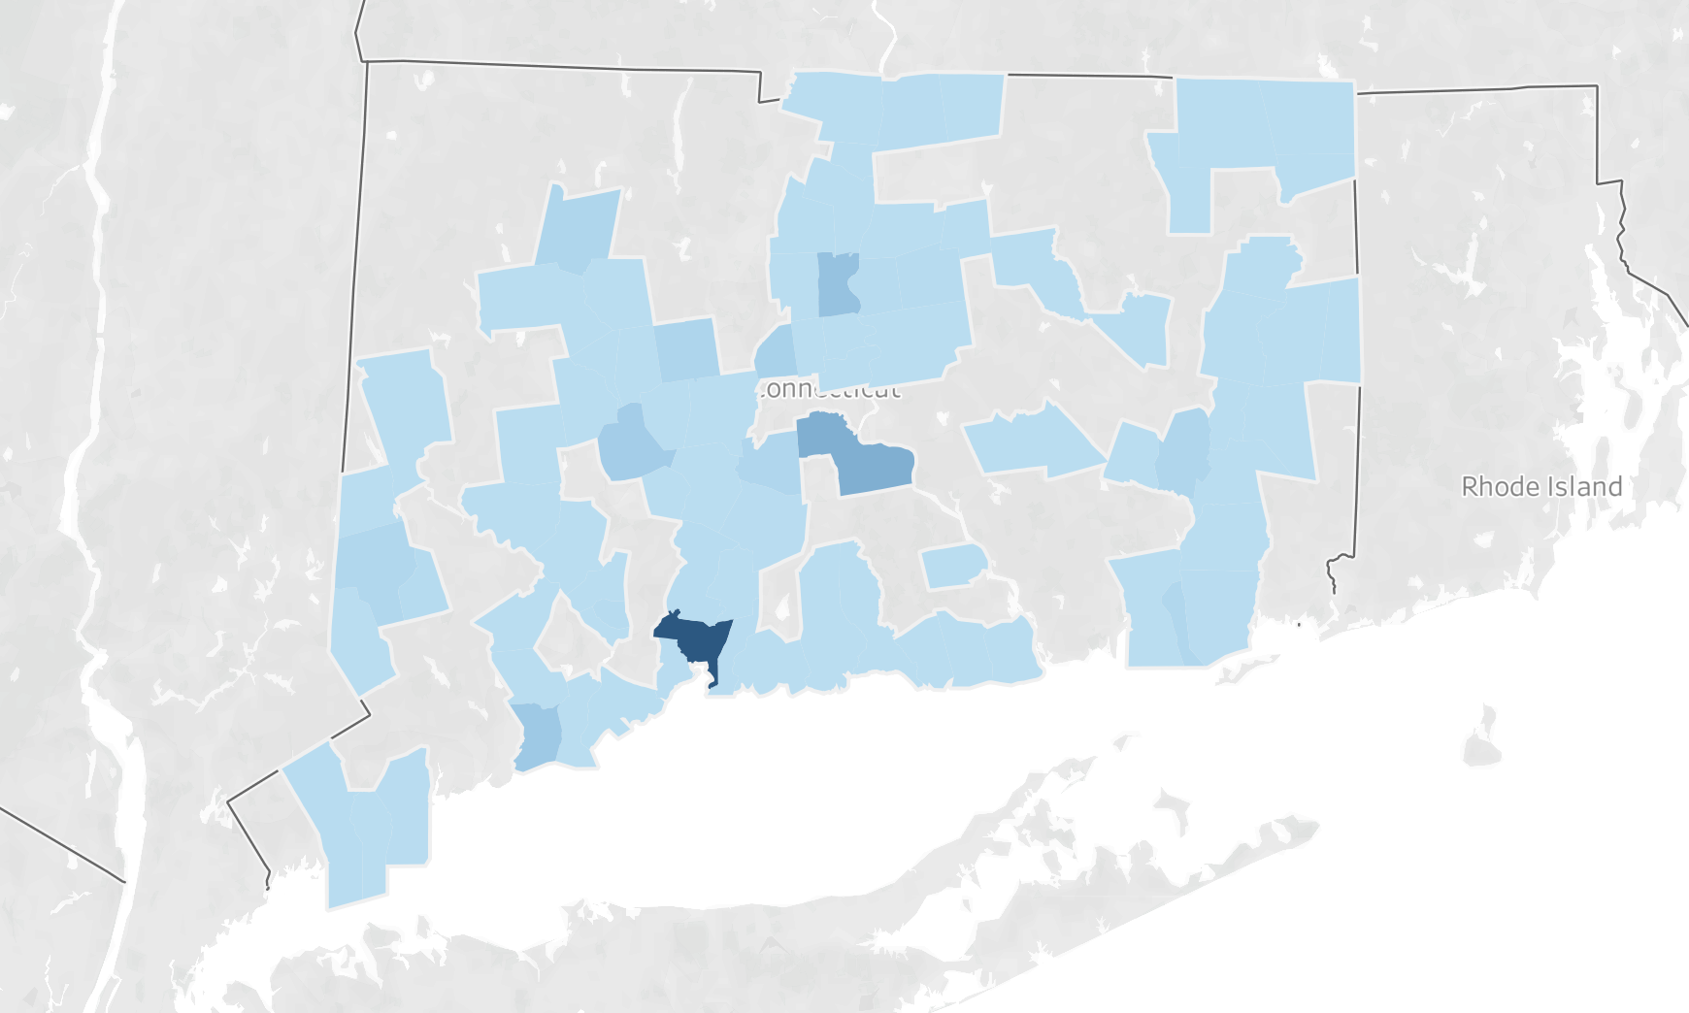
Where are most of the clients going after The Connection?
A total of 981 clients were discharged to New Haven. Middletown (329 clients) and Hartford (197 clients) took in the second and third most clients among all cities in Connecticut.
Hartford
Middletown
New Haven
Notes:
KELI
New Haven 27.4% Middletown 9.2% Hartford 5.5%

Slide 9
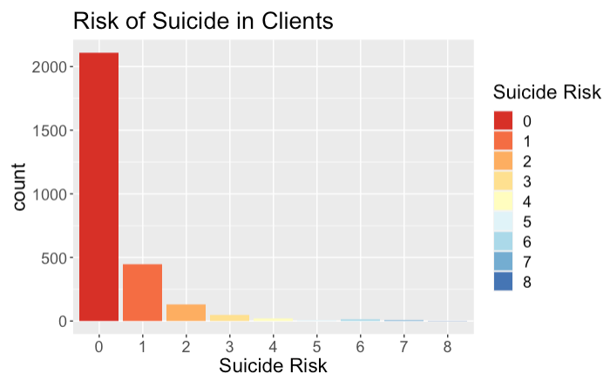
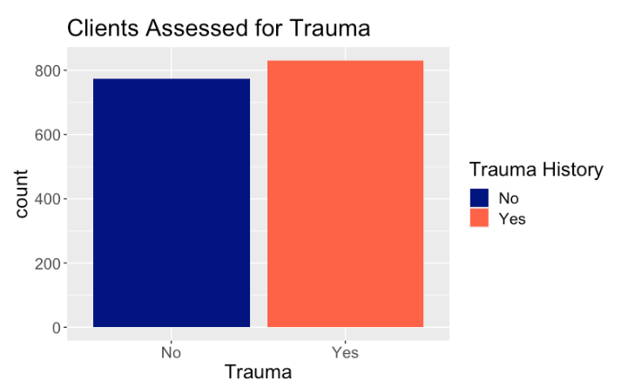
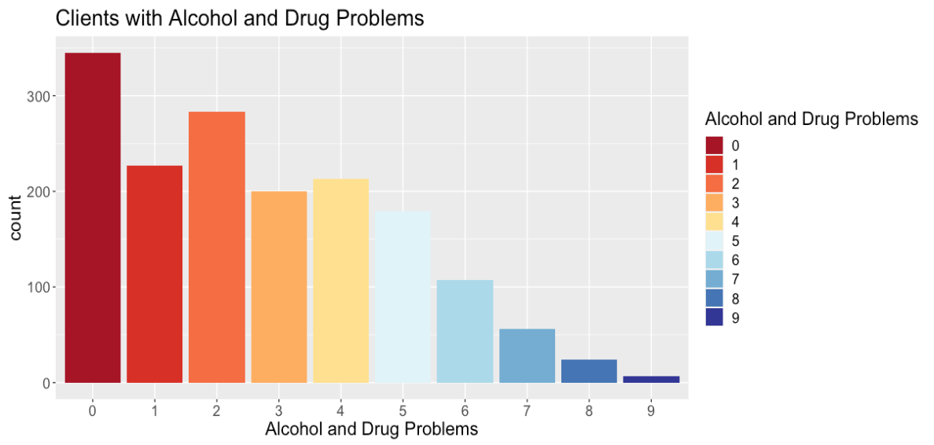
Descriptive Data
~52%
~48%
Notes:
LEAH

Slide 10
Regression Analysis
2
Multiple regression analysis was conducted to assess the relationship between clients’ incident scores (the outcome variable) and client alcohol or drug involvement, criminal history, risk level - Suicide & Homicide, and ASUS scale risk factors (predictors).
The regression model also controlled for demographic factors including age, race, and marital status.
Notes:
LEAH

Slide 11
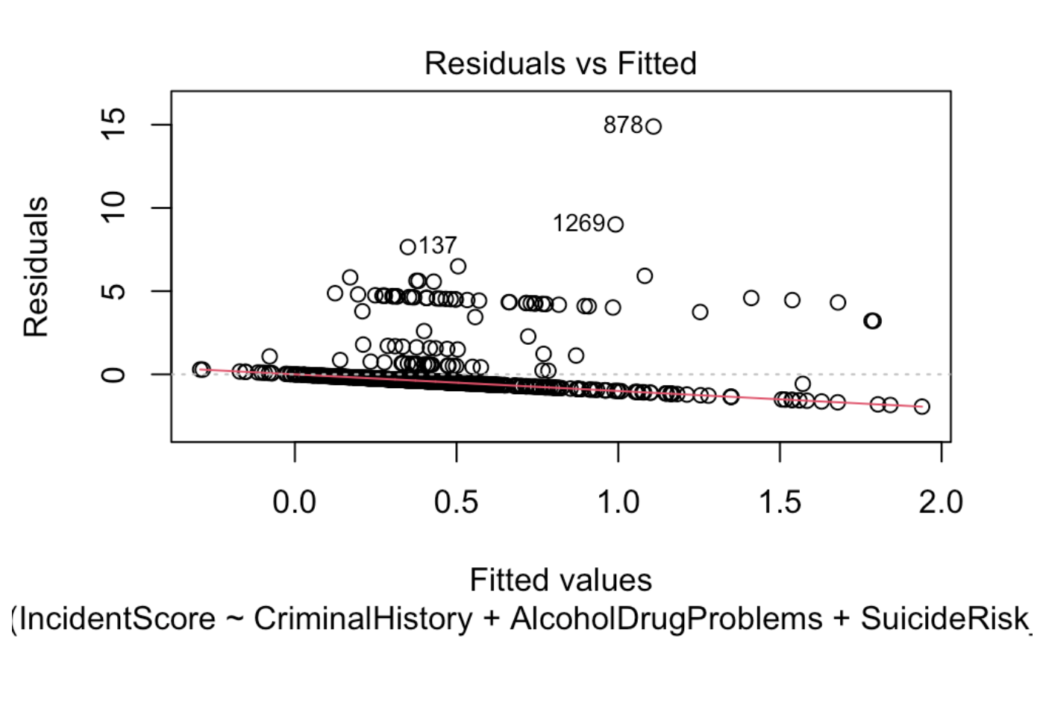
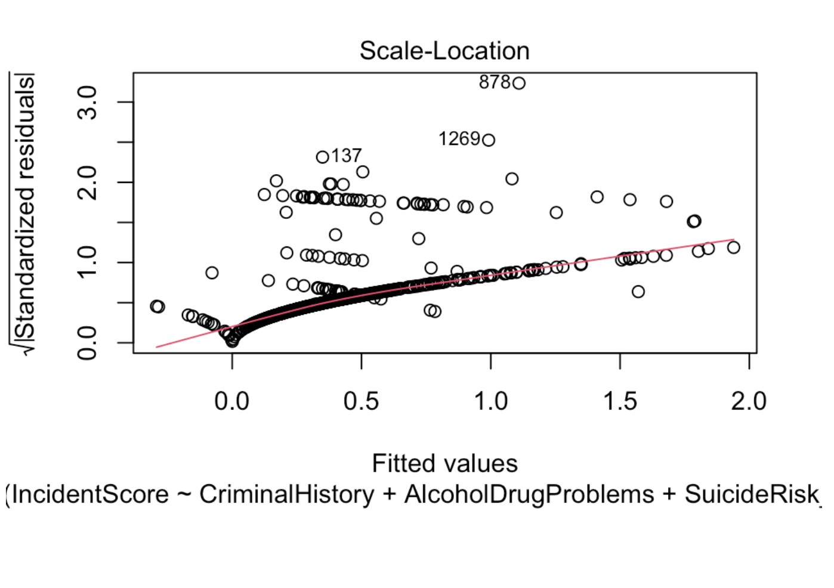
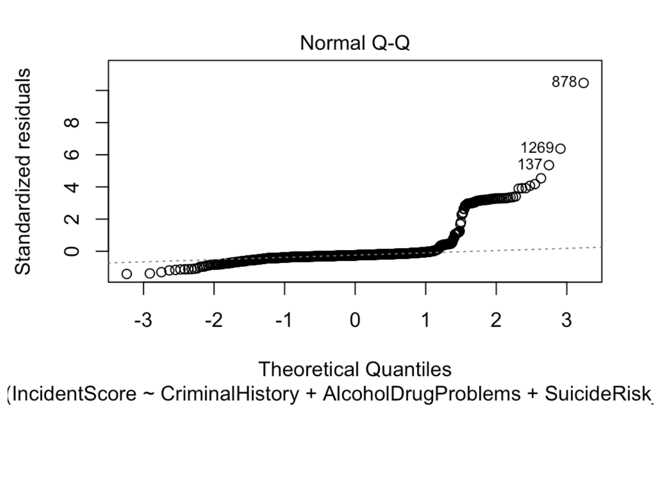
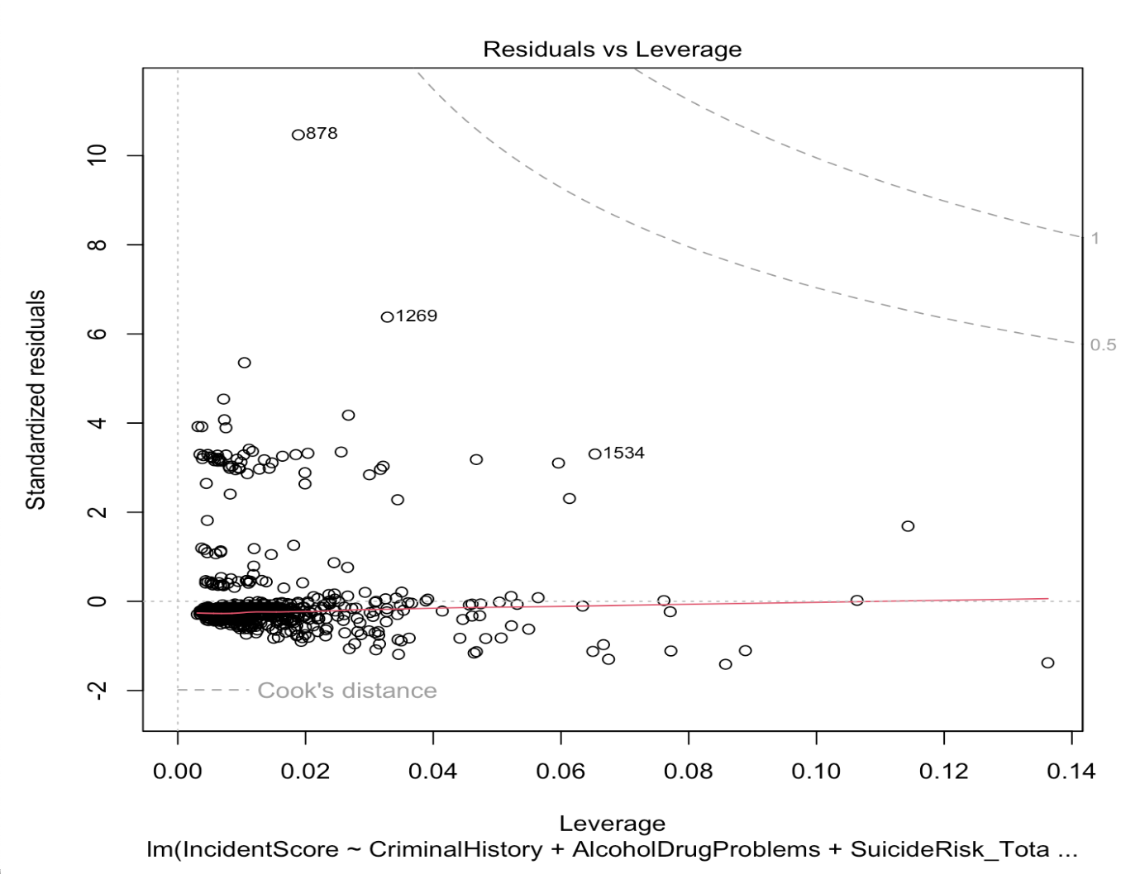
Regression Results I
Suicidal risk (b = 0.24, p <0.001) and having an alcohol or other drug use problem in the past 6 months (b = 0.025397, p <0.001) were significantly associated with a higher Incident Score.
After controling for demographic factors, suicidal risks and Alcohol and Drug Problems in the last 6 months still remain significantly associated with incident score.
Notes:
LEAH

Slide 12
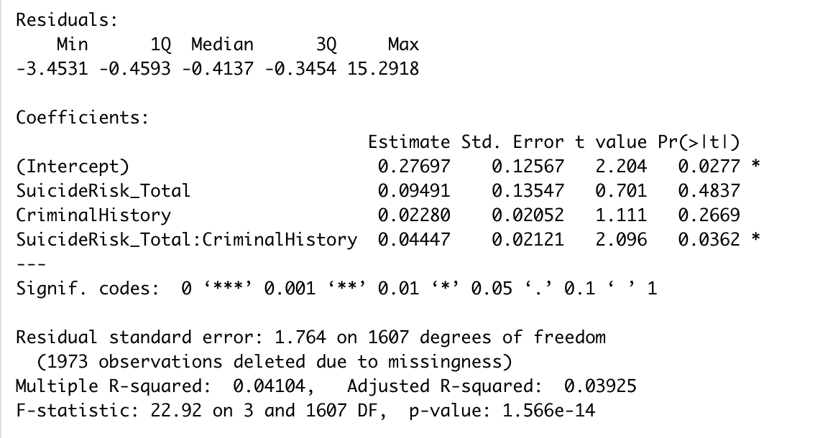
Regression Results II
Suicidal Risk and Criminal History were found to have an interaction in relation to Incident Score given by a P = 0.0362 (p < 0.05).
What is the interaction?
Higher suicide risk increases the impact that a person’s criminal history would have on # of behaviorial incidinents while in Connection programming
Notes:
LEAH
Lastly, after running a simple regression with an interaction term with Incident Score being the response and Suicidal Risk being the response and Criminal History being the interaction term. Suicidal Risk and Criminal History were found to have an interaction in relation to Incidencet Score (p = 0.036).

Slide 13
Latent Class Analysis
3
Latent class analysis (LCA) produces a categorical latent class membership variable. Clients are assigned to a class based on the similarity of their pattern of response on the classification variables to other clients.
LCA was conducted to identify the risk profiles on the subsample of 1814 clients without missing data on variables included in the analysis.

Slide 14
1814 clients. 8 programs.
Sample
Primarily male, single or not married, with no religion beliefs
25.58% in Class 1 - High Risk (n=464)
56% Caucasian or White, 21% African American or Black
25.85% in Class 2 - Low Risk (n = 469)
49% African American or Black, 19% Caucasian or White
48.57% in Class 3- Moderate Risk (n = 881)
44% African American or Black, 26% Caucasian or White
**Data from past 50 years with the exception of some fields being recently added for tracking

Slide 15
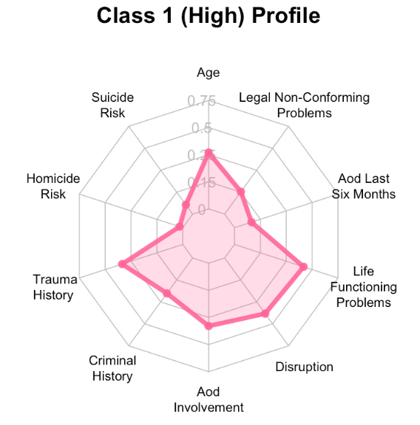
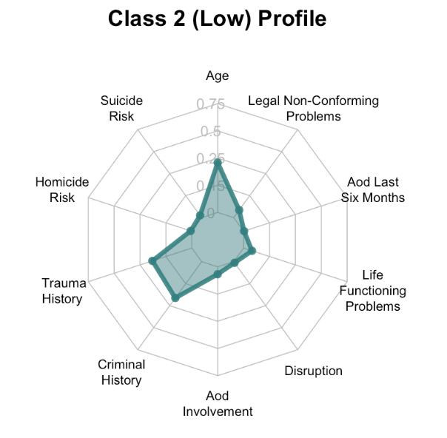
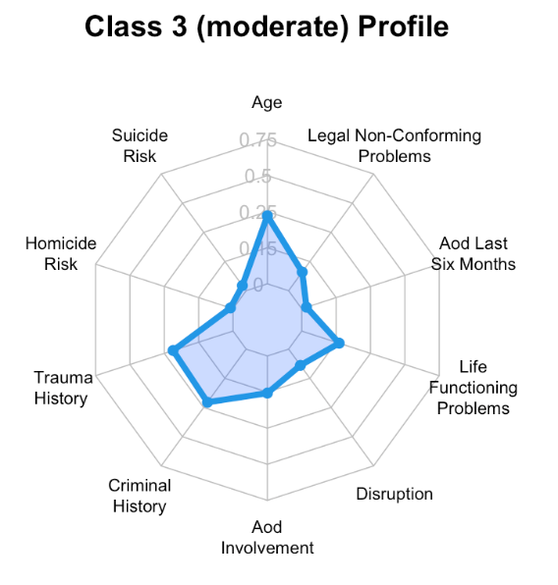
LCA Classification Results:
* all values were means of the classification variables for each latent class
* values were rescaled using min-max difference only for radarchart displaying purpose
High Risk Class
Low Risk Class
Moderate Risk Class

Slide 16
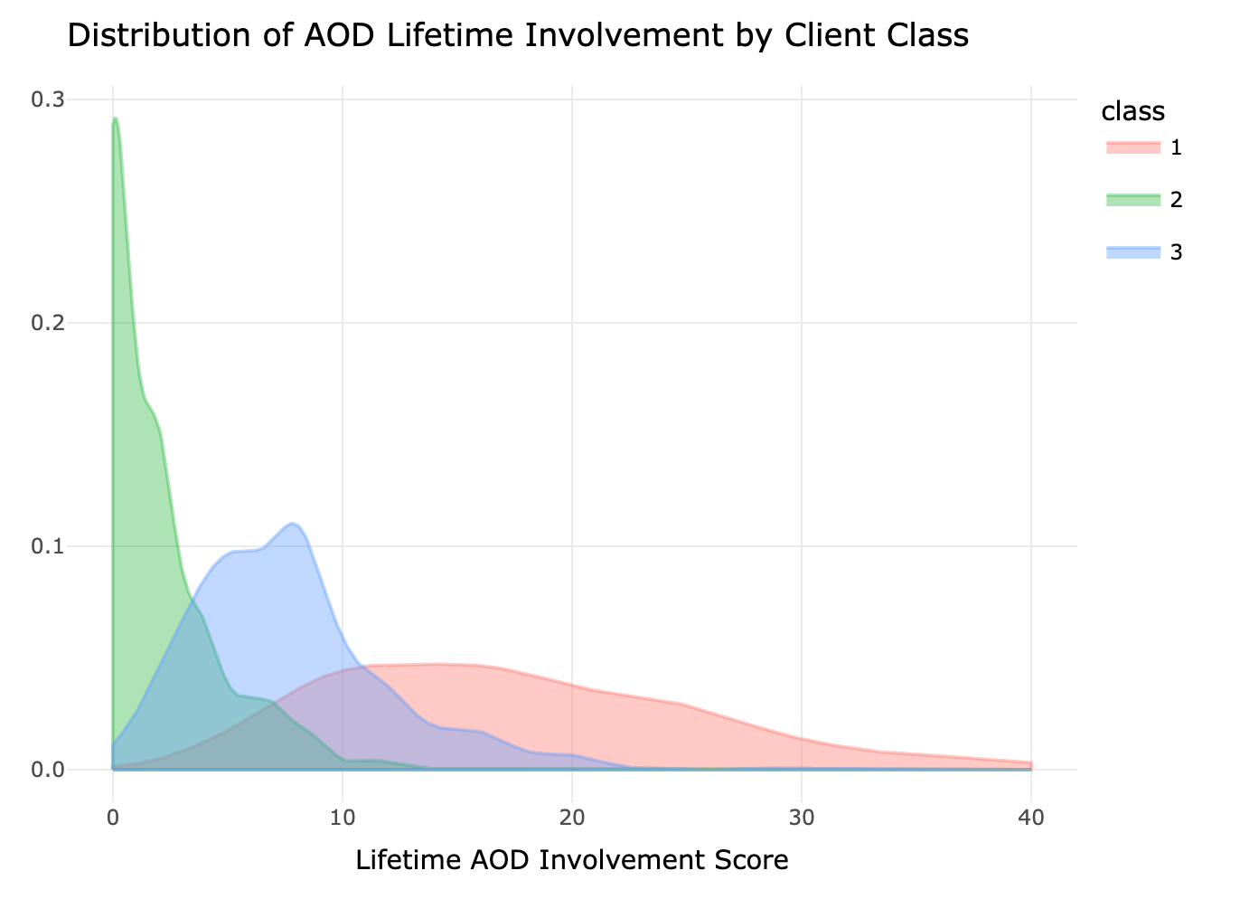
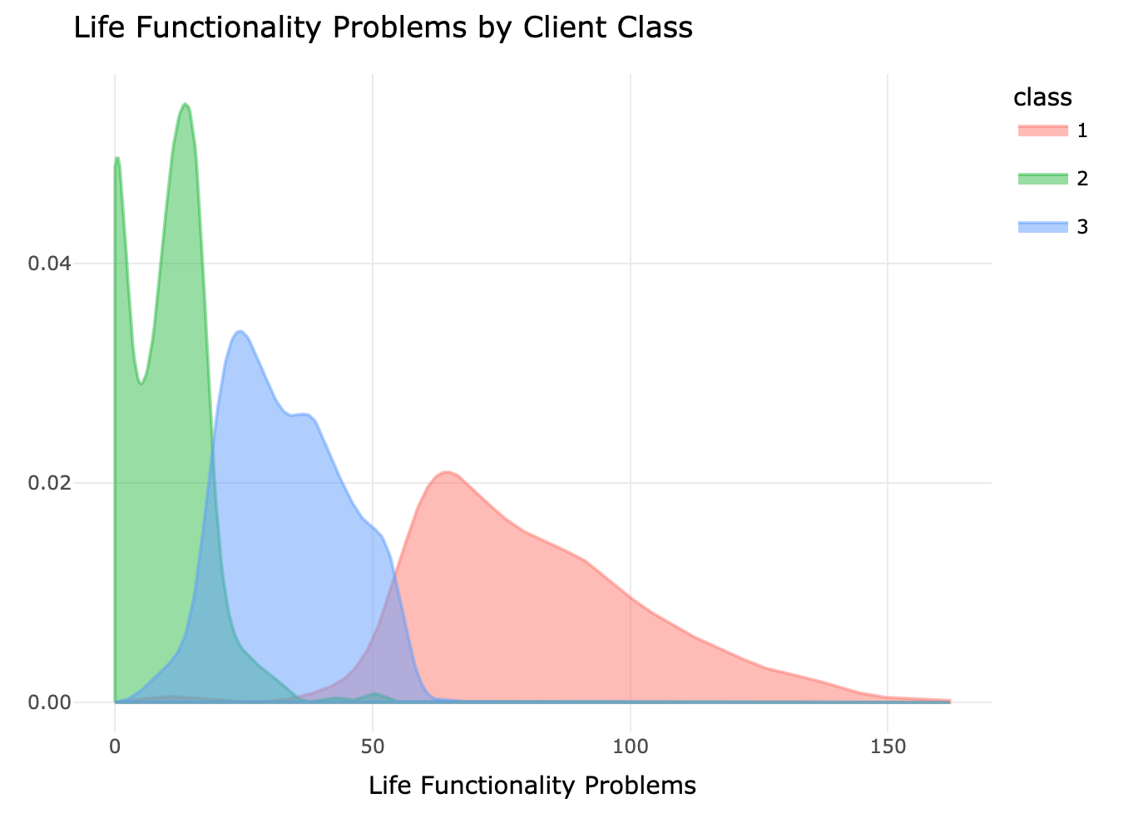
AOD Involvement &
Life Functioning Problems

Slide 17
Risk Level — Suicide
& Homicide
 | Class 1 (n=464)) | Class 2 (n=469) | Class 3 (n=881))
Suicide: Low | 93.75% (n=435) | 99.36% (n=466) | 98.52% (n=868)
Suicide: Medium | 4.53% (n=21) | 0.64% (n=3) | 1.36% (n=12)
Suicde: High | 1.72% (n=8) | 0% (n=0) | 0.11% (n=1)
Homicide: Low | 85.13% (n=395) | 97.65% (n=458) | 94.89% (n=836)
Homicide: Medium | 11.64% (n=54) | 2.13% (n=10) | 4.54% (n=40)
Homicide: High | 3.23% (n=15) | 0.21% (n=1) | 0.57% (n=5)
Class 1 (high risk) had the highest proportion of clients with medium and high suicidal and homicidal risk levels.
Class 2 (Low risk) had the highest proportion of clients with both low suicidal and homicidal risk levels.

Slide 18
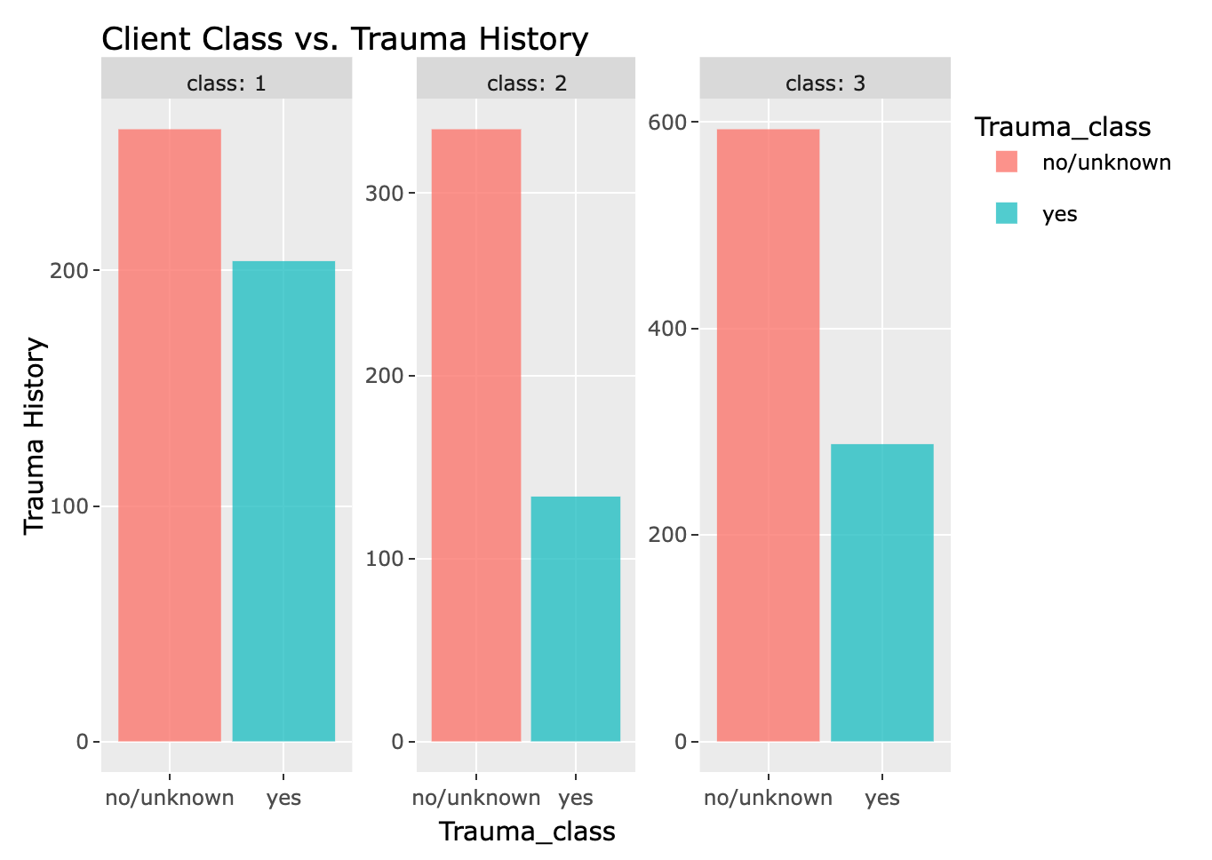
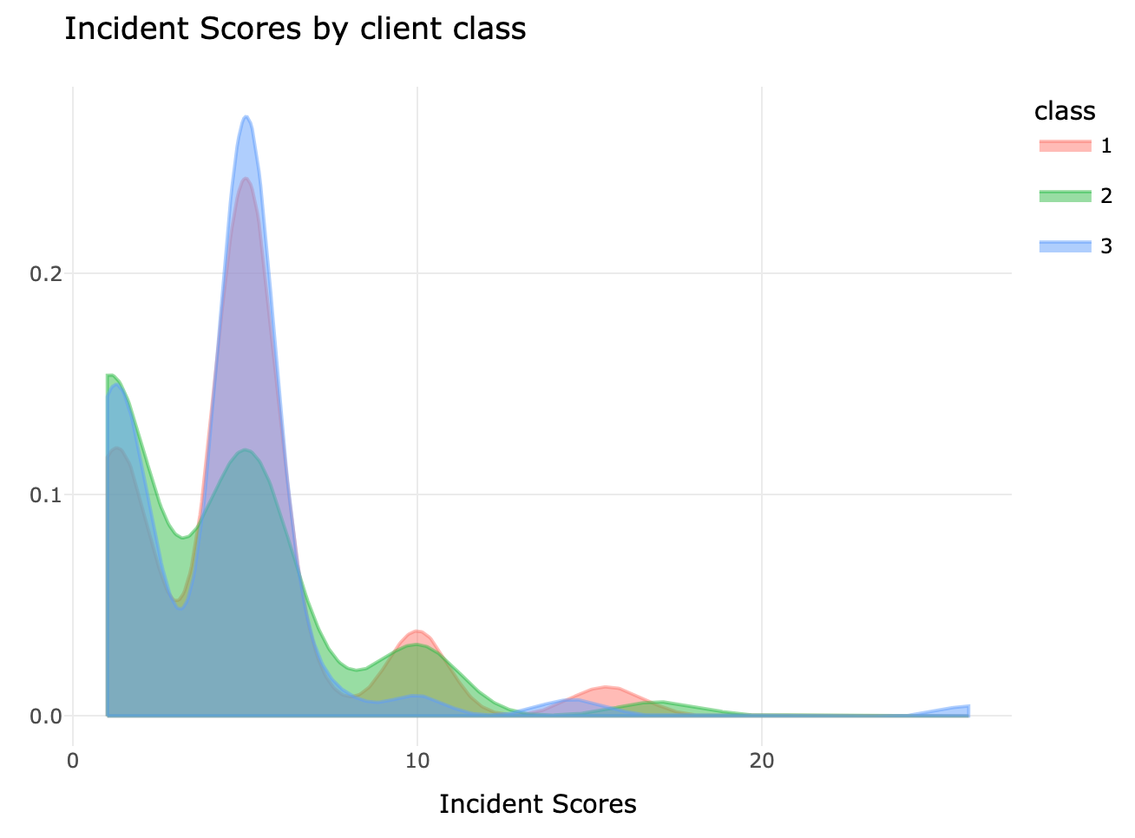
Trauma History & Incident Scores

Slide 19
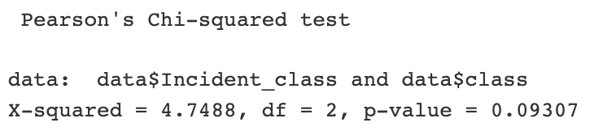
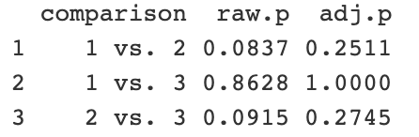
Chi-square: Incident vs. Client Class
Incident Class | Class 1 (n=464)) | Class 2 (n=469) | Class 3 (n=881)
YES | 2.59% (n=12) | 4.9% (n=23) | 2.95% (n=26)
NO | 97.41% (n=452) | 95.1% (n=446) | 97.05% (n=855)
Class 2 - Low Risk Class had a significantly greater likelihood of having behavior incidents (4.9% clients with incident history).
Class 1 - High Risk Class had the relatively lowest likelihood of having behavior incidents (97.41% clients with no incident history), but it didn’t differ from Class 2 - Moderate Class significantly (p-value = 0.8628, compared to Class 1).
All differences detected were only marginally significant (p-values < 0.1 only).

Slide 20
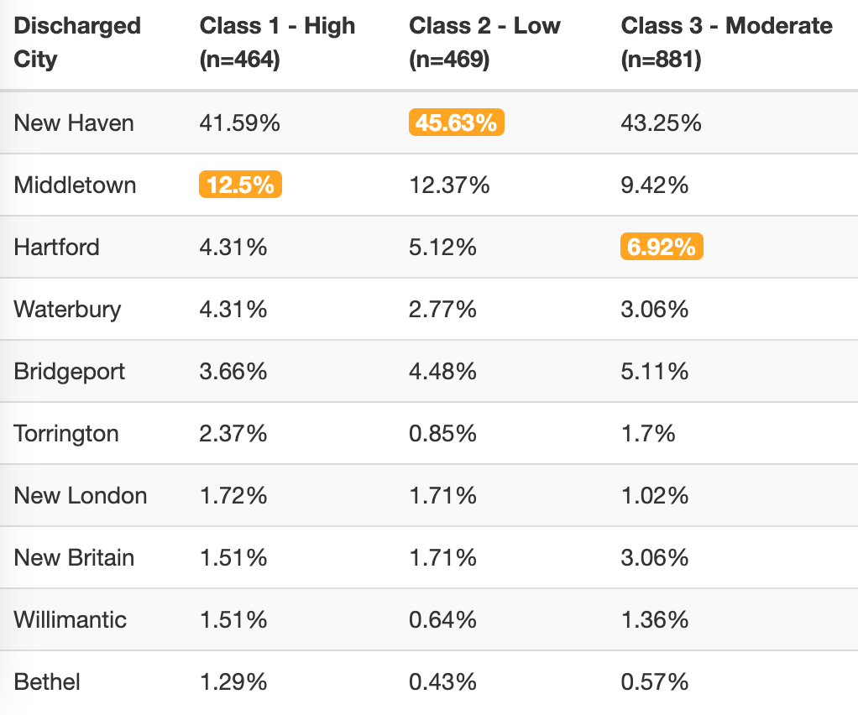
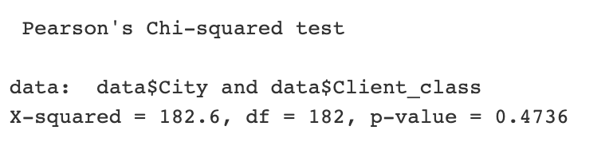
Top 10 Discharged City vs. Client Class
Client class didn’t differ significantly in their discharged location.
All three classes have higher proportion of clients discharged to New Haven, Middletown, and Hartford.

Slide 21
Conclusions
Clients’ suicidal risk and involvement with alcohol and drugs in last six months were the most significant predictors of higher incident scores.
Three unique classes were identified: high, low, and moderate risk class based on level of severity in all classification variables such as trauma history and life functioning problems.
Low risk client class had a significantly greater chance of having behavior incidents, while high risk class and moderate risk class didn’t differ significantly from each other regarding incident history.
These findings may be helpful in identifying clients who are at higher risk for having behavior incidents based on recidivism risk factors, thus providing targeted services or actions to better help them adjust and succeed.
Notes:
KELI
Low risk client class w/ greater change of behavior incidents → again this could be explained by the level of supervision and freedom that clients had based on how severe their psychological and social problems were.
+ future research can look into if client classes differ significantly in severity/number or a particular type of behavior incidents.

Slide 22
Limitations
Missing data entries in drug & employment datasets
Certain variables (e.g. trauma history) were highly skewed due to the amount of unknown responses.
Latent class analysis results may be more specific and detailed with larger sample size.
Causal relationship cannot be concluded from the current study.
Notes:
There were many missing data entries in drug and employment datasets, but it will be interesting to look at clients’ employment status after discharge from the problem.
Certain variables such as trauma history were highly screwed because responses of both unknown and no were coded as 0. Having more sufficient and meaningful data can definitely improve our analyses.
Our latent class analysis was only based on half of clients sample due to missing data entries, the client class profiles can be more complete and detailed with larger sample size.
Causal relationship cannot be concluded from the current study, but it is still interesting to see how each major variable correlates to behavioral incidents.

Slide 23

Thanks! Questions?
Place your screenshot here
THE CONNECTION
Notes:
LEAH

