Slide 1
CSS

Slide 2
CSS stands for Cascading Style Sheets. It is the language for describing the presentation of Web pages, including colours, layout, and fonts, thus making our web pages presentable to the users.

Slide 3
CSS Box Model
According to CSS, every element on your web page fits into a box. This is known as the CSS Box Model.
Understanding the CSS Box Model will help you lay elements out on your page. It will also help you understand how the elements will react to one another.

Slide 4
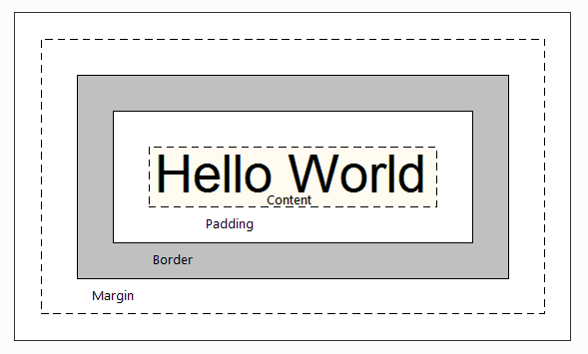

Slide 5
The containing block of this page allows for a maximum width of 800px. Our box will stretch to fit that.
In CSS, the width of the box is only the width of the content. To calculate the actual amount of horizontal space the box will take up, we have to add the margin, border, and padding amounts for each side.
This is the same box as the

Slide 6
The content of the box above is 200px. However, we have margins, borders and padding on the left and right of the box. Firebug can easily show us this.

Slide 7
By adding all of the margin, borders, and padding on the left and right of the box to the specified width of 200px, we get 264px. The width of the above box is 200px, but the actual amount of vertical space it takes up is 264px.
If we wanted this same box to fit into a space of 400px, we would have to calculate the box width.

Slide 8
Box Model Elements and Syntax
There are majorly four elements in a box-model on which the behavior of the box (element) relies. These are:
Content: This is the main content of the element. It can be text, links, images, videos or any other content.
Padding: This is the gap between the content and the border (which is another element) of the content.
Border: This can be visualized as a solid boundary of the content of the element.
Margin: This is the space that is maintained between various boxes on a particular page i.e. the space between two borders.

Slide 9
Syntax:
element_name{
height:<value>;
width:<value>;
border:<value>;
padding: <value>;
margin:<value>;
}

Slide 10
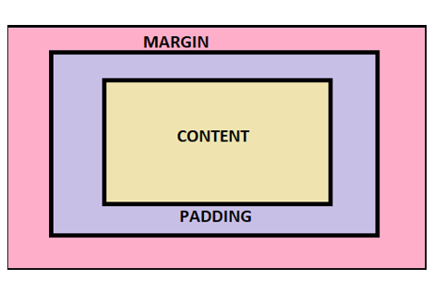

Slide 11
Designing layout for multiple elements on a page.
We will be using the External CSS approach for this example as well. Hence we will create a CSS file.
We will write the layout style for the heading element <h2>. We will fix the text properties also. The styling code for <h2> should be similar to this snippet of code:

Slide 12
h2{
width: 500px;
font-size: 20px;
padding: 20px 50px;
border: 10px double blueviolet;
margin: 10px 50px;
background-color: lightcoral;
text-align: center;
}

Slide 13
The display property specifies the display behavior (the type of rendering box) of an element. — W3
There are various values of the display property. I will be covering the following parts in this piece:
display: none vs. visibility: hidden
display: block
display: inline
display: inline-block

Slide 14
Display: None vs. Visibility: Hidden
We can hide elements by declaring a display: none value. Another way is to declare visibility: hidden instead of display: none, but there is a difference between them.

Slide 15
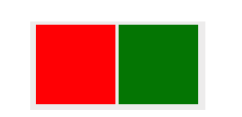
#box-2 {
display: none;
width: 100px;
height: 100px;
background: blue;
}

Slide 16
Block vs. Inline
Have you ever noticed that some HTML tags like <div>, <p>, <ul> take full-width of space and each starts with a new line, whereas other HTML tags like <span>, <img> or <a> don’t need a new line and can be placed side by side?
This is because of the different display behaviors: Block or inline. Let’s see the difference with a short example. Without any CSS, I create an HTML template with <p> and <span> tags:

Slide 17
<body>
<p>I'm a paragraph</p>
<p>I'm a paragraph too</p>
<span>I'm a word</span>
<span>I'm a word too.</span>
</body>

Slide 18
Display: Inline-block
In some cases, both of the display values may not be enough for better web design. At that point, a third display behavior comes to the rescue and also makes alignment much easier: display: inline-block .

Slide 19
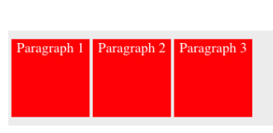
p {
display: inline-block;
height: 100px;
width: 100px;
background: red;
color: white;
}

Slide 20
The CSS position property defines, as the name says, how the element is positioned on the web page.
If you are interested in reading about the font properties, articles about the relative font size and CSS columns might be of interest.
So, there are several types of positioning: static, relative, absolute, fixed, sticky, initial, and inherit. First of all, let's explain what all of these types mean.

Slide 21
Static - this is the default value, all elements are in order as they appear in the document.
Relative - the element is positioned relative to its normal position.
Absolute - the element is positioned absolutely to its first positioned parent.
Fixed - the element is positioned related to the browser window.
Sticky - the element is positioned based on the user's scroll position.

Slide 22
What Is Relative Positioning?
When you set the position relative to an element, without adding any other positioning attributes (top, bottom, right, left) nothing will happen. When you add an additional position, such as left: 20px the element will move 20px to the right from its normal position. Here, you can see that this element is relative to itself. When the element moves, no other element on the layout will be affected.

Slide 23
In this example, you will see how the relatively positioned element moves when its attributes are changed. The first element moves to the left and top from its normal position, while the second element stays in the same place because none of the additional positioning attributes were changed.

Slide 24
HTML
1
<div id="first_element">First element</div>
2
<div id="second_element">Second element</div>

Slide 25
CSS
#first_element {
position: relative;
left: 30px;
top: 70px;
width: 500px;
background-color: #fafafa;
border: solid 3px #ff7347;
font-size: 24px;
text-align: center;
}
​

Slide 26
#second_element {
position: relative;
width: 500px;
background-color: #fafafa;
border: solid 3px #ff7347;
font-size: 24px;
text-align: center;
}

Slide 27
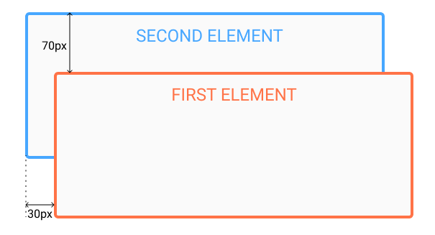

Slide 28
What Is Absolute Positioning?
This type of positioning allows you to place your element precisely where you want it.
The positioning is done relative to the first relatively (or absolutely) positioned parent element. In the case when there is no positioned parent element, it will be positioned related directly to the HTML element (the page itself).
An important thing to keep in mind while using absolute positioning is to make sure it is not overused, otherwise, it can lead to a maintenance nightmare.
The next thing, yet again, is to show an example.
In the example, the parent element has the position set to relative. Now, when you set the position of the child element to absolute, any additional positioning will be done relative to the parent element. The child element moves relative to the top of the parent element by 100px and right of the parent element by 40px.

Slide 29
HTML
<div id=”parent”>
<div id=”child”></div>
</div>

Slide 30
CSS
#parent {
position: relative;
width: 500px;
height: 400px;
background-color: #fafafa;
border: solid 3px #9e70ba;
font-size: 24px;
text-align: center;
}
​

Slide 31
#child {
position: absolute;
right: 40px;
top: 100px;
width: 200px;
height: 200px;
background-color: #fafafa;
border: solid 3px #78e382;
font-size: 24px;
text-align: center;
}

Slide 32
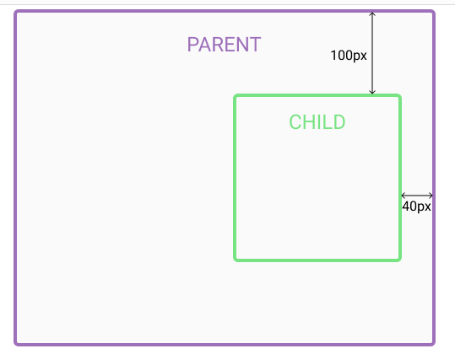

Slide 33
float property is used to decide which element floats and which doesn't.
It's value can either be left or right. An element with float style property floats in the extreme left or in the extreme right side of the parent element.
An element doesn't take the complete width like a block level element, when float style property is applied, rather it allows its siblings to surround it.

Slide 34
p {
float: left | right;
}

Slide 35
clear property
Whenever we use float property on any element, the elements below it try to fill up the space emptied by the float element, as the float element either moves to the left or the right boundary.
This behaviour can distort your webpage design. To avoid the elements below the floating element to surround it, clear property is used.
By prodiving clear:right style to the element below the floating element, we inform the element, to stay clear off the element which is floating right. Similarly clear:left, stays clear off the floating left element. And clear:both works for both.

Slide 36
img {
float: right;
height: 150px;
}

Slide 37
<h2>CSS Float Property: Right Value</h2>
<p><img src='https://images.unsplash.com/photo-1613535449480-bb56b88d1886?crop=entropy&cs=tinysrgb&fit=max&fm=jpg&ixid=MnwxNDU4OXwwfDF8cmFuZG9tfHx8fHx8fHx8MTYxNzgwNzU4MA&ixlib=rb-1.2.1&q=80&w=400' alt='surfer holding a surfboard walking in the ocean'>In this example, the CSS float property is defined by the right value. That tells the browser two things. The first is that the image floats to the right in the paragraph. The second is that the text in the paragraph wraps around the image. Notice that the CSS includes a type selector to target the image, which is contained in the paragraph.</p>

Slide 38
The border property is a shorthand syntax in CSS that accepts multiple values for drawing a line around the element it is applied to.
.box {
border: 3px solid red;
height: 200px;
width: 200px;
}

Slide 39
border
The border shorthand CSS property sets an element's border. It sets the values of border-width, border-style, and border-color.

Slide 40
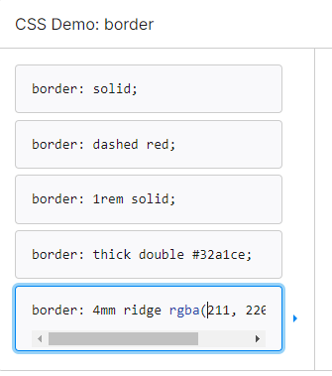

Slide 41
border: solid;
border: 2px dotted;
border: outset #f33;
border: medium dashed green;
border: inherit;
border: initial;
border: revert;
border: revert-layer;
border: unset;

Slide 42
CSS transforms are a collection of functions that allow to shape elements in particular ways:
translate: moves the element along up to 3 axis (x,y and z)
rotate: moves the element around a central point
scale: resizes the element
skew: distorts the element

Slide 43
transform properties
There are 3 CSS transform properties available:
transform defines which transform function to use (translate, rotate, scale…)
transform-origin allows to modify the origin point of a transformation (works like background positions)
transform-style is for 3d settings
Note that unlike background and border, transform is not a shorthand property.
We’ll only use transform here.

Slide 44
The CSS transform property changes the shape, position, and orientation of page elements. Values of the CSS transform property are functions that transform the target element, including translate(), scale(), and rotate().

Slide 45
translate() Method
The CSS translate() method alters the position of an element along the x-axis (horizontally) or along the y-axis (vertically) based on the parameters assigned.
Syntax
transform: translate (tx, ty)
Or,
transform: translate (tx)
The tx, and ty refer to the x, and y axes.

Slide 46
xample
Suppose you want to move an image to a certain position using the translate() method then follow the example below.
HTML
<img src="dog.jpg" alt="Dog">
CSS
img {
width: 250px;
height: 100px;
transform: translate(50px, 50px);
}

Slide 47
rotate() Method
For the purpose of rotating an element clockwise or anti-clockwise based on the degree specified, the rotate() method is used.
Syntax
transform: rotate (degrees)
The degrees parameter defines the angle from which the element should be rotated.

Slide 48
Example
Consider the example below to understand the working of the rotate() method.
HTML
<div>
This is a normal div container.
</div>
<div class="clockwise">
This div container is rotated 25 degrees clockwise.
</div>
<div class="anticlockwise">
This div container is rotated 25 degrees anti-clockwise.
</div>
Here we have specified three div containers to demonstrate the concept of the rotate() method.

Slide 49
CSS
div {
width: 250px;
height: 100px;
background-color: bisque;
border: 1px solid gray;
}
.clockwise {
transform: rotate(25deg);
}
.anticlockwise {
transform: rotate(-25deg);
}

Slide 50
scale() Method
In order to enhance or reduce the size of an element based on the specified width, and height the scale() method is used.
Syntax
transform: scale (sx, sy)

Slide 51
transform: scale (sx)
The sx, and sy represent the horizontal and vertical dimensions respectively.
Example
The example below demonstrates the working of the scale() method.
HTML
<div>The size of the div container is increased two times of its original width, and height.</div>
In the above code, we have simply created a div element.

Slide 52
CSS
div {
width: 200px;
height: 100px;
margin: 130px;
background-color: bisque;
border: 1px solid black;
transform: scale(2,2);
}
Using CSS properties we are assigning some width, height, and margin to the div element and lastly we are using the scale() method to increase the width and height of the element twice its original width and height.

Slide 53
scaleX() Method
For the purpose of altering the width of an element, the scaleX() method is used.
Syntax
transform: scaleX (sx)
The sx parameter represents the horizontal dimension of an element.

Slide 54
Example
Let’s say you want to decrease the width of an element then consult the example below.
CSS
div {
transform: scaleX(0.5);
}
In above code, we are using the scaleX() method to decrease the width of a div container.

Slide 55
The scaleX() method is working properly.
scaleY() Method
For the purpose of altering the height of an element, the scaleY() method is used.

Slide 56
transform: scaleY (sy)
The sy parameter defines the value of y-axis.
Example
Consider the example below.
CSS
div {
transform: scaleY(2);
}
Here we are using the scaleY() method to increase the height of the div element.

Slide 57
skew() Method
This method skews an element horizontally and vertically based on the degrees specified.
Syntax
transform: skew (sx, sy)
Or,
transform: skew (sx)
The sx, and sy represent the x, and y axes.

Slide 58
Example
Suppose you wish to skew an element along x and y axes..
HTML
<div>
This is a normal div container.
</div>
<div class="skew">
This div container is skewed 10 degrees horizontally, and 15 degrees vertically.
</div>
Here we have defined two div containers to demonstrate the working of the skew() method.

Slide 59
CSS
div {
width: 200px;
height: 100px;
background-color: bisque;
border: 1px solid gray;
}
.skew {
transform: skew(10deg,15deg);
}
Apart from styling the div containers we are skewing the second div container 10 degrees along X-axis and 15 degrees along Y-axis.

Slide 60
translate() Method
rotate() Method
scale() Method
scaleX() Method
scaleY() Method
skew() Method
skewX() Method
skewY() Method
matrix() Method

Slide 61
CSS Gradients
CSS gradients display progressive transitions between two or more specified colors. Gradients can be used in backgrounds.
There are three types of gradients:
Linear Gradients
Radial Gradients
Conic Gradients

Slide 62
Linear Gradients
The linear-gradient creates an image that consists of a smooth transition between two or more colors along a straight line. It can have a starting point and a direction along with the gradient effect.

Slide 63
<!DOCTYPE html>
<html>
<head>
<title>Title of the document</title>
<style>
.gradient {
height: 300px;
background-color: blue;
background-image: linear-gradient(#0052b0, #b340b3);
}
</style>
</head>
<body>
<div class="gradient"></div>
</body>
</html>

Slide 64
Left to Right
Changing a linear-gradient rotation specifying the direction starting from left transitioning to right.

Slide 65
<!DOCTYPE html>
<html>
<head>
<title>Title of the document</title>
<style>
.gradient {
height: 300px;
background-color: blue;
background-image: linear-gradient(to right, #0052b0 ,#b340b3);
}
</style>
</head>
<body>
<div class="gradient"></div>
</body>
</html>

Slide 66
Diagonal gradients
Gradients can be run diagonally specifying both the horizontal and vertical starting positions. It starts at the top left and goes to the bottom right.

Slide 67
<!DOCTYPE html>
<html>
<head>
<title>Title of the document</title>
<style>
.gradient {
height: 300px;
background-color: blue;
background-image: linear-gradient(to bottom right, #0052b0, #b340b3);
}
</style>
</head>
<body>
<div class="gradient"></div>
</body>
</html>

Slide 68
Introduction to CSS Text Effects
Many properties of CSS text effects help to provide various styling in the words of a sentence in an HTML page with CSS.So that words will get the various pattern, orientations, and designs by using various text effects of the CSS. Utilizing its various values of the parameters to get a better design of the web page which is as per the required design in a web page development. In this article, we will demonstrate the techniques that a web page designer can apply to the text of an HTML page by using CSS text effects property with many examples.

Slide 69
By this time, we have already mastered the CSS Text properties like –
Text Color (using color)
Text Alignment (using text-align)
Text Direction(using direction)
Text bold (using tag)
Text Size (using font-size)
Text Line Height (using line-height)
Space between words (using word-spacing)
Space between Letters (using letter-spacing)
Text Decoration (using text-decoration)
Outline Text (using text-stroke)
Indent the Text (using text-indent)
Transform the text from lower to upper case and vice versa (using text-transform)

Slide 70
We also covered the shadow effects in detail like-
Text shadow
Box-shadow
Let us master some Text Effects properties like
word-wrap
word-break
text-overflow
writing-mode

Slide 71
1. Word-wrap
The word-wrap breaks the long words which are not able to fit in the same line to the next line.
word-wrap takes one of the following values –
normal – This follows the normal word break rule.
break-word – This breaks the long words which do not fit in the line to the next line so it wraps the long words in such a way that the extra letters flows in the next line.
inherit – This gets the word-wrap property from its parent.

Slide 72
Example of word-wrap
#word-wrap-normal {
background-color: deepskyblue;
width: 200px;
height: 150px;
padding:10px;
}
#word-wrap-break {
background-color:hotpink;
width:200px;
height:150px;
padding:10px;
word-wrap:break-word;
}

Slide 73
2. Word-break
The word-break property specifies how words should break at the end of the line.
word-break takes one of the following values –
normal – This does not break the long words into the next line. It goes with the flow and the text can go in the same line even beyond the container or div. The line will only break if there are white spaces or space between 2 consecutive words
keep-all – For Chinese/Japanese/Korean (CJK) texts, do not use the word-break property at all. For other texts i.e. Non-CJK texts, the word break will be normal.
break-word – Break the unbreakable words at arbitrary points to prevent the overflow
break-all – Words should break between 2 characters to prevent the overflow.
inherit – This gets the word-break property from its parent

Slide 74
Example of word-break
#word-break-normal {
background-color: deepskyblue;
width: 200px;
height: 150px;
padding:10px;
word-break:normal;
}
#word-break-keepall {
background-color:hotpink;
width:200px;
height:150px;
padding:10px;
word-break:keep-all;
}
#word-break-breakall {
background-color:gold;
width:200px;
height:150px;
padding:10px;
word-break:break-all;
}

Slide 75
3. text-overflow
The text-overflow decides how the text will be displayed to the user in case the text overflows its boundary i.e. it decides whether to clip the text or show some dots etc.
This takes any one of these values –
clip – This property clips(cuts) the overflowed texts
ellipsis – In this case, there will be 3 dots(…) to show the clipped text
string – The particular string will use the data type <string> to show the clipped text. This works on Firefox browser only. We do not advise to use this in production.
inherit – The given element will acquire the text-overflow property from its parent
The text-overflow does not work on its own. You should code white-space: nowrap & overflow: hidden along with this.

Slide 76
Example of text-overflow
h2 {
background-color: black;
width: 100px;
height: 80px;
}
#txt-clip {
text-overflow:clip;
color:white;
white-space:nowrap;
overflow:hidden;
}
#txt-ellipsis {
text-overflow:ellipsis;
color:white;
white-space:nowrap;
overflow:hidden;
}
#txt-string {
text-overflow:"---";
color:white;
white-space:nowrap;
overflow:hidden;
}

Slide 77
3D Text
By using the text-shadow, we are going to create a beautiful 3D text.
If you need a detailed knowledge of text-shadow , then this article is the best one.

Slide 78
Example of 3D-Text
h2 {
font-size:85px;
text-shadow:0px 0px 0 rgb(237,237,237),1px 1px 0 rgb(230,230,230),2px 2px 0 rgb(222,222,222),3px 3px 0 rgb(214,214,214),4px 4px 0 rgb(207,207,207),5px 5px 0 rgb(199,199,199),6px 6px 0 rgb(191,191,191),7px 7px 0 rgb(184,184,184),8px 8px 0 rgb(176,176,176),9px 9px 0 rgb(169,169,169),10px 10px 0 rgb(161,161,161),11px 11px 0 rgb(153,153,153),12px 12px 0 rgb(146,146,146),13px 13px 0 rgb(138,138,138),14px 14px 0 rgb(130,130,130),15px 15px 0 rgb(123,123,123),16px 16px 0 rgb(115,115,115),17px 17px 0 rgb(107,107,107),18px 18px 0 rgb(100,100,100),19px 19px 0 rgb(92,92,92), 20px 20px 0 rgb(84,84,84),21px 21px 20px rgba(0,0,0,1),21px 21px 1px rgba(0,0,0,0.5),0px 0px 20px rgba(0,0,0,.2);
}

Slide 79
CSS Text Moving Effect
Move texts show important information to the user.
Some of the websites contains a moving text before the header to show important information about an advertisement, an offer, etc.
Let us create that using the animation.

Slide 80
.animation-ex1 {
position:relative;
font-size:25px;
-webkit-animation:txt-moving 5s linear infinite;
animation:txt-moving 5s linear infinite;
}
@-webkit-keyframes txt-moving {
0% {left:0;}
50% {left:50%;}
100% {left:100%;}
}
@keyframes txt-moving {
0% {left:0;}
50% {left:50%;}
100% {left:100%;}
}

