Slide 1


Austrian Flag Rendering with OpenGL
A study of basic 3D graphics programming using C++ and modern OpenGL libraries
Repository: Cyb3R0xSASA/elnmsa-flag
Technologies: OpenGL, GLFW, GLAD, GLM
Language: C++

Slide 2


A Minimalist OpenGL Graphics Demo
GOAL
Render a simple 2D object—the Austrian flag—using a modern OpenGL pipeline
FOCUS
Demonstrates the fundamental setup required for any OpenGL application
KEY COMPONENTS
Initialization, shader compilation, vertex buffer management, and rendering loop
EDUCATIONAL VALUE
Clear, concise example for learning the basics of C++ graphics programming

Slide 3


Modern OpenGL: A Foundation for Graphics
Technology
Role in Project
Description
OpenGL
Graphics API
Industry-standard API for rendering 2D and 3D vector graphics
GLFW
Window Management
Handles window creation, context management, and user input
GLAD
Function Loader
Loads all necessary OpenGL function pointers for the OS and driver
GLM
Math Library
Provides vector and matrix math utilities for graphics programming

Slide 4

Establishing the Graphics Context
GLFW INITIALIZATION
CONTEXT HINTS
Creates the main application window and the OpenGL context. The initialization process checks for success and terminates gracefully if it fails. Lines 41-59
Specifies the OpenGL version (3.3 Core Profile) to ensure modern features are used. This ensures compatibility with the shader code and modern graphics techniques. Lines 47-49
GLAD LOADING
INPUT HANDLING
Crucial step to access the OpenGL functions provided by the driver. GLAD loads all necessary function pointers for the specific operating system and graphics driver. Lines 63-67
A simple processInput function checks for the ESC key to close the window. This provides basic user interaction and graceful application termination. Lines 32-35

Slide 5
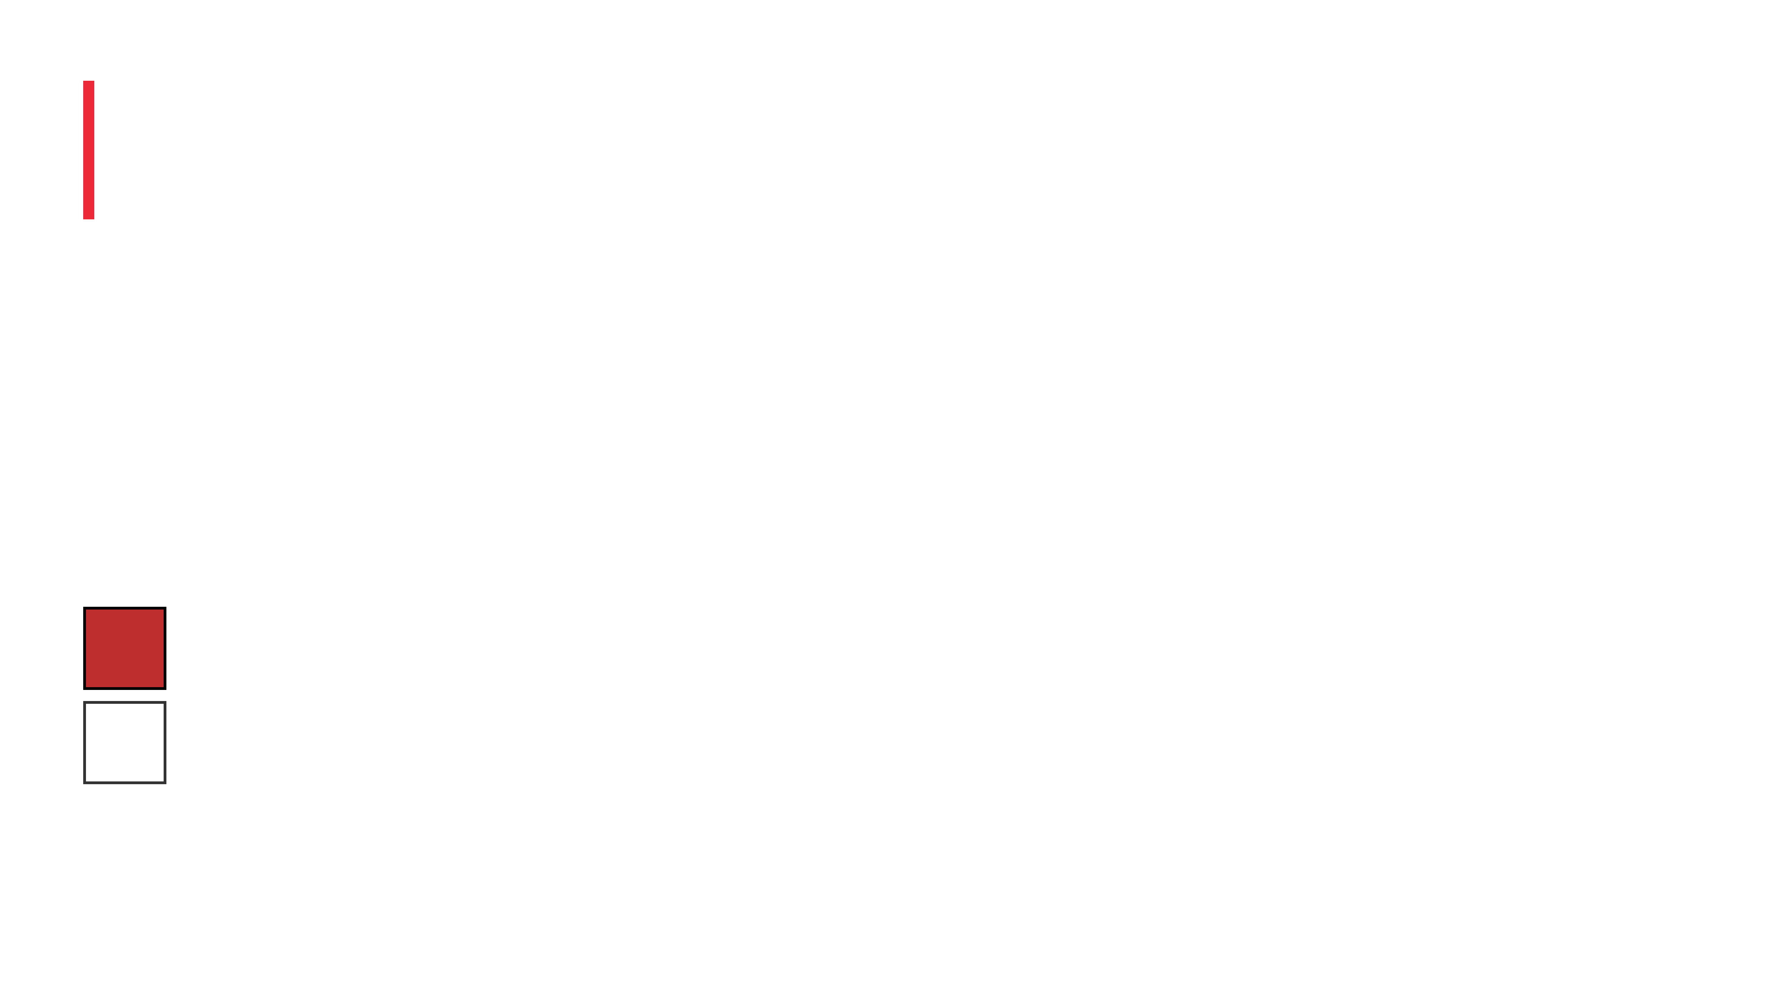

Vector Mathematics for Color
WHAT IS GLM?
A header-only C++ library designed to work seamlessly with OpenGL's data types and mathematical operations
COLOR REPRESENTATION
Colors are defined as 3-component vectors (glm::vec3) representing Red, Green, and Blue (RGB) channels
AUSTRIAN FLAG COLORS
RED
glm::vec3(0.749f, 0.184f, 0.184f)
WHITE
glm::vec3(1.0f, 1.0f, 1.0f)
GPU EFFICIENCY
GLM ensures color data is stored in a format optimized for GPU processing and rendering

Slide 6

From Data to Shape
THE FLAG'S SHAPE
VERTEX DATA
The flag is composed of three horizontal rectangles: two red sections (top and bottom) and one white section (middle). Each rectangle is rendered using two triangles.
Total Vertices:
12 points
Data per Vertex:
x, y, r, g, b (5 floats)
Structure:
Position (2D) + Color (RGB)
INDEX BUFFER (ELEMENT BUFFER OBJECT)
The indices array defines how vertices are connected to form triangles. Each rectangle requires 6 indices (2 triangles × 3 vertices per triangle). With 3 rectangles, the total is 18 indices. This approach allows efficient reuse of vertex data and clear definition of the drawing order.

Slide 7

Preparing Data for the GPU
VAO
VBO
Vertex Array Object
Vertex Buffer Object
Stores the configuration of the VBO and attribute pointers. Acts as a container that remembers how vertex data is organized and interpreted.
Holds the actual vertex data including coordinates and colors. Stores raw geometric information that will be processed by the GPU.
EBO
ATTRIBUTE POINTERS
Element Buffer Object
Data Interpretation
Holds the indices that determine the order of drawing. Specifies which vertices form each triangle, enabling efficient geometry definition.
Tell OpenGL how to interpret the raw data in the VBO. Define the layout of vertex attributes such as position and color in memory.

Slide 8

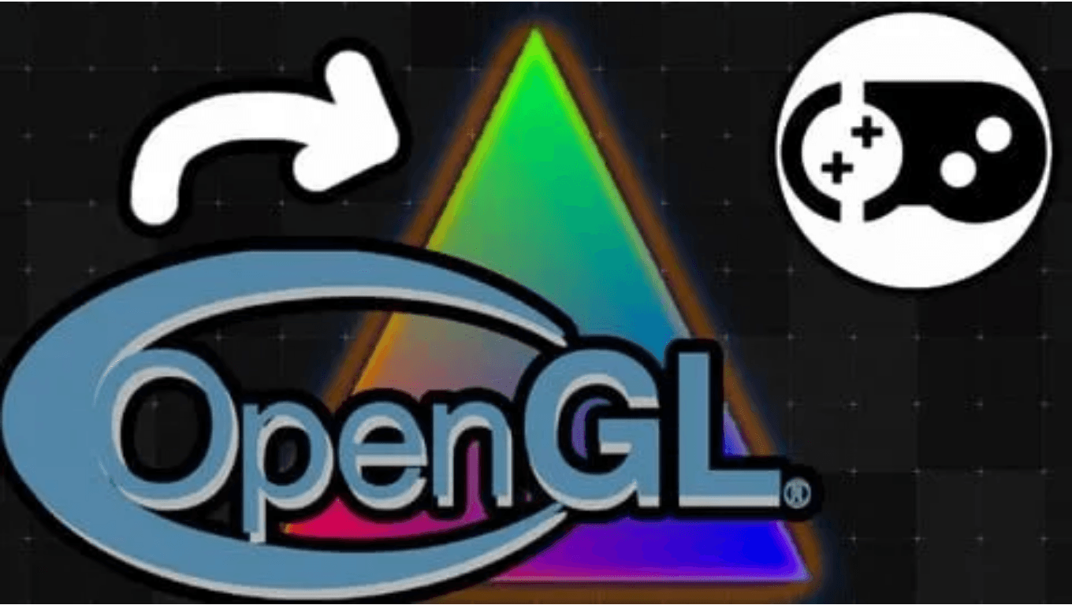
The GPU's Program
Shaders are small programs that run directly on the GPU, defining how geometry is transformed and how pixels are colored.
VERTEX SHADER
Responsible for processing vertex data. In this project, it primarily passes the position and color data through to the next stage of the graphics pipeline.
FRAGMENT SHADER
Responsible for calculating the final color of each pixel (fragment). It takes the interpolated color from the vertex shader and outputs the final color to the screen.

Slide 9
Continuous Drawing
The Heart of the Application
The
while (!glfwWindowShouldClose(window))
loop runs continuously until the user closes the window. This loop is where all rendering happens, executing
many times per second to create smooth animation.
Input Polling
Checks for user events such as keyboard input or window events. The
processInput(window)
function monitors for the ESC key press to allow graceful
application termination.
Clearing the Screen
glClear(GL_COLOR_BUFFER_BIT)
resets the drawing surface by clearing the color buffer. This ensures each frame starts fresh without artifacts from the previous
frame.
Drawing Command
glDrawElements(GL_TRIANGLES, 18, GL_UNSIGNED_INT, 0)
executes the actual drawing based on the configured VAO and EBO. It renders 18 indices as triangles,
which forms the complete Austrian flag.
Buffer Swapping
glfwSwapBuffers(window)
displays the newly rendered frame to the screen. This technique prevents flickering by using double buffering—drawing off-screen
and then displaying the complete frame.

Slide 10


Summary of the Learning Experience
PROJECT SUCCESS
Successfully implemented a 2D graphic (the Austrian flag) using a modern OpenGL 3.3 Core Profile setup with C++ and essential graphics libraries.
KEY SKILL LEARNED
The fundamental workflow of an OpenGL application: setup, data buffering, shader compilation, and the rendering loop that brings graphics to life.
FUTURE EXPANSION
This basic structure can be extended to render complex 3D models, apply textures, implement advanced lighting effects, and create interactive graphics.
CALL TO ACTION
Explore the shaders and vertex data to understand how simple changes can drastically alter the final output. Continue learning and experimenting with graphics programming.

