Slide 1
Checkpoint 1 Project O Analysis
Cloud Computing and Virtualization
Beatriz Moreira Nº25262

Slide 2
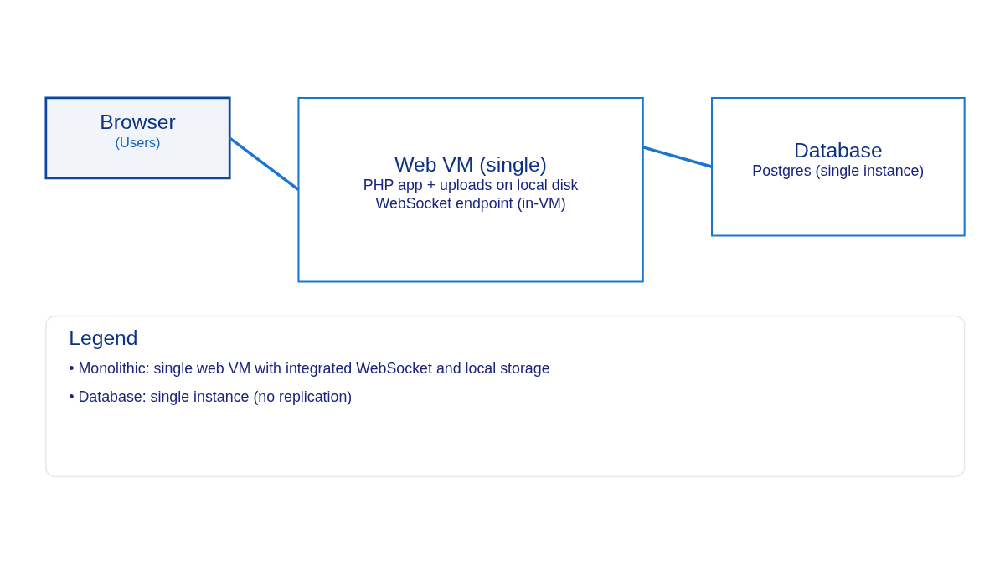
Project O (Original)
Simple PHP web application (Project O)
Single web VM serving PHP/HTML/JS
Local filesystem for uploads
Single relational DB (Postgres)
WebSocket endpoint on the same single web VM (current/monolithic architecture)

Slide 3
Main Limitations
Single web server: no horizontal scaling or redundancy
Local sessions: not shareable across nodes
Local uploads: not durable or accessible by multiple nodes
Single DB: single point of failure; no HA
WebSocket on web VM: hard to scale
No load balancer, no automated provisioning, limited monitoring

Slide 4
Initial Requirements
Horizontal web tier (multiple web VMs)
Centralized sessions (Redis)
Shared storage for uploads (NFS/Gluster or object storage)
DB replication and failover (repmgr or Patroni)
Highly-available load balancer (nginx/HAProxy + Keepalived)
WebSocket handling embedded in each Web VM (workers) + Redis Pub/Sub for cross-instance messaging; LB sticky sessions when needed
Automation with Ansible + Vagrant
Basic monitoring (Prometheus + Grafana)

Slide 5
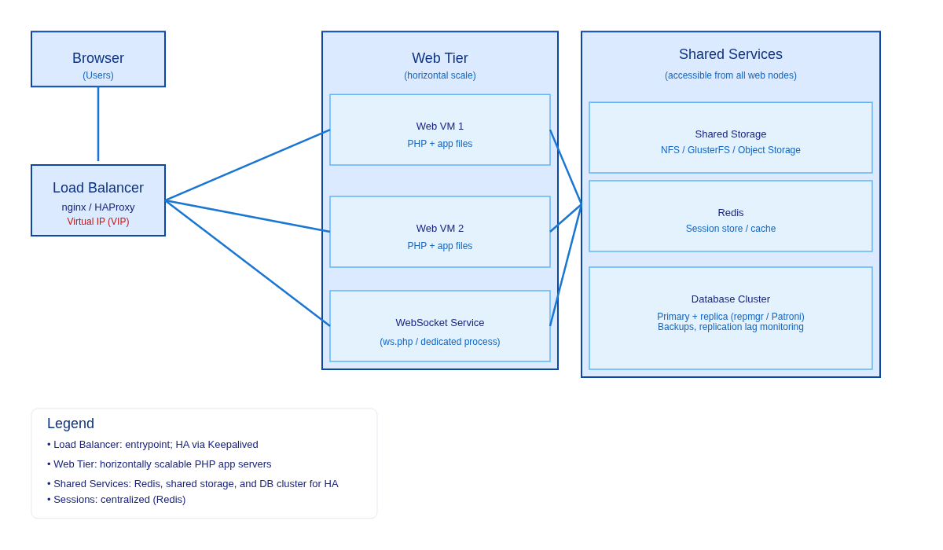
Simple Architecture Diagram

Slide 6
Initial Plan for Solution A (Vagrant/VMs)
Define VM roles in `Vagrantfile`: LBs, web nodes, storage, Redis, DB cluster, WS nodes.
Provision with Ansible: install PHP, web server, mount shared storage, configure Redis and DB replication.
Configure Keepalived on LBs for virtual IP and health checks.
Make PHP app stateless: switch session handler to Redis; update `public_html/_dotenv.php` if needed.
Move uploads to shared storage and update `upload.php`.
Configure DB replication + failover.
Route WebSocket traffic: keep WebSocket workers embedded in each Web VM, use LB sticky sessions and Redis Pub/Sub to propagate messages between instances.
Add monitoring (node exporter, Prometheus, Grafana).
Test scaling and failover (simulate node failures).

