Slide 1
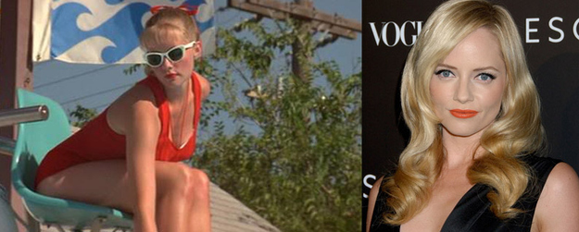
35 of Your Favorite Childhood Crushes… Where Are They Now?
[#13 is Absolutely stunning!]

Slide 2

35 of Your Favorite Childhood Crushes… Where Are They Now?
[#13 is Absolutely stunning!]

Slide 3
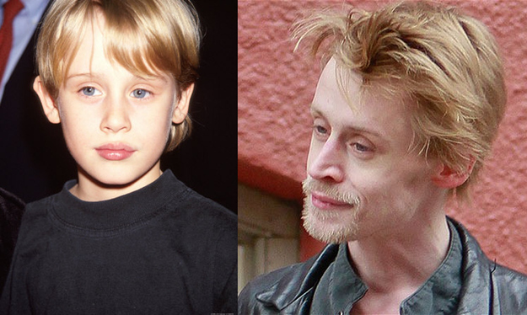
35 of Your Favorite Childhood Celebs… Where Are They Now?
[#13 is Absolutely stunning!]

