Slide 1

Department of Computer Science and Engineering
(Cyber Security)
PROJECT TITLE: XKill - Internship & Skill Program Portal
COURSE: Web Programming
SEMESTER:5
NAME: S.Balamurugan
REG NO:241901014

Slide 2
INTRODUCTION
Project: XKill is a full-stack web portal where students browse skill programs, register and pay online
Domains: Web Development, App Development, AI/ML, Data Science and Cyber Security
Users: Students register and enroll; admin verifies payments and registrations
Scope: Responsive React frontend with a Django REST API backend and database

Slide 3
PROBLEM STATEMENT / OBJECTIVE
Problem: Program registration and payment proof were handled through scattered forms and manual checks
Problem: No single place to browse programs, enroll, track status and contact the team
Objective: Build a responsive web application for program discovery, sign-up and enrollment
Objective: Secure user authentication with JWT
Objective: Payment screenshot upload and admin verification of each registration
Objective: Contact form with email notification

Slide 4
TOOLS, TECHNOLOGIES AND IMPLEMENTATION
Frontend: React 19, Vite, React Router, Framer Motion, Lucide icons, Axios
Backend: Django 6, Django REST Framework, SimpleJWT authentication
Database: SQLite (development), PostgreSQL via dj-database-url (production)
Storage / Deploy: Cloudinary for screenshots; Gunicorn, WhiteNoise, CORS headers
Modules: Signup/Login, program catalogue, enrollment with payment upload, admin verify, contact form, PDF and QR generation

Slide 5
RESULT AND CONCLUSION
Result: Working responsive website: Home, Programs, Course Detail, Placement Program, Registration and Verify pages
Result: REST API: signup, login, token refresh, profile, enroll, contact and verify endpoints
Result: Admin panel to review payments and verify registrations
Conclusion: The project applies client-side routing, REST APIs, authentication and database design from the Web Programming course
Future scope: Online payment gateway, automatic certificate generation, student dashboard

Slide 6

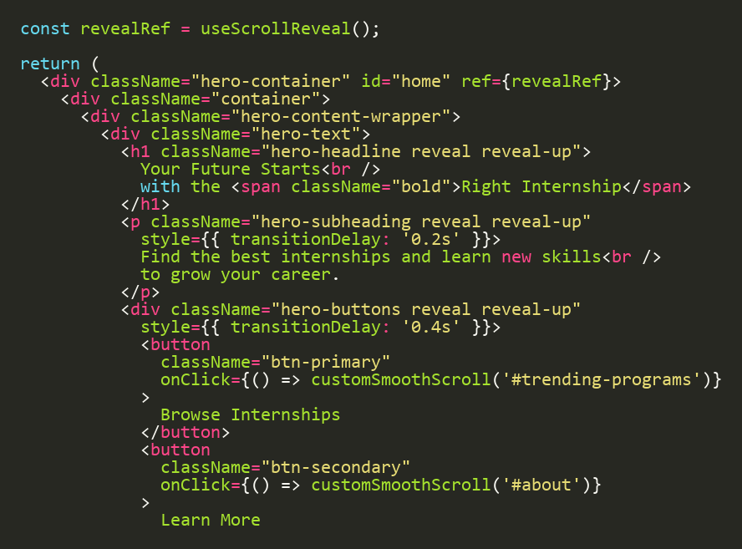
OUTPUT: HOME PAGE
Screenshot: Home Page
Landing page with hero section and call-to-action buttons
Code: src/components/Hero.jsx

Slide 7
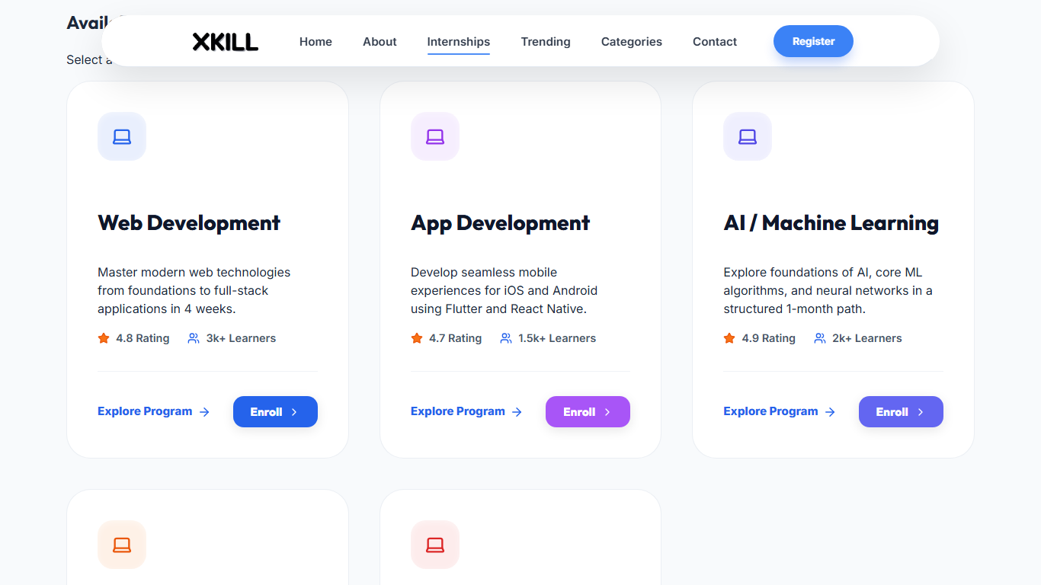
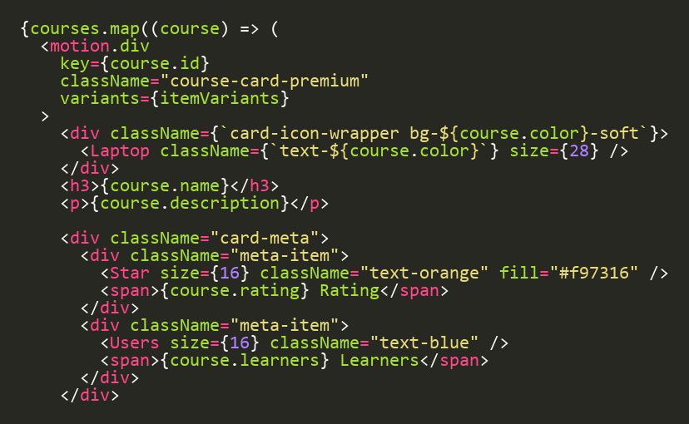
OUTPUT: PROGRAMS PAGE
Screenshot: Programs Page
Program cards rendered from data with Explore and Enroll actions
Code: src/pages/Programs.jsx

Slide 8
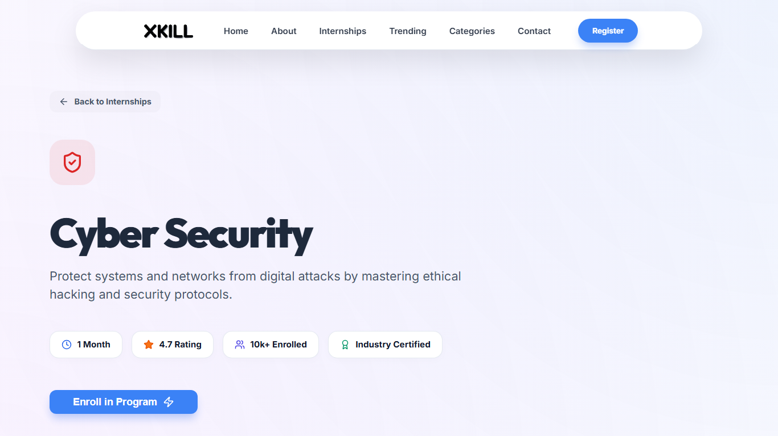
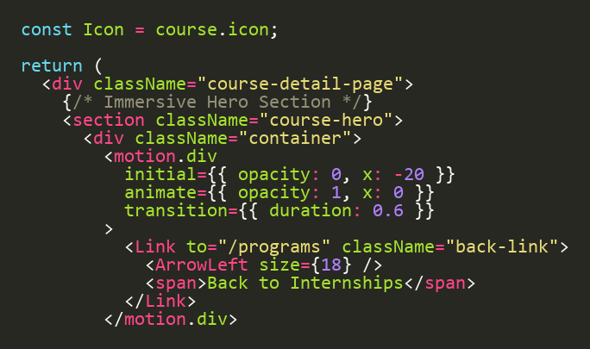
OUTPUT: COURSE DETAIL PAGE
Screenshot: Course Detail Page
Code: src/pages/CourseDetail.jsx
Course hero section with animated back link and details

Slide 9
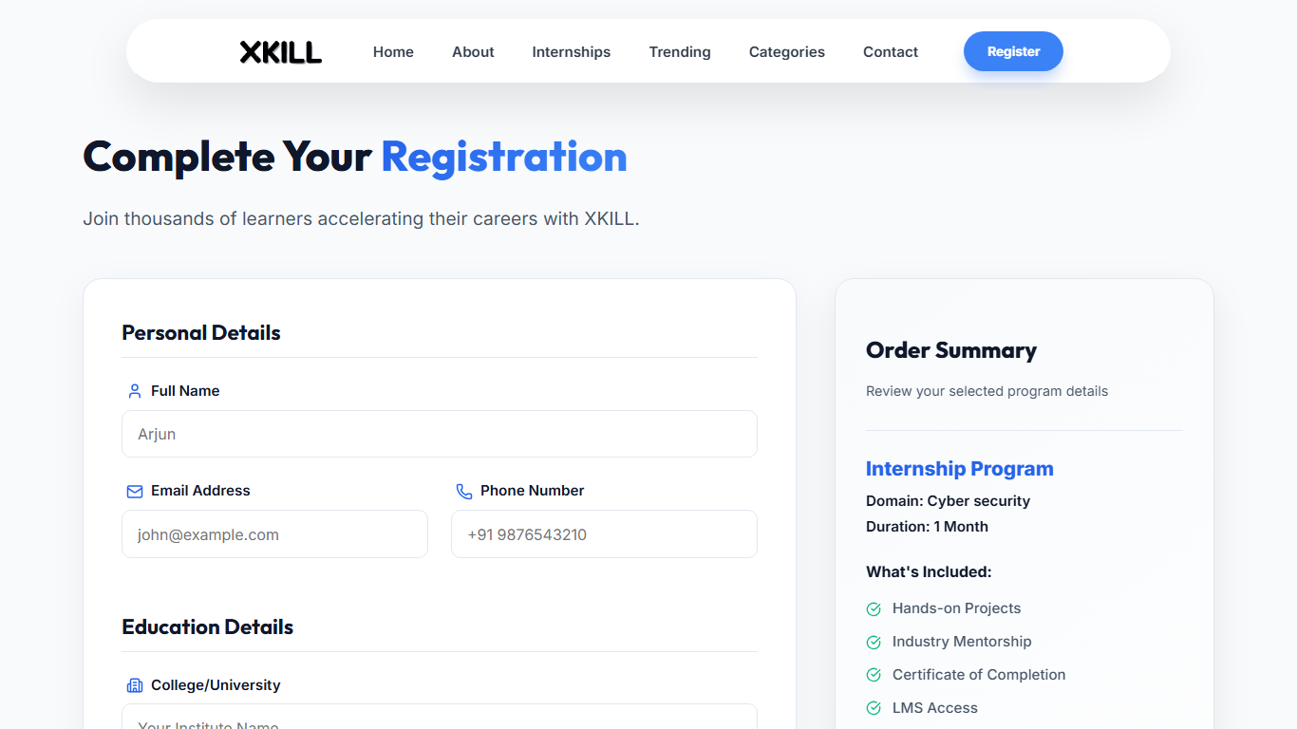
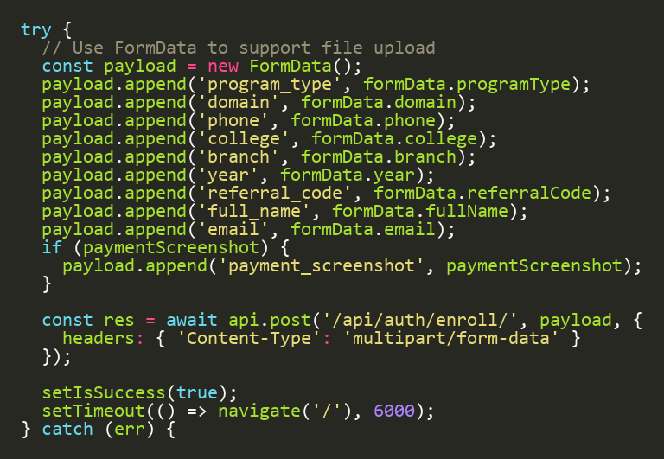
OUTPUT: REGISTRATION PAGE
Screenshot: Registration Page
Form submit builds FormData and posts to /api/auth/enroll/
Code: src/pages/Registration.jsx

